Slide 1
NOVA Project greater Bogotá
Prepared by
Bravo Consulting Group
for
Organización Terpel

Slide 2
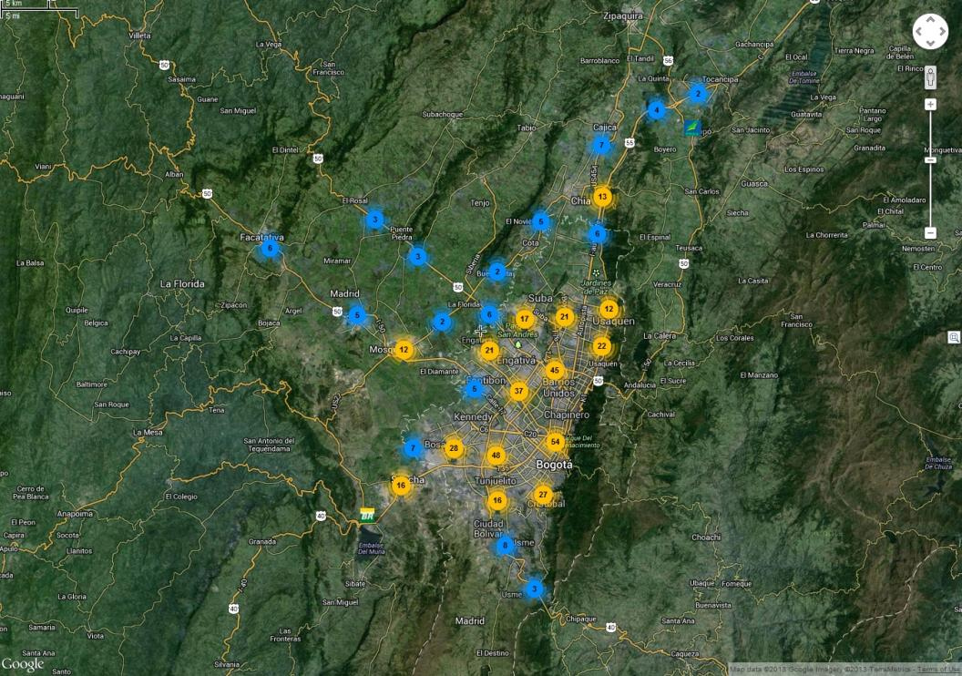
Greater Bogotá - boundary

Slide 3
Bogotá update
BCG updated the Bogotá Planner ©. The update considered recent volumes for both the Petrobras and Terpel networks. It also included major market changes that have occurred since 2010. Traffic counts and demographic information remained unchanged.

Slide 4
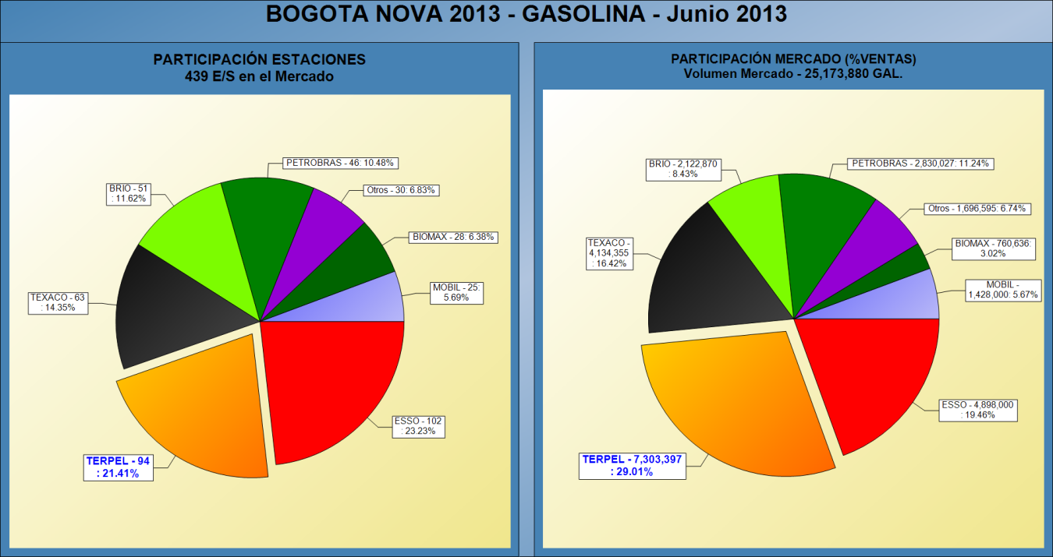
Market shares - gasoline

Slide 5
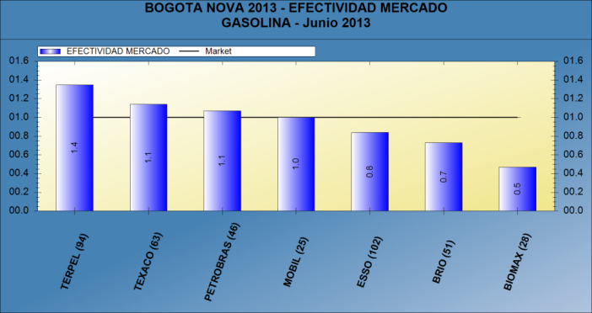
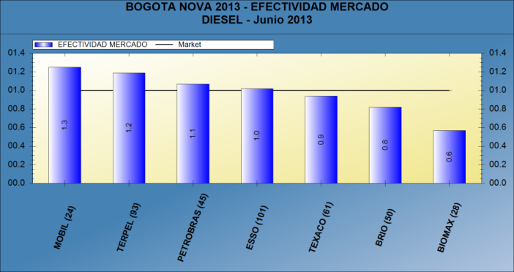
Market effectiveness
Petrobras presents a market effectiveness of 1.1
Market Effectiveness is the result of the Market Share divided by the Outlet Share. It indicates how well a company is utilizing the outlets it operates. A rating of 1.0 is average.

Slide 6
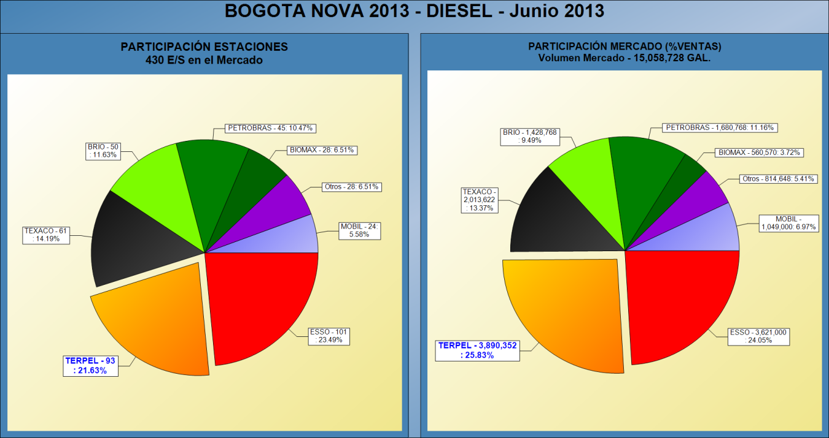
Market shares - gasoline

Slide 7
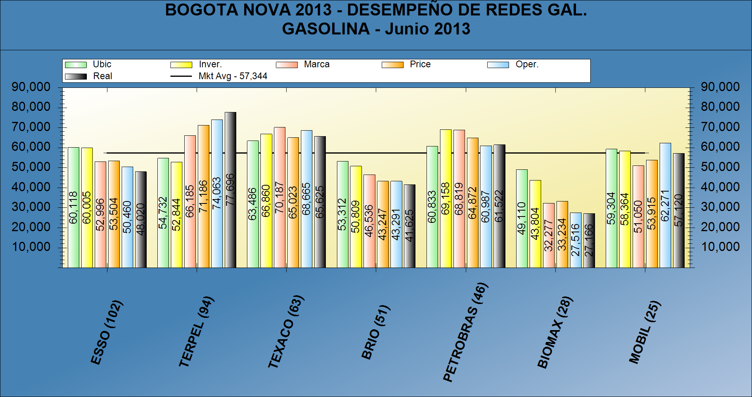
Network performance - Gasoline

Slide 8
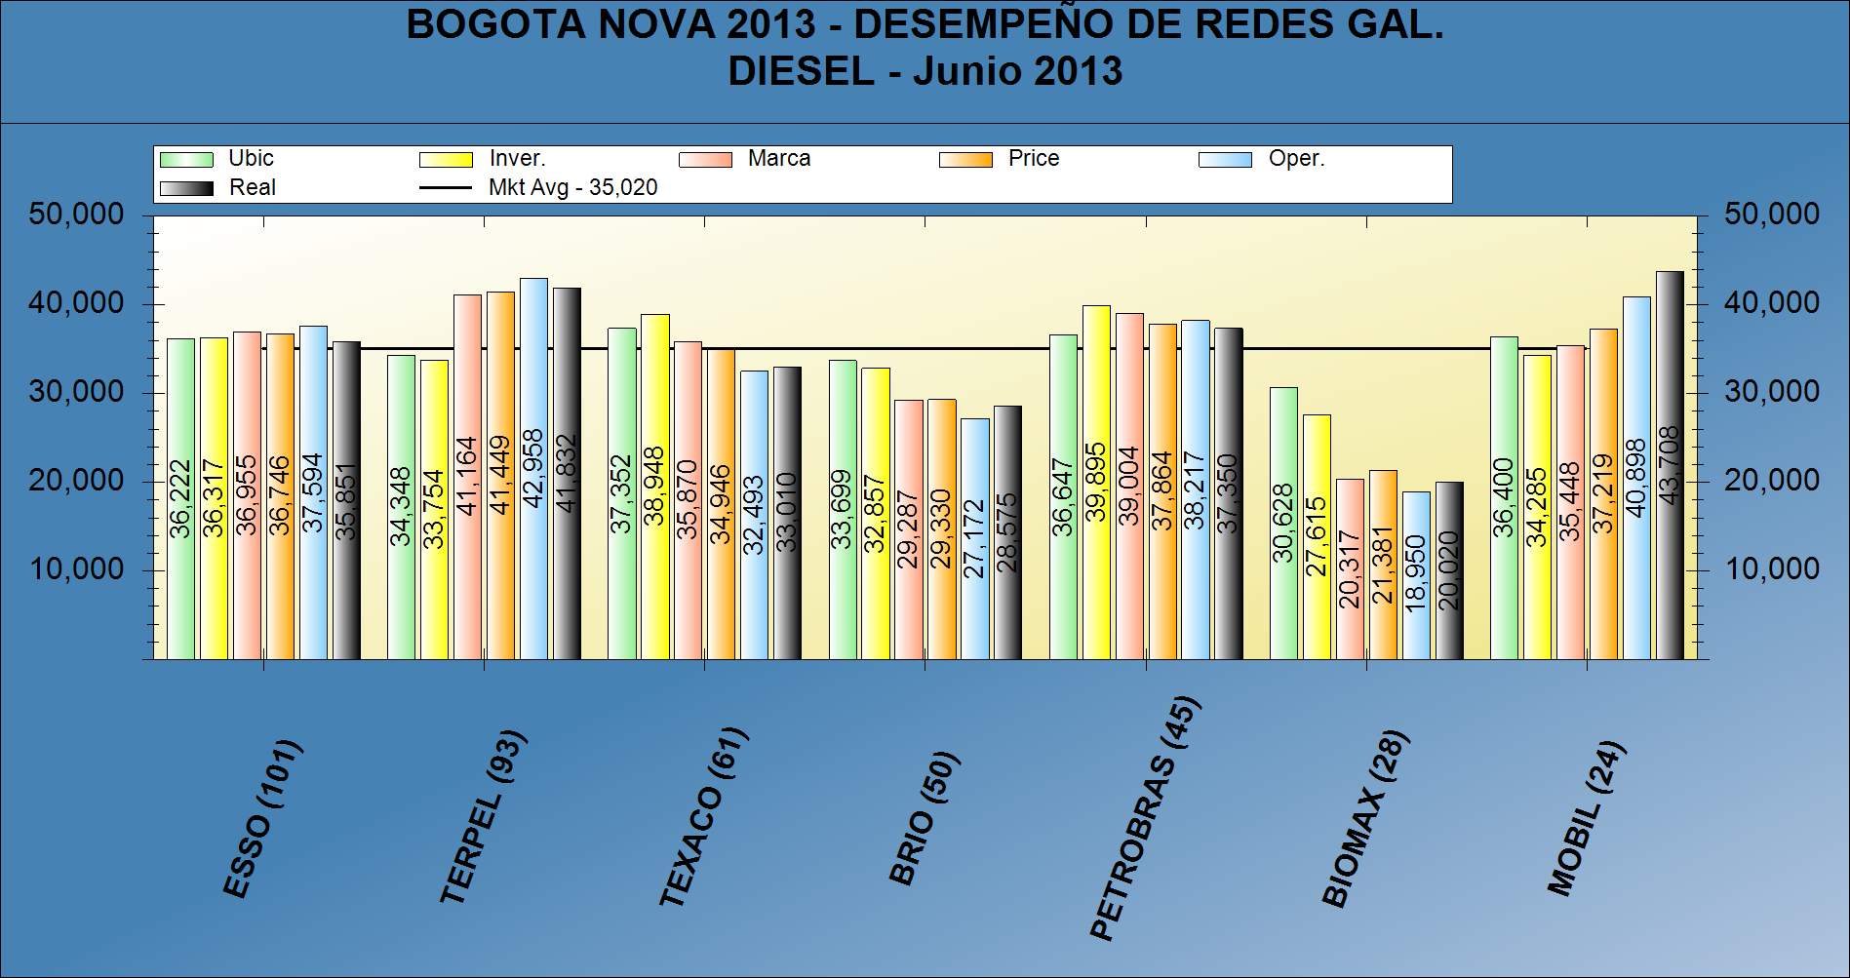
Network performance- Diesel

Slide 9
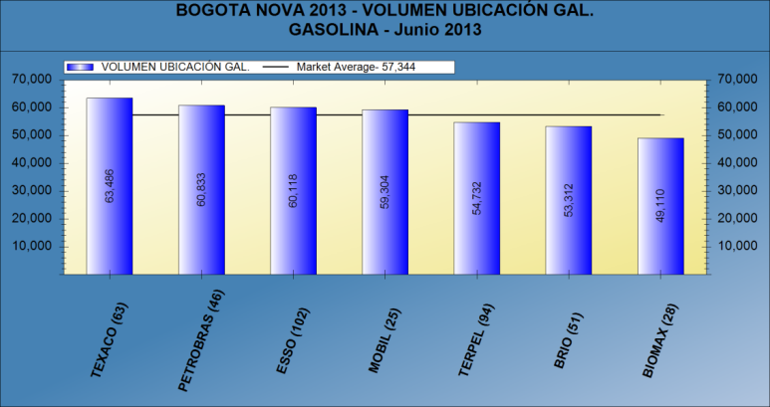
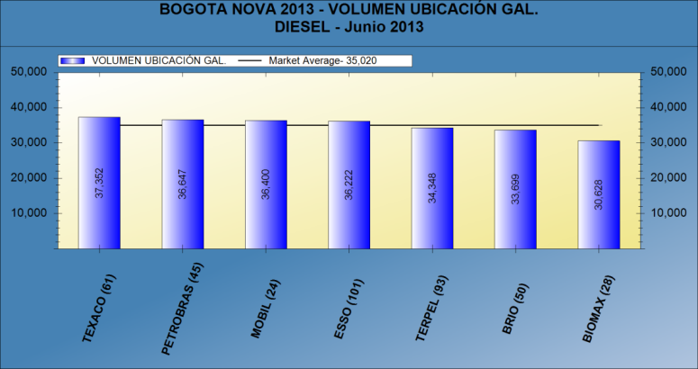
Location volume
With an average Location Volume of 97,480 gallons of gasoline & diesel per month, Petrobras has the second best location in Bogotá.
Location Volume represents the 'raw site strength' of an outlet: the volume an outlet would achieve if the only factors that influenced its performance were traffic, demand, number of competitors and the outlet's proximity to its competition.

Slide 10
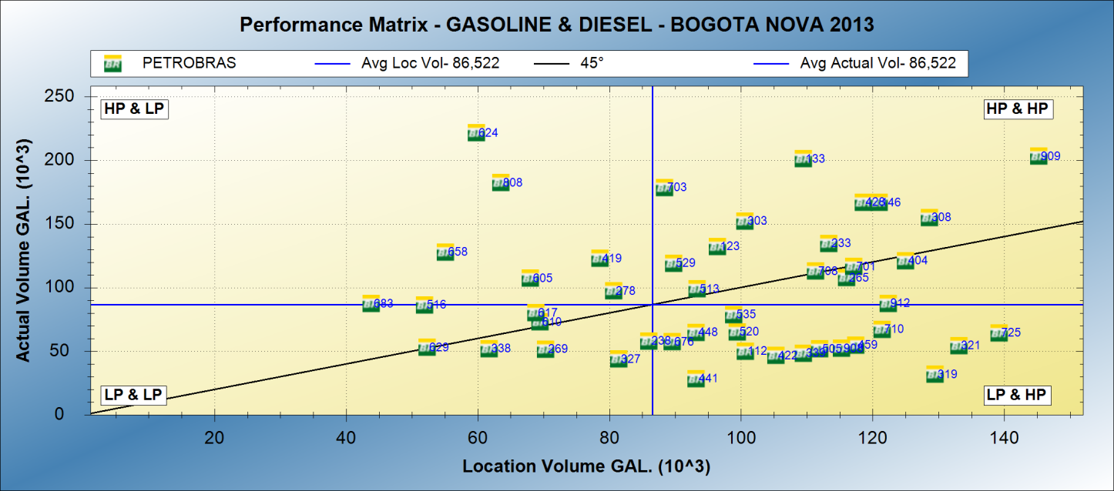
Quadrant analysis
High Potential – High-Performance – 13 outlets – 26% → 41.4% volume
High Potential – Low-Performance – 15 outlets – 30% > 18.7% volume
Low Potential – Low-Performance – 10 outlets – 20% > 14.2% volume
Low Potential – High-Performance – 8 outlets – 16% > 25.6% volume
Outlets with Potential for improvement

Slide 11
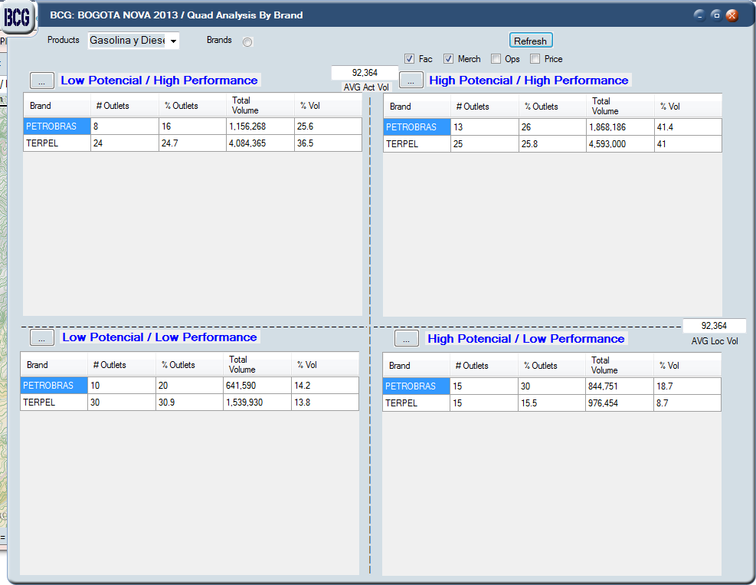
Quadrant analysis

Slide 12
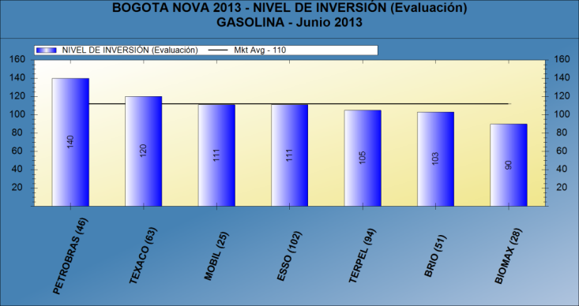
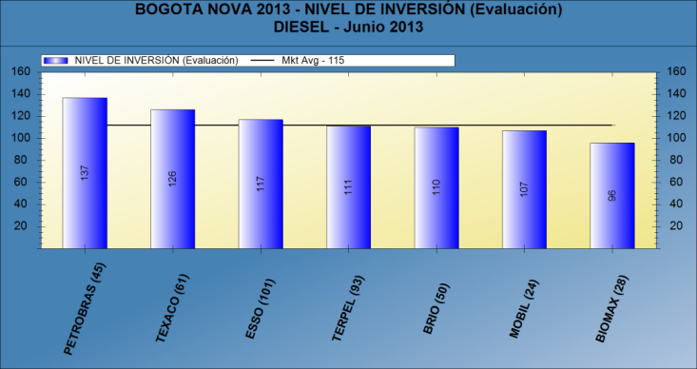
Facility Score
Petrobras boasts the best facilities in the market.
Facility Score represents the physical characteristics of each site. It includes factors such as fueling positions, lot size, appearance rating, accessibility rating and the attributes of the facilities of the ancillary offering.

Slide 13
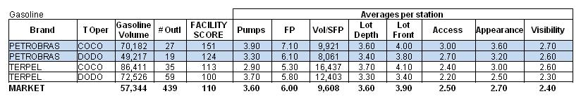
Facility & merchandising score detail
Lot depth/Lot Front
< 20M
20-40 M
41-60 M
61-100 M
>100 M
Evaluations
Poor
Below Avg.
Average
Above Avg.
Superior

Slide 14
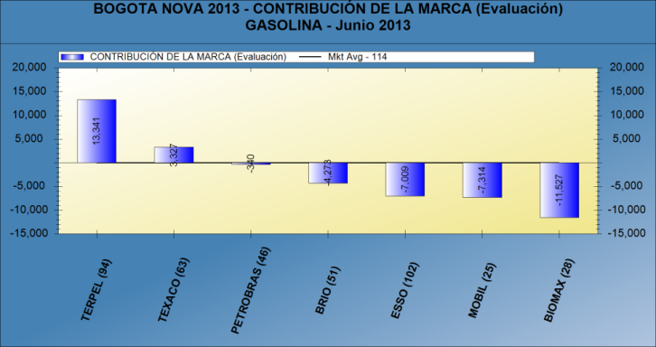
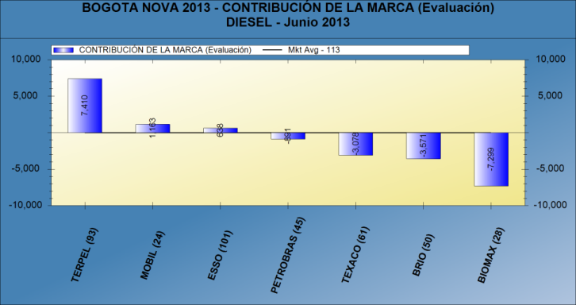
Brand contribution
Petrobras’ Brand performance is slightly below average.

Slide 15
Merger simulation
Using the 2013 volume update of the Bogotá’s Planner Model, BCG simulated the brand acquisition of the Petrobras Network.

Slide 16
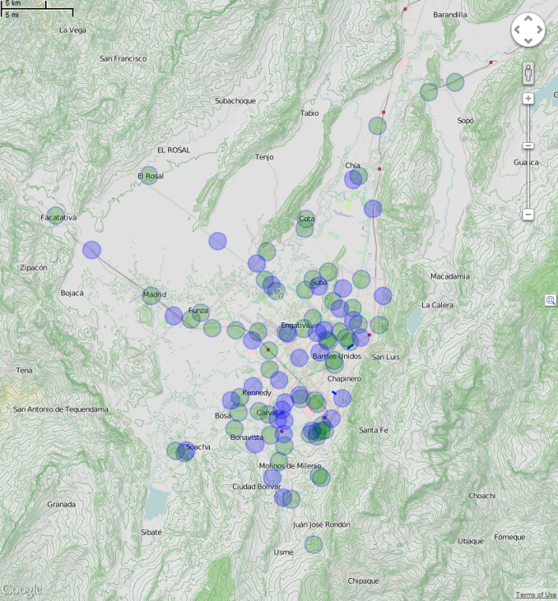
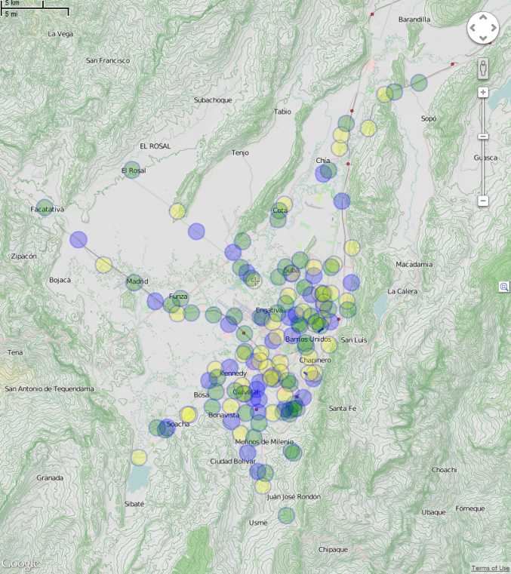
Terpel outlet density
Blue: TERPEL COCO’s Network
July 2013
After Acquisition
Green: TERPEL DODO’s Network
Yellow: Petrobras

Slide 17
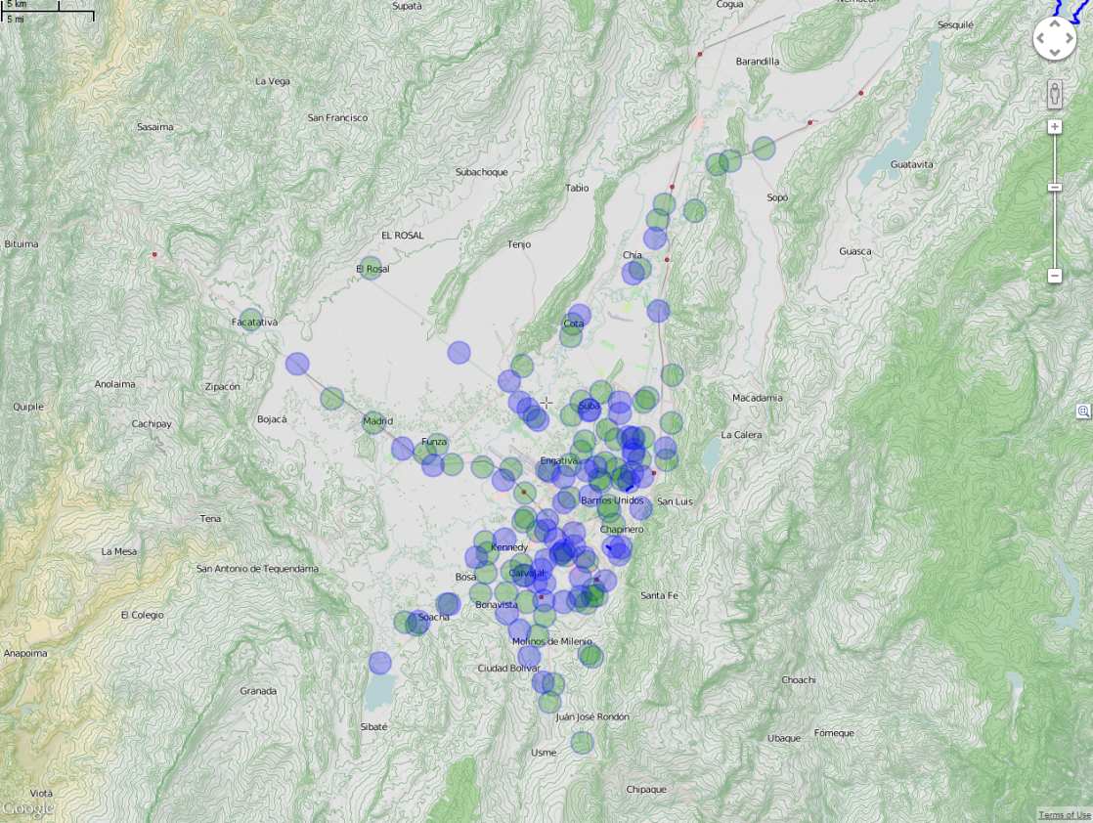
New terpel network after merger
Blue: COCO’s
Green: DODO’s

Slide 18
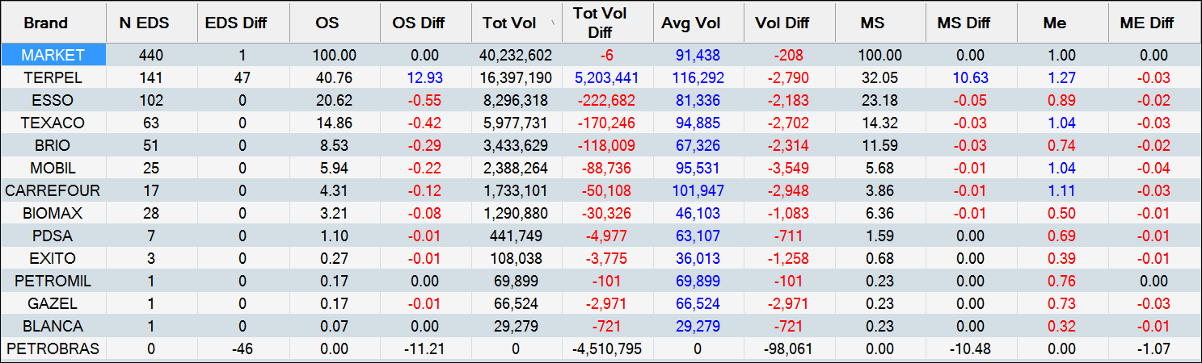
Case 1–brand Acquisition
Gasoline & Diesel

Slide 19
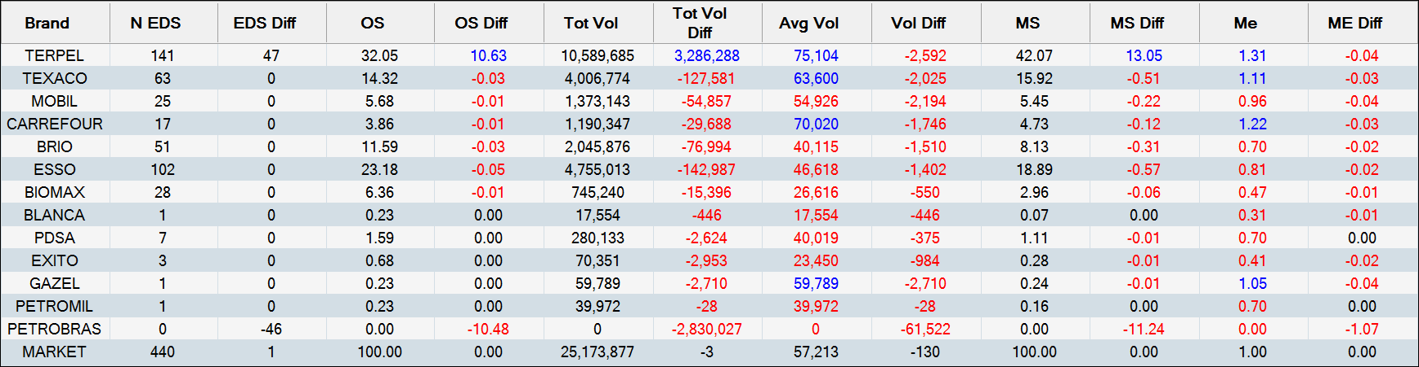
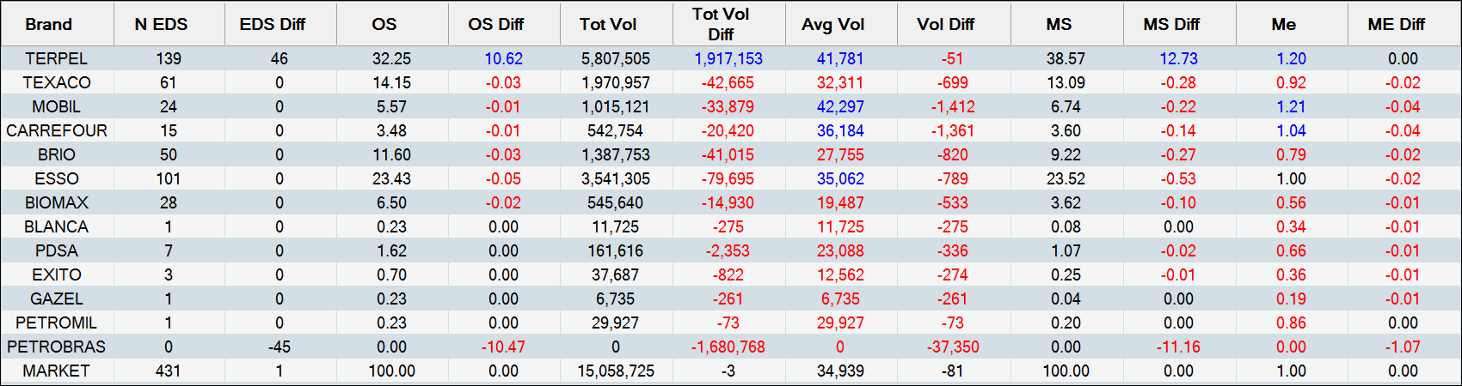
Case 1–brand Acquisition
Gasoline
Diesel

Slide 20
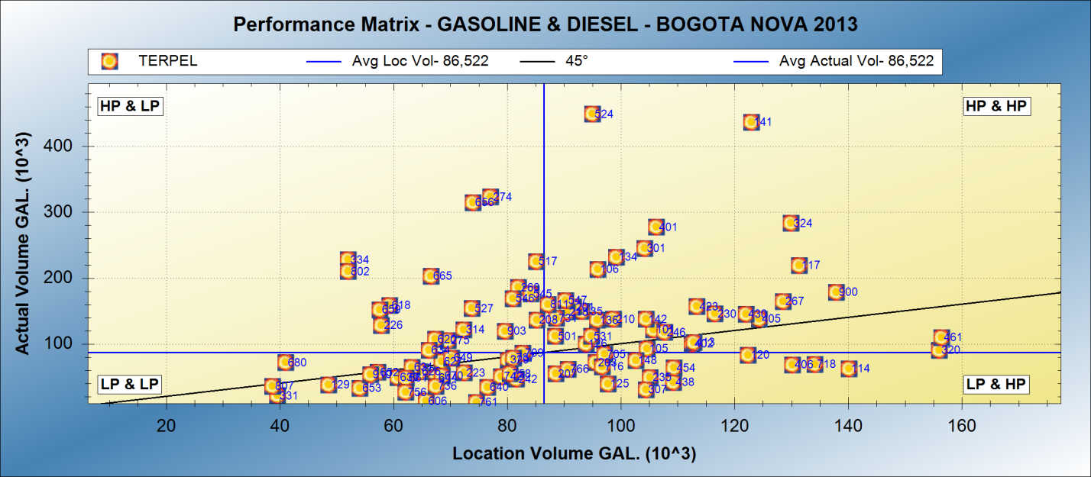
New network performance

Slide 21
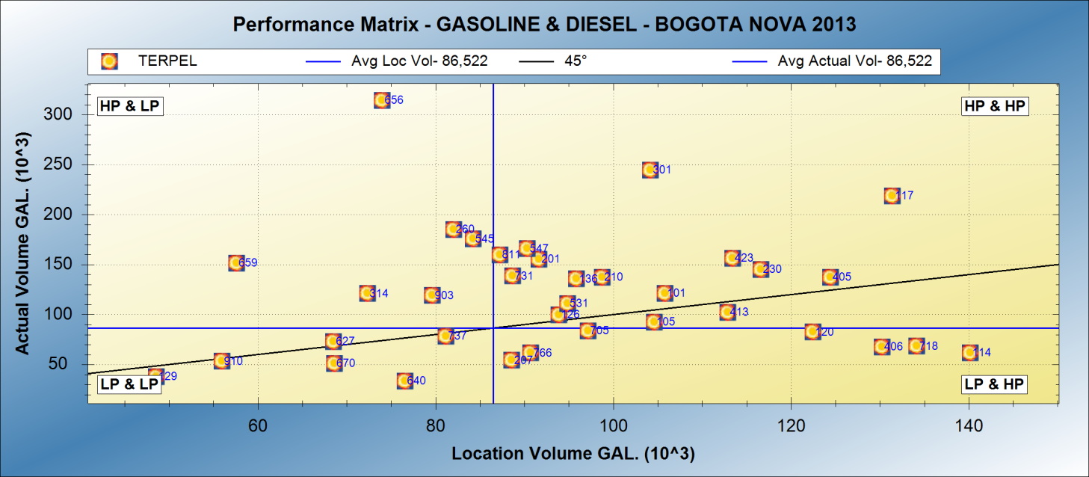
New network performance- CoCO

Slide 22
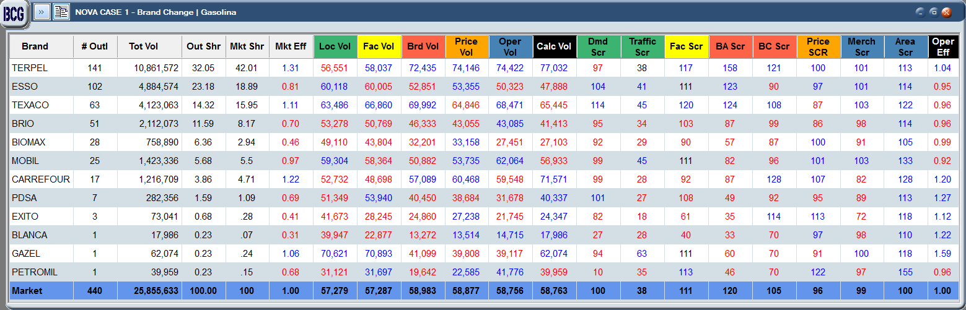
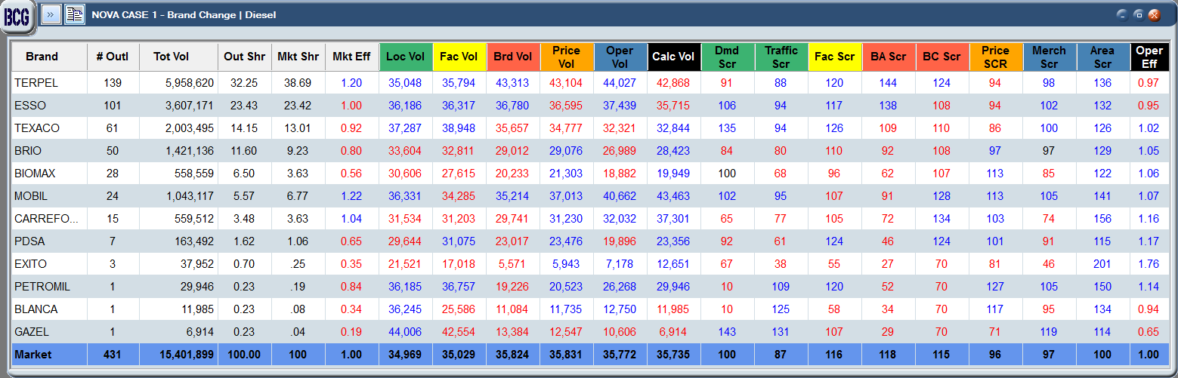
market summary – brand Acquisition
Gasoline
Diesel

