Slide 1
Executive summary
VILLAVICENCIO
Prepared for
TERPEL
by
Bravo Consulting Group, Inc.
October 2019

Slide 2
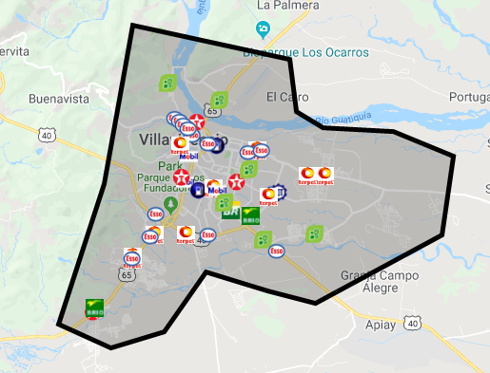
Market area

Slide 3
Bravo Consulting Group
Market summary - gasoline

Slide 4
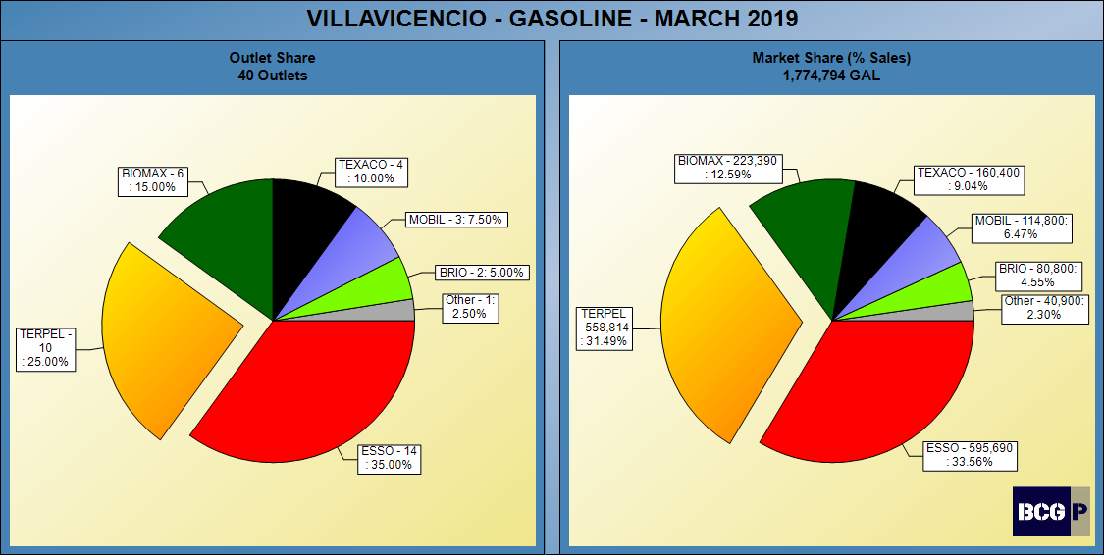
GASOLINE SHARES

Slide 5
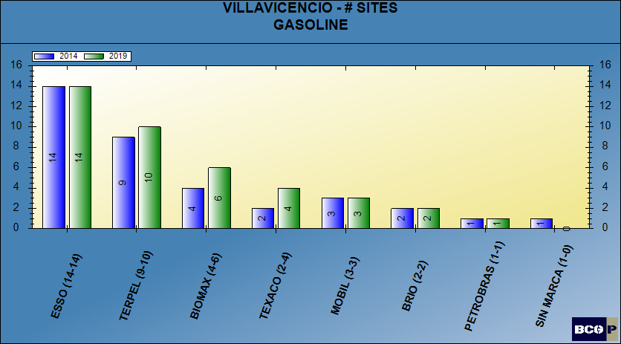
NUMBER OF SITES - GASOLINE

Slide 6
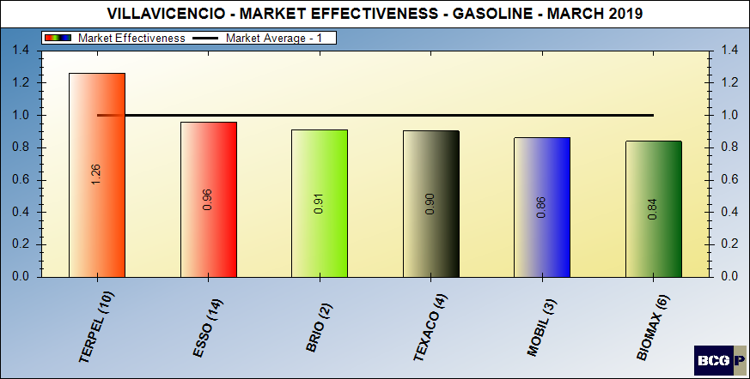
Gasoline market effectiveness

Slide 7
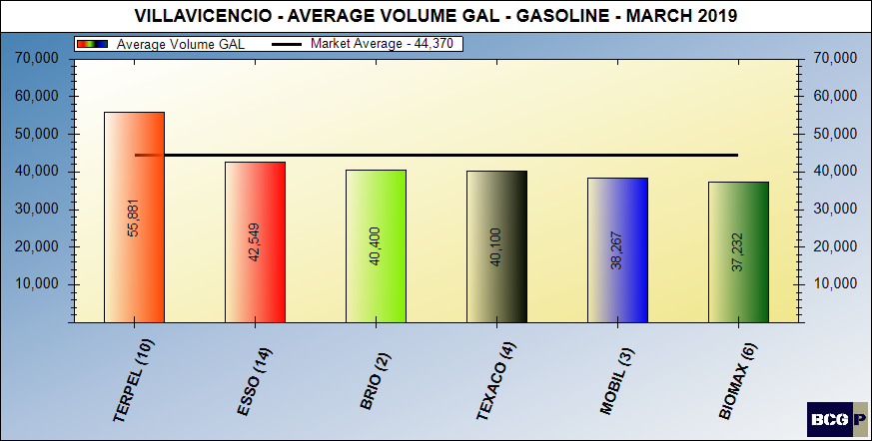
Gasoline average volumes

Slide 8
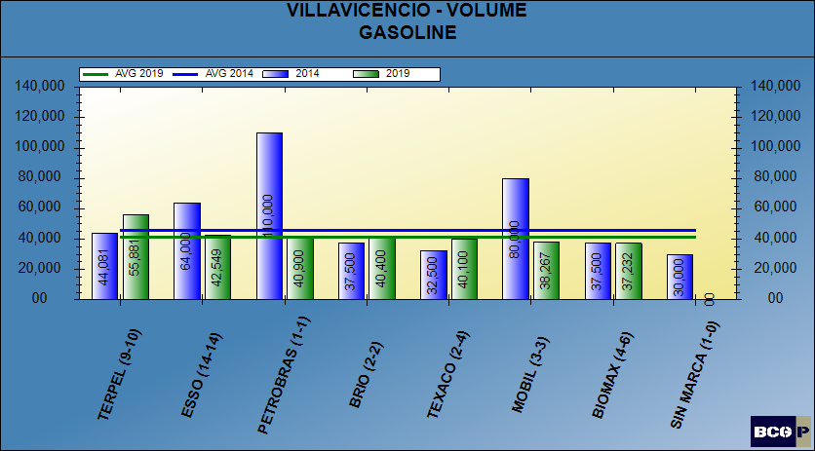
GASOLINE AVERAGE VOLUMES

Slide 9
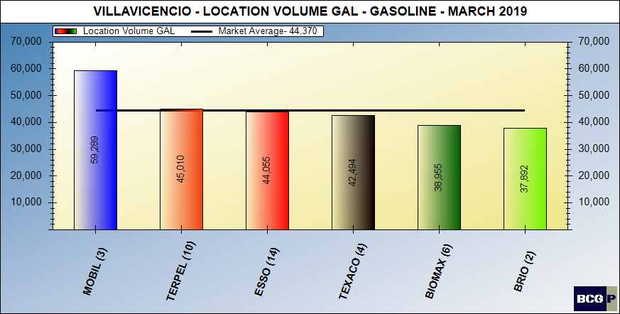
Location volume - gasoline

Slide 10
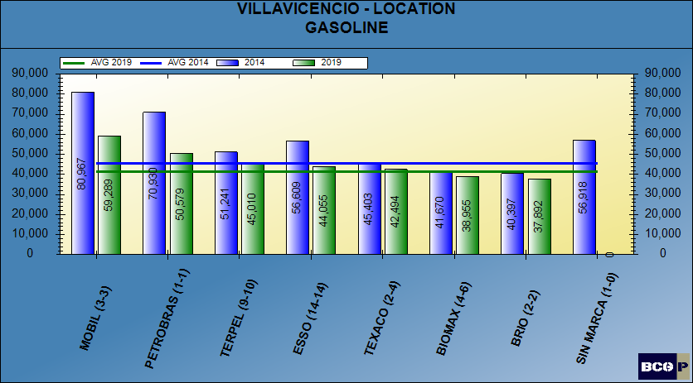
LOCATION VOLUME - GASOLINE

Slide 11
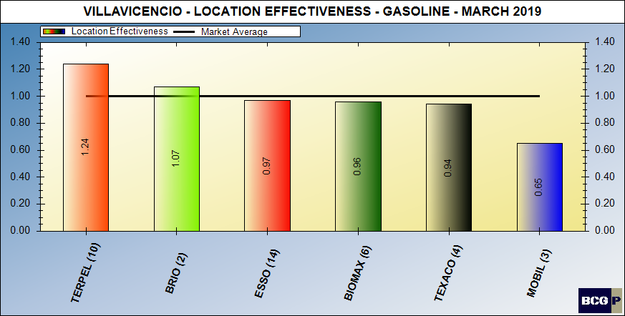
Location volume effectiveness – gasoline

Slide 12
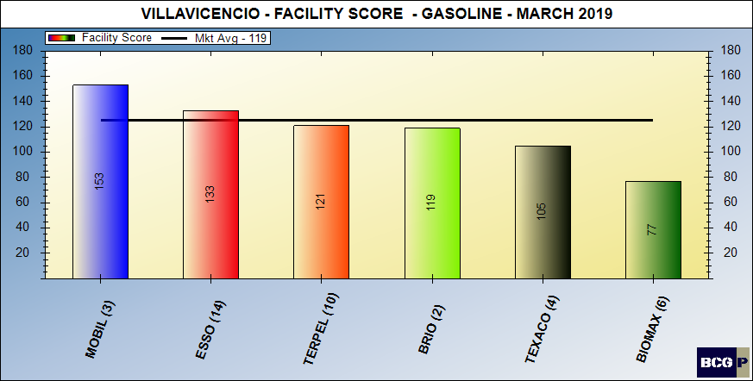
Facility score - gasoline

Slide 13
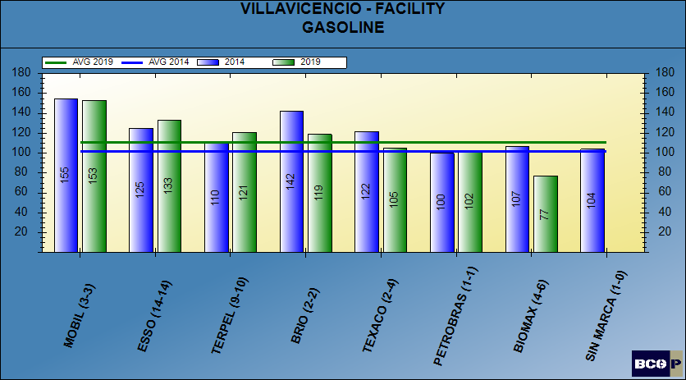
FACILITY SCORE - GASOLINE

Slide 14
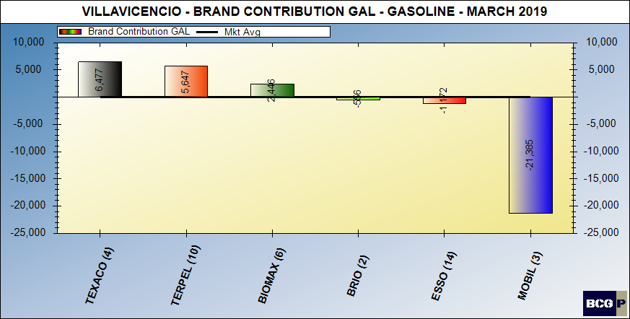
Brand contribution - gasoline

Slide 15
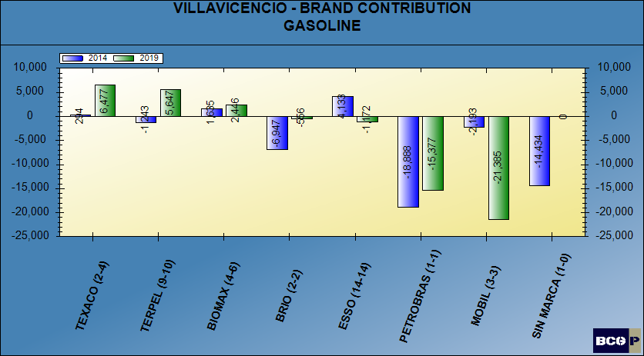
BRAND CONTRIBUTION - GASOLINE

Slide 16
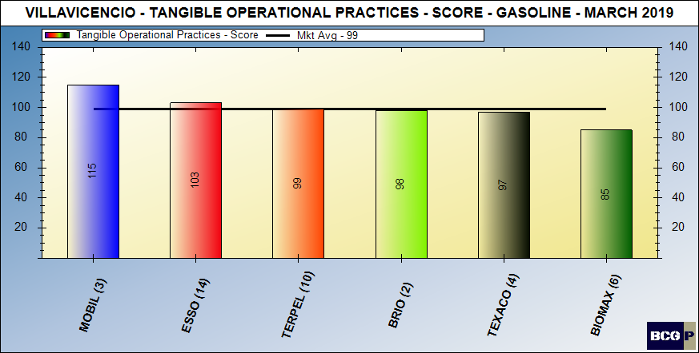
Merchandising score - gasoline

Slide 17
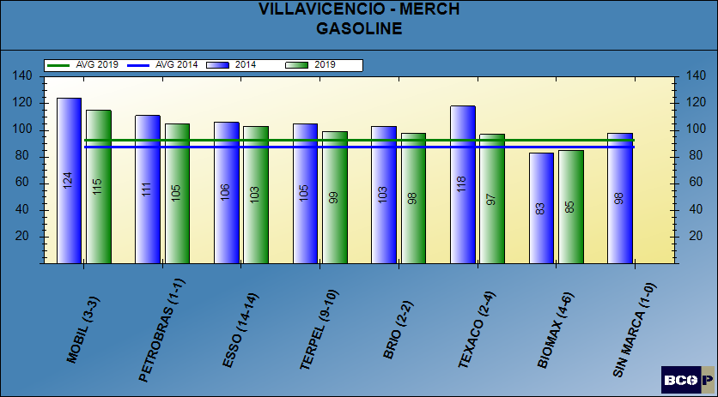
MERCHANDISING SCORE - GASOLINE

Slide 18
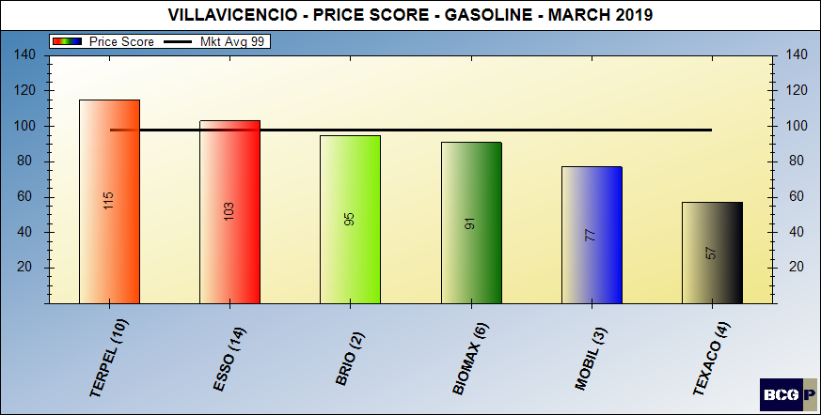
Pricing posture - gasoline

Slide 19
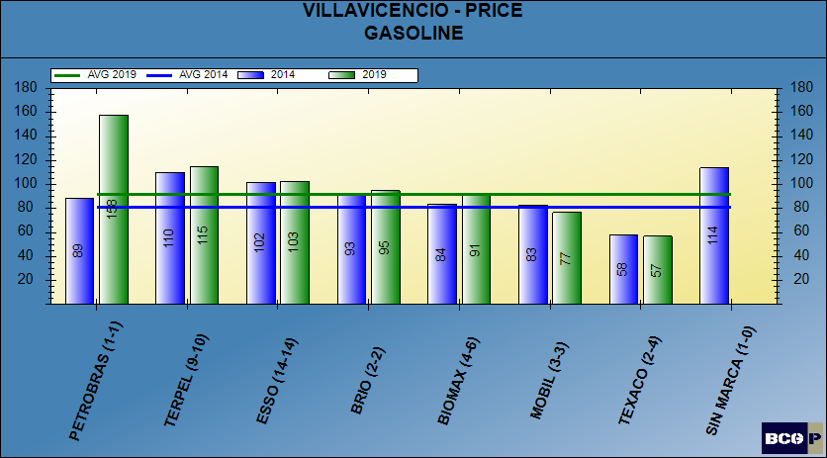
PRICING POSTURE - GASOLINE

Slide 20
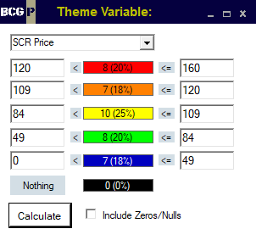
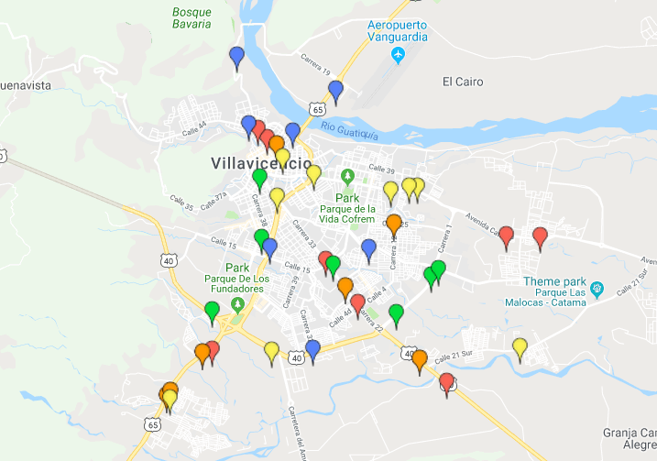
PRICE THEMATIC MAP - GASOLINE

Slide 21
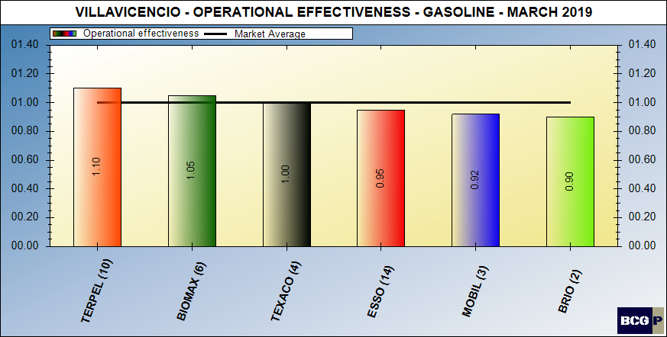
dealer (intangible) contribution – gasoline

Slide 22
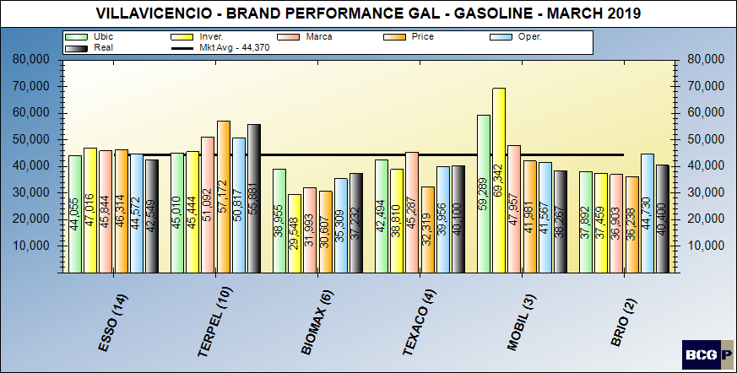
Brand performance – gasoline

Slide 23
MARKET SUMMARY - GASOLINE

Slide 24
Bravo Consulting Group
Market summary - diesel

Slide 25
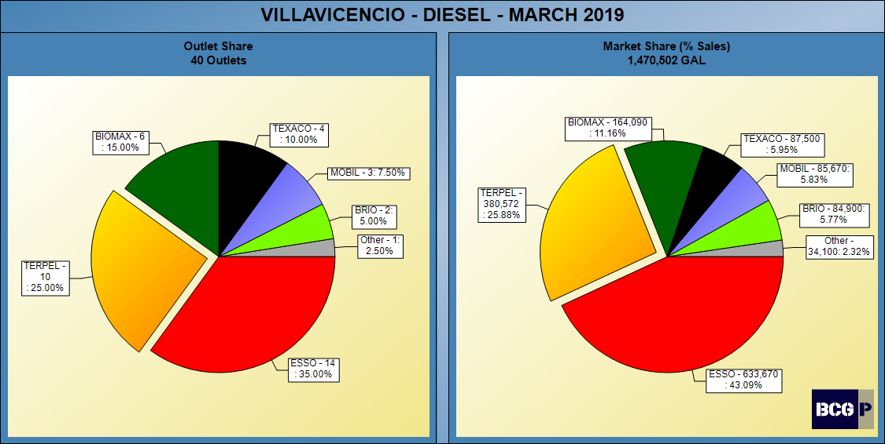
DIESEL SHARES

Slide 26
NUMBER OF SITES - DIESEL

Slide 27
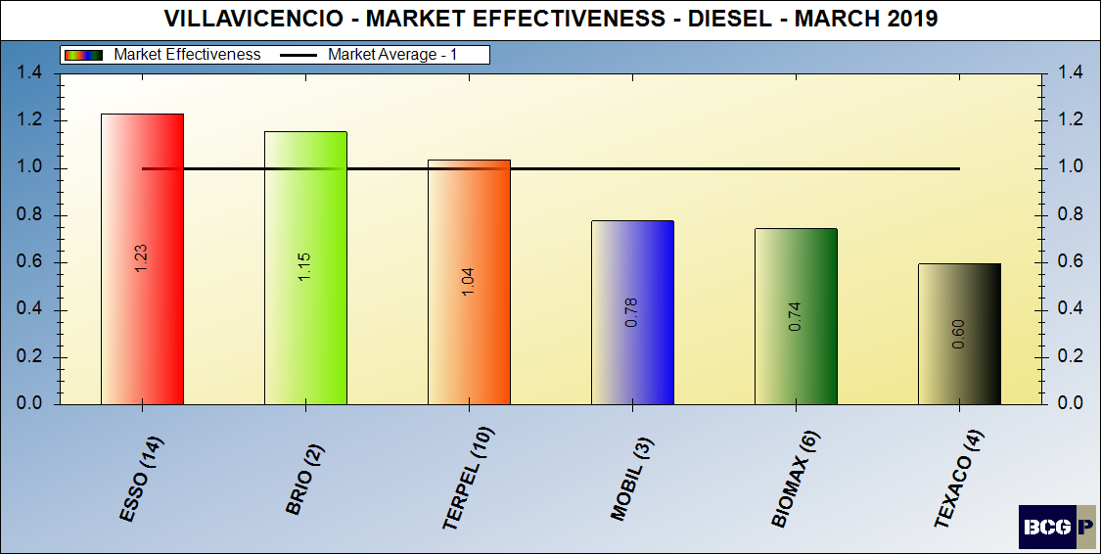
market effectiveness - diesel

Slide 28
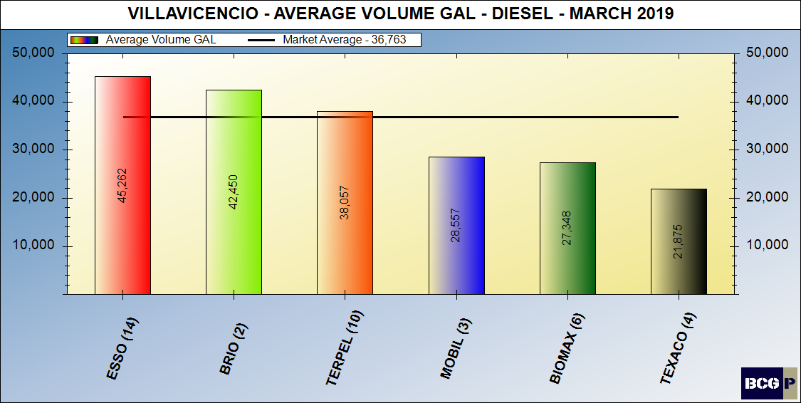
average volumes - DIESEL

Slide 29
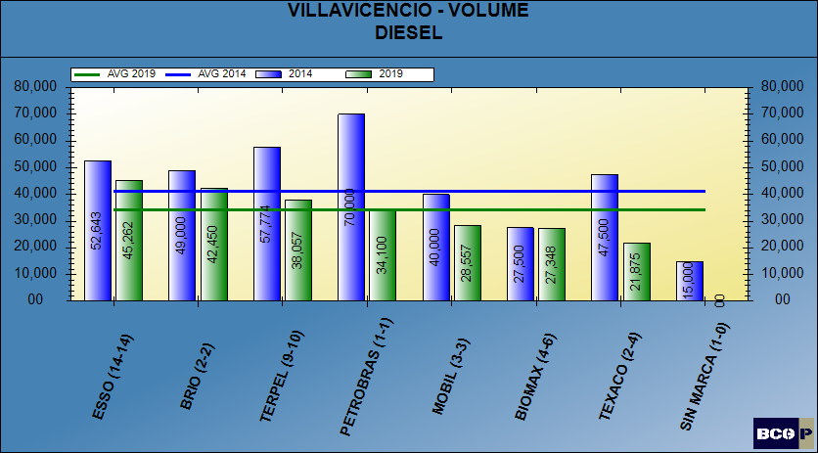
AVERAGE VOLUMES - DIESEL

Slide 30
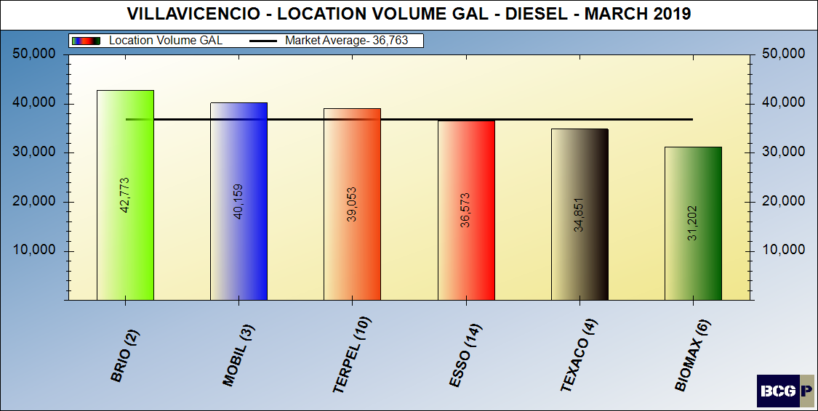
Location volume - diesel

Slide 31
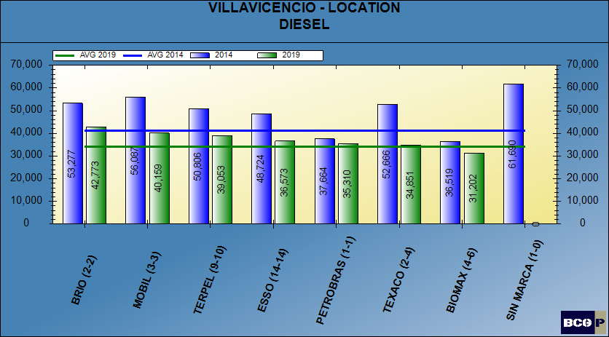
LOCATION VOLUME - DIESEL

Slide 32
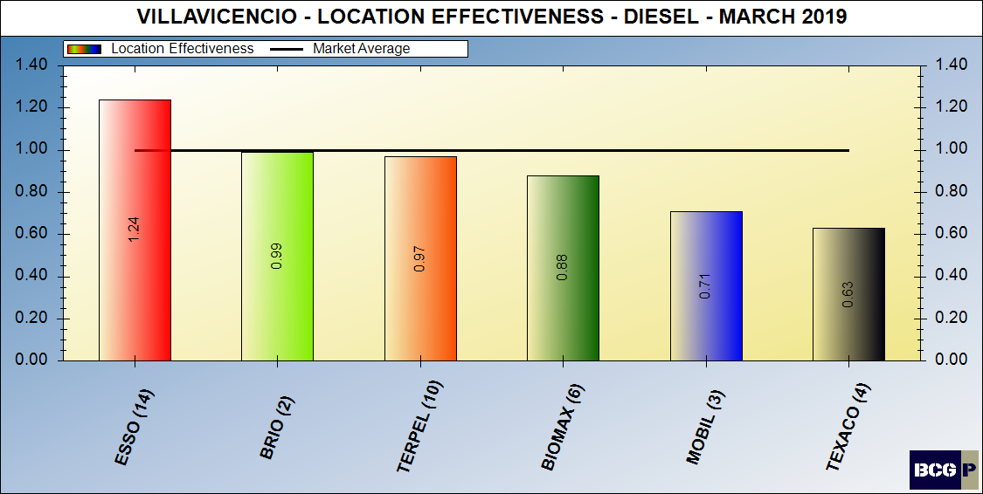
Location volume effectiveness – diesel

Slide 33
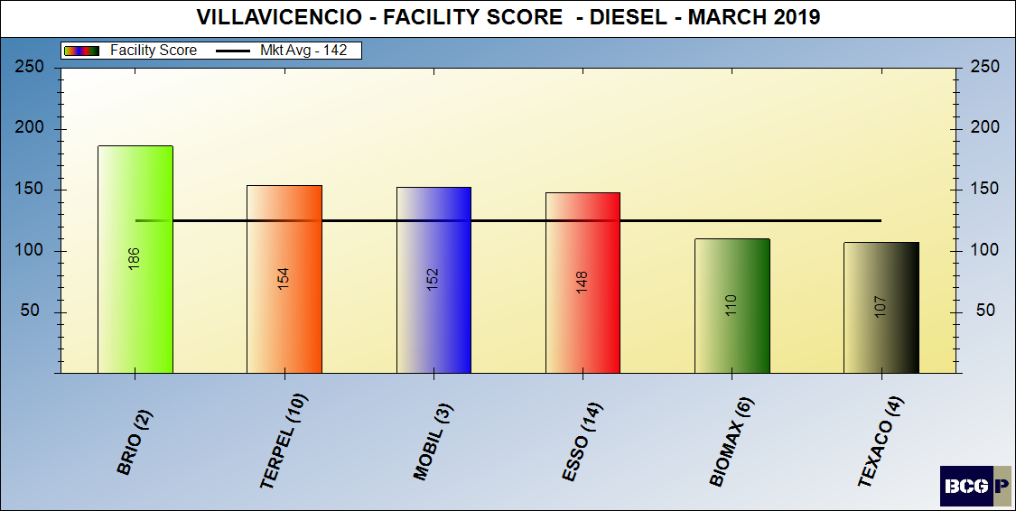
Facility score - diesel

Slide 34
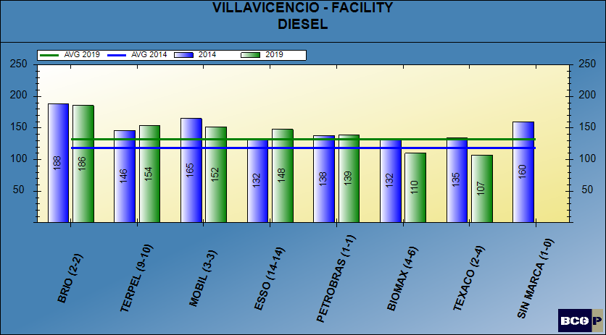
FACILITY SCORE - DIESEL

Slide 35
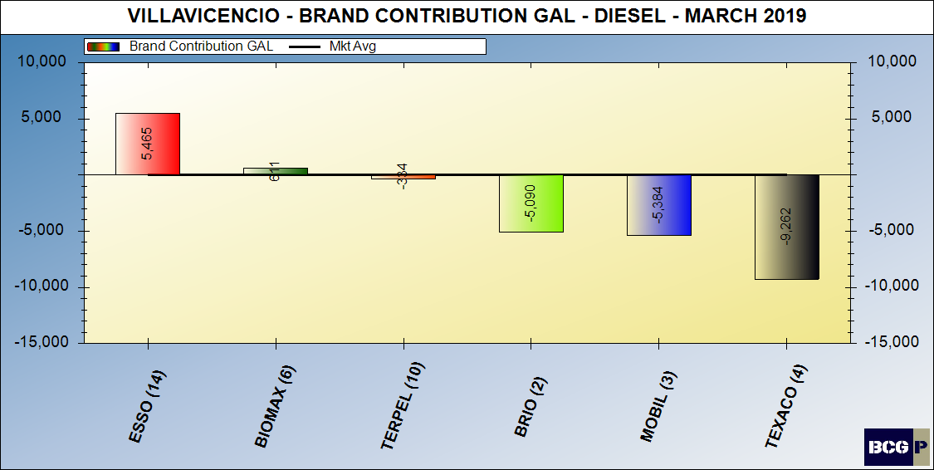
Brand contribution - diesel

Slide 36
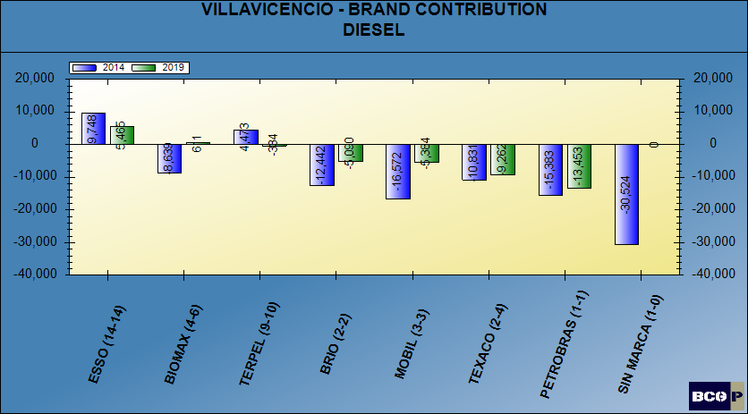
BRAND CONTRIBUTION - DIESEL

Slide 37
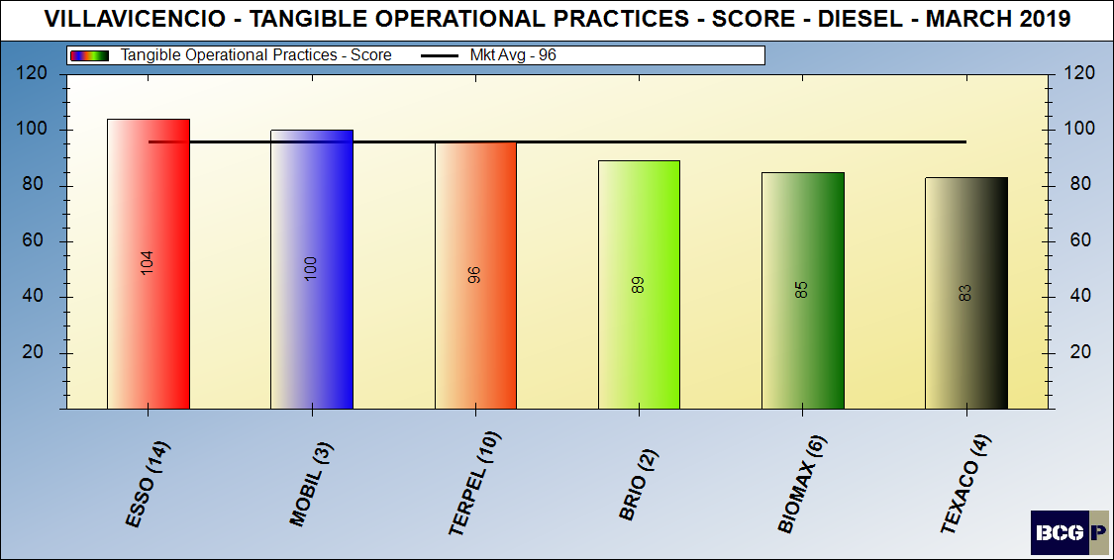
Merchandising score - diesel

Slide 38
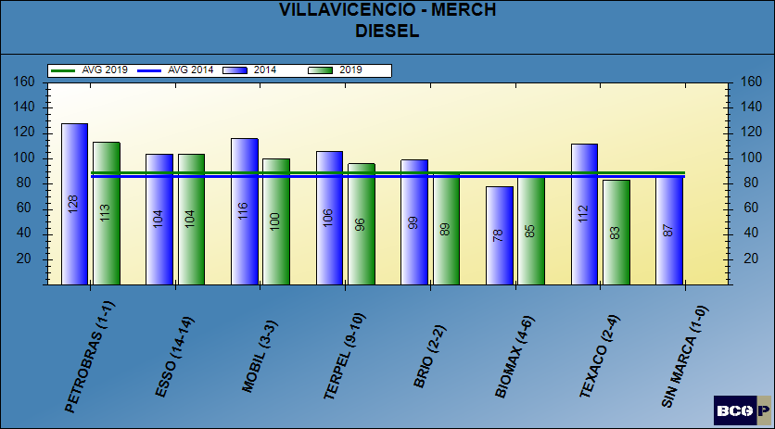
Merchandising score - diesel

Slide 39
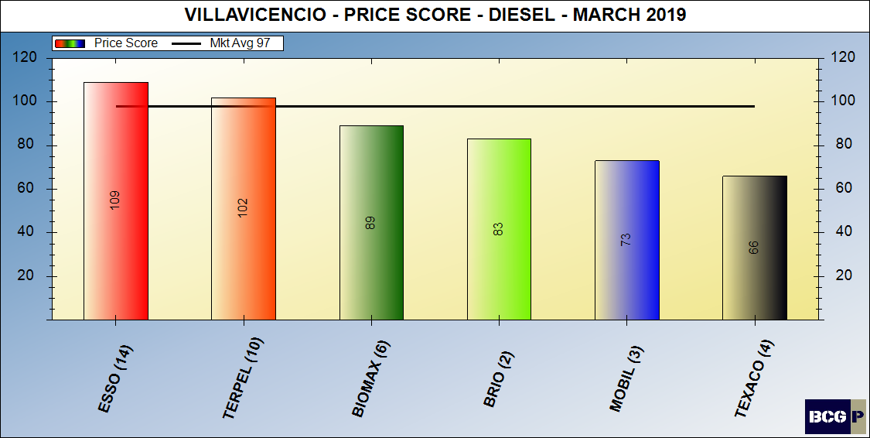
Pricing posture - diesel

Slide 40
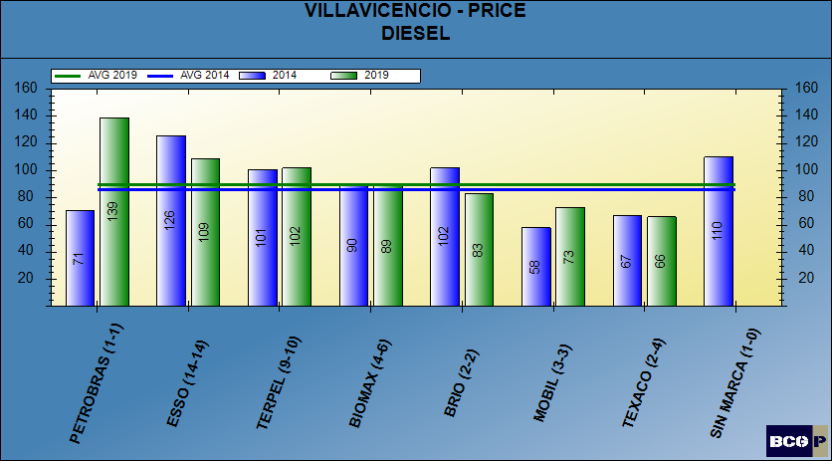
Pricing posture - diesel

Slide 41
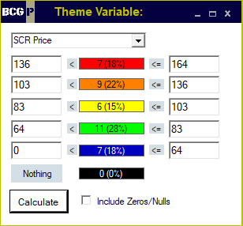
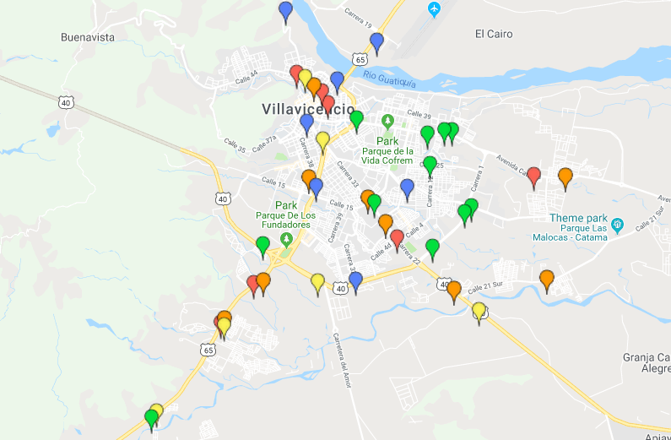
PRICE THEMATIC MAP - DIESEL

Slide 42
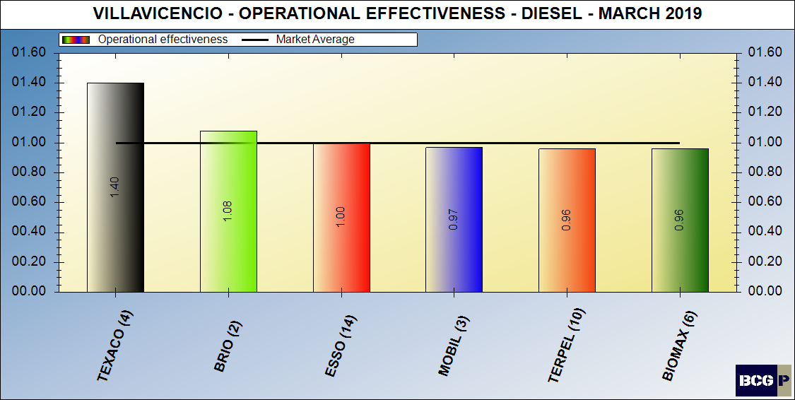
dealer (intangible) contribution – diesel

Slide 43
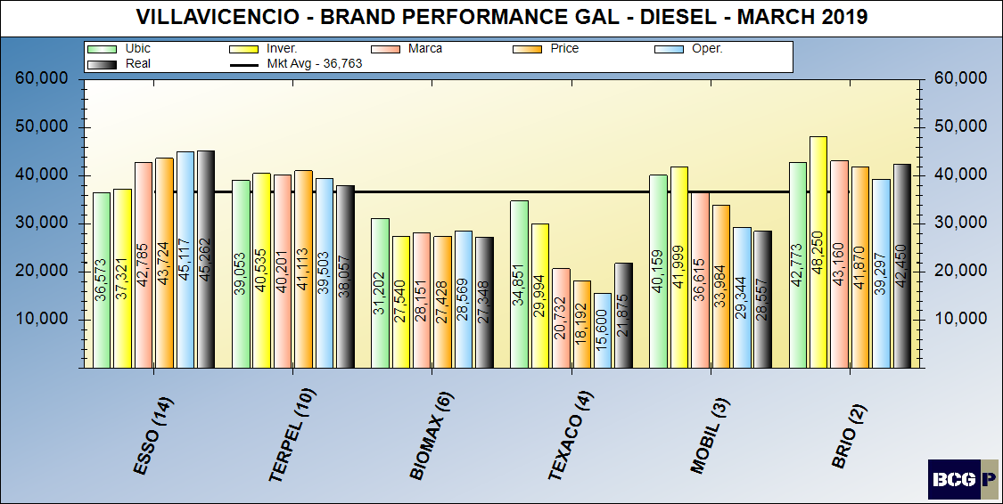
Brand performance – diesel

Slide 44
MARKET SUMMARY - DIESEL

Slide 45
Bravo Consulting group
QUADRANT –TERPEL
gasoline & diesel

Slide 46
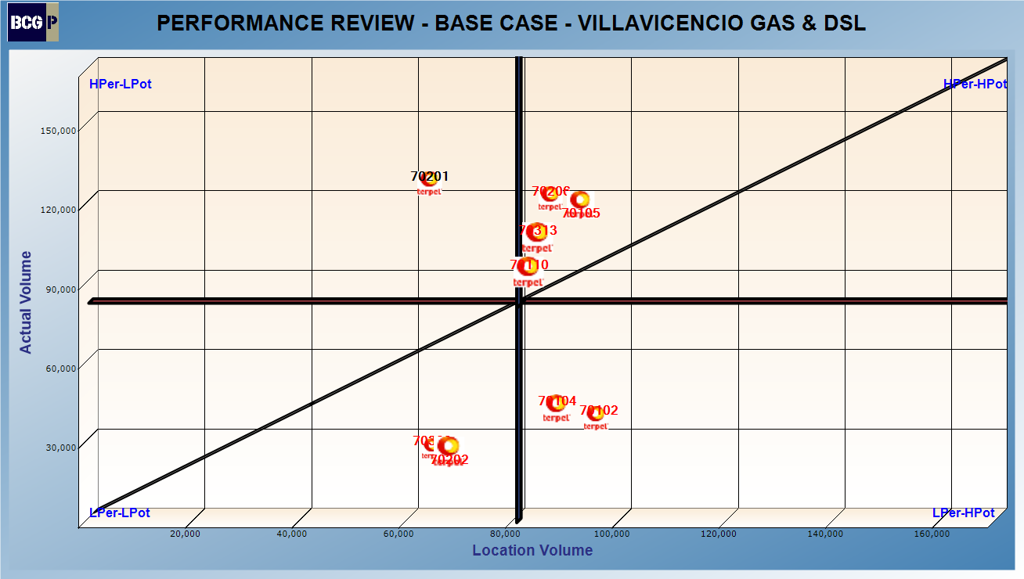
QUADRANT – GASOLINE & DIESEL

Slide 47
Bravo Consulting group
Performance analysis gasoline & diesel

Slide 48
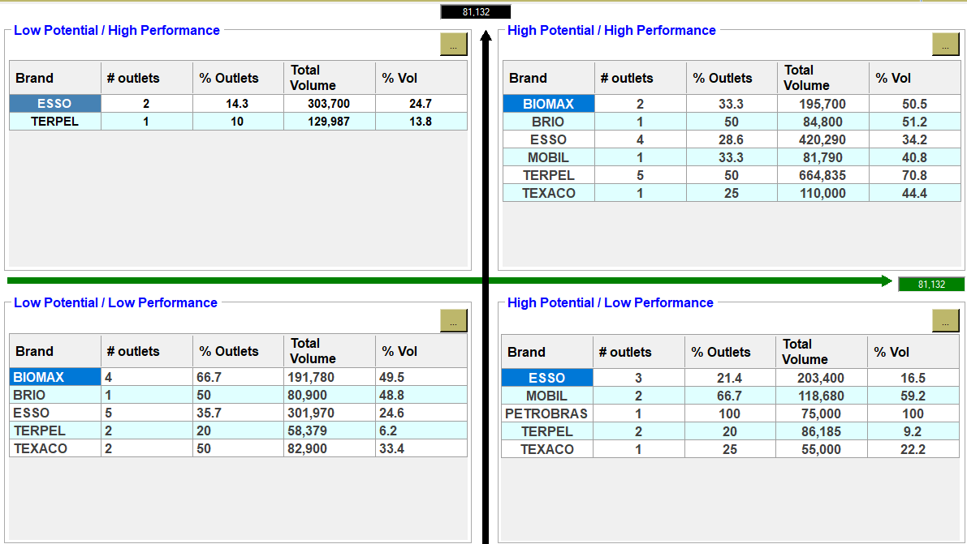
PERFORMANCE ANALYSIS – GASOLINE & DIESEL

Slide 49
Bravo Consulting Group
Market summary - GNV

Slide 50
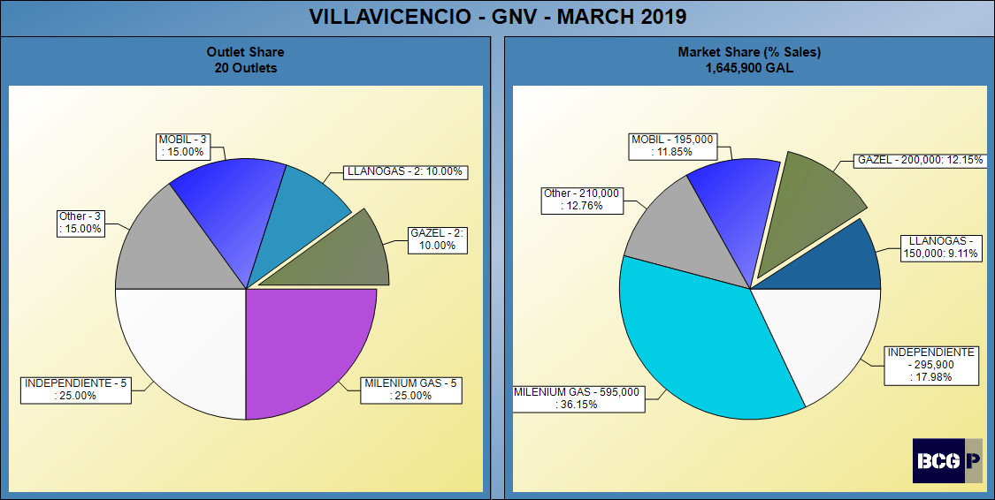
Gnv SHARES

Slide 51
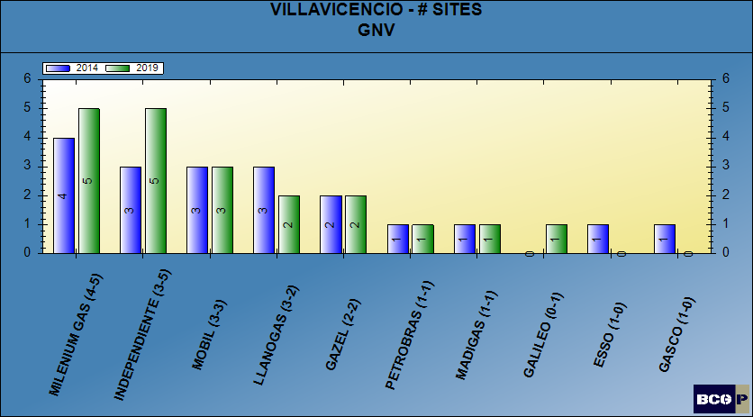
NUMBER OF SITES - gnv

Slide 52
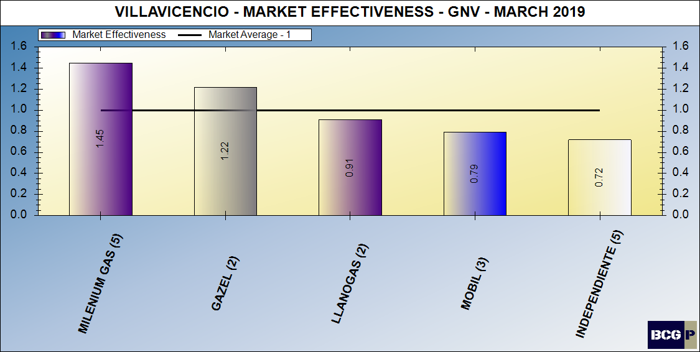
Gnv MARKET EFFECTIVENESS

Slide 53
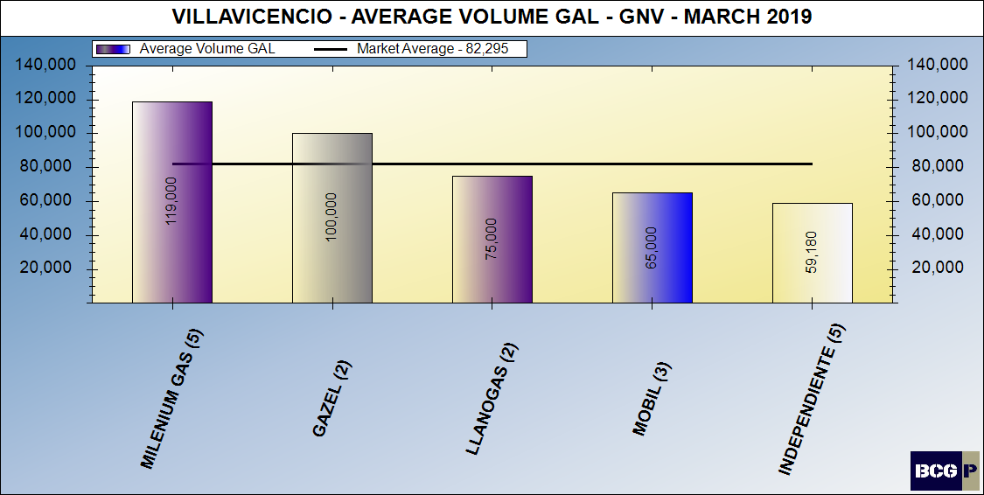
AVERAGE VOLUMES - GNV

Slide 54
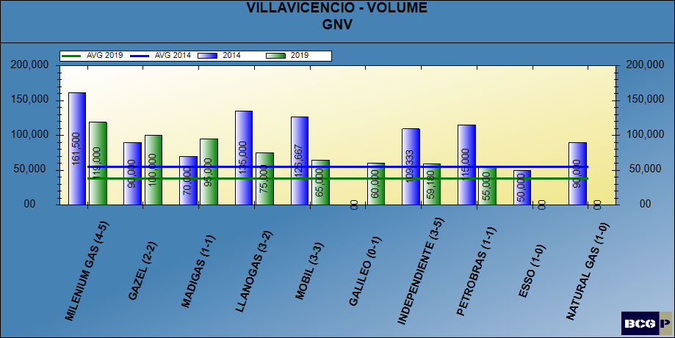
AVERAGE VOLUMES - GNV

Slide 55
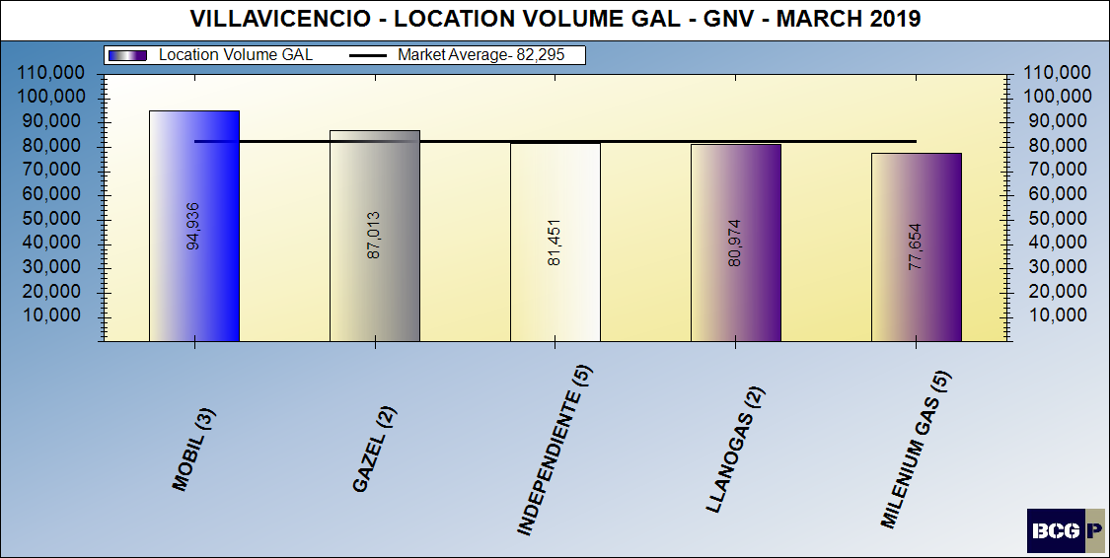
LOCATION VOLUME - GNV

Slide 56
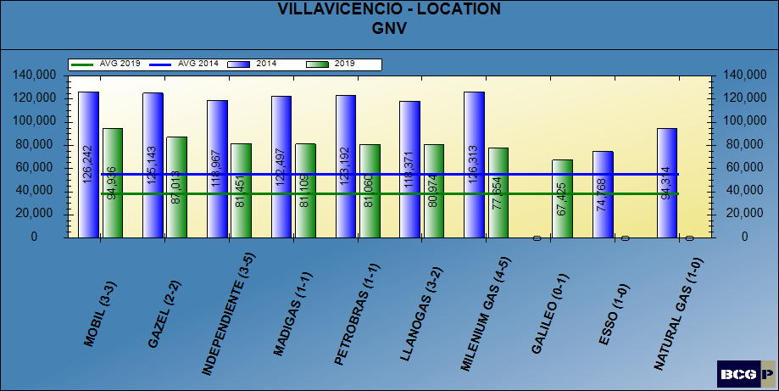
LOCATION VOLUME - GNV

Slide 57
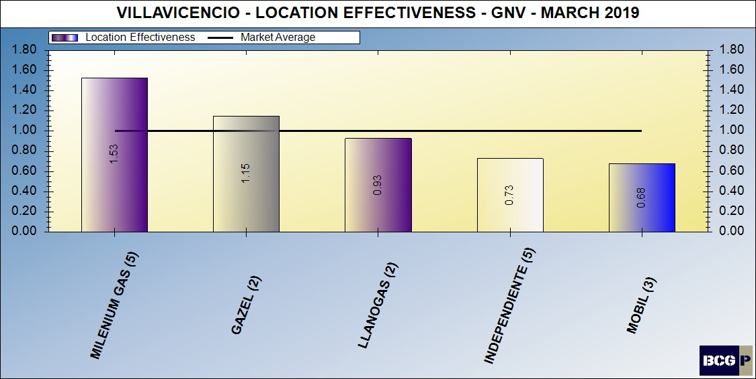
LOCATION VOLUME EFFECTIVENESS - GNV

Slide 58
FACILITY SCORE - GNV

Slide 59
FACILITY SCORE - GNV

Slide 60
BRAND CONTRIBUTION - GNV

Slide 61
BRAND CONTRIBUTION - GNV

Slide 62
MERCHANDISING SCORE - GNV

Slide 63
MERCHANDISING SCORE - GNV

Slide 64
PRICING POSTURE - GNV

Slide 65
PRICING POSTURE - GNV

Slide 66
PRICE THEMATIC MAP - GNV

Slide 67
DEALER (INTANGIBLE) CONTRIBUTION - GNV

Slide 68
BRAND PERFORMANCE - GNV

Slide 69
MARKET SUMMARY - GNV

Slide 70
Bravo Consulting Group
OUTLET REVIEW

Slide 71
BCG ID 70102 - madigas

Slide 72
BCG ID 70104 – m&m del llano

Slide 73
BCG ID 70105 - montecarlo

Slide 74
BCG ID 70110 – milenium gas pavitos

Slide 75
BCG ID 70201 - elite

Slide 76
BCG ID 70202 - catama

Slide 77
BCG ID 70206 – llanos del oriente

Slide 78
BCG ID 70210 - LAS PALMAS

Slide 79
BCG ID 70309 - surtillanos

Slide 80
BCG ID 70313 - MILENIUMGAS SEÑORA VILLAVICENCIO

