Slide 1
Executive summary
POPAYAN
Prepared for
TERPEL
by
Bravo Consulting Group, Inc.
November 2018

Slide 2
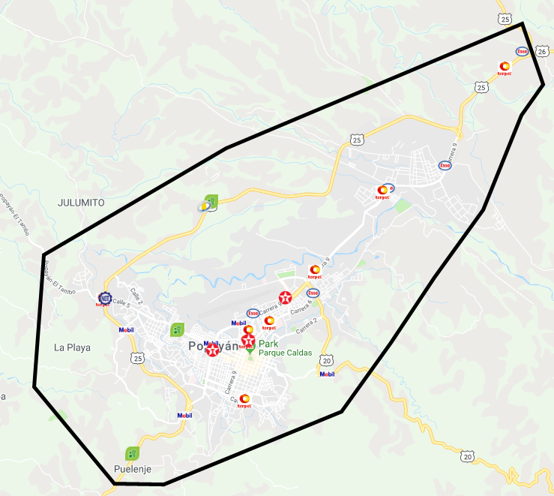
Market area

Slide 3
Bravo Consulting Group
Market summary - gasoline

Slide 4
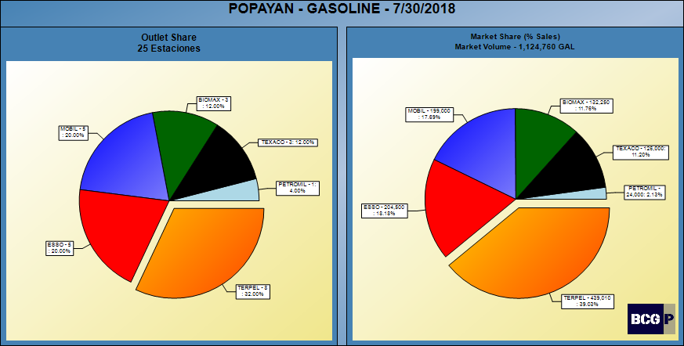
GASOLINE SHARES

Slide 5
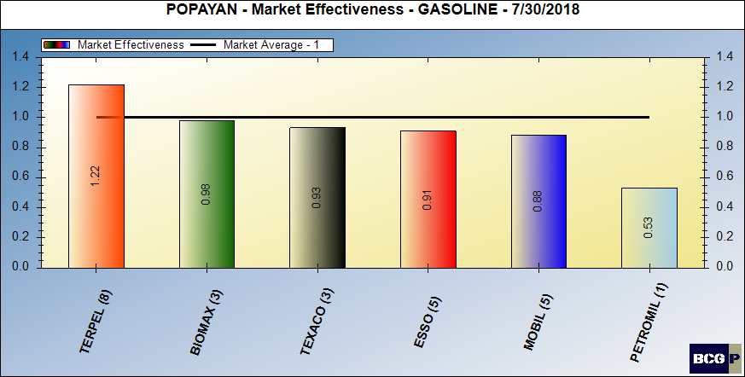
Gasoline market effectiveness

Slide 6
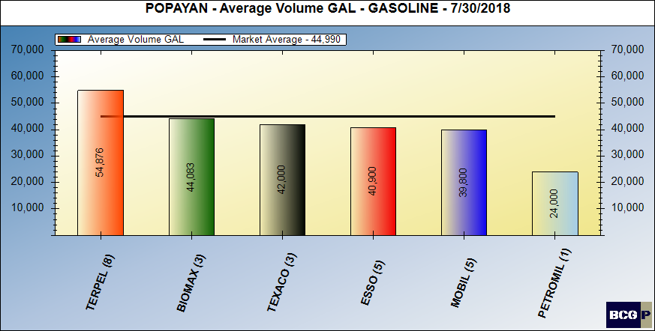
Gasoline average volumes

Slide 7
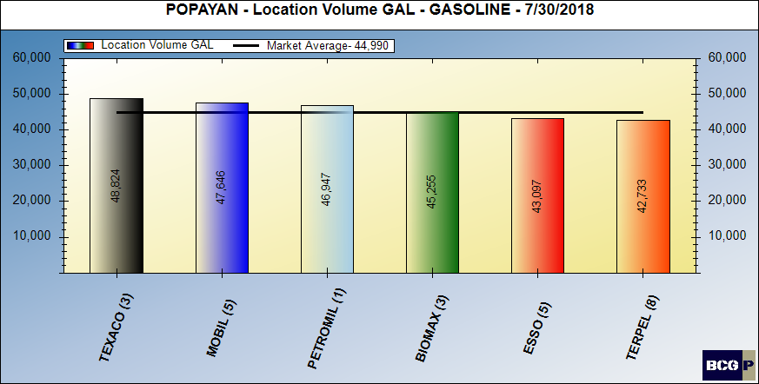
LOCATION VOLUME - GASOLINE

Slide 8
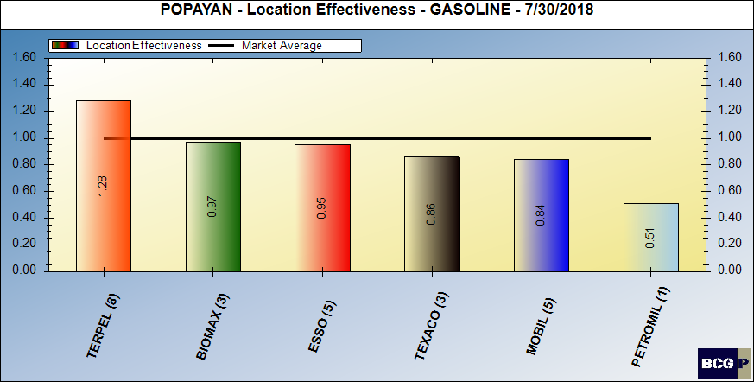
Location volume effectiveness – gasoline

Slide 9
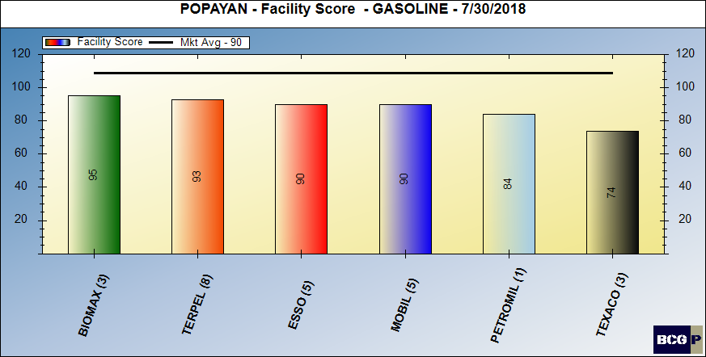
FACILITY SCORE - GASOLINE

Slide 10
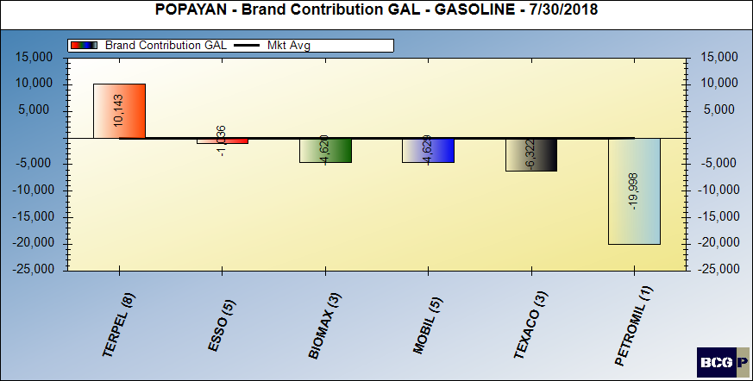
Brand contribution - gasoline

Slide 11
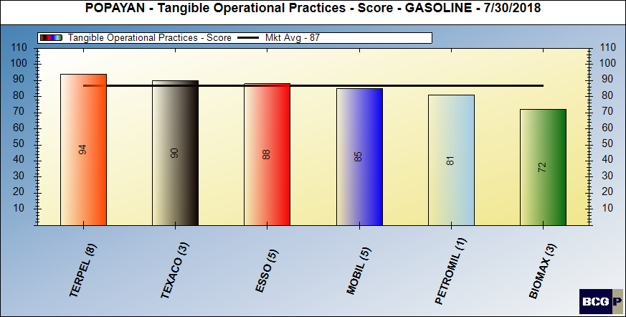
Merchandising score - gasoline

Slide 12
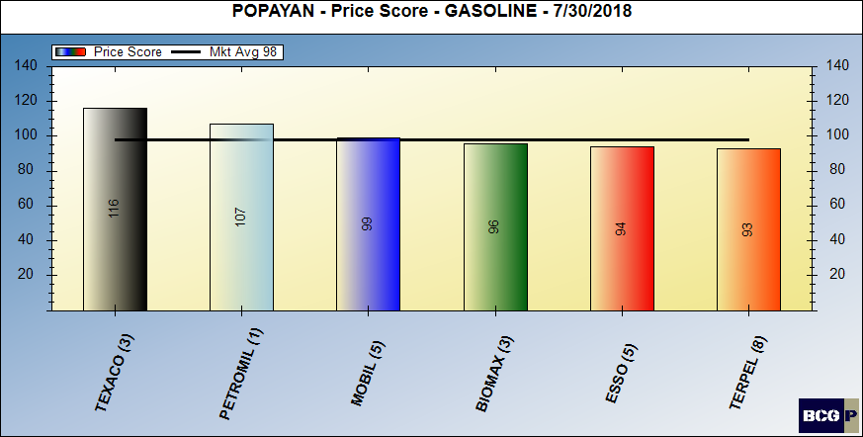
Pricing posture - gasoline

Slide 13
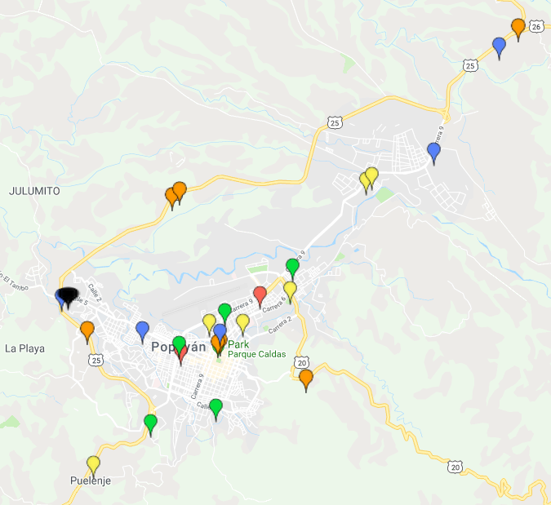
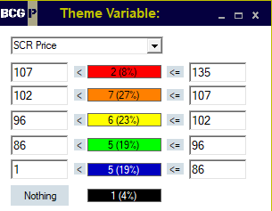
PRICE THEMATIC MAP - GASOLINE

Slide 14
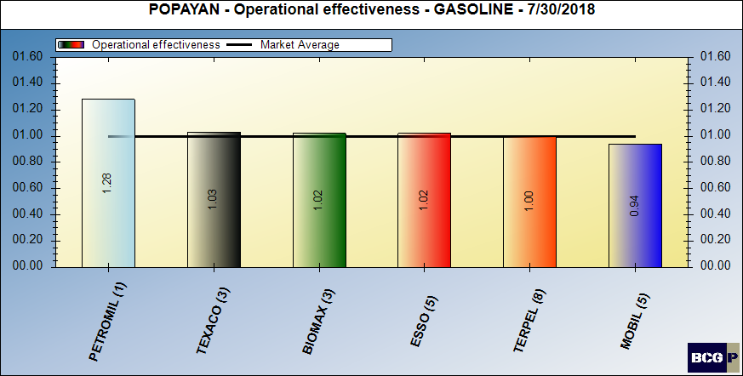
dealer (intangible) contribution – gasoline

Slide 15
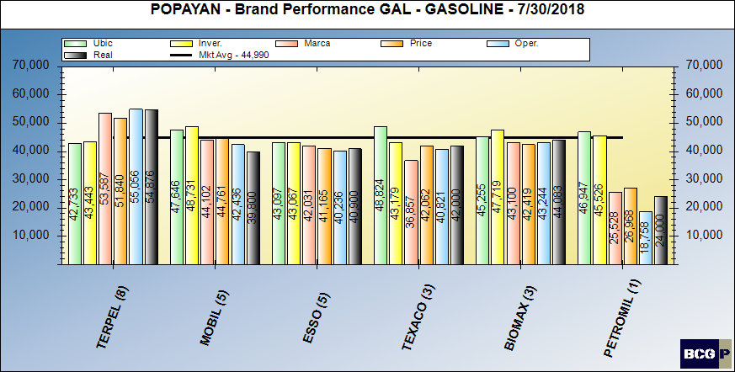
Brand performance – gasoline

Slide 16
MARKET SUMMARY - GASOLINE

Slide 17
Bravo Consulting Group
Market summary - diesel

Slide 18
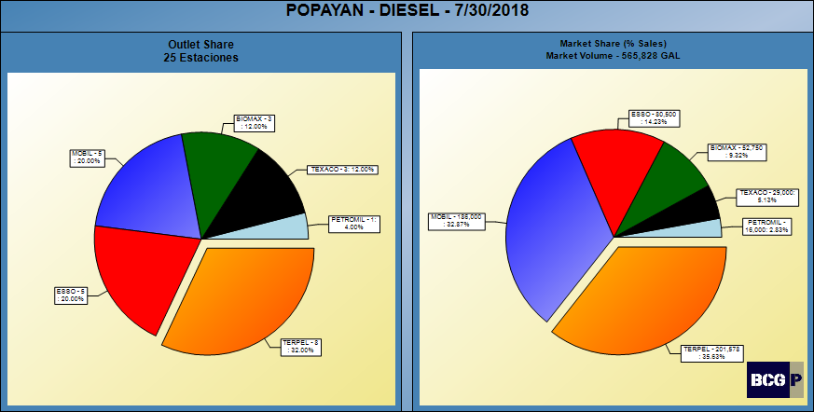
DIESEL SHARES

Slide 19
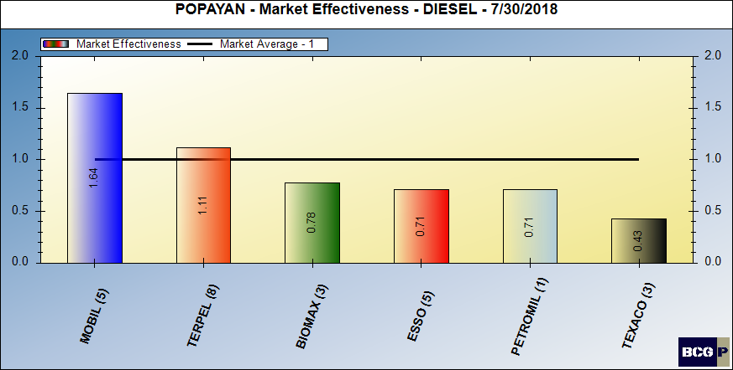
market effectiveness - diesel

Slide 20
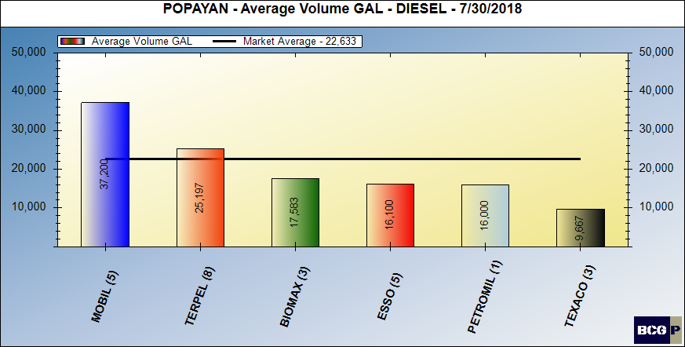
AVERAGE VOLUMES - DIESEL

Slide 21
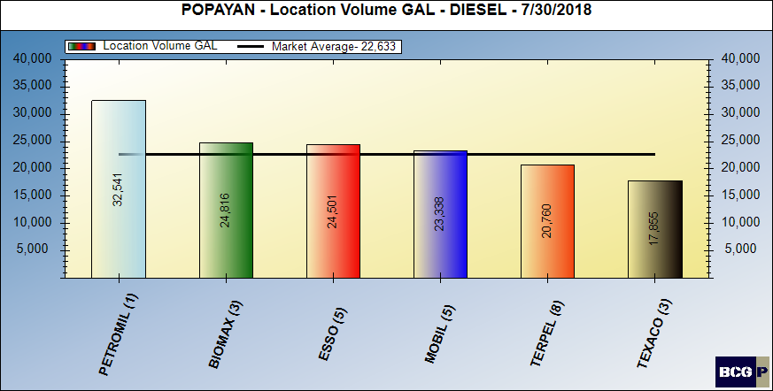
Location volume - diesel

Slide 22
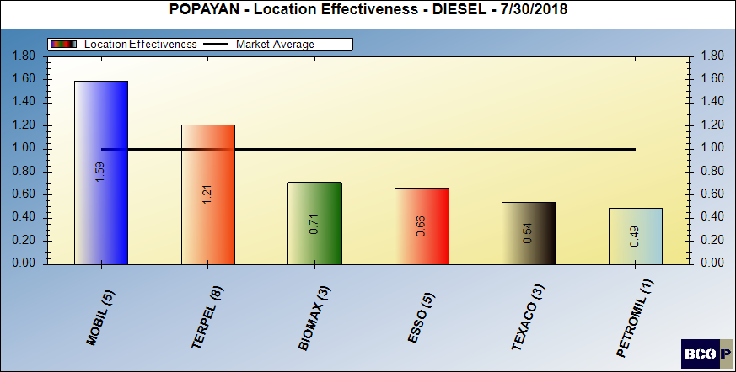
Location volume effectiveness – diesel

Slide 23
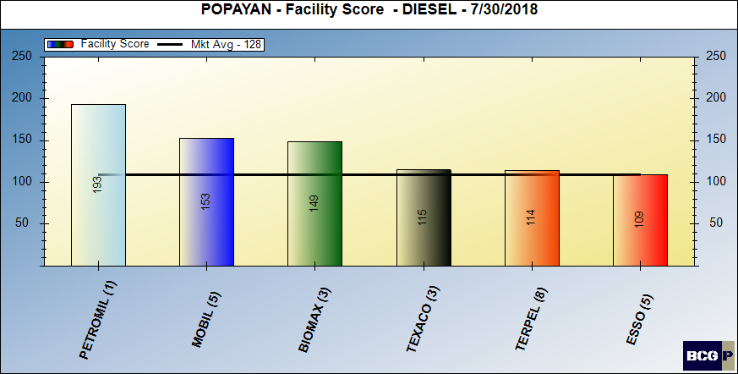
FACILITY SCORE - DIESEL

Slide 24
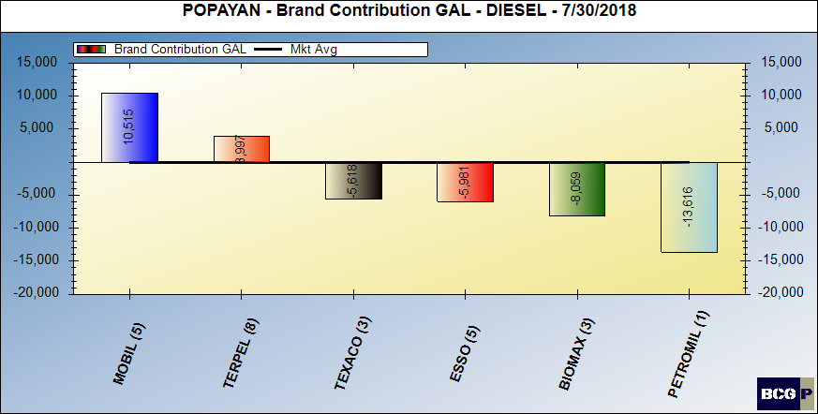
BRAND CONTRIBUTION - DIESEL

Slide 25
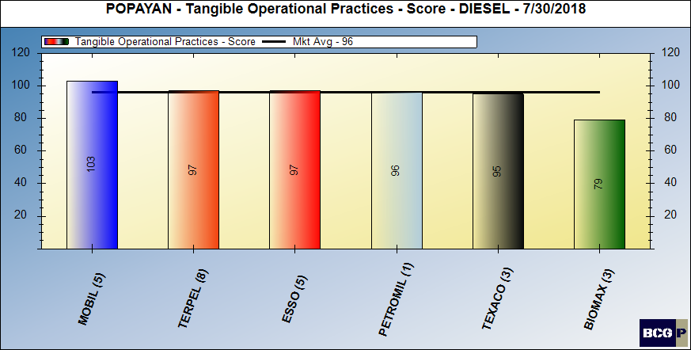
Merchandising score - diesel

Slide 26
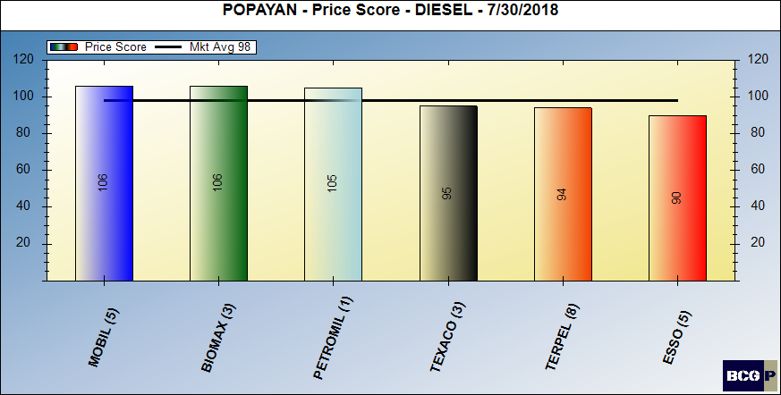
Pricing posture - diesel

Slide 27
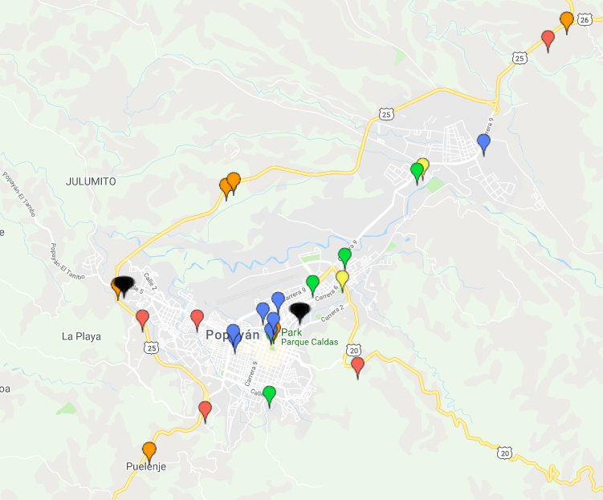
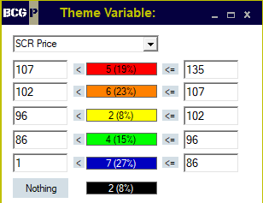
PRICE THEMATIC MAP - DIESEL

Slide 28
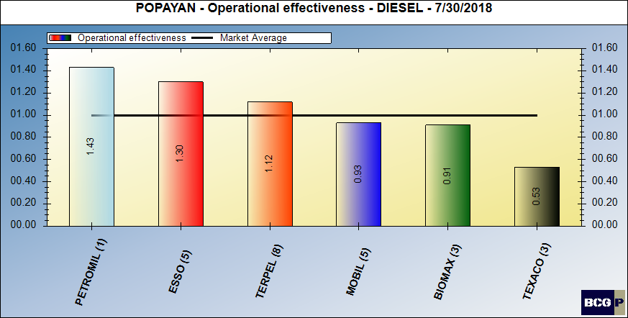
dealer (intangible) contribution – diesel

Slide 29
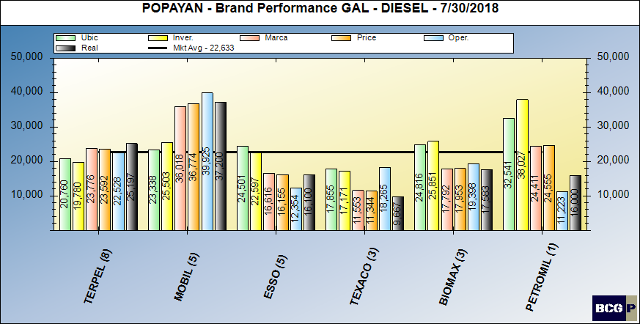
Brand performance – diesel

Slide 30
MARKET SUMMARY - DIESEL

Slide 31
Bravo Consulting group
QUADRANT –TERPEL
gasoline & diesel

Slide 32
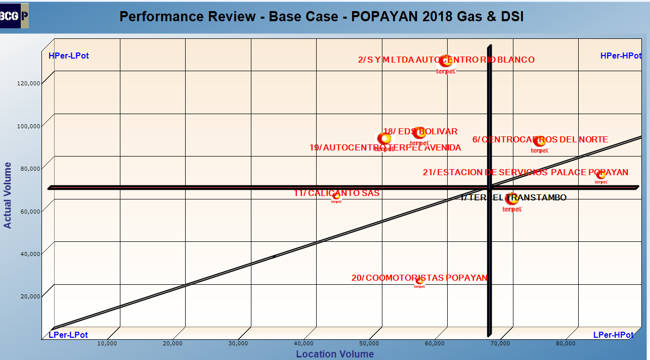
QUADRANT – GASOLINE & DIESEL

Slide 33
Bravo Consulting group
Performance analysis gasoline & diesel

Slide 34
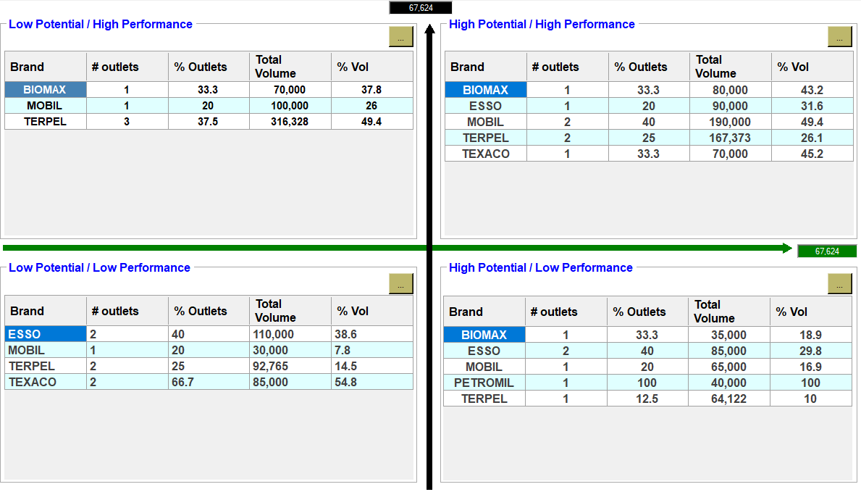
PERFORMANCE ANALYSIS – GASOLINE & DIESEL

Slide 35
Bravo Consulting Group
Market summary - GNV

Slide 36
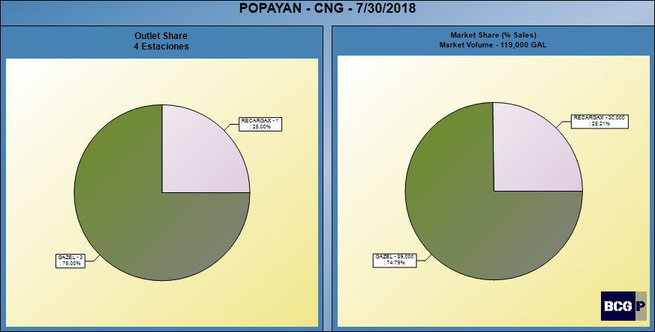
CNG SHARES

Slide 37
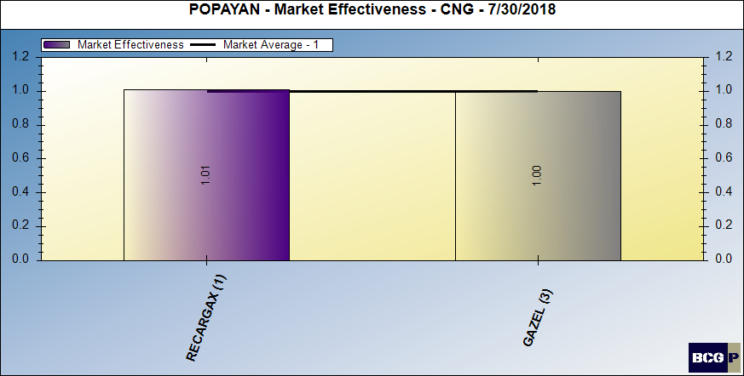
CNG MARKET EFFECTIVENESS

Slide 38
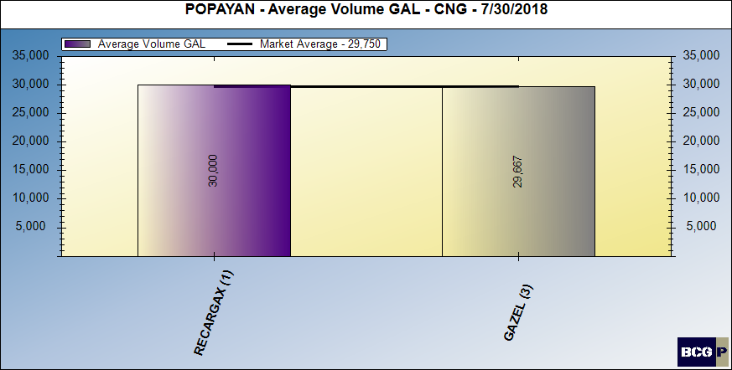
AVERAGE VOLUMES - GNV

Slide 39
LOCATION VOLUME - CNG

Slide 40
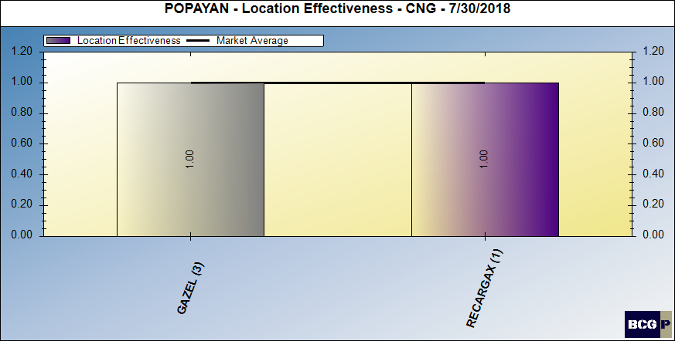
LOCATION VOLUME EFFECTIVENESS - CNG

Slide 41
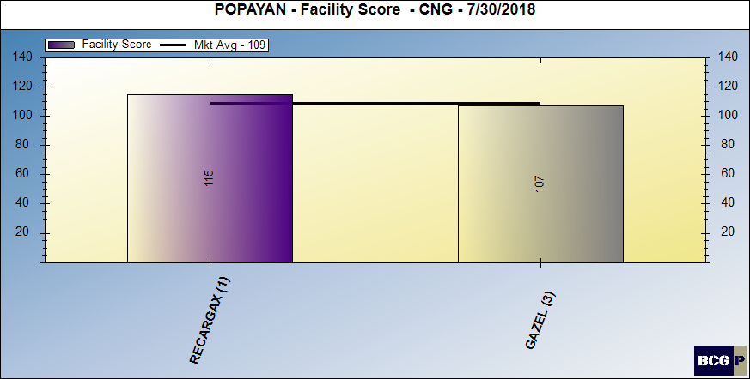
FACILITY SCORE - CNG

Slide 42
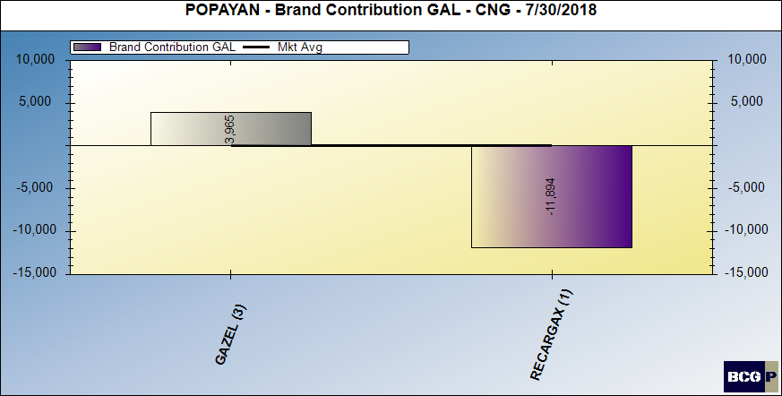
BRAND CONTRIBUTION - CNG

Slide 43
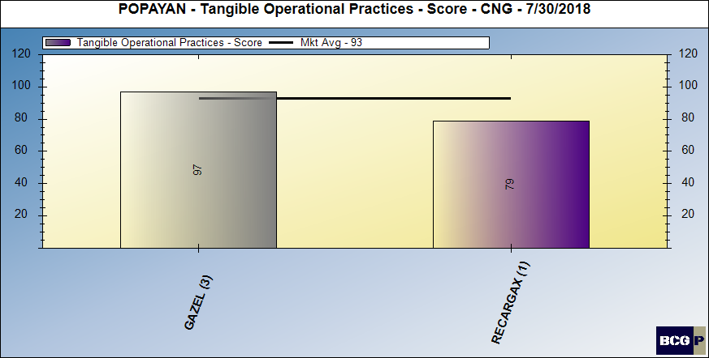
MERCHANDISING SCORE - CNG

Slide 44
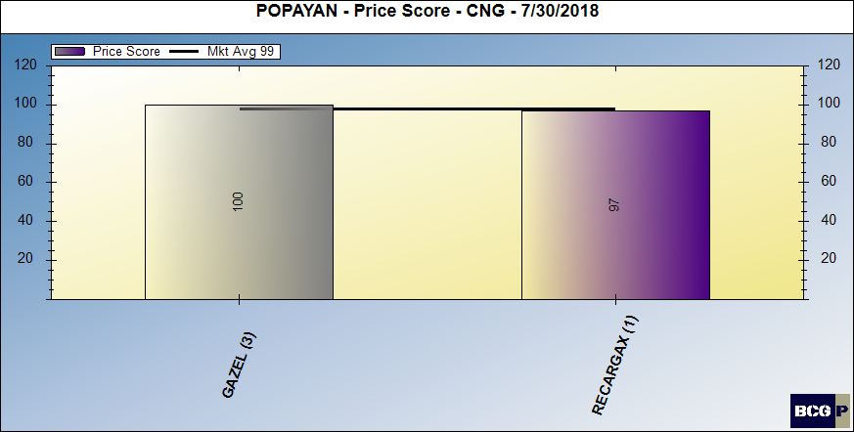
PRICING POSTURE - CNG

Slide 45
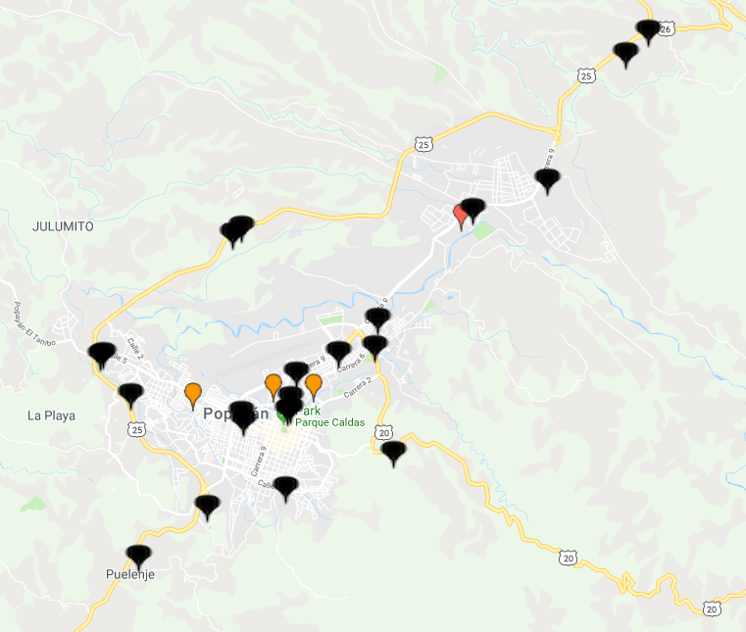
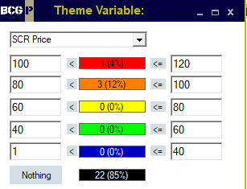
PRICE THEMATIC MAP - CNG

Slide 46
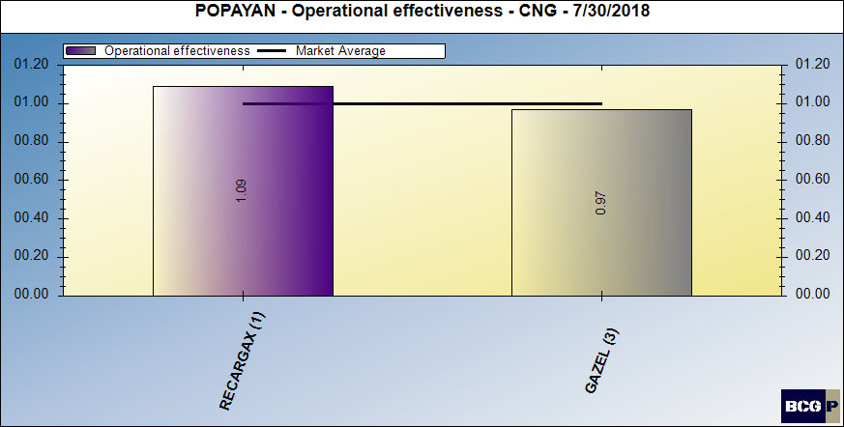
DEALER (INTANGIBLE) CONTRIBUTION - CNG

Slide 47
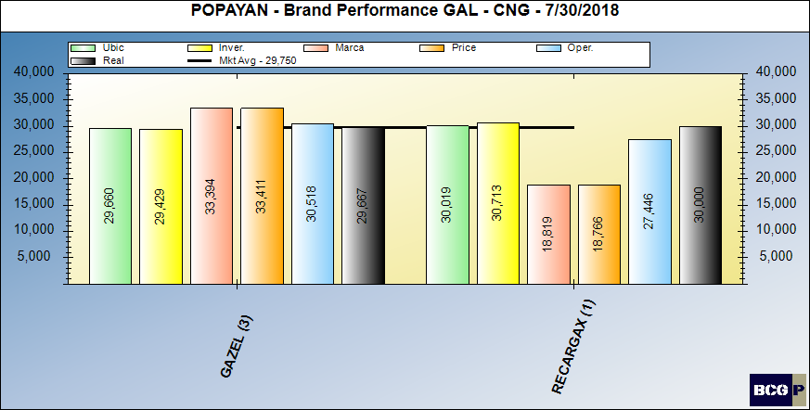
BRAND PERFORMANCE - CNG

Slide 48
MARKET SUMMARY - CNG

Slide 49
Bravo Consulting Group
OUTLET REVIEW

Slide 50
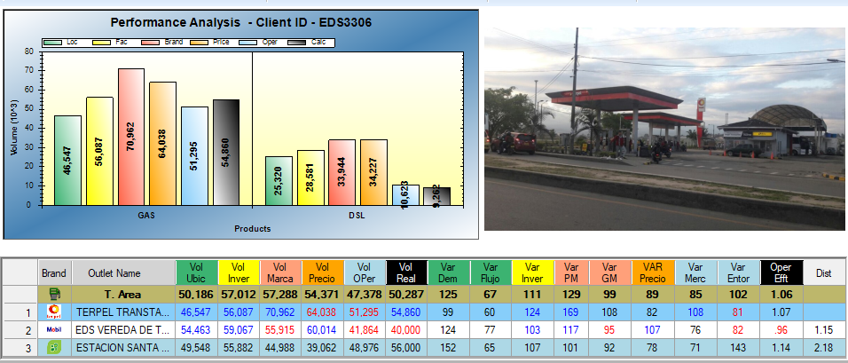
BCG ID 1 - TERPEL TRANSTAMBO

Slide 51
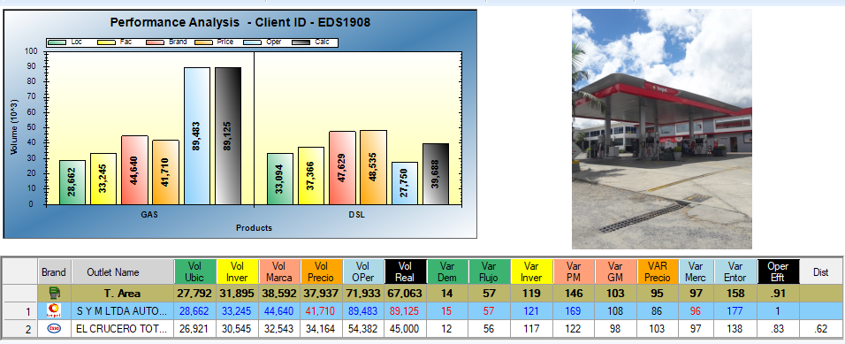
BCG ID 2 - S Y M LTDA AUTOCENTRO RIO BLANCO

Slide 52
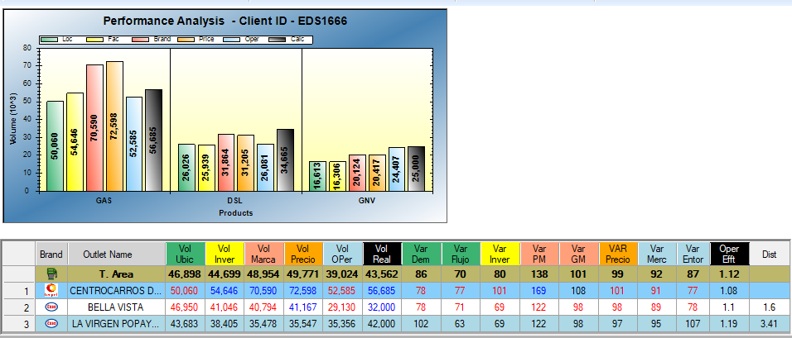
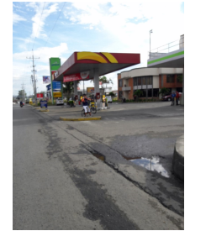
BCG ID 6 - CENTROCARROS DEL NORTE

Slide 53
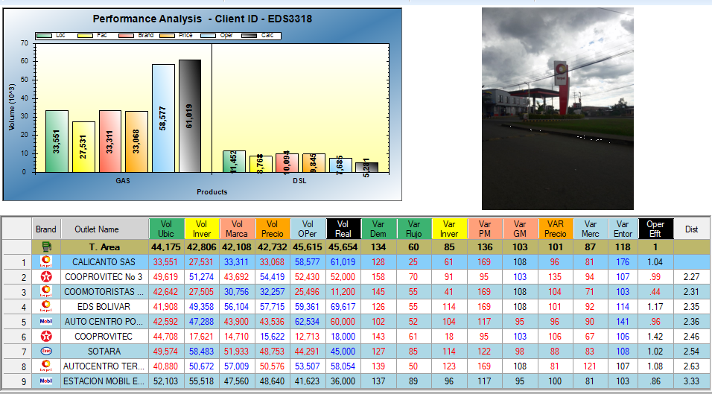
BCG ID 11 - CALICANTO SAS

Slide 54
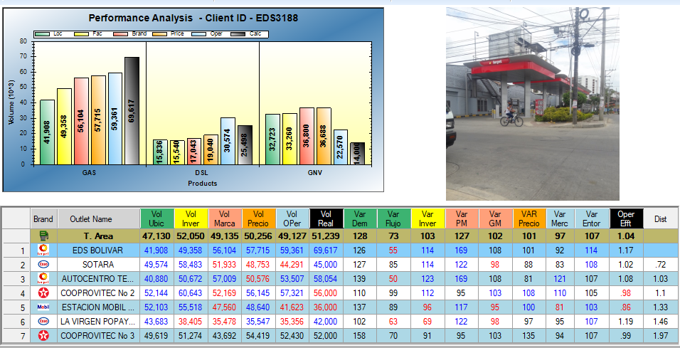
BCG ID 18 - EDS BOLIVAR

Slide 55
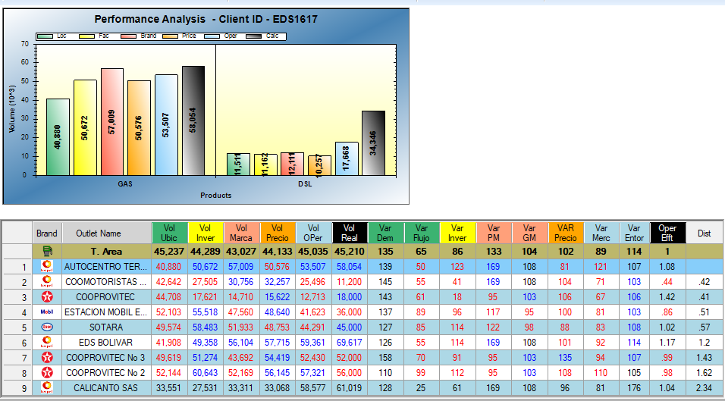
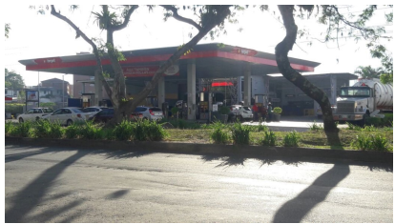
BCG ID 19 - AUTOCENTRO TERPEL AVENIDA

Slide 56
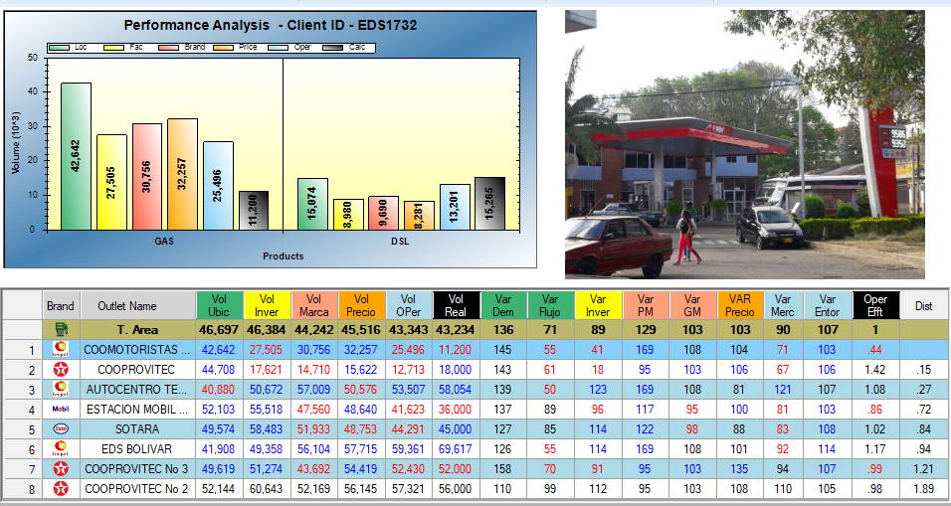
BCG ID 20 - COOMOTORISTAS POPAYAN

Slide 57
BCG ID 21 - ESTACION DE SERVICIOS PALACE POPAYAN

