Slide 1
Executive summary
BOGOTA
Prepared for
TERPEL
by
Bravo Consulting Group, Inc.
October 2019

Slide 2
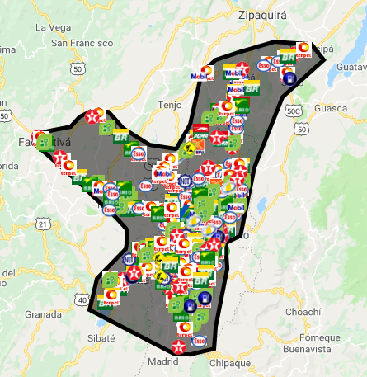
Market area

Slide 3
Bravo Consulting Group
Market summary - gasoline

Slide 4
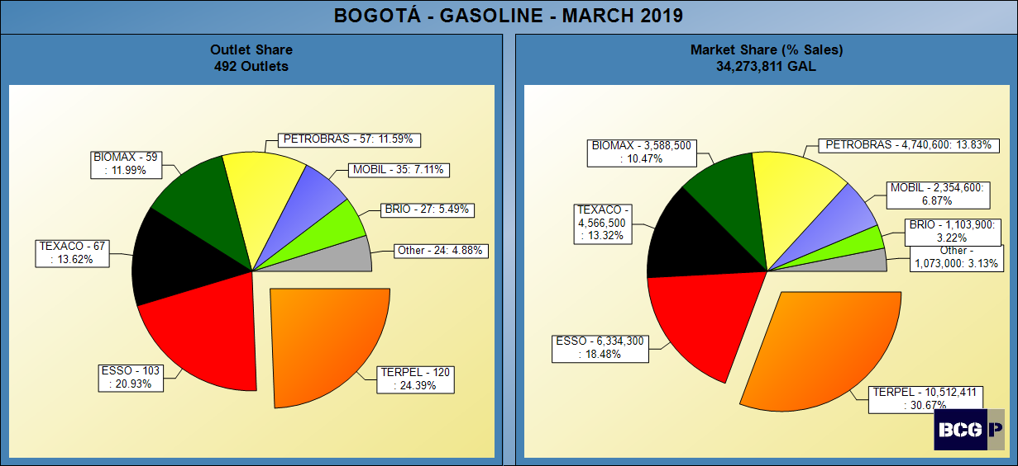
GASOLINE SHARES

Slide 5
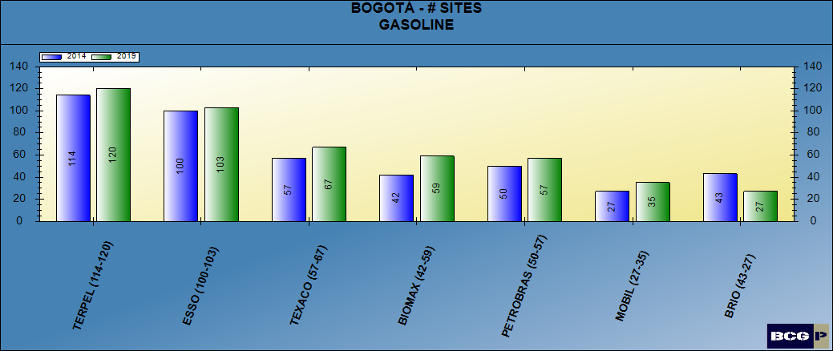
NUMBER OF SITES - GASOLINE

Slide 6
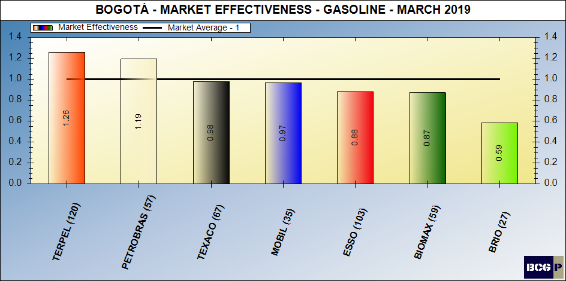
Gasoline market effectiveness

Slide 7
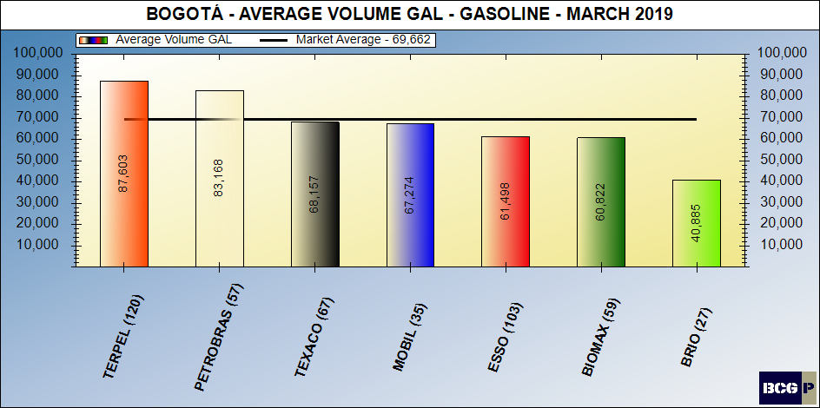
Gasoline average volumes

Slide 8
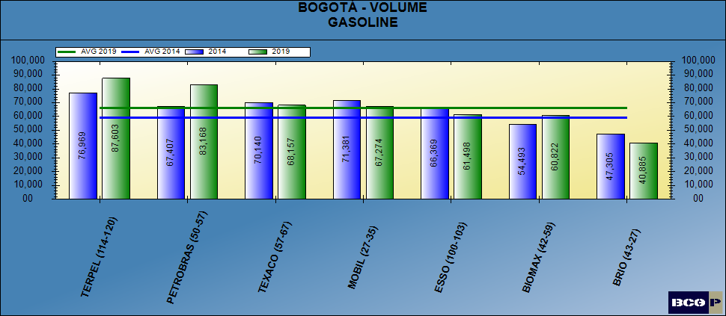
GASOLINE AVERAGE VOLUMES

Slide 9
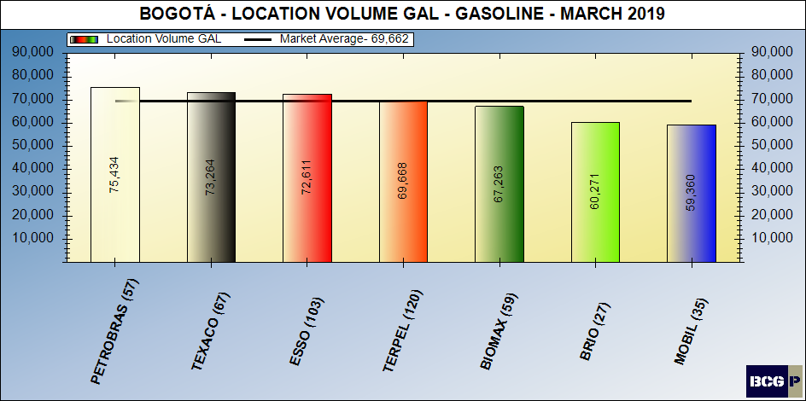
Location volume - gasoline

Slide 10
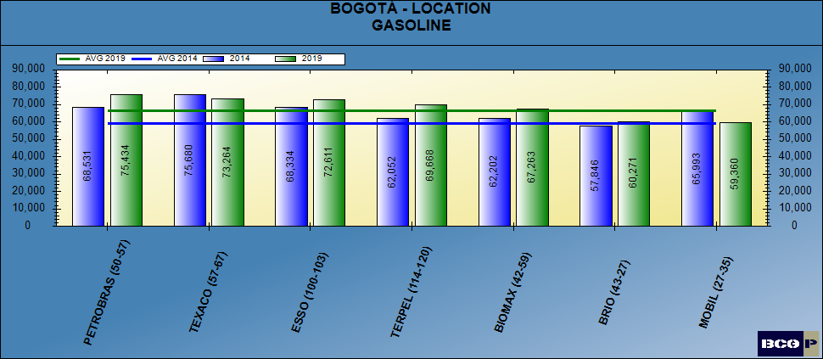
LOCATION VOLUME - GASOLINE

Slide 11
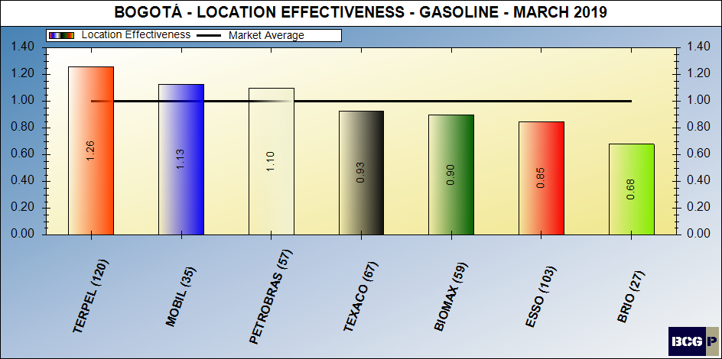
Location volume effectiveness – gasoline

Slide 12
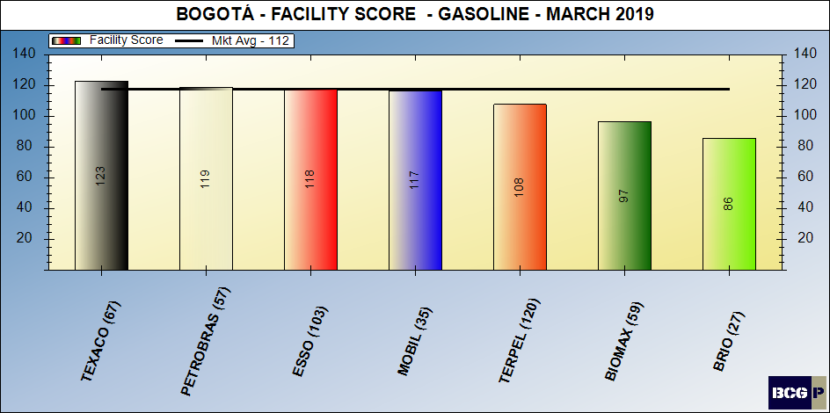
Facility score - gasoline

Slide 13
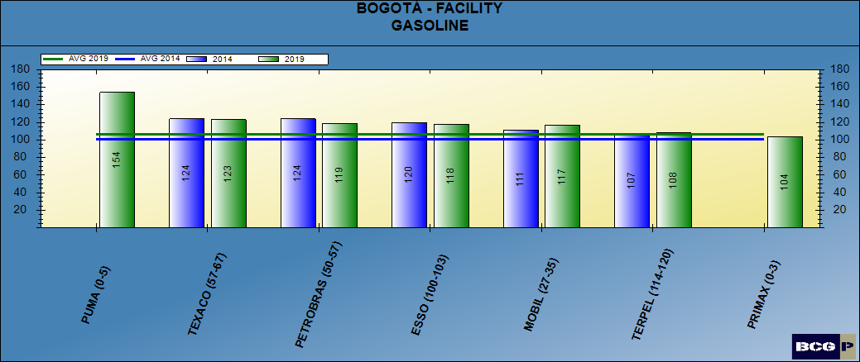
FACILITY SCORE - GASOLINE

Slide 14
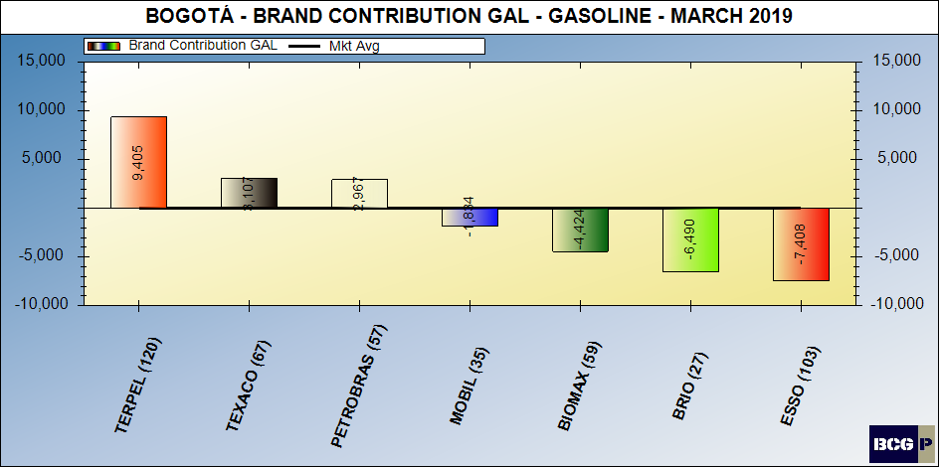
Brand contribution - gasoline

Slide 15
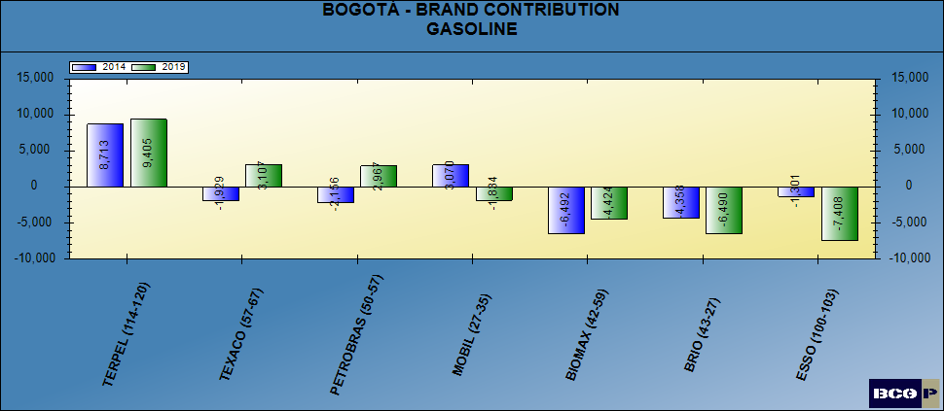
BRAND CONTRIBUTION - GASOLINE

Slide 16
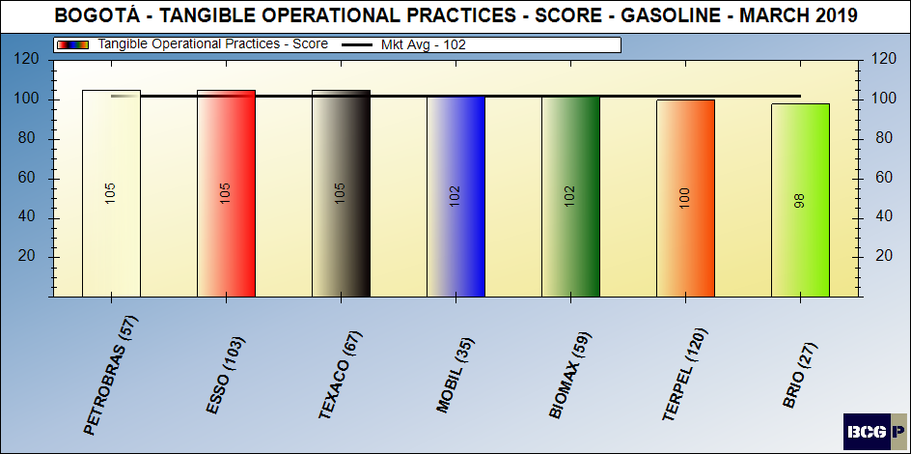
Merchandising score - gasoline

Slide 17
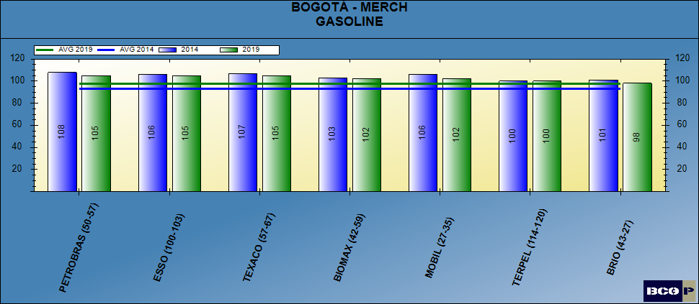
MERCHANDISING SCORE - GASOLINE

Slide 18
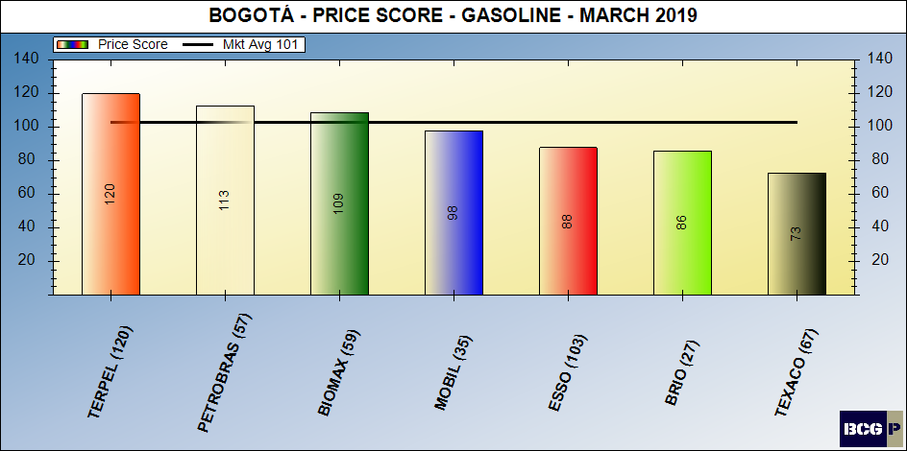
Pricing posture - gasoline

Slide 19
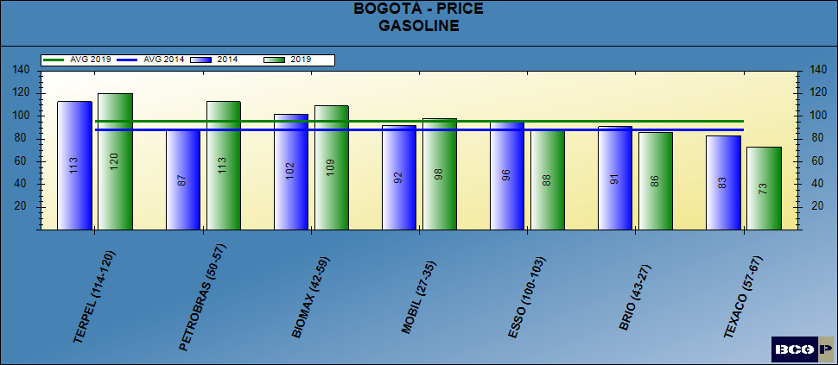
PRICING POSTURE - GASOLINE

Slide 20
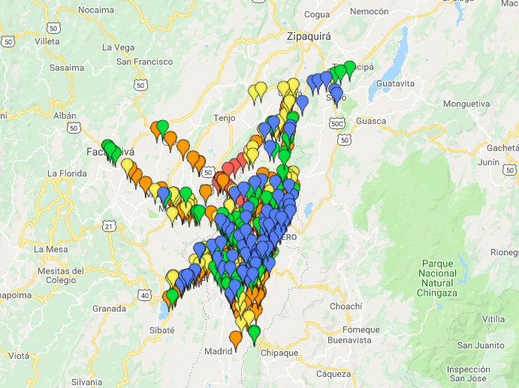
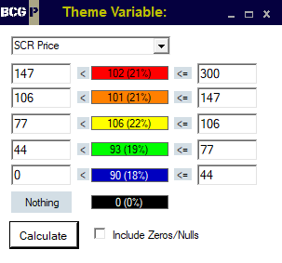
PRICE THEMATIC MAP - GASOLINE

Slide 21
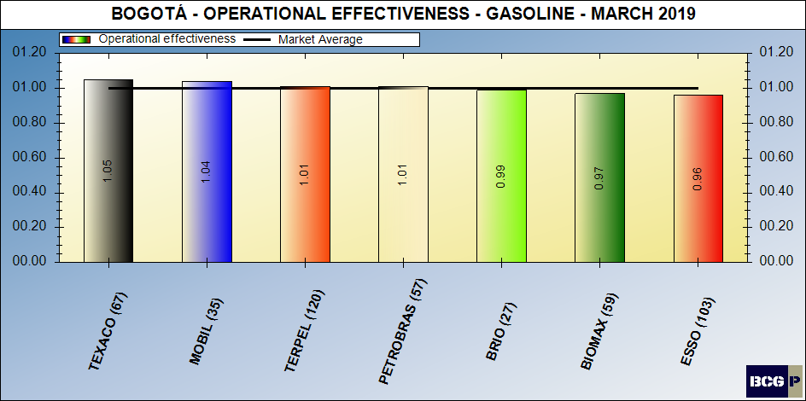
dealer (intangible) contribution – gasoline

Slide 22
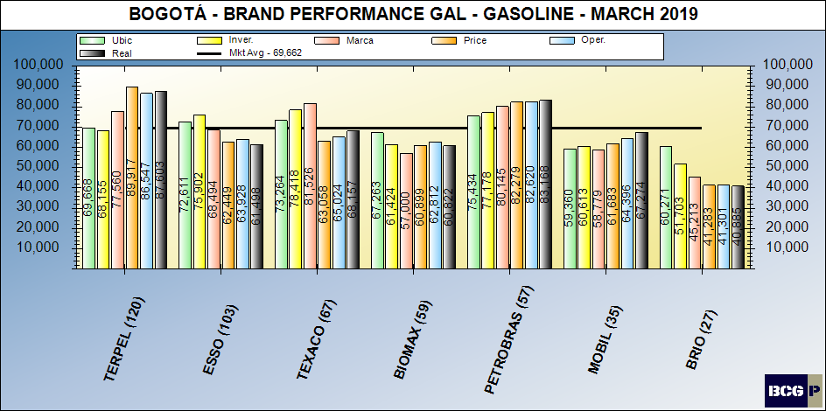
Brand performance – gasoline

Slide 23
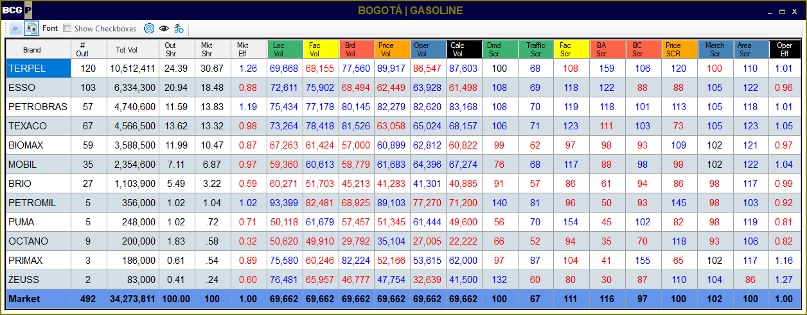
MARKET SUMMARY - GASOLINE

Slide 24
Bravo Consulting Group
Market summary - diesel

Slide 25
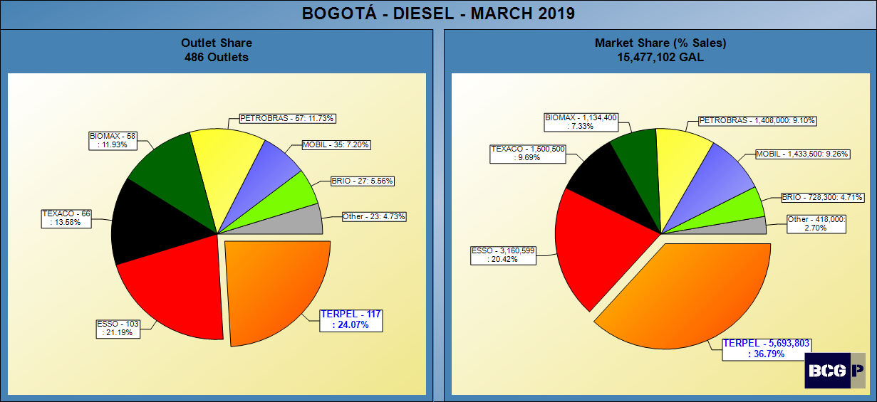
DIESEL SHARES

Slide 26
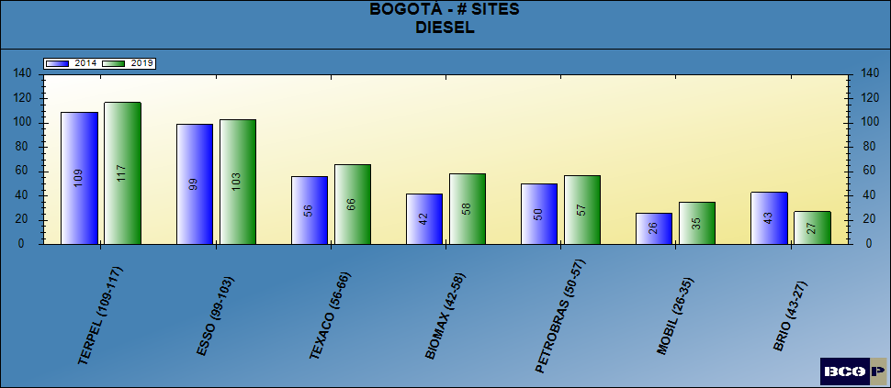
NUMBER OF SITES - DIESEL

Slide 27
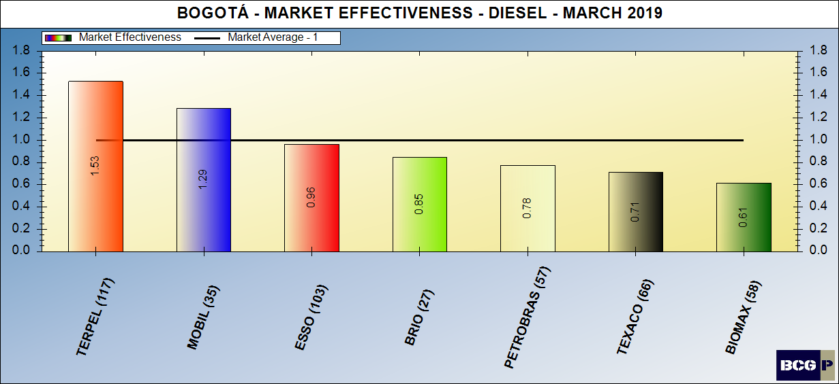
market effectiveness - diesel

Slide 28
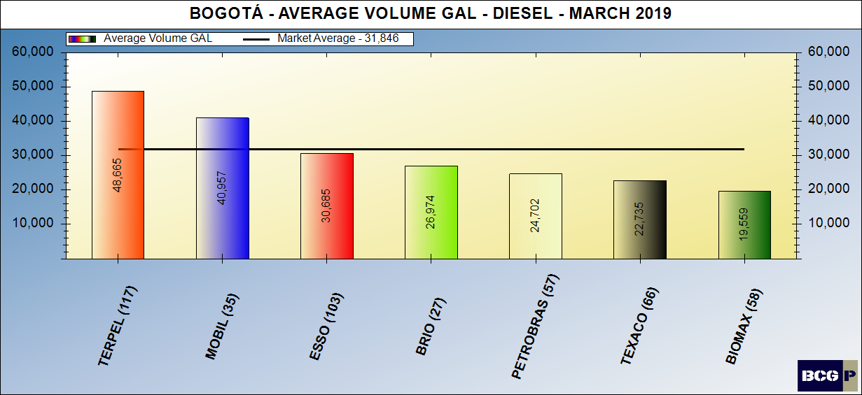
average volumes - DIESEL

Slide 29
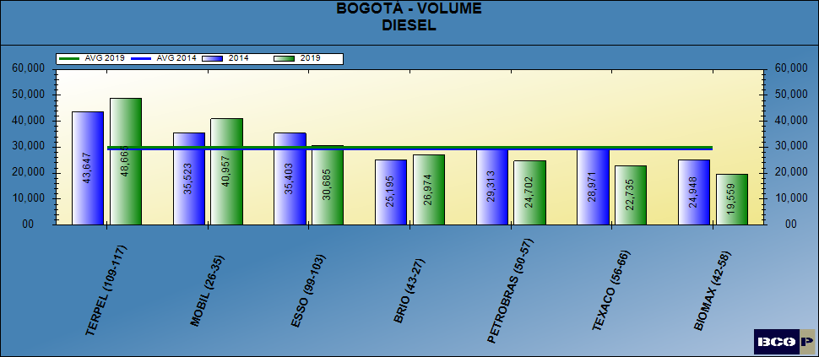
AVERAGE VOLUMES - DIESEL

Slide 30
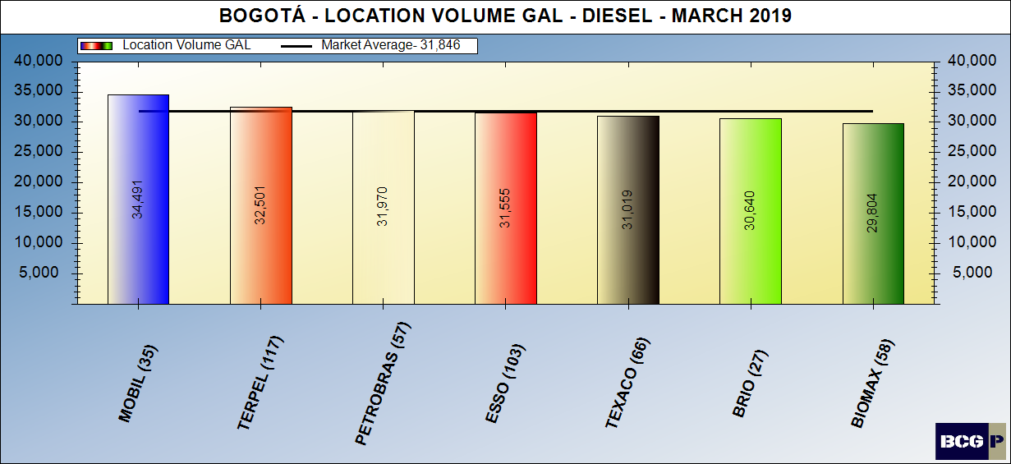
Location volume - diesel

Slide 31
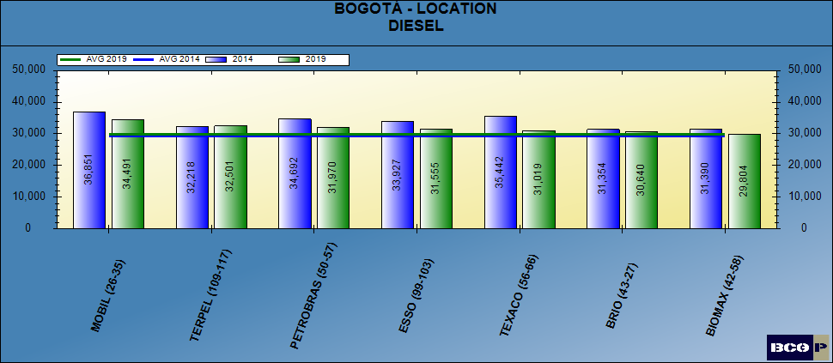
LOCATION VOLUME - DIESEL

Slide 32
Location volume effectiveness – diesel

Slide 33
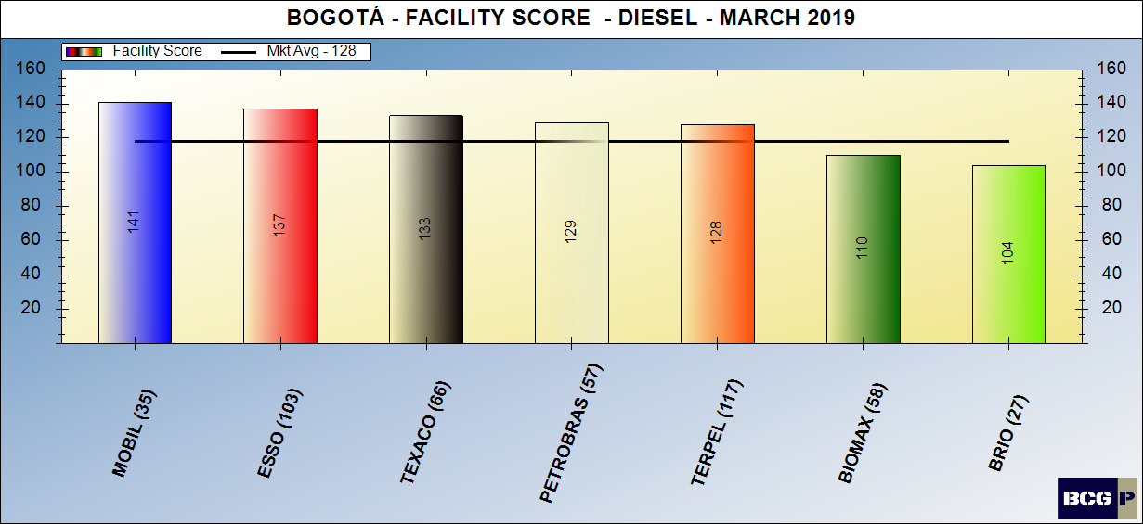
Facility score - diesel

Slide 34
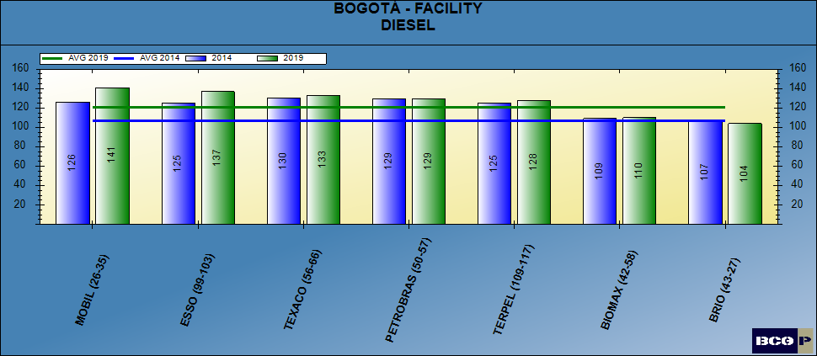
FACILITY SCORE - DIESEL

Slide 35
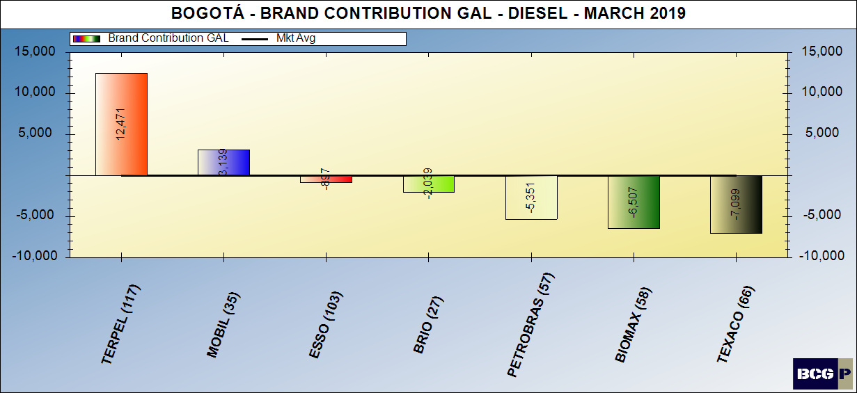
Brand contribution - diesel

Slide 36
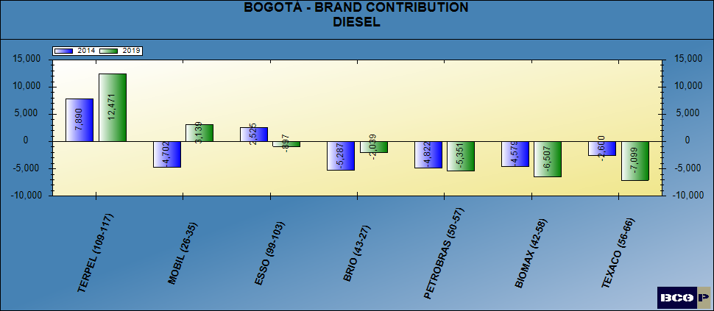
BRAND CONTRIBUTION - DIESEL

Slide 37
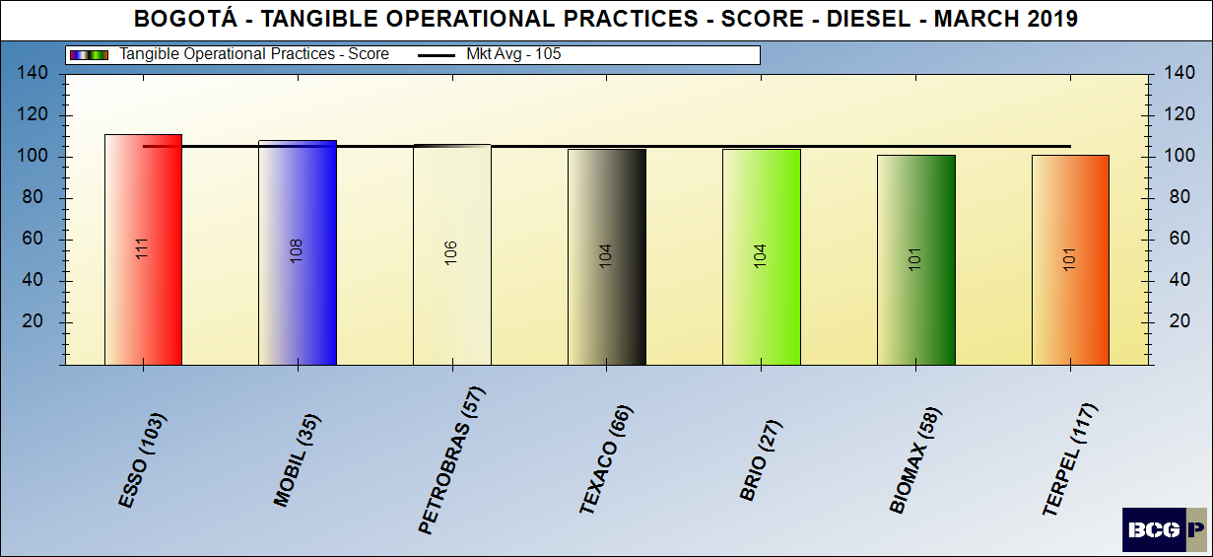
Merchandising score - diesel

Slide 38
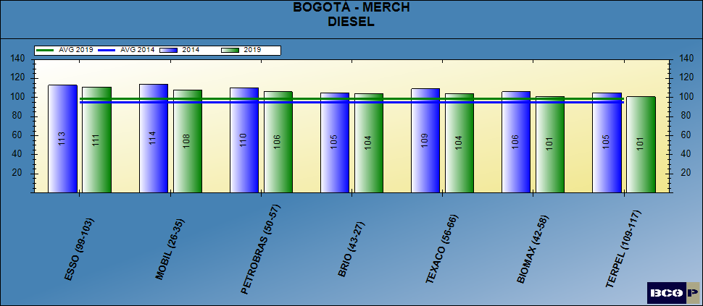
Merchandising score - diesel

Slide 39
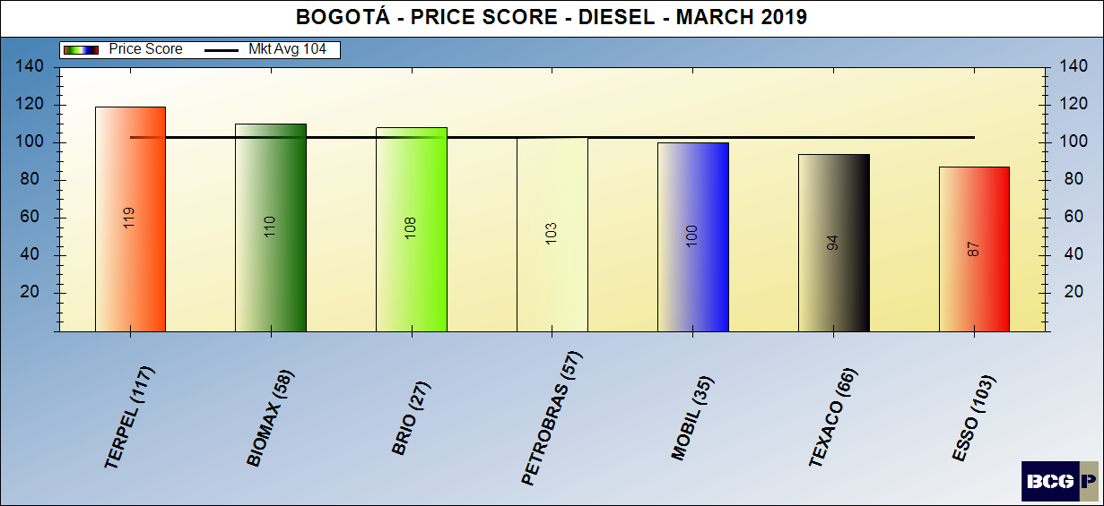
Pricing posture - diesel

Slide 40
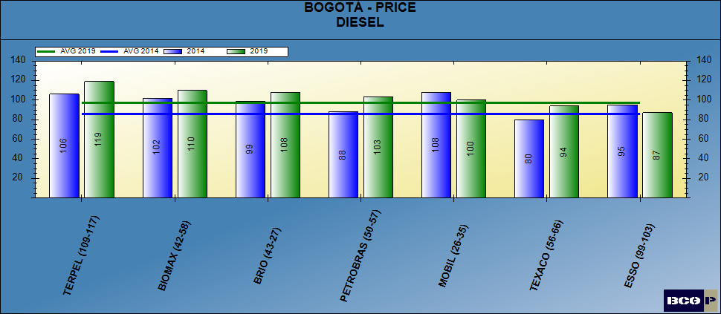
Pricing posture - diesel

Slide 41
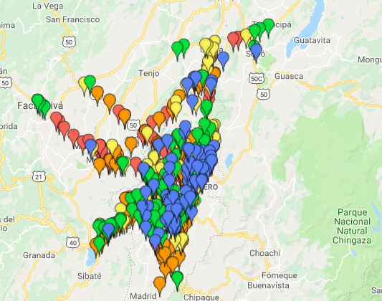
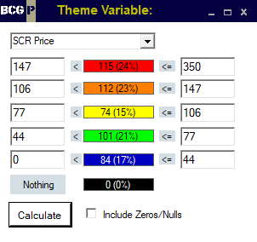
PRICE THEMATIC MAP - DIESEL

Slide 42
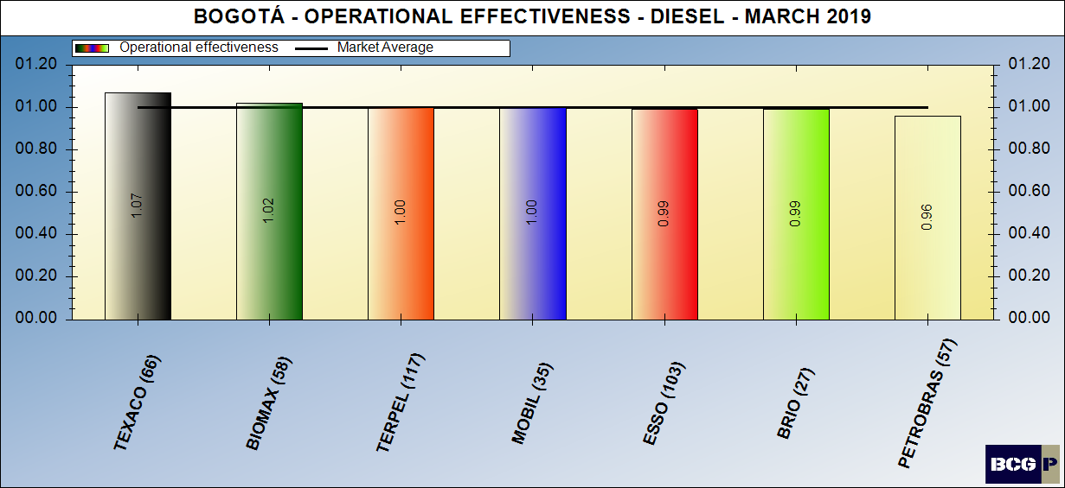
dealer (intangible) contribution – diesel

Slide 43
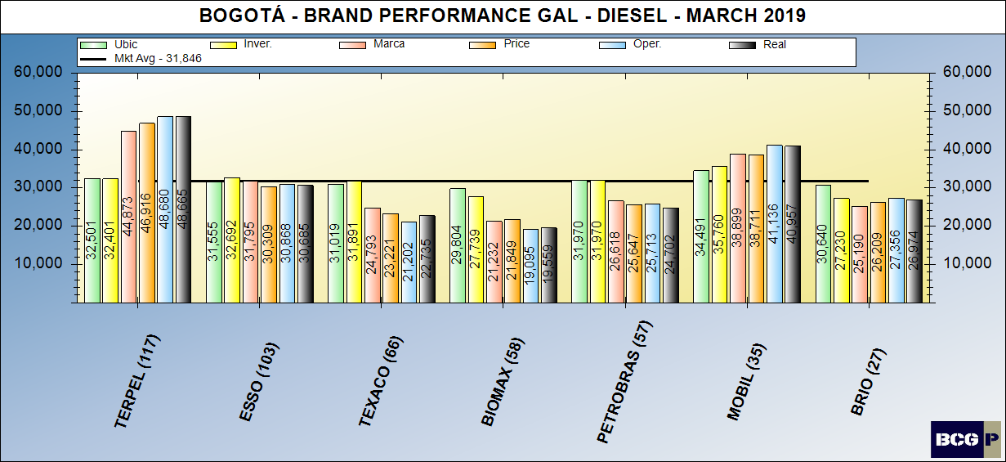
Brand performance – diesel

Slide 44
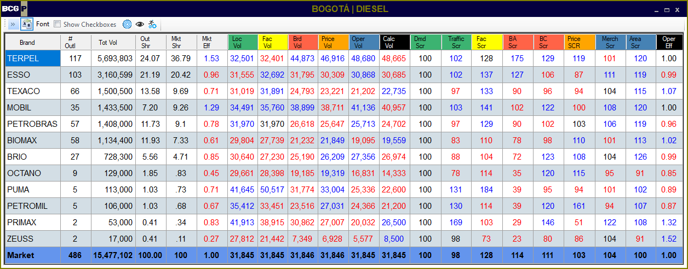
MARKET SUMMARY - DIESEL

Slide 45
Bravo Consulting group
QUADRANT –TERPEL
gasoline & diesel

Slide 46
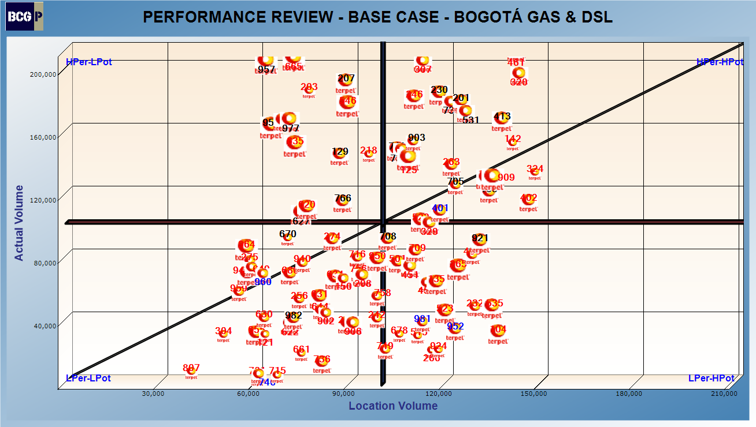
QUADRANT – GASOLINE & DIESEL

Slide 47
Bravo Consulting group
Performance analysis gasoline & diesel

Slide 48
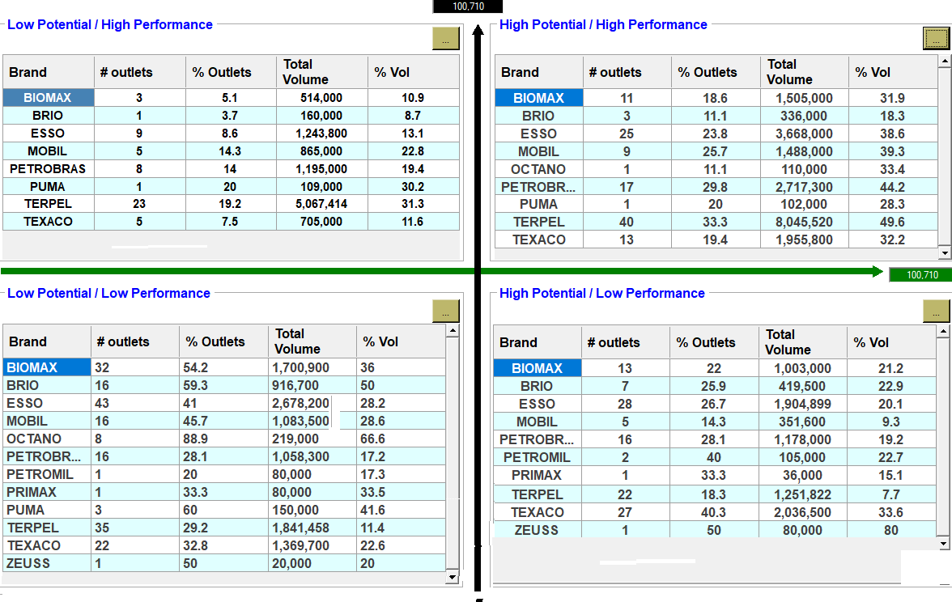
PERFORMANCE ANALYSIS – GASOLINE & DIESEL

Slide 49
Bravo Consulting Group
Market summary - GNV

Slide 50
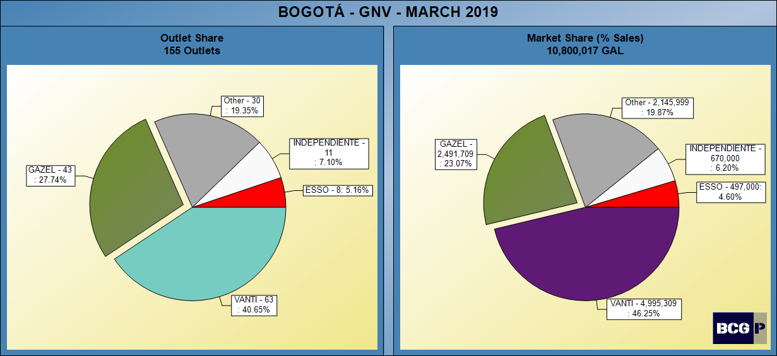
Gnv SHARES

Slide 51
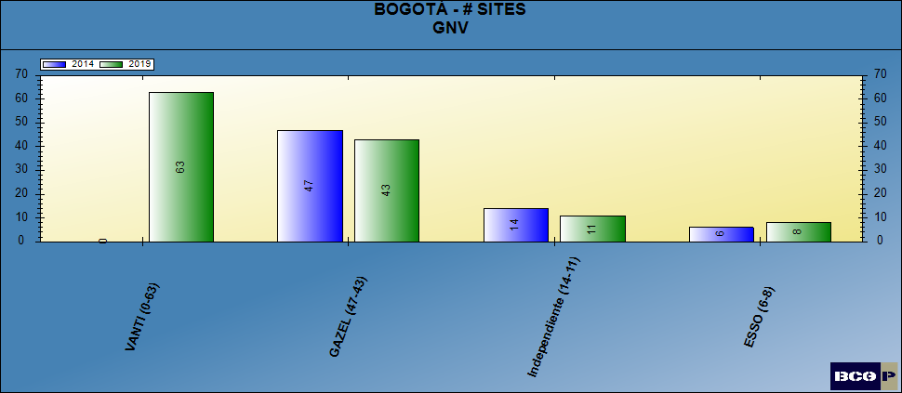
NUMBER OF SITES - gnv

Slide 52
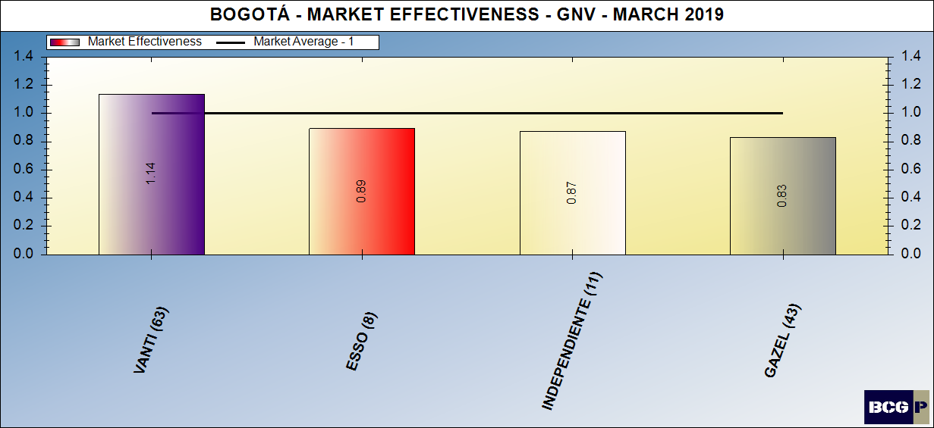
Gnv MARKET EFFECTIVENESS

Slide 53
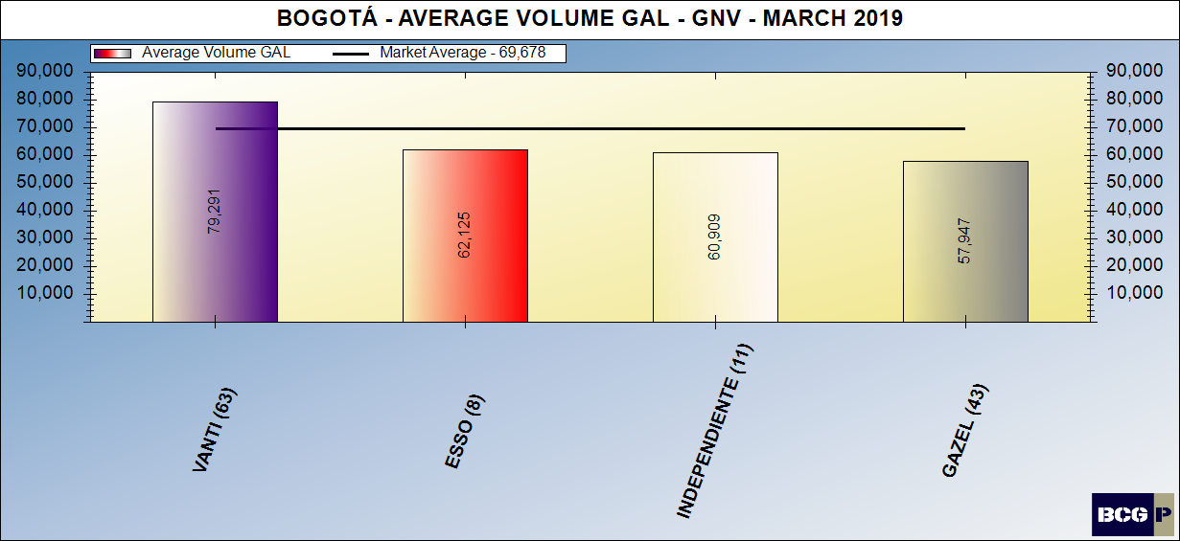
AVERAGE VOLUMES - GNV

Slide 54
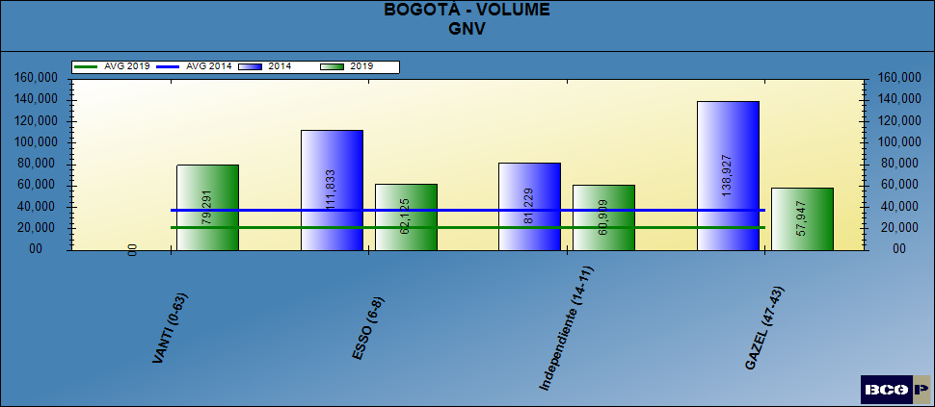
AVERAGE VOLUMES - GNV

Slide 55
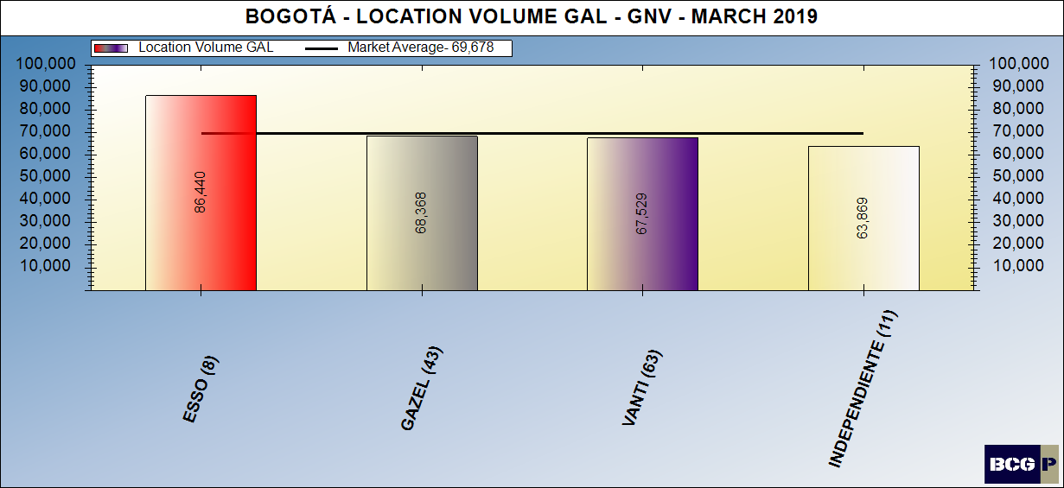
LOCATION VOLUME - GNV

Slide 56
LOCATION VOLUME - GNV

Slide 57
LOCATION VOLUME EFFECTIVENESS - GNV

Slide 58
FACILITY SCORE - GNV

Slide 59
FACILITY SCORE - GNV

Slide 60
BRAND CONTRIBUTION - GNV

Slide 61
BRAND CONTRIBUTION - GNV

Slide 62
MERCHANDISING SCORE - GNV

Slide 63
MERCHANDISING SCORE - GNV

Slide 64
PRICING POSTURE - GNV

Slide 65
PRICING POSTURE - GNV

Slide 66
PRICE THEMATIC MAP - GNV

Slide 67
DEALER (INTANGIBLE) CONTRIBUTION - GNV

Slide 68
BRAND PERFORMANCE - GNV

Slide 69
MARKET SUMMARY - GNV

Slide 70
Bravo Consulting Group
OUTLET REVIEW

Slide 71
BCG ID 101 – LA 49

Slide 72
BCG ID 104 – SAN CAYETANO

Slide 73
BCG ID 105 – ENGATIVA

Slide 74
BCG ID 106 – PORTAL DE ALAMOS

Slide 75
BCG ID 114 - PONTEVEDRA

Slide 76
BCG ID 117 - AV BOYACÁ

Slide 77
BCG ID 120 - CRUZ ROJA

Slide 78
BCG ID 121 - CARREFOUR CALLE 80

Slide 79
BCG ID 125 - LOS ROBLES - CALLE 80

Slide 80
BCG ID 126 - LA FLORIDA

Slide 81
BCG ID 129 - TERMINAL DE CARGA

Slide 82
BCG ID 135 - AURES II

Slide 83
BCG ID 136 - CONEJERA

Slide 84
BCG ID 141 - EDÉN

Slide 85
BCG ID 142 - SERVI RUEDAS

Slide 86
BCG ID 150 - SANTANA

Slide 87
BCG ID 201 - EDS LA 68

Slide 88
BCG ID 203 - INVERSIONES R&R LTDA / VENECIA

Slide 89
BCG ID 207 - LAS VEGAS

Slide 90
BCG ID 208 - SANTA LUCÍA

Slide 91
BCG ID 210 - GANADERO

Slide 92
BCG ID 218 - ANDALUCIA

Slide 93
BCG ID 230 - MATATIGRES

Slide 94
BCG ID 232 - ALQUERIA

Slide 95
BCG ID 242 - LA ESTRELLITA

Slide 96
BCG ID 246 - ROMA

Slide 97
BCG ID 256 - BOSA

Slide 98
BCG ID 260 - BETANIA

Slide 99
BCG ID 263 - SEVILLANA

Slide 100
BCG ID 265 - INCOCENTRO

Slide 101
BCG ID 266 - CARREFOUR AUTOPISTA SUR

Slide 102
BCG ID 270 - MARRUECOS

Slide 103
BCG ID 274 - LA HERRADURA

Slide 104
BCG ID 275 - ALTAMIRA

Slide 105
BCG ID 301 - COMPOSTELLA

Slide 106
BCG ID 304 - CARREFOUR 170

Slide 107
BCG ID 307 - LA JUANA

Slide 108
BCG ID 314 - MOTOMART

Slide 109
BCG ID 320 - JUANCAMAR Y CIA S EN C

Slide 110
BCG ID 324 - AUTONORTE

Slide 111
BCG ID 329 - ACAPULCO

Slide 112
BCG ID 401 - LAS VILLAS

Slide 113
BCG ID 402 - PASADENA

Slide 114
BCG ID 405 - PLAZA 127

Slide 115
BCG ID 406 - CALASANZ

Slide 116
BCG ID 413 - PASEO LA 15

Slide 117
BCG ID 423 - JAVERIANA

Slide 118
BCG ID 451 - AV 28

Slide 119
BCG ID 454 - JUAN MARTIN

Slide 120
BCG ID 461 - SAN JOSÉ DE QUITO

Slide 121
BCG ID 501 - CATAM

Slide 122
BCG ID 503 - LAS PALMAS

Slide 123
BCG ID 515 - TINTALITO

Slide 124
BCG ID 522 - CIUDAD DE CALI

Slide 125
BCG ID 523 - HAYUELOS

Slide 126
BCG ID 524 - INSETRANSA

Slide 127
BCG ID 527 - VILLA ALSACIA

Slide 128
BCG ID 531 - VILLA CLAUDIA

Slide 129
BCG ID 535 - 1ERO DE MAYO

Slide 130
BCG ID 546 - FONTIBON

Slide 131
BCG ID 547 - MARIANA

Slide 132
BCG ID 618 - CARICADAS / APOSENTOS SOPO

Slide 133
BCG ID 620 - TIBITO

Slide 134
BCG ID 622 - PUEBLO VIEJO

Slide 135
BCG ID 627 - CHIA

Slide 136
BCG ID 630 - COTA

Slide 137
BCG ID 631 - VARIANTE COTA - OPERADORES DE COMBUSTIBLES SAS

Slide 138
BCG ID 634 - SIBERIA OPERADORES

Slide 139
BCG ID 635 - EL CHARQUITO - SINALOA

Slide 140
BCG ID 644 - EL ROSAL

Slide 141
BCG ID 649 - INVERSIONES C2 /C2 FACATATIVA

Slide 142
BCG ID 655 - MOSQUERA

Slide 143
BCG ID 656 - LA TORRE

Slide 144
BCG ID 659 - EL CORZO

Slide 145
BCG ID 661 - ASOJUNTAS

Slide 146
BCG ID 665 - EL PIRE

Slide 147
BCG ID 670 - RETORNO

Slide 148
BCG ID 678 - TREBOL

Slide 149
BCG ID 680 - SILMA

Slide 150
BCG ID 705 - COLON

Slide 151
BCG ID 708 - AMERICAS II

Slide 152
BCG ID 709 - CARRERA

Slide 153
BCG ID 710 - SAN ANDRES

Slide 154
BCG ID 715 - CARRERA 30

Slide 155
BCG ID 716 - PALOQUEMAO

Slide 156
BCG ID 718 - AMERICAS

Slide 157
BCG ID 731 - TRINIDAD

Slide 158
BCG ID 736 - EL CARMEN

Slide 159
BCG ID 737 - GARROLLANTAS

Slide 160
BCG ID 746 - REAL TRANSPORTADORA

Slide 161
BCG ID 749 - ROOSVELT

Slide 162
BCG ID 756 - GRAN TAX

Slide 163
BCG ID 758 - SAN BERNARDO

Slide 164
BCG ID 761 - LIEVANO

Slide 165
BCG ID 766 - CENTRO

Slide 166
BCG ID 802 - ALVAZAR

Slide 167
BCG ID 807 - VILLA SOFIA

Slide 168
BCG ID 811 - EGAS AVE BOYACA

Slide 169
BCG ID 900 - CALLE 80

Slide 170
BCG ID 902 - CARREFOUR TERREROS

Slide 171
BCG ID 903 - PRIMERO DE MAYO

Slide 172
BCG ID 906 - CALLE 190

Slide 173
BCG ID 909 - LOS ABUELOS

Slide 174
BCG ID 910 - BASCULA

Slide 175
BCG ID 921 - EL TRIANGULO

Slide 176
BCG ID 924 - SANTA FE

Slide 177
BCG ID 940 - BRAZUELOS

Slide 178
BCG ID 941 - INDUMIL

Slide 179
BCG ID 950 - HCM TOCANCIPA

Slide 180
BCG ID 952 - PRADERA AV 68

Slide 181
BCG ID 957 - SANTA TERESA

Slide 182
BCG ID 958 - INTEXORA

Slide 183
BCG ID 959 - AVENIDA PRADILLA

Slide 184
BCG ID 960 - LA REPUBLICA

Slide 185
BCG ID 964 - CHUSACA

Slide 186
BCG ID 969 - AEROPUERTO

Slide 187
BCG ID 977 - CORZO II

Slide 188
BCG ID 980 - ESPIRITU SANTO

Slide 189
BCG ID 981 - SANTANDER

Slide 190
BCG ID 982 - BUENOS AIRES

