Slide 1
Executive summary
Armenia
Prepared for
TERPEL
by
Bravo Consulting Group, Inc.
November 2018

Slide 2
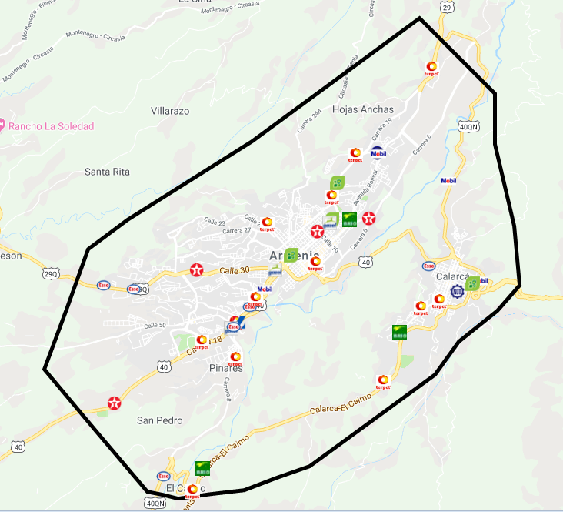
Market area

Slide 3
Bravo Consulting Group
Market summary - gasoline

Slide 4
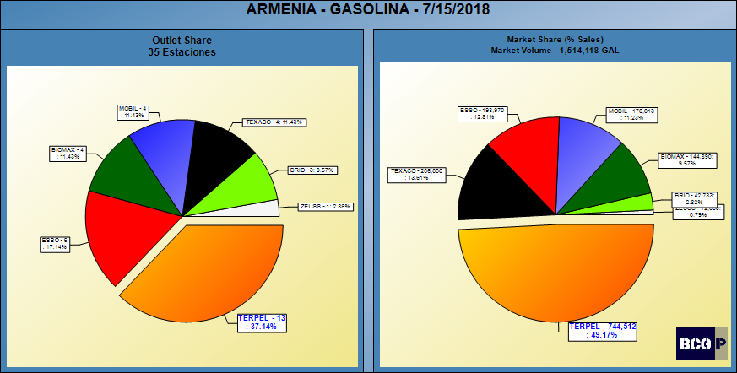
GASOLINE SHARES

Slide 5
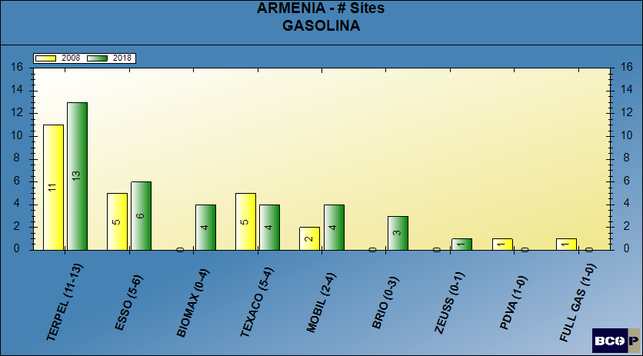
NUMBER OF SITES - GASOLINE

Slide 6
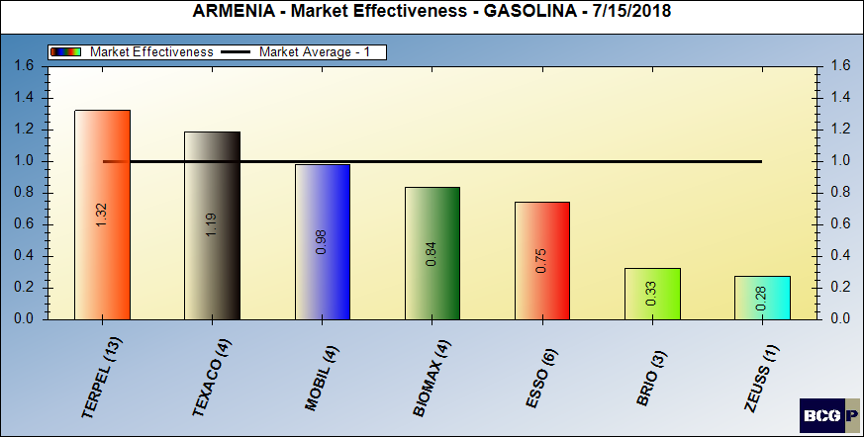
Gasoline market effectiveness

Slide 7
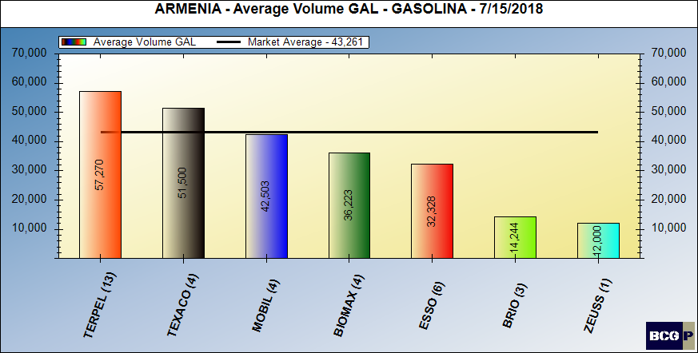
Gasoline average volumes

Slide 8
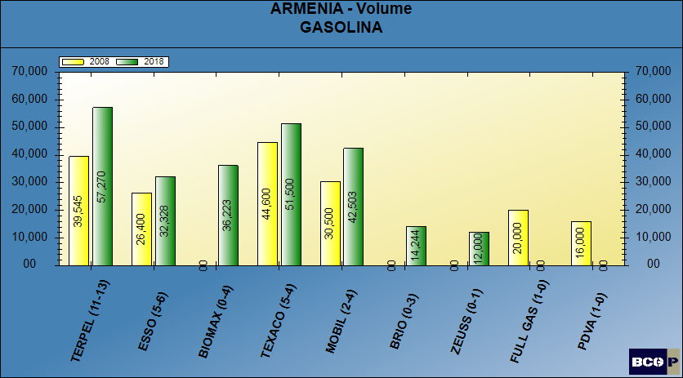
GASOLINE AVERAGE VOLUMES

Slide 9
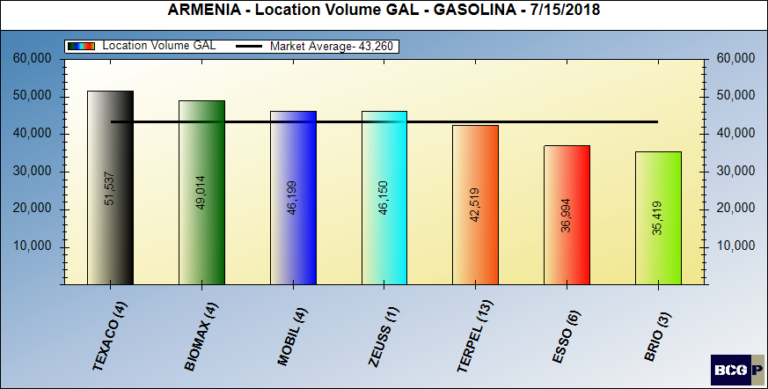
Location volume - gasoline

Slide 10
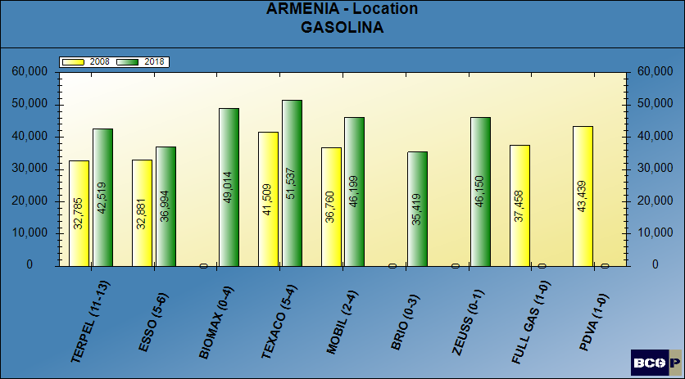
LOCATION VOLUME - GASOLINE

Slide 11
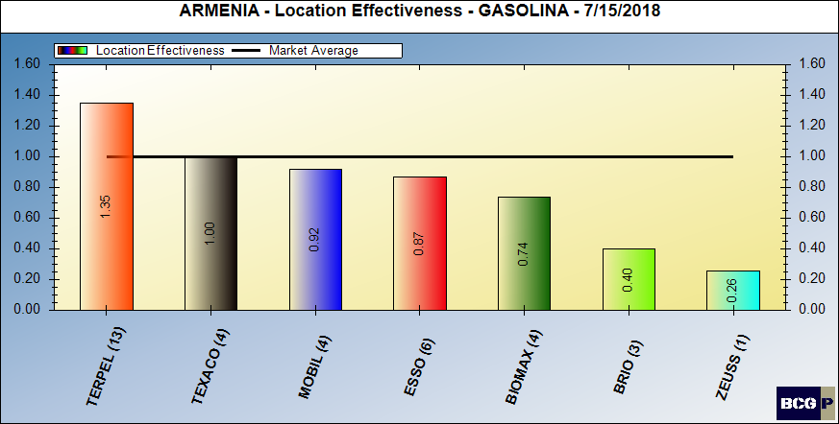
Location volume effectiveness – gasoline

Slide 12
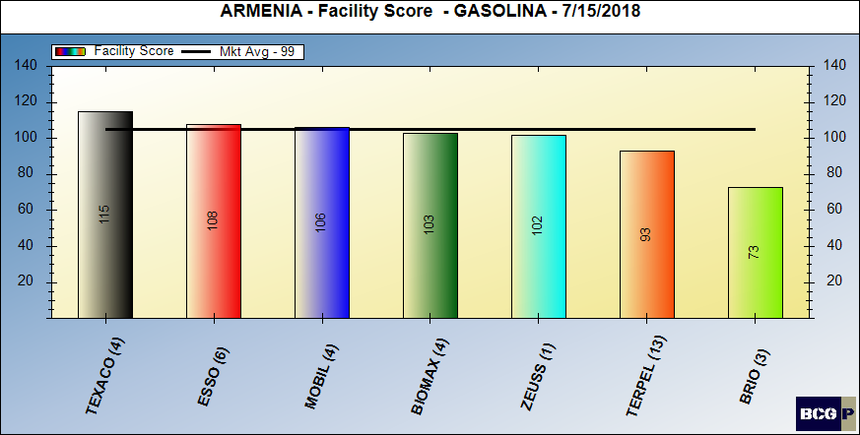
Facility score - gasoline

Slide 13
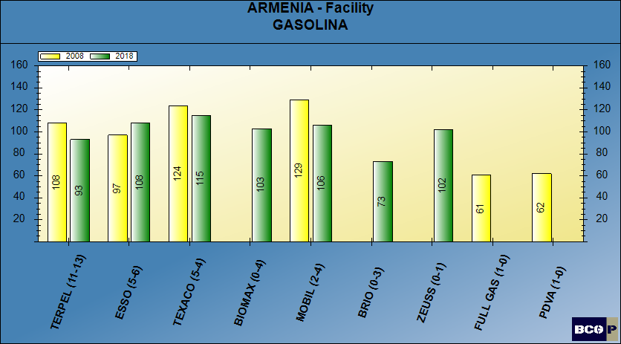
FACILITY SCORE - GASOLINE

Slide 14
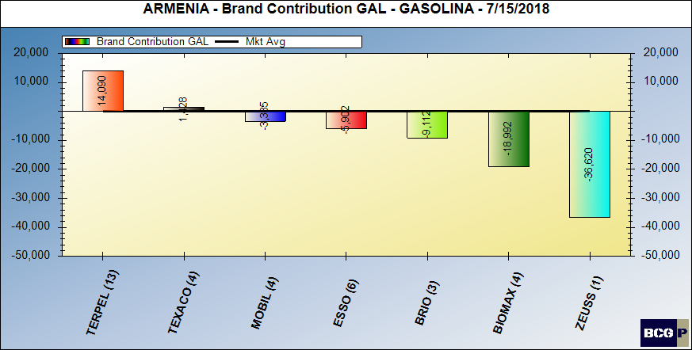
Brand contribution - gasoline

Slide 15
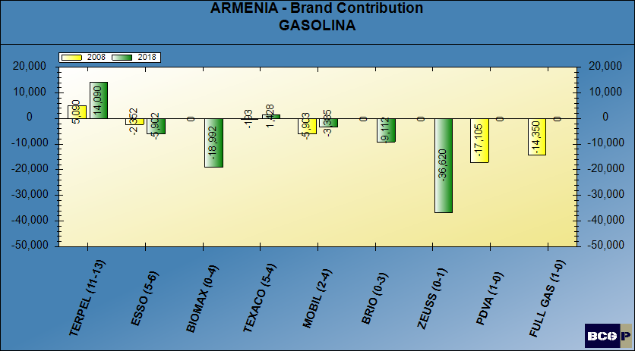
BRAND CONTRIBUTION - GASOLINE

Slide 16
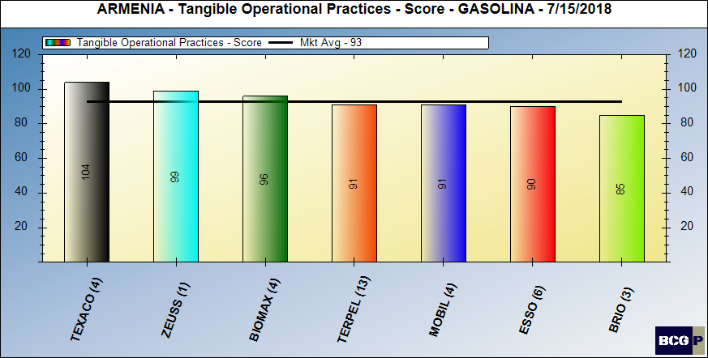
Merchandising score - gasoline

Slide 17
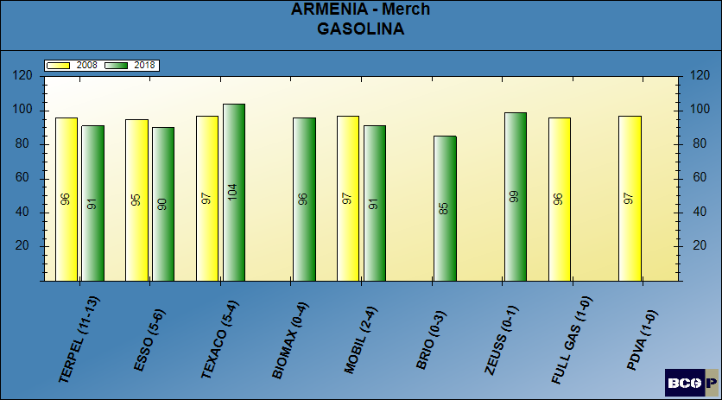
MERCHANDISING SCORE - GASOLINE

Slide 18
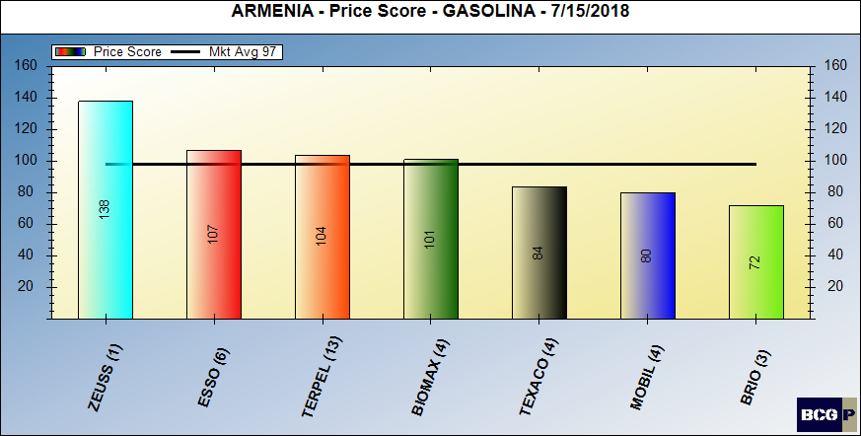
Pricing posture - gasoline

Slide 19
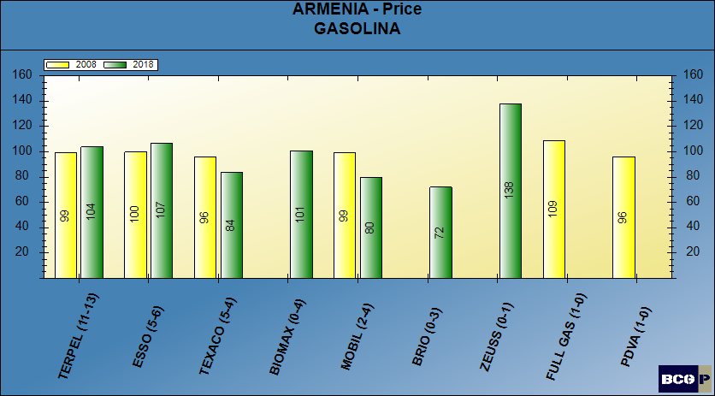
PRICING POSTURE - GASOLINE

Slide 20
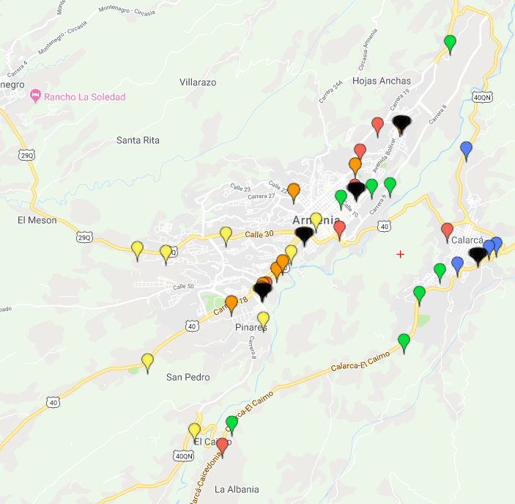
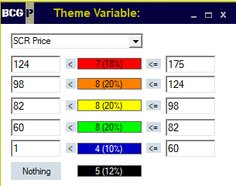
PRICE THEMATIC MAP - GASOLINE

Slide 21
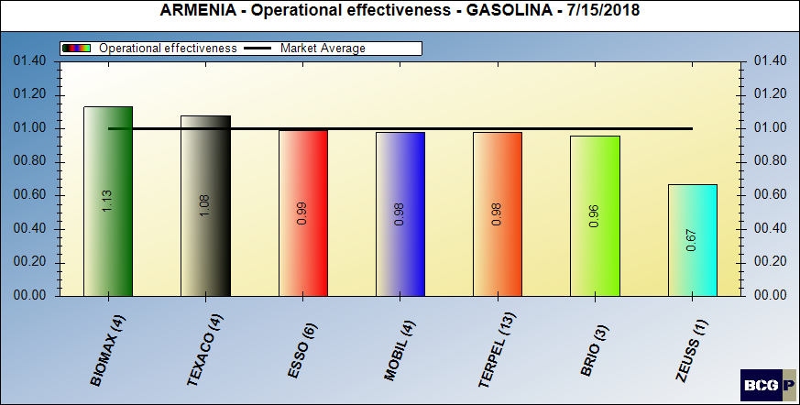
dealer (intangible) contribution – gasoline

Slide 22
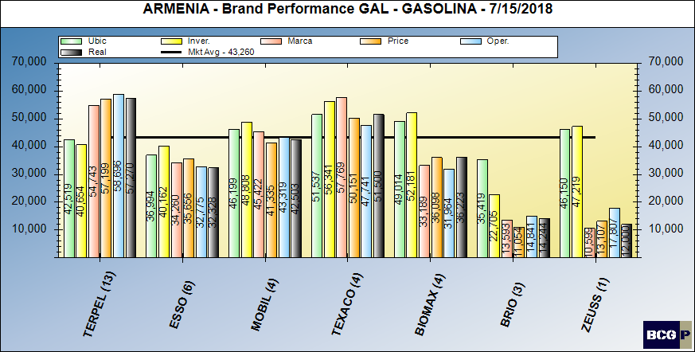
Brand performance – gasoline

Slide 23
MARKET SUMMARY - GASOLINE

Slide 24
Bravo Consulting Group
Market summary - diesel

Slide 25
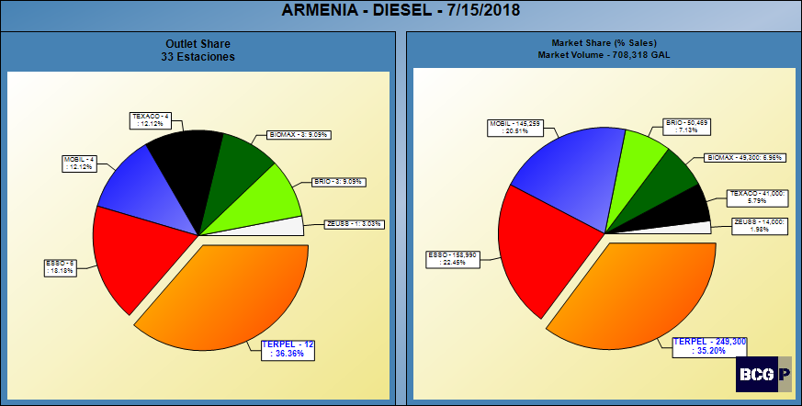
DIESEL SHARES

Slide 26
NUMBER OF SITES - DIESEL

Slide 27
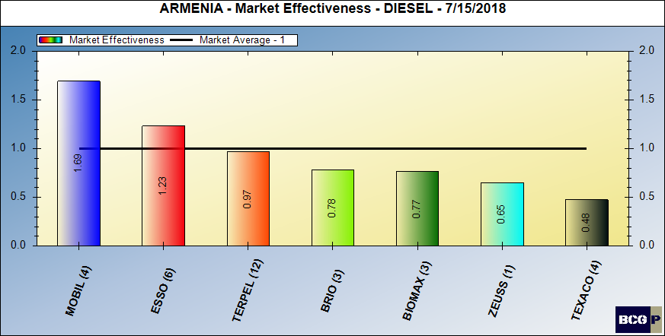
market effectiveness - diesel

Slide 28
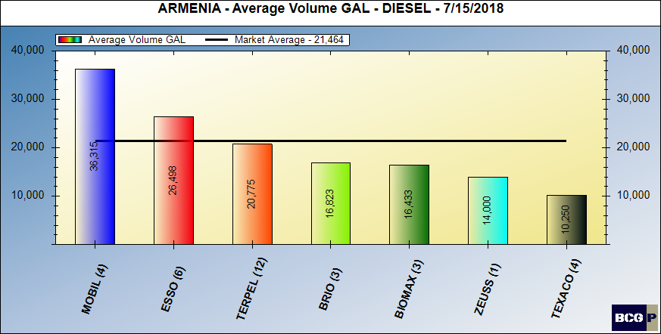
average volumes - DIESEL

Slide 29
AVERAGE VOLUMES - DIESEL

Slide 30
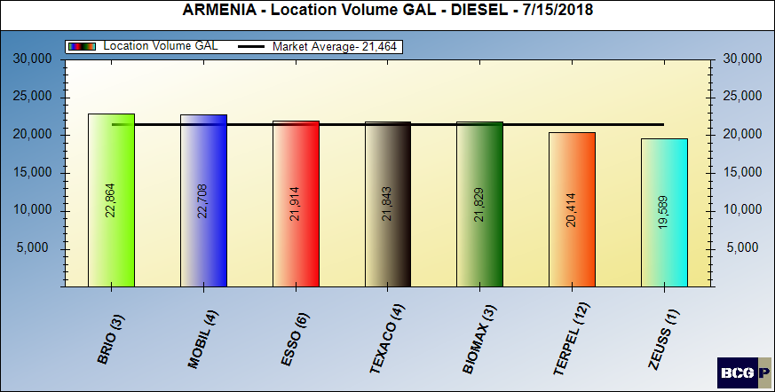
Location volume - diesel

Slide 31
LOCATION VOLUME - DIESEL

Slide 32
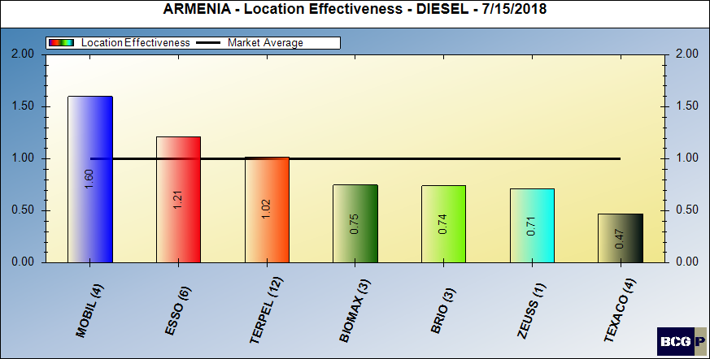
Location volume effectiveness – diesel

Slide 33
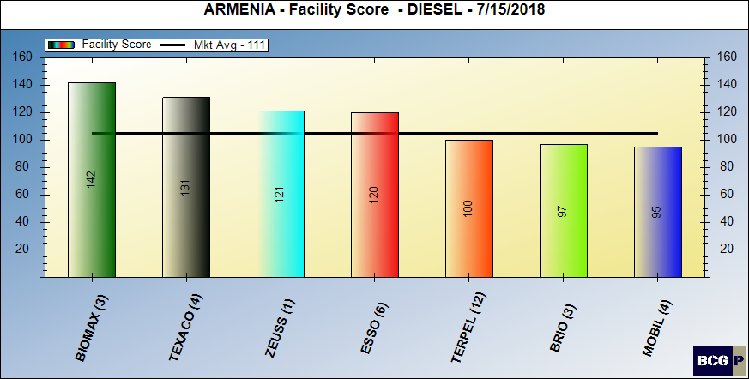
Facility score - diesel

Slide 34
FACILITY SCORE - DIESEL

Slide 35
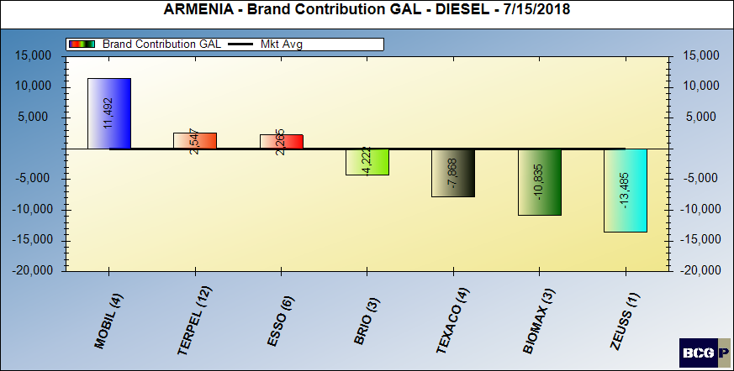
Brand contribution - diesel

Slide 36
BRAND CONTRIBUTION - DIESEL

Slide 37
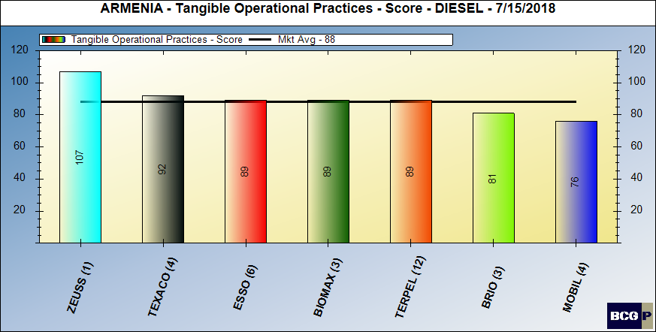
Merchandising score - diesel

Slide 38
Merchandising score - diesel

Slide 39
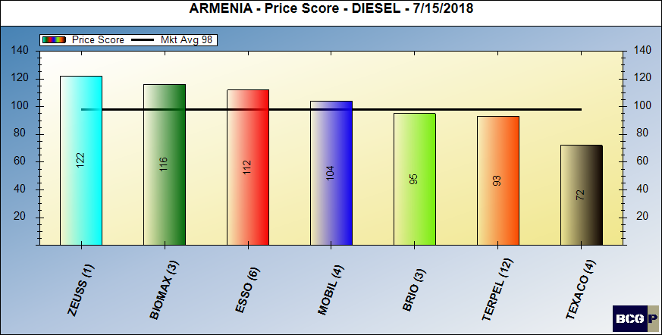
Pricing posture - diesel

Slide 40
Pricing posture - diesel

Slide 41
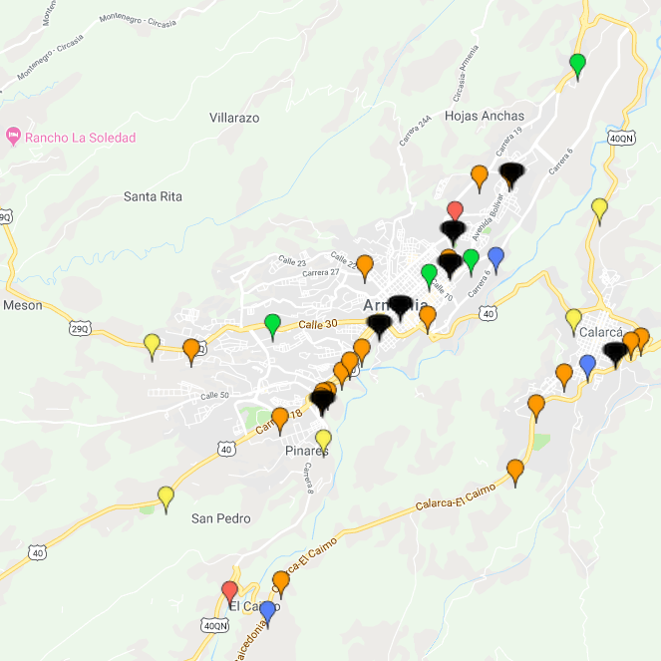
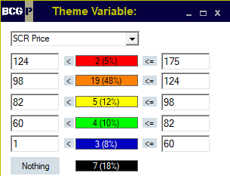
PRICE THEMATIC MAP - DIESEL

Slide 42
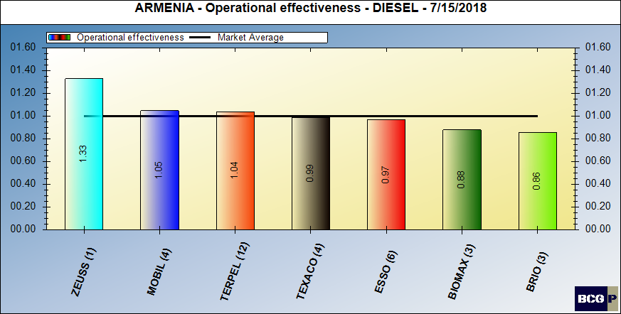
dealer (intangible) contribution – diesel

Slide 43
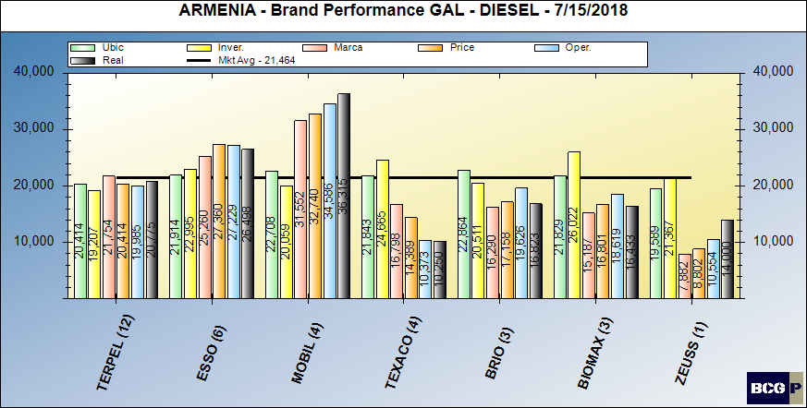
Brand performance – diesel

Slide 44
MARKET SUMMARY - DIESEL

Slide 45
Bravo Consulting group
QUADRANT –TERPEL
gasoline & diesel

Slide 46
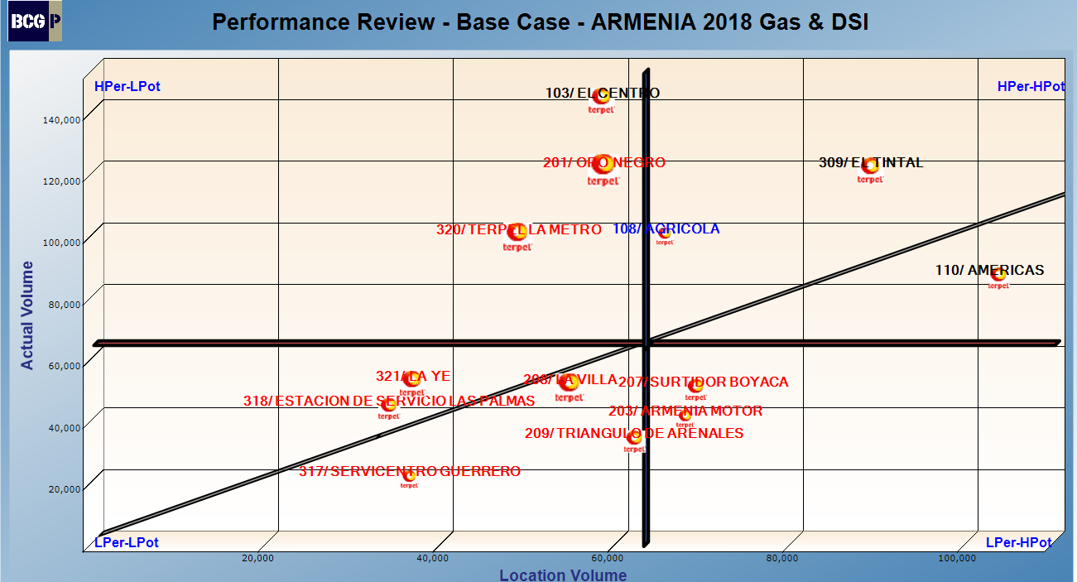
QUADRANT – GASOLINE & DIESEL

Slide 47
Bravo Consulting group
Performance analysis gasoline & diesel

Slide 48
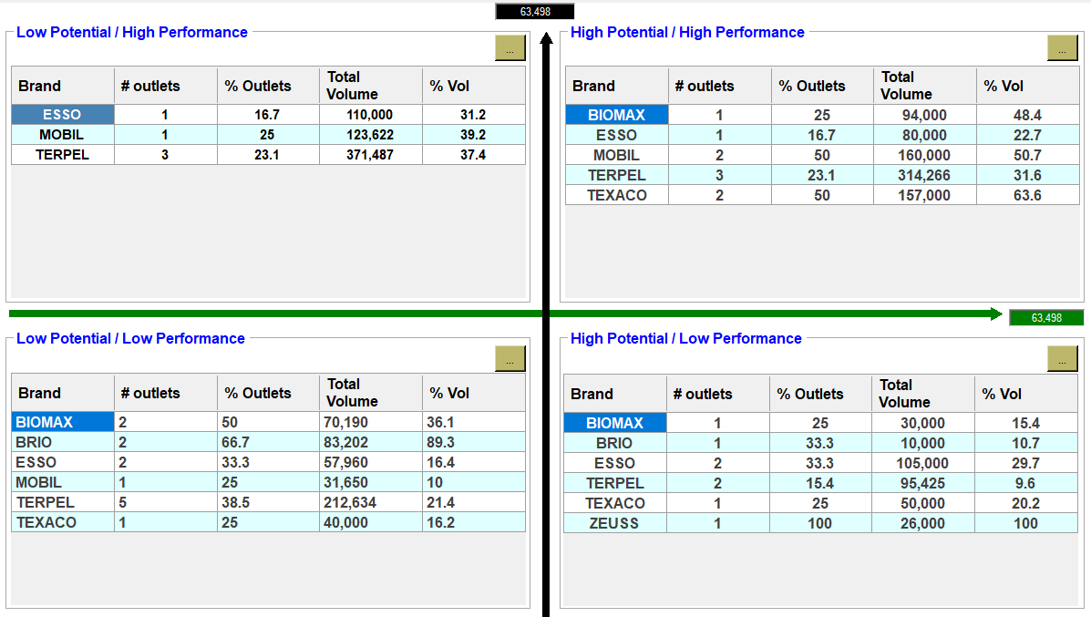
PERFORMANCE ANALYSIS – GASOLINE & DIESEL

Slide 49
Bravo Consulting Group
Market summary - cng

Slide 50
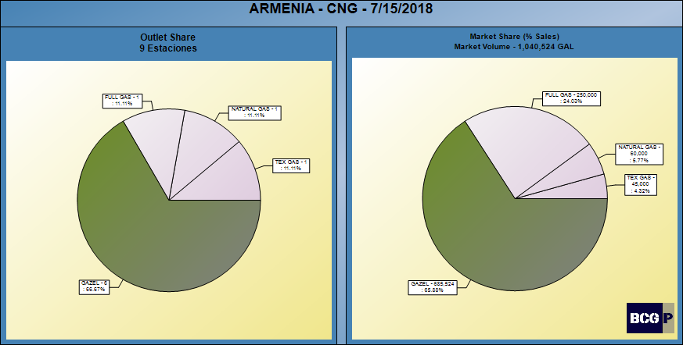
CNG SHARES

Slide 51
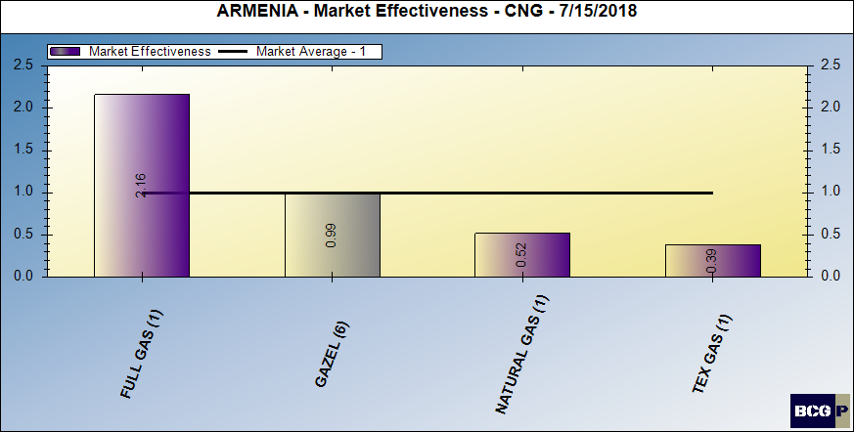
CNG MARKET EFFECTIVENESS

Slide 52
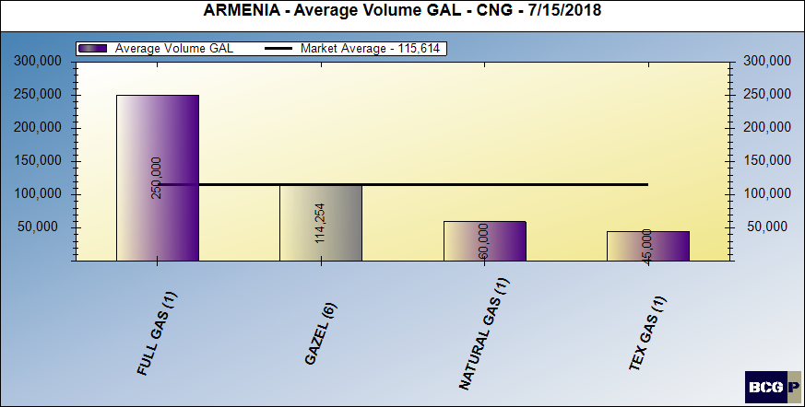
AVERAGE VOLUMES - GNV

Slide 53
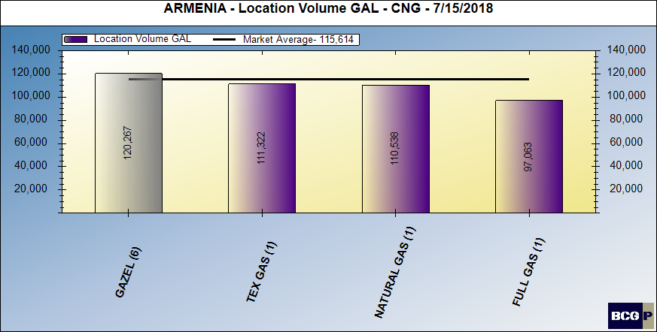
LOCATION VOLUME - CNG

Slide 54
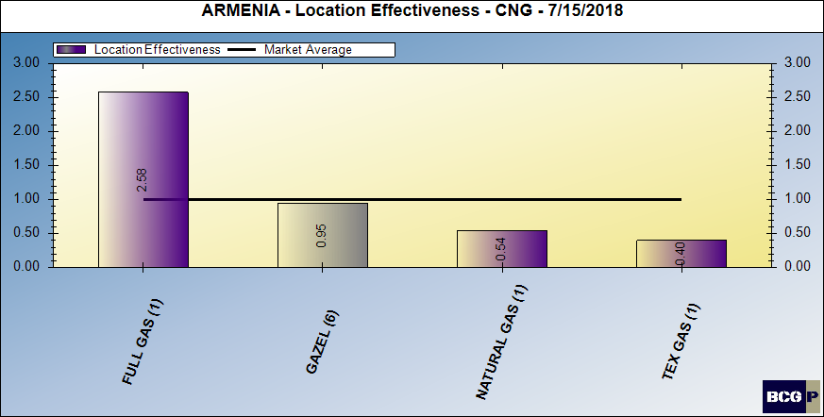
LOCATION VOLUME EFFECTIVENESS - CNG

Slide 55
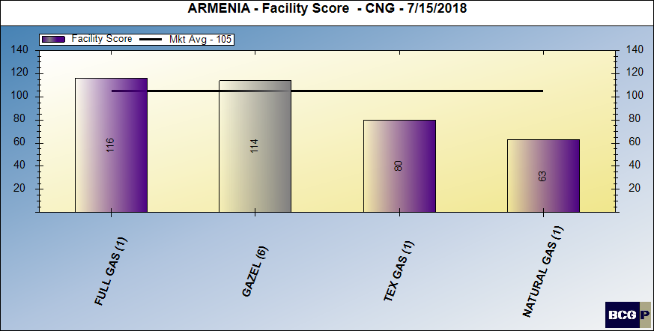
FACILITY SCORE - CNG

Slide 56
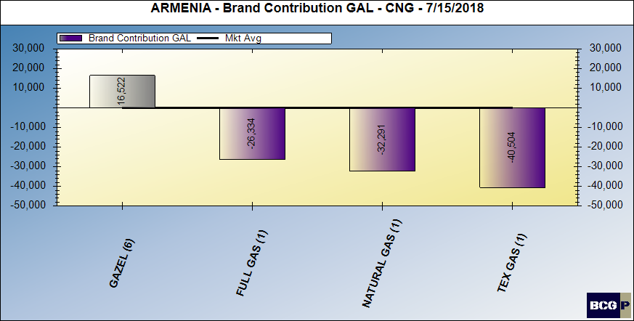
BRAND CONTRIBUTION - CNG

Slide 57
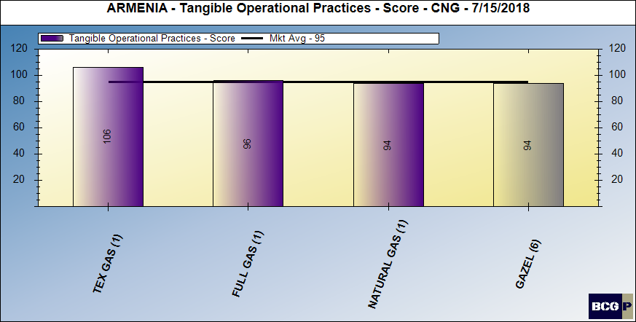
MERCHANDISING SCORE - CNG

Slide 58
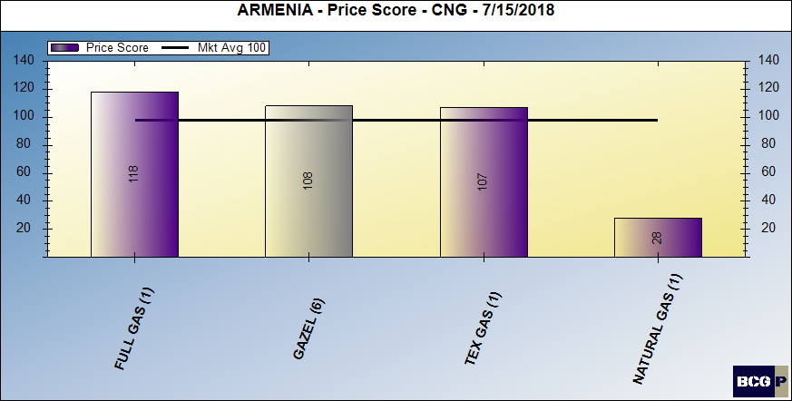
PRICING POSTURE - CNG

Slide 59
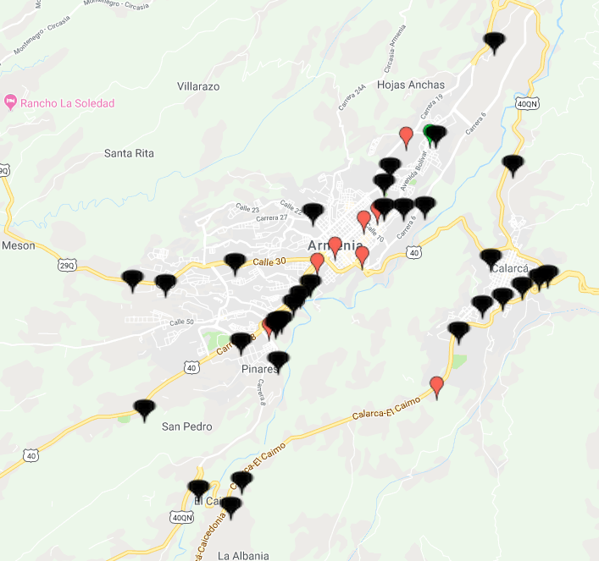
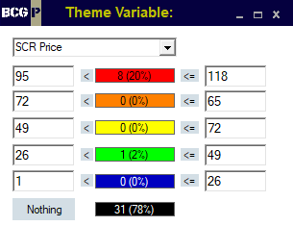
PRICE THEMATIC MAP - CNG

Slide 60
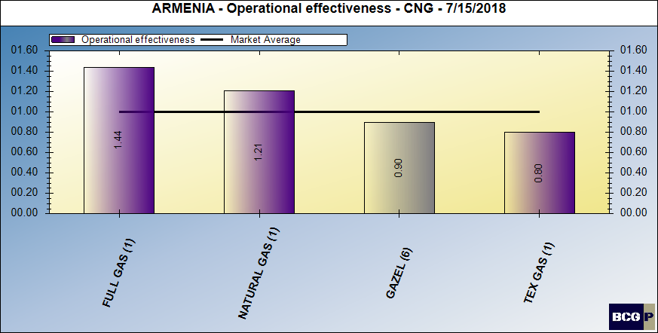
DEALER (INTANGIBLE) CONTRIBUTION - CNG

Slide 61
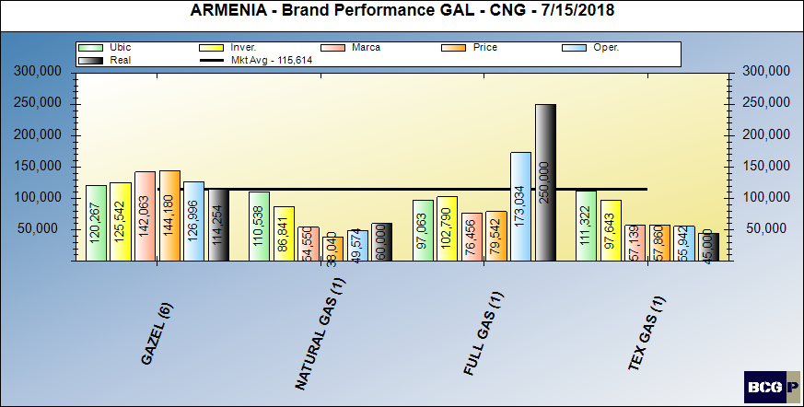
BRAND PERFORMANCE - CNG

Slide 62
MARKET SUMMARY - CNG

Slide 63
Bravo Consulting Group
OUTLET REVIEW

Slide 64
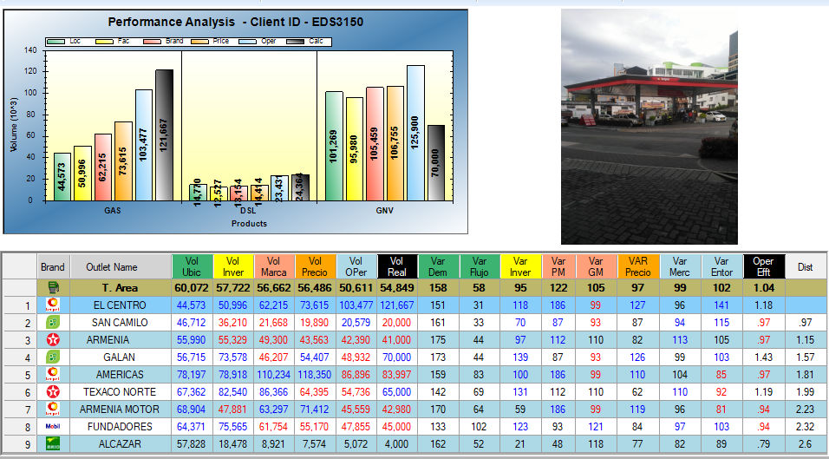
BCG ID 103 - EL CENTRO

Slide 65
BCG ID 108 - AGRICOLA

Slide 66
BCG ID 110 - AMERICAS

Slide 67
BCG ID 201 - ORO NEGRO

Slide 68
BCG ID 203 - ARMENIA MOTOR

Slide 69
BCG ID 207 - SURTIDOR BOYACA

Slide 70
BCG ID 208 - LA VILLA

Slide 71
BCG ID 209 - TRIANGULO DE ARENALES

Slide 72
BCG ID 309 - EL TINTAL

Slide 73
BCG ID 317 - SERVICENTRO GUERRERO

Slide 74
BCG ID 318 - ESTACION DE SERVICIO LAS PALMAS

Slide 75
BCG ID 320 - TERPEL LA METRO

Slide 76
BCG ID 321 - LA YE

