Slide 1
A proactive process to identify the opportunities that will bring the highest return
Network Planning
By
Bravo Consulting Group
For
My Client

Slide 2
Training Planning
Schedule
Contrato
Peru y Colombia
Software – warnings
Role Regional Planner
Calendario
Honduras y Panama Tactic
Modelo

Slide 3
Profile Network Planner
Retail experience
TM or similar
Analytical Skills
Able to interpret data,
Implement regional directives
Leadership

Slide 4
Who are we?
BCG is a consulting company that provides personalized and customized consulting services to a selected client base in the Retail Petroleum and Convenience Store Industry.

Slide 5
What is BCG’s competency?
Network Planning & Retail Network Optimization
Identify high potential areas within a market
Evaluates and identifies Operational Opportunities
Pricing Strategies
Merchandising Practices
Divestment Candidates
Provides a complete system of market intelligence
Includes in-depth and objective information of your outlets and the competition
Price Optimization
Price Zoning
Key Competitors
Price rules
Price Optimization
Consulting & Support

Slide 6
Market area studies
Central America Caribbean
Honduras
Nicaragua
Puerto Rico
El Salvador
Guatemala
Panama
South America
Colombia
Chile
Japan
Hokkaido
Africa
Angola

Slide 7
BCG Solutions
BCG Optimizer©
Optimization
Modeling
BCG Planner©
Business Intelligence
Analysis
BCG Analyzer©
Data
Resource Investment
Notes:
BCG offers solutions to meet any need and any budget. With BCG, you can choose which level of service is right for you.
Data Examples – Demographics, Traffic Counts, Retail Outlet Surveys, Market Share Reports
Analysis Examples – S.W.O.T. (strengths, weaknesses, opportunities, threats) Analysis - we benchmark your sites vs. your competitors. Customer Profiling - we geocode your customer addresses and identify their lifestyle profile. Market Ranking Analysis - we prioritize geographies using variables that are relevant to your objective.
Modeling Examples – Our network planning tool, Retail Explorer, is an example of one of the models that we offer. We also have price zoning models that allow our clients to segment markets based on natural pockets of consumer spending for establishing DealerTankwagon prices.
Optimization Examples – At the high end of the scale, we offer complex optimization models. In the network planning arena, we offer a Capital Optimization Solution (COS) that tests thousands of possible site actions and provides resulting volume projections and economics to identify the “optimal” network plan. We also offer PriceIt! Pro, a tool that recommends daily street prices that will allow you to maintain volume while maximizing profit.

Slide 8
BCG Planner
Network
Planning
Data Base
Volume
Projections
GIS
Dynamic system to facilitate the decision making process in the Retail Business
Market Analysis
Consumer Behavior
Competitors Benchmarking
Client Position

Slide 9
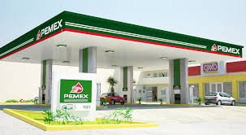
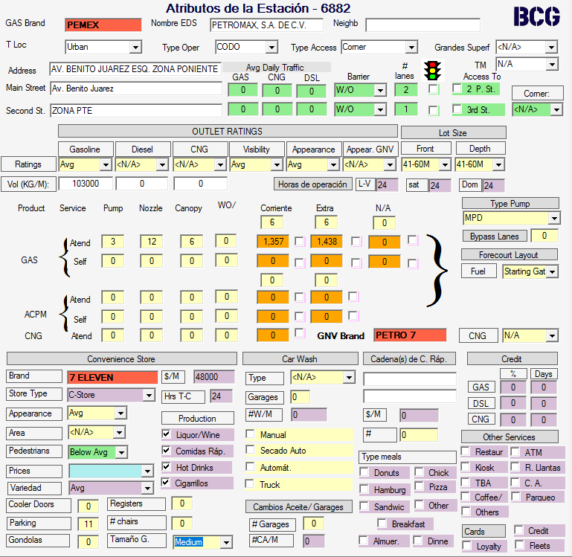
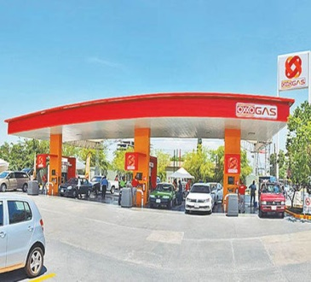
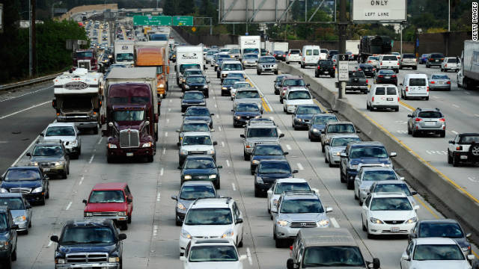
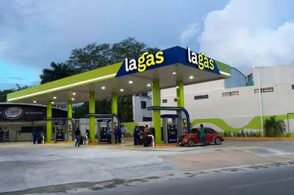
The process begins with a detail market area study
Detailed Survey of all Service Stations
Traffic Counts

Slide 10
Census Data
Population, Households, income -→ Autos

Slide 11
Traffic counts of all Streets in the market

Slide 12
BCG model creation Process
Calculates Variable
Scores
Defines
Spatial
Iteration
Calibrates
Consumer
Behavior
Identifies
Local Area
Patterns
Quantifies
Operations
Determines
Brand Value

Slide 13
Model Creation Steps
3
4
5
Adjust local CONSUMER preferences
Calculate BRAND contribution
Identify local Area Patterns: AREA SCORE
Determine the quality of the operation
Calculate Variable Scores
1
2

Slide 14
Variable Scores are Calculated
Calculates Variable
Scores
Brand
Traffic
Investment
Price
Merchandising

Slide 15
Calculates Variable Scores
Calculate Variable Scores
Methods to evaluate each component of the Retail Value Chain
Investment
Business
Practices
Demand
Traffic
Price

Slide 16
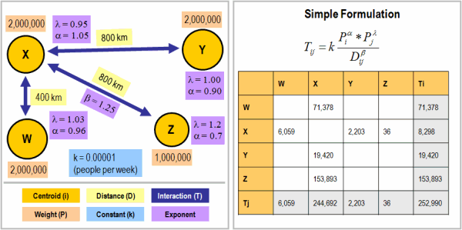
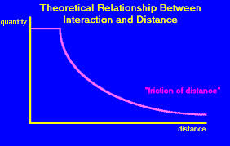
Spatial Iteration Model
Establishes
Spatial
Iteration
)
(
ß
(Var1 site)
___________________________________
$$f\left(Var1\right)=$$
∑
Var1 Competitors
________________________________
(Distance*Var1 Decay curve)

Slide 17
How is the Spatial geographic interaction handled?
Routing distances

Slide 18
Retail Value Chain - Calibration
Calibrates
Consumer
Behavior
$Volume=$ $f\left(D\right)ß1⥃f\left(T\right)ß2⥃f\left(I\right)ß3$ $⥃f\left(M\right)ß4$ $⥃f\left(P\right)ßn$
Adjustment of the weights of each variable score minimizing the error (difference between calculated and real volume)
Location
Tafficc
Demand
Local
Area
Brand
Operation
Investment
Price
Business
Practices

Slide 19
Calibrate local preferences…
Calibrates
Consumer
Behavior
Absolute Variables
Adjusts the weights of each variable score minimizing the error (difference between calculated volume and real volume)
Demand^{α1}
Traffic ^{α2}
Investment^{α3}
Merch^{α4}
Price ^{α5}
Volume 1
The system calculates an initial volume for each station in the market using the absolute variable scores.
Notes:
El modelo pasa por un proceso de calibracióne para ajustarse a la realidad local.

Slide 20
Step 2: Brand Contribution
Determines
Brand Value
Notes:
En este ejemplo el modelo, con base en las variables absolutas, esperaría que la mayoría de las EDS vendiese menos de lo que venden. Hay un patrón positivo que pede ser atribuido a la marca ya que esta presente el la gran mayoria de puntos de la marca en cuestion.

Slide 21
Step 2: Brand Contribution
Determines
Brand Value
Notes:
En este ejemplo el modelo, con base en las variables absolutas, esperaría que la mayoría de las EDS vendiese menos de lo que venden. Hay un patrón positivo que pede ser atribuido a la marca ya que esta presente el la gran mayoria de puntos de la marca en cuestion.

Slide 22
Step 2: Brand Contribution
Determines
Brand Value
Notes:
En este ejemplo, tambin identificamos un patrón. Excepto que es negativo. Una marca que consistentemnet vende menos de o que el modelo esperaría.

Slide 23
Step 2: Brand Contribution
Determines
Brand Value
Notes:
En este ejemplo, tambien identificamos un patrón. Excepto que es negativo. Una marca que consistentemnet vende menos de lo que el modelo esperaría.

Slide 24
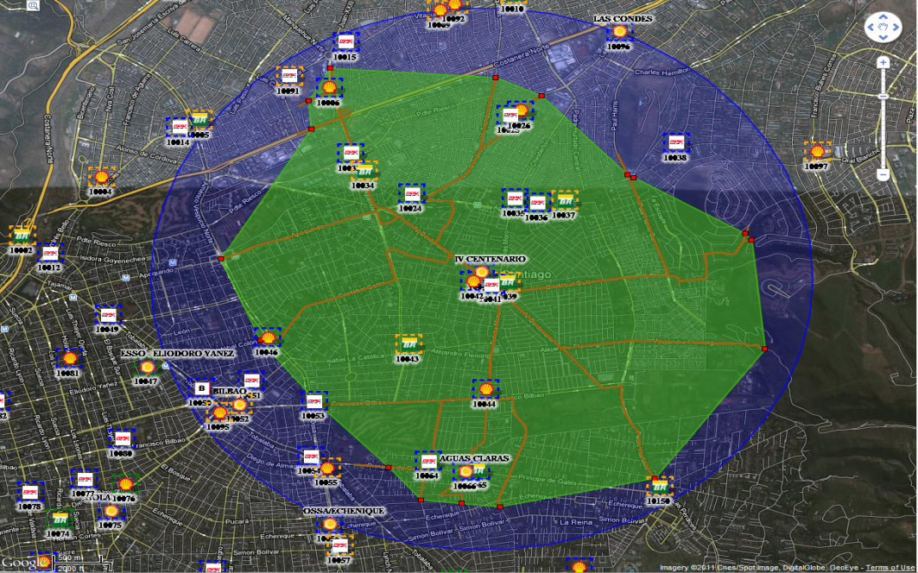
Area score
Identifies
Local Area
Patterns
Is there a performance pattern displayed by the outlets of a region that could be explained by the conditions of the trade area?
This variable is derived statistically using Spatial Autocorrelation
Notes:
Spatial dependency or auto-correlation
Spatial dependency is the co-variation of properties within geographic space: characteristics at proximal locations appear to be correlated, either positively or negatively. Spatial dependency leads to the spatial autocorrelation problem in statistics since, like temporal autocorrelation, this violates standard statistical techniques that assume independence among observations. For example, regression analyses that do not compensate for spatial dependency can have unstable parameter estimates and yield unreliable significance tests. Spatial regression models (see below) capture these relationships and do not suffer from these weaknesses. It is also appropriate to view spatial dependency as a source of information rather than something to be corrected
Locational effects also manifest as spatial heterogeneity, or the apparent variation in a process with respect to location in geographic space. Unless a space is uniform and boundless, every location will have some degree of uniqueness relative to the other locations. This affects the spatial dependency relations and therefore the spatial process. Spatial heterogeneity means that overall parameters estimated for the entire system may not adequately describe the process at any given location.

Slide 25
Area score example: luanda

Slide 26
Area Score
Identifies
Local Area
Patterns
What factors can generate area patterns?
High crime areas
Tourist locations
Industrial areas
Operational restrictions
Price sinks
These patterns need not be cause and effect oriented, simply consistent...
and therefore predictable

Slide 27
Factors that May Impact Area Score
Identifies
Local Area
Patterns
Areas of high crime (customer may be uncomfortable at that site)
Sites located near a state line (tax difference issues)
Going to work vs. Going home locations
Highly transient area
Compensation for lack of, or discrepancy in demographic or traffic data
Synergy of retail offerings at the stations
Presence of alternative product segments (c-store, car wash, etc.)
Customer segmentation (prevalence of a specific consumer group)
Level of the nearby consumer’s expenditure and number of transactions at the station
Drive times within the trade area
Leftovers of Back Side of demand

Slide 28
Final Step: Operation Scores
Quantifies
Operations
During this phase the model calculates the effect of the contribution of the outlet’s operation or intangibles.
This score is outlet specific.
If all factors have been modeled whatever difference may still exist should be attributed to operations and/or intangible characteristics if the outlet
The outlet scores exhibits a normal distribution
60% of outlets present average operations.

Slide 29
Final Step: Operation Scores
Quantifies
Operations
Dealer / Manager
Location
Facility
1. Attitude/personality of crew and dealer
2. Length of time dealer has been at outlet
3. Reputation of mechanic/service work
4. Number of attendants at rush hour
5. Recent change in pricing posture
6. Inconsistent pricing relative to competition
7. Recent hours change
8. Cross merchandising offered on products or services other than car wash
9. Desirability of adjacent or nearby business
10. Lighting at night
11. Equipment frequently out of order
1. Edge of study boundary or territory
2. Areas of higher/lower price due to various tax differentials
3. Beer sales (wet or dry areas)
4. Convenience food demand
5. road construction at outlet or in general area before or during survey
6. Ethnic and age make-up of trade area
7. Outlet located in or near a “price-sink” area
8. Desirability of adjacent or nearby business
1. Outlet recently opened, mature volume not available
2. Lighting at night
3. Outlet ratings aren’t sufficient to describe how bad or good a facility is (appearance, accessibility, visibility)
4. Equipment frequently out of order

Slide 30
Once the consumer behavior model is created
Performance
Operation
Price
Brand
Investment
Location
We want to understand the contribution that each variable has to volume performance

Slide 31
Analytical Volumes
Location
Demand
Traffic
--
--
--
--
--
160,000
Investment
Demand
Traffic
Investment.
--
--
--
--
120,000
Brand
Demand
Traffic
Investment
Brand
--
--
--
115,000
Price
Demand
Traffic
Investment
Brand
Price
115,000
Operation
Demand
Traffic
Investment
Brand
Price
Business Practices
Local Area
--
125,000
Actual
Demand
Traffic
Investment
Brand
Price
Business Practices
Local Area
Operation
140,000
Monthly
Units
Strengths and weaknesses of outlets are modeled taking into account the geo-spatial influence of competing outlets

Slide 32
Trade Area Analysis
Variable Scores describe outlet’s strength and weaknesses
Benchmark volumes quantify the contribution of the variables in the Retail Value Chain

Slide 33
Identification of Operational Opportunities
Gasoline Evaluation;
Good location
Facilities better than it’s immediate trade area
However, operator shows a well below average performance
Recommendation
Operational couching or substitution

Slide 34
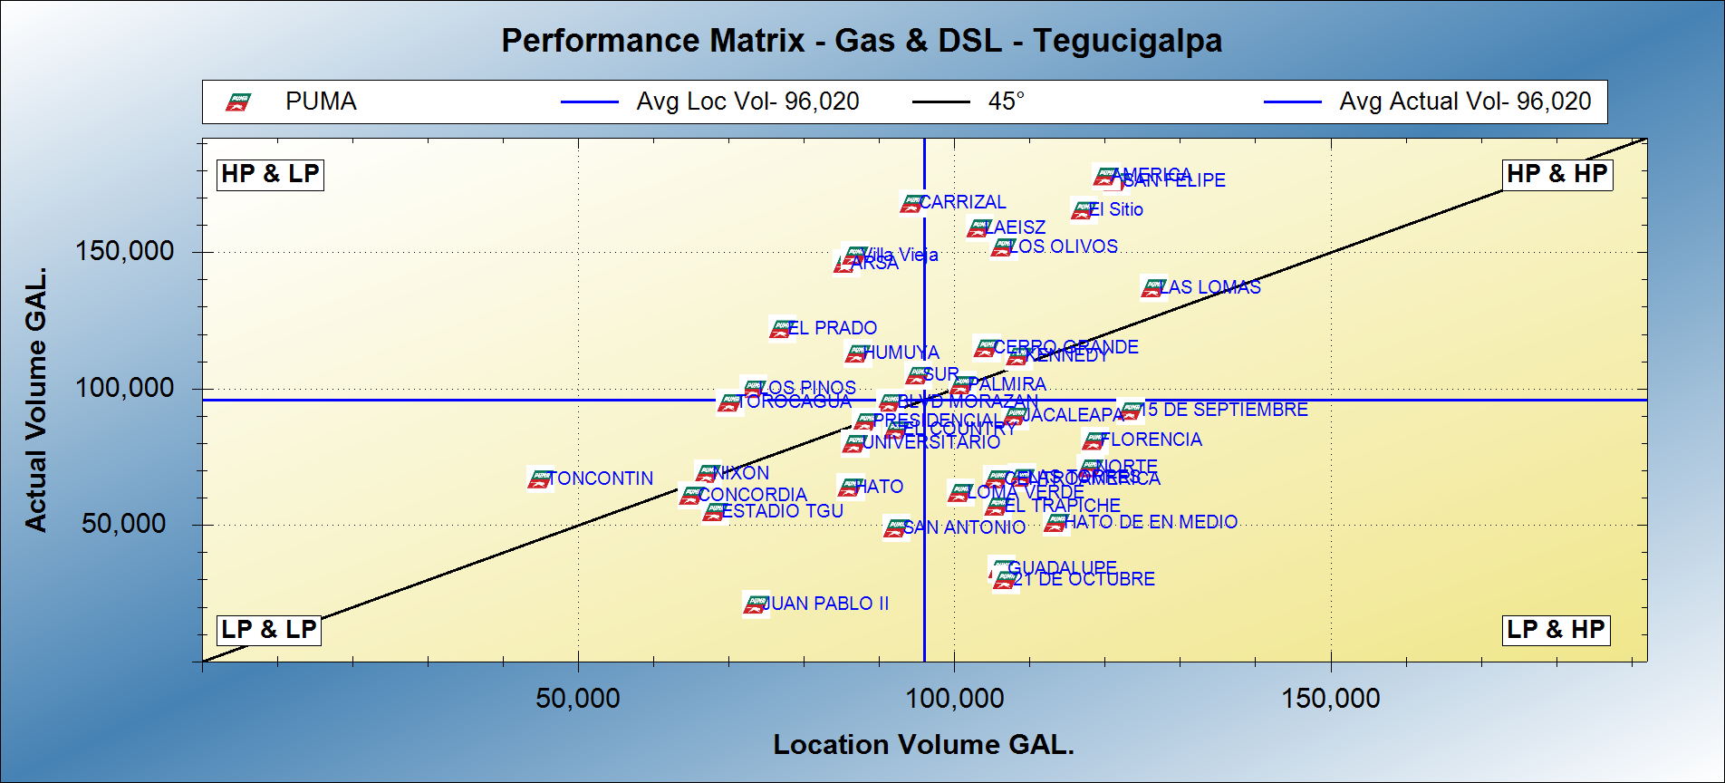
Provides tools for Network Optimization
Good operators in bad locations
Stars
Divestment Candidates
Low Performers but with High potential

Slide 35
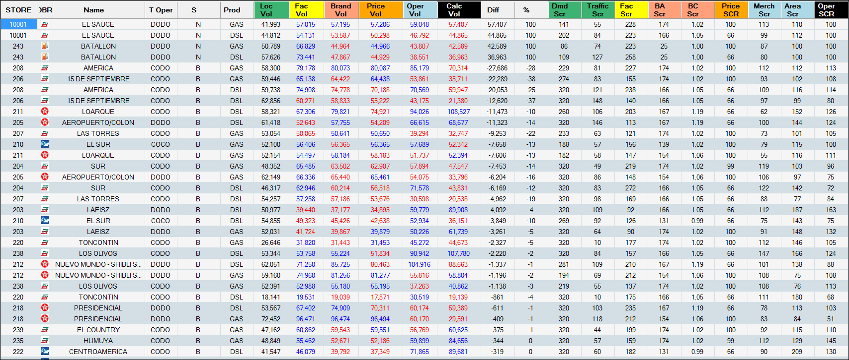
Proactive search of New Locations
How much volume will it sell?
Is it a good location?
Where will the volume come from?
How much is cannibalized from other Puma stations?
How about the C-Store performance?

Slide 36
Network Planning Process
Integrated Plan
Economics & Approval
Individual site strategies
Market Analysis/ Market Objectives
Implementation
Monitoring
Network plans help target capital toward risk-managed investments and position a brand’s network to withstand competitive pressures and fluctuations in consumer behavior

Slide 37
Objective
Implementation of a proactive standard Network Planning process that will identify the opportunities that will bring the highest return to the brand.
Evaluation of each client outlet
Impact of competitive action and reactions
Proactive search of new locations
Network Optimization
Use of “Best-of-Practices” in the development of the strategies for each station and for each market.

Slide 38
Thank you!!!!

