Slide 1
A proactive process to identify the opportunities that will bring the highest return
Network Planning
By
Bravo Consulting Group
For

Slide 2
Market Shares

Slide 3
Market Effectiveness

Slide 4
Location Volume

Slide 5
Facility Scores

Slide 6
Price Score

Slide 7
Brand Contribution

Slide 8
Network Performance Comparison

Slide 9
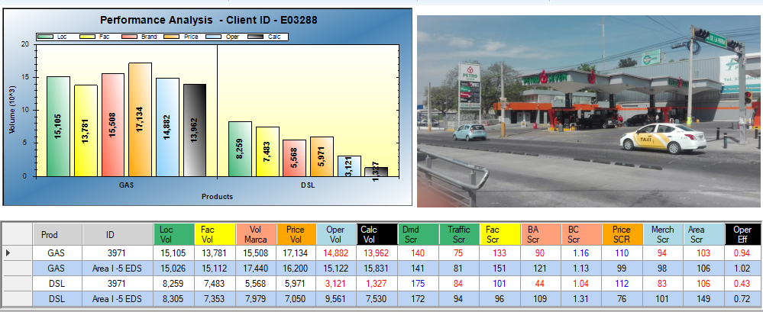
3971 / 3288 TOLTECA, S.A. - CL GOBERNADOR CURIEL N 3467 - PL/9496/EXP/ES/2015

Slide 10
Performance Review - Gasoline

Slide 11
TURBOSIMBA Simulation

Slide 12
Retail Gaps – Market Update

Slide 13
Gasoline & Diesel

Slide 14
Trade Area & Site Assessment
Location volume above average
Facilities below average
Operational Opportunities

Slide 15
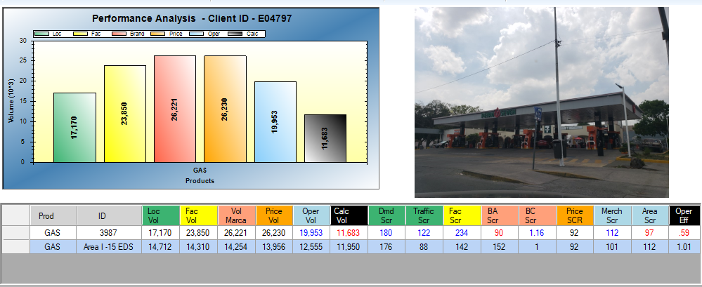
3987 / 4797 FEDERALISMO II - CALZ. DEL FEDERALISMO NTE - PL/11951/EXP/ES/2015

Slide 16
Trade Area & Site Assessment
Location volume above average
Positive contribution of facilities, brand and price
Operational Opportunities

Slide 17
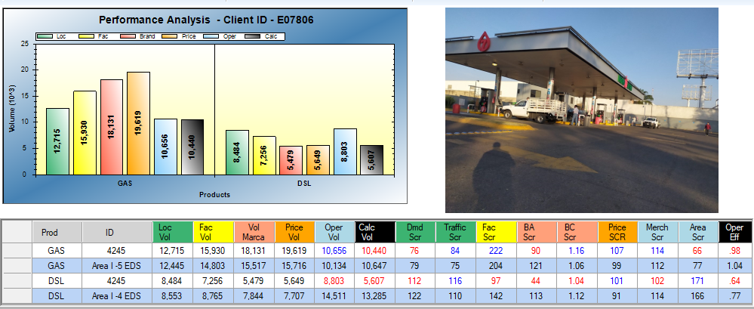
4245 / 7806 SERVICIOS SAN SEBASTIANITO - PERIFERICO SUR SN - PL/8193/EXP/ES/2015

Slide 18
Trade Area & Site Assessment
New Site under construction in trade area
Location volume above average
Positive contribution of facilities, brand and price
Low area score

Slide 19
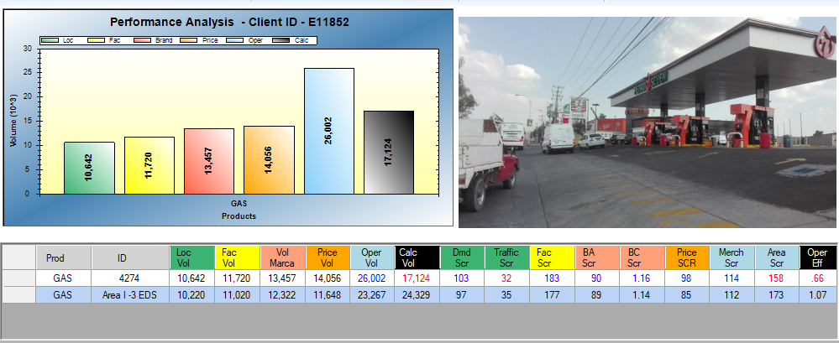
4274 / 11852 ITESO II - PERIFERICO SUR NO. 8745 - AUXILIAR - PL/546/EXP/ES/2015

Slide 20
Good location
Positive contribution of other scores
Trade Area Sites have higher sales

Slide 21
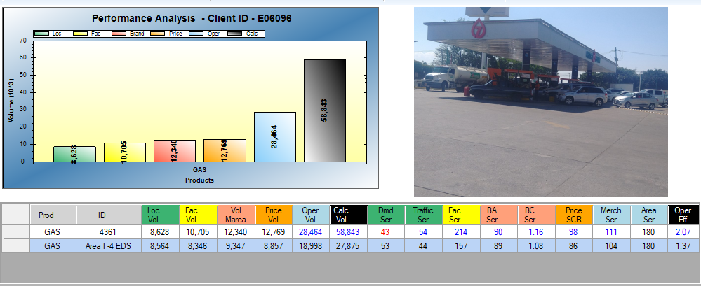
4361 / 6096 LA TIJERA - CARRETERA GUDALAJARA - MORELIA NO. 1501 - PL/518/EXP/ES/2015

Slide 22
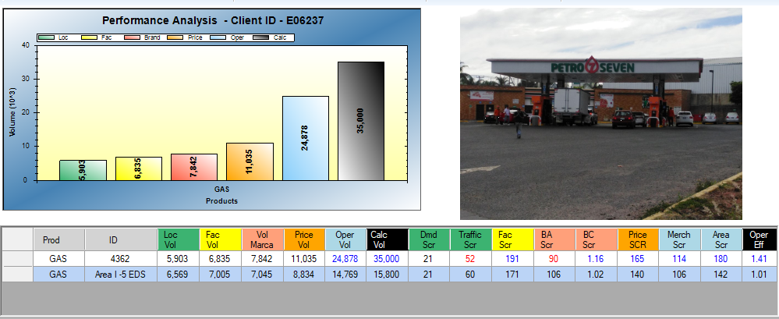
4362 / 6237 TLAJOMULCO - CARRETERA GUADALAJARA - MEXICO KM. 13.5 - PL/512/EXP/ES/2015

Slide 23
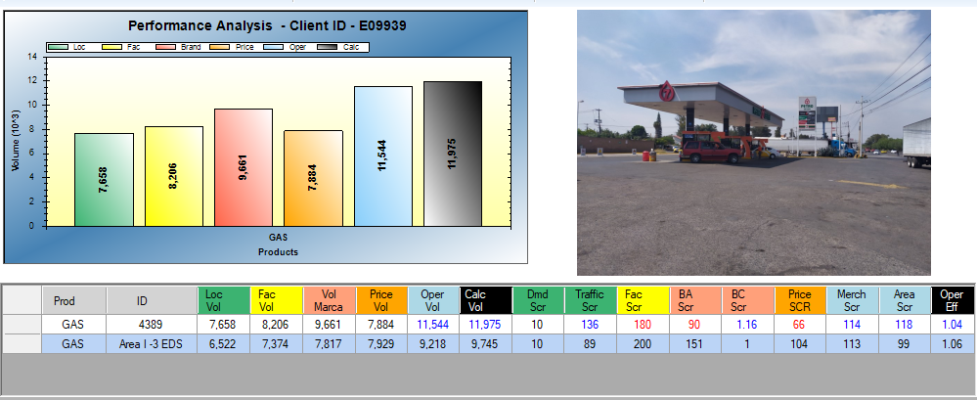
4389 / 9939 CAJITITLÁN - CARR. GUADALAJARA - CHAPALA - PL/623/EXP/ES/2015

Slide 24
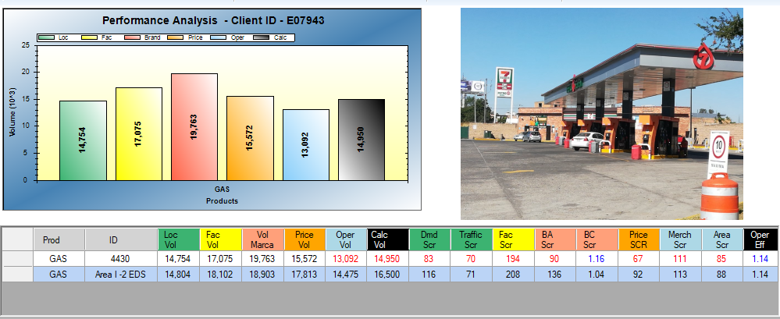
4430 / 7943 AUT. TONALÁ - LAS TORRES NO. 55 - LATERAL - PL/452/EXP/ES/2015

Slide 25
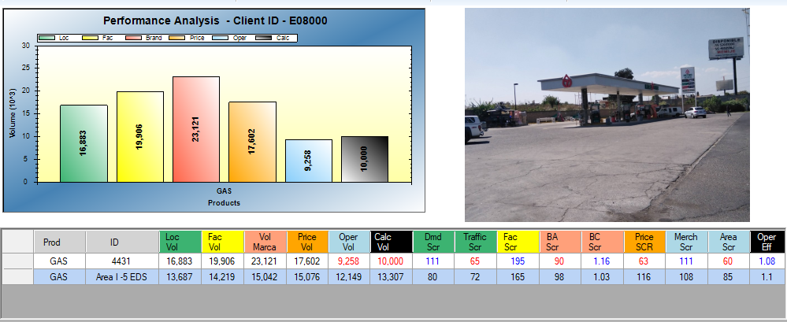
4431 / 8000 AUT. MÉXICO - AUTOPISTA GUADALAJARA-ZAPOTLANEJO KM. 18 - AUXILIAR - PL/549/EXP/ES/2015

Slide 26
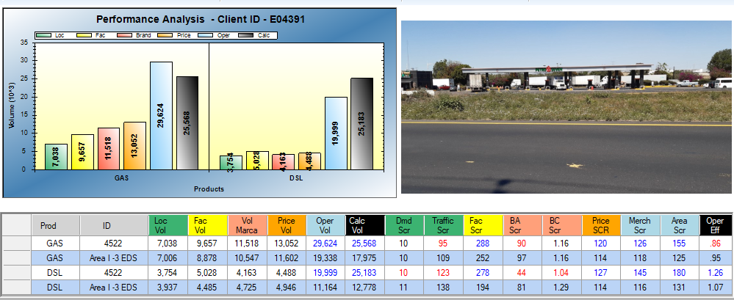
4522 / 4391 OURO PRETO - CARR. GUADALAJARA-NOGALES KM.13900 - PL/10548/EXP/ES/2015

Slide 27
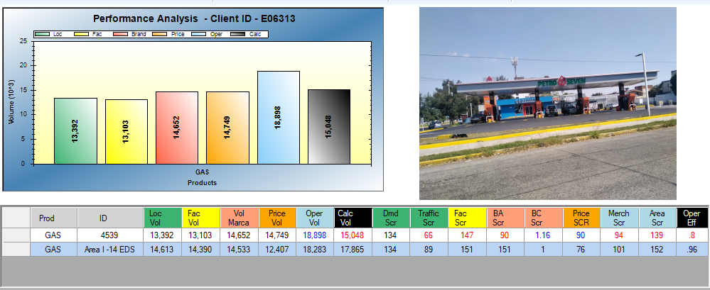
4539 / 6313 COMBUSTIBLES, ADITIVOS Y SERVICIOS MAGICOS - AV. LAZARO CARDENAS NO. 4183 - PL/13716/EXP/ES/2016

Slide 28
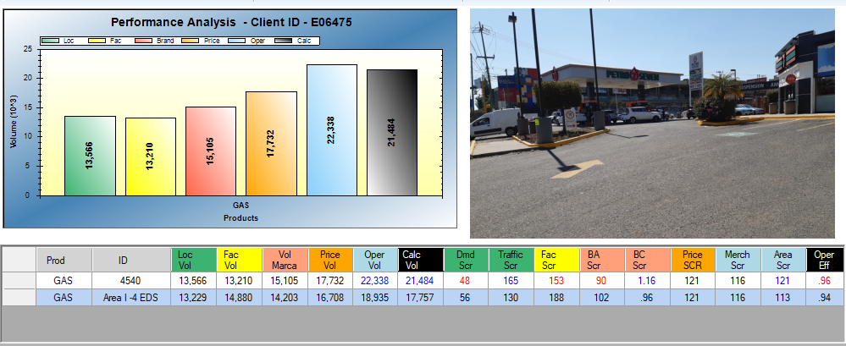
4540 / 6475 TEC DE MTY - AV. AVIACIÓN - PL/465/EXP/ES/2015

Slide 29
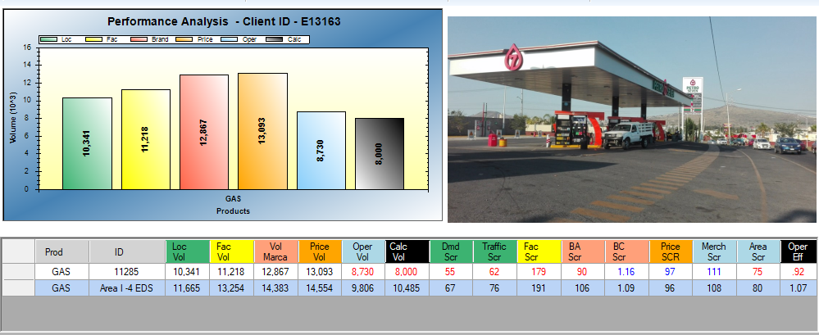
11285 / 13163 PROLONGACION 8 DE JULIO ESQ. ATARDECER - AV. JESÚS MICHEL GONZÁLEZ - PL/19682/EXP/ES/2016

