Slide 1
a proactive process to identify the opportunities that will bring the highest return to PUMA ENERGY
Network planning
For Puma Energy
By
Bravo Consulting Group

Slide 2

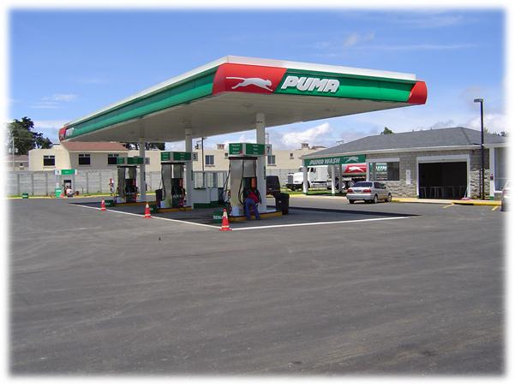
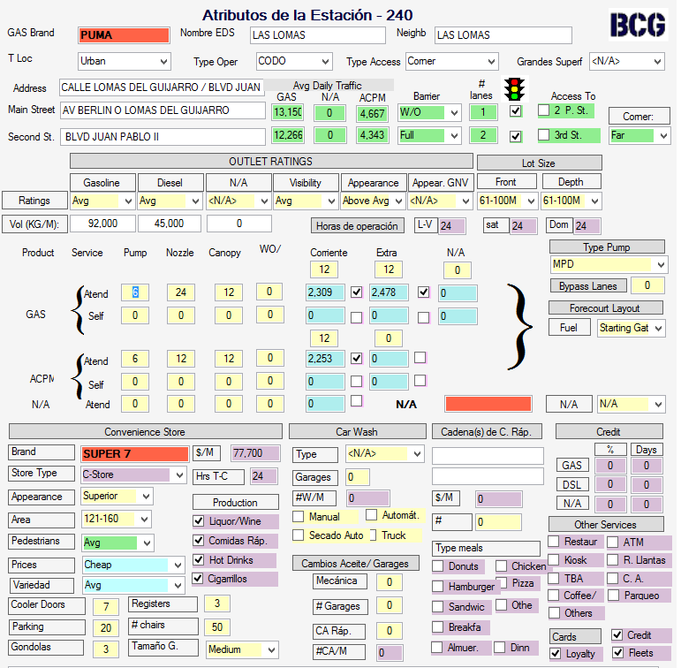
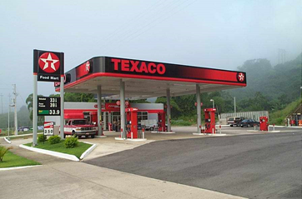

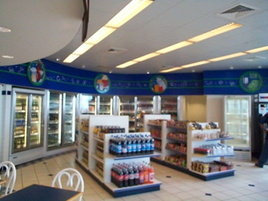
The process begins with a detailed market area study
Survey of all Service Stations
Traffic Counts

Slide 3
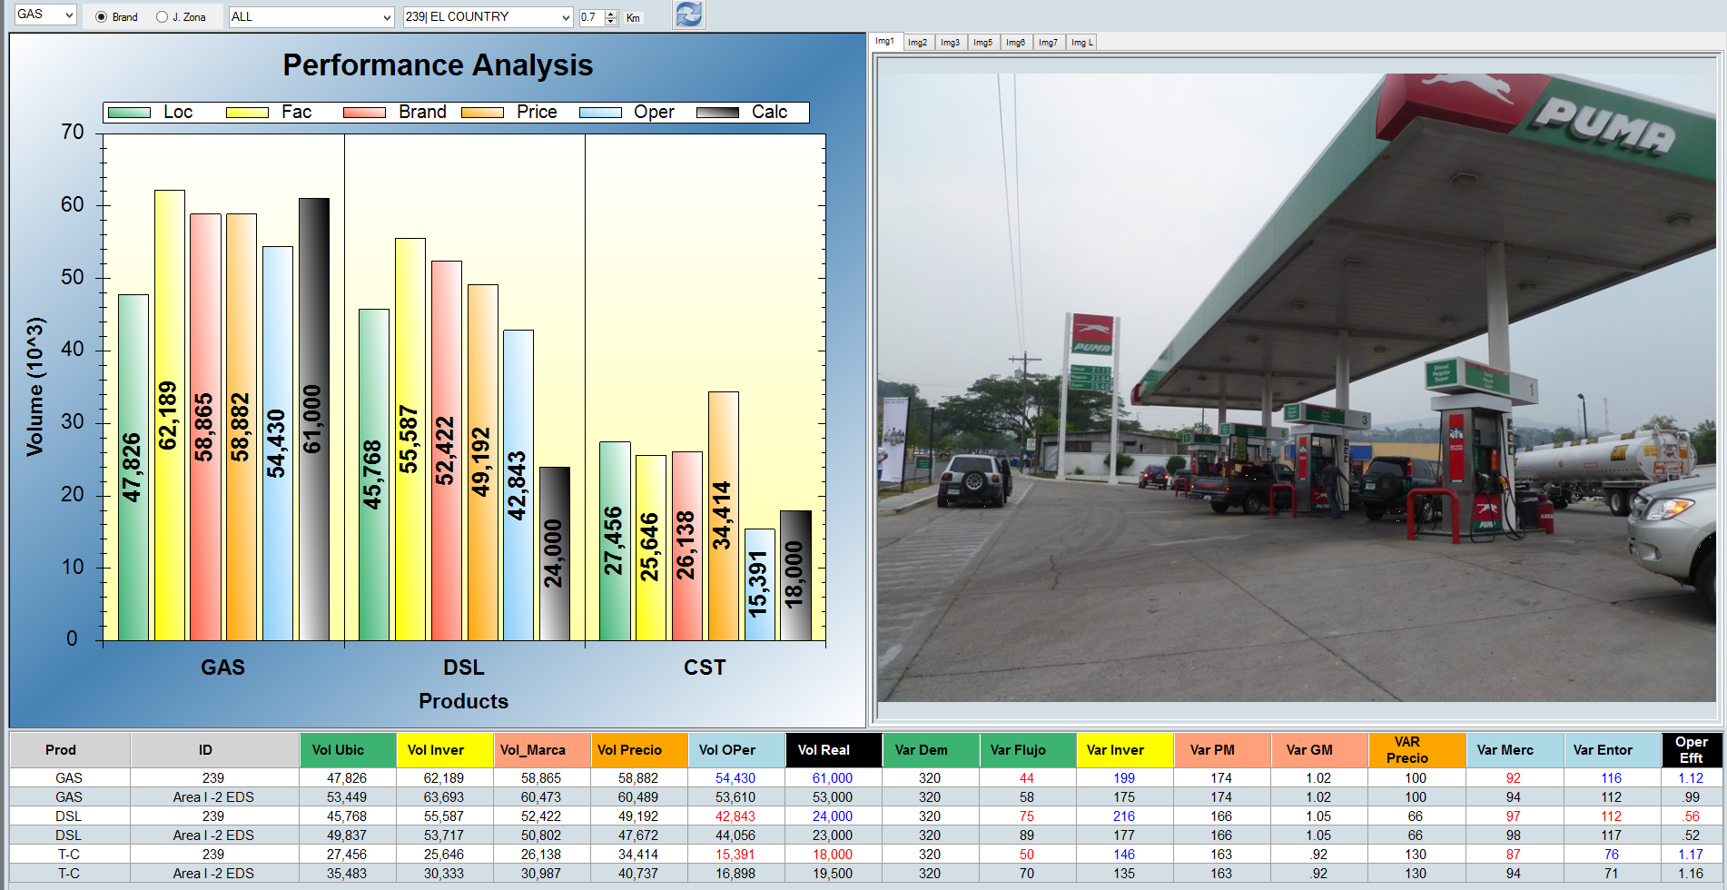
A consumer behavior model is then created
Variable Scores describe outlet’s strength and weaknesses
Benchmark Volumes quantify the contribution of the variables in the Retail Value Chain

Slide 4
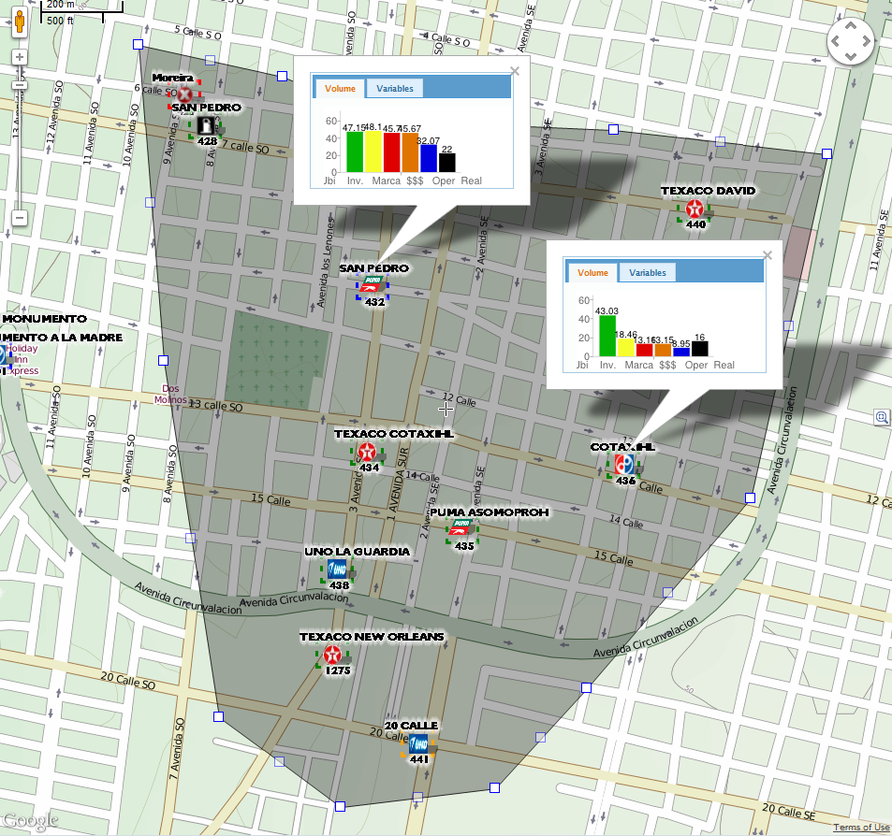
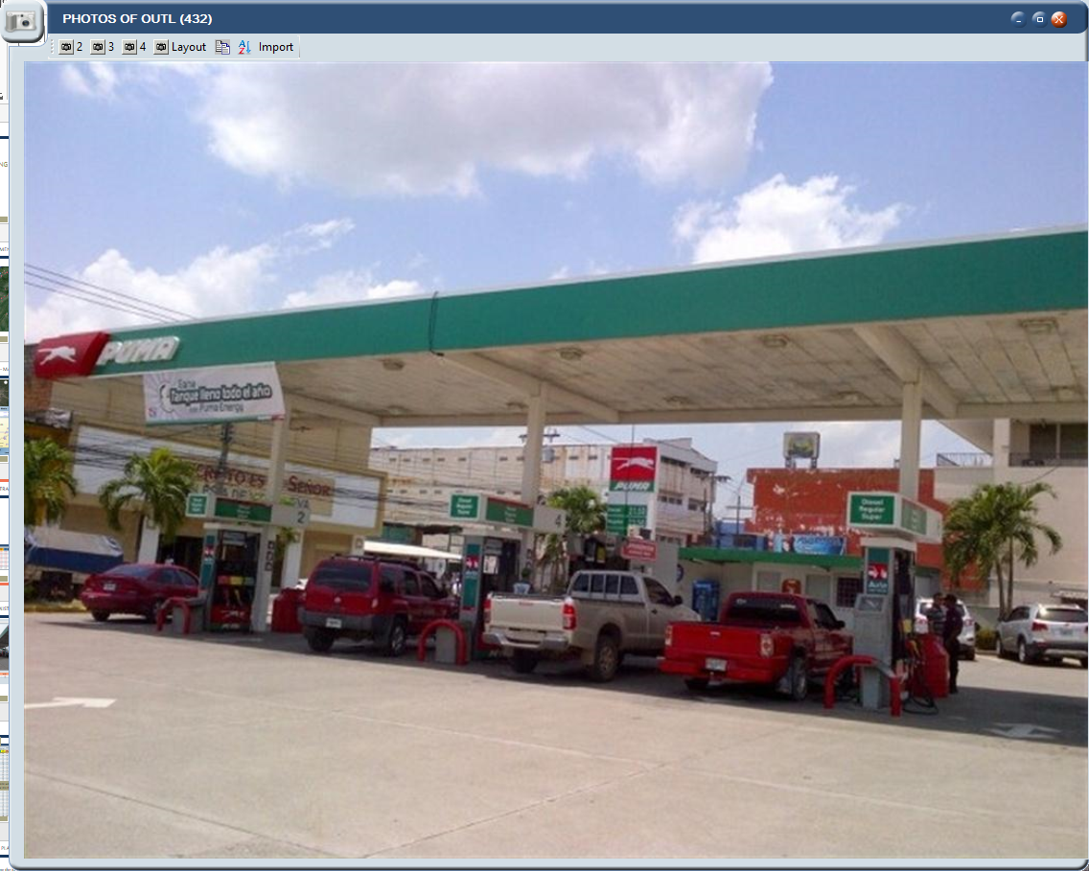
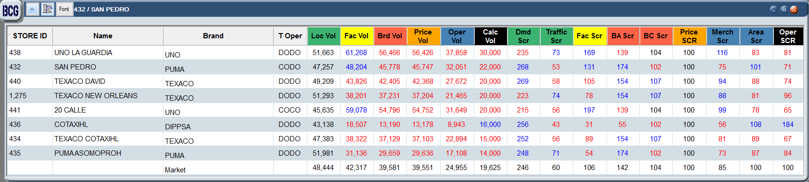
trade area intelligence

Slide 5
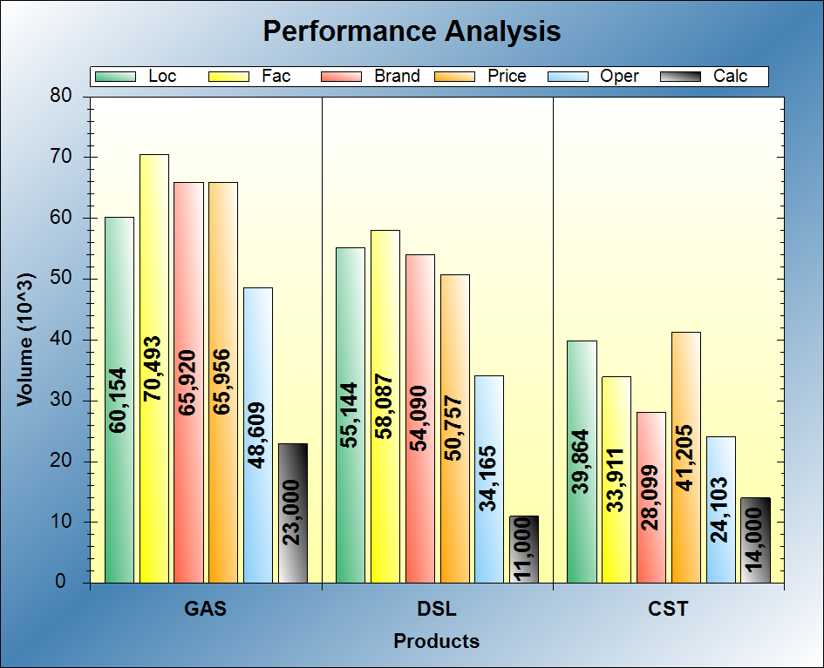
Identification of operational opportunities
Gasoline Evaluation:
  Excellent location
  Facilities better than immediate trade area
  However, operational practices show evidence of a well below average performance
Recommendation:
  Operational coaching or substitute operator

Slide 6
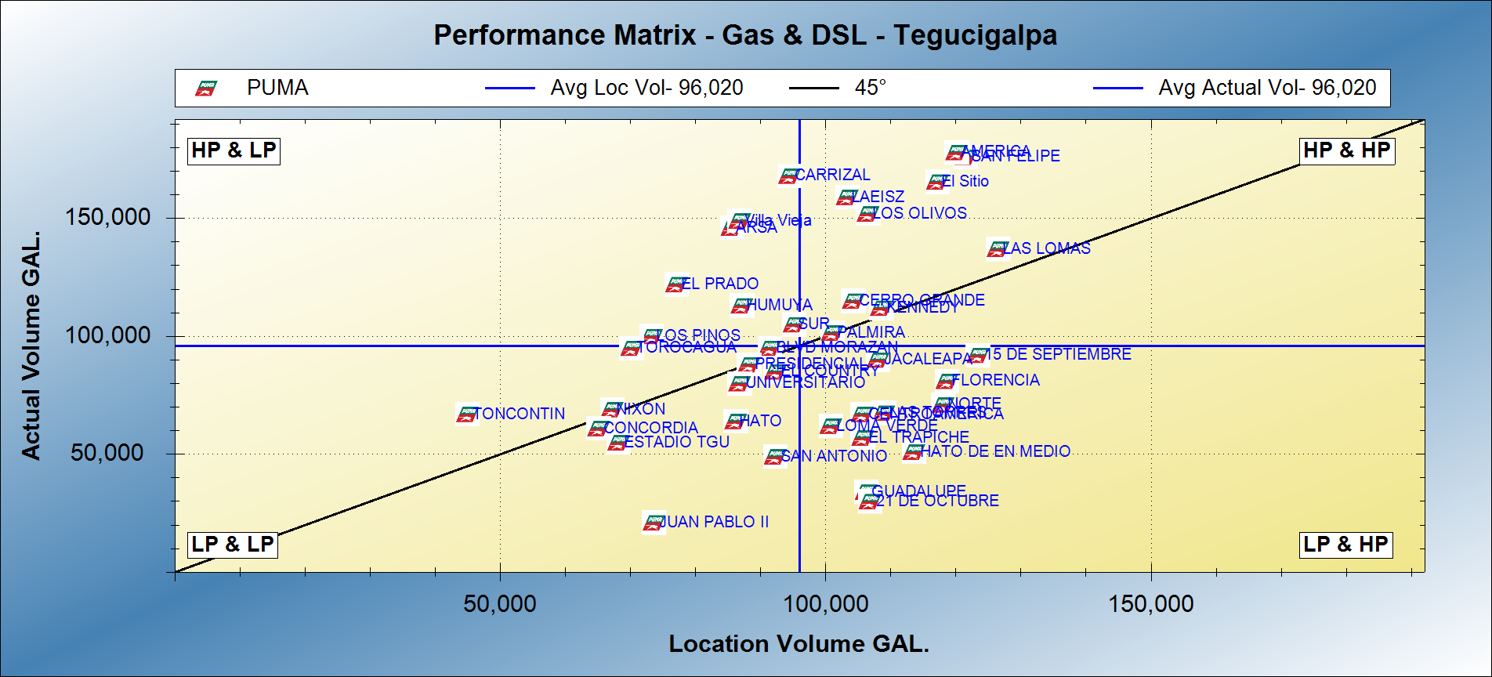
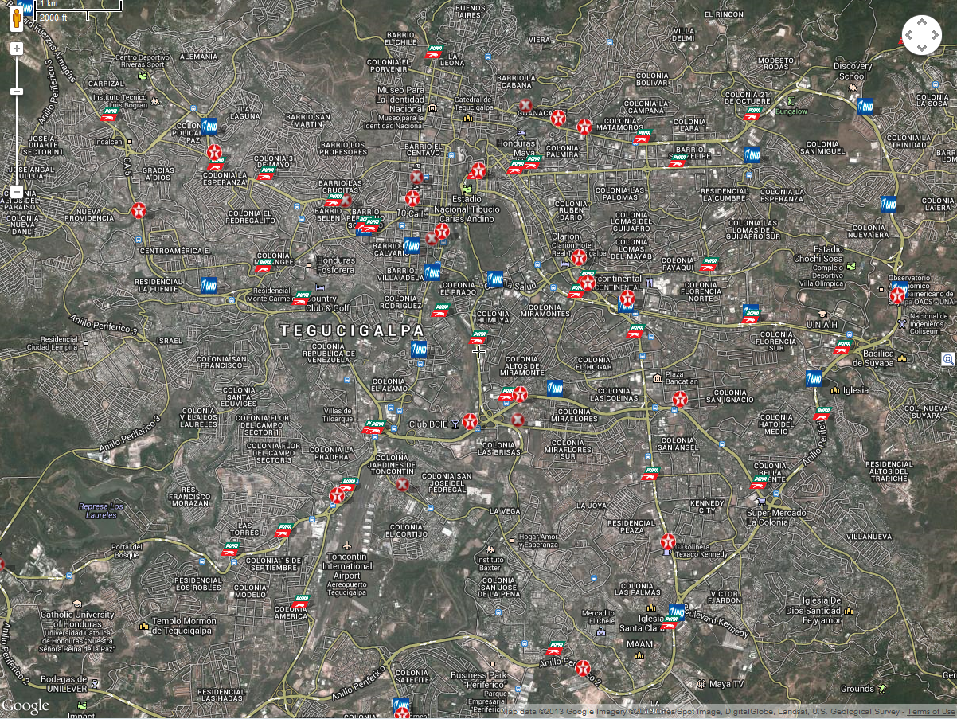
Provides tools for Network optimization
Good operators in poor locations
Stars
Divestment candidates
Low performers but high potential

Slide 7
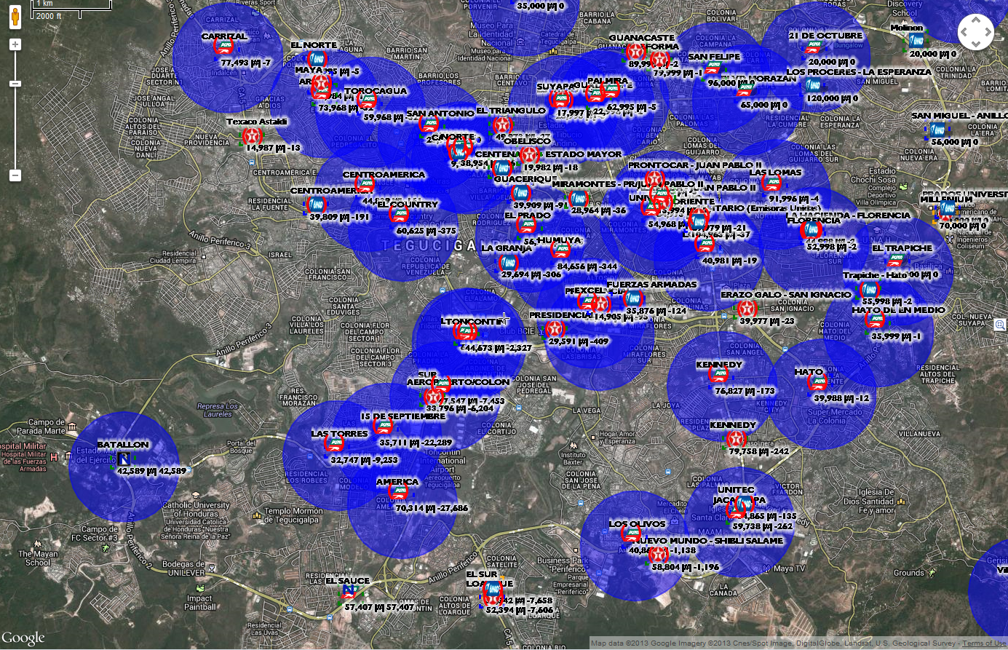
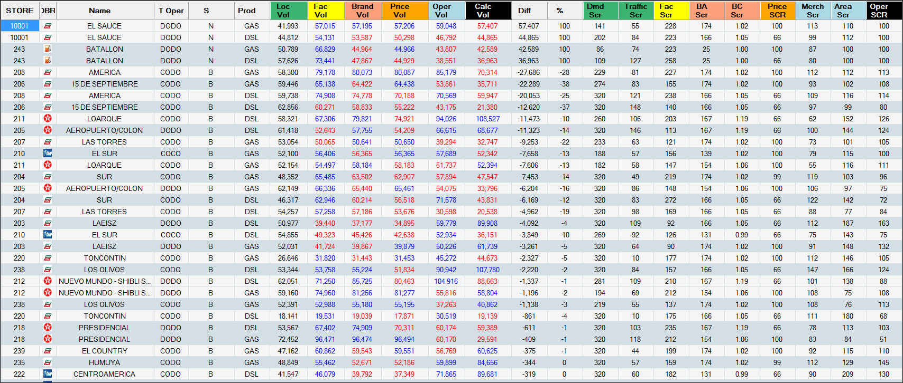
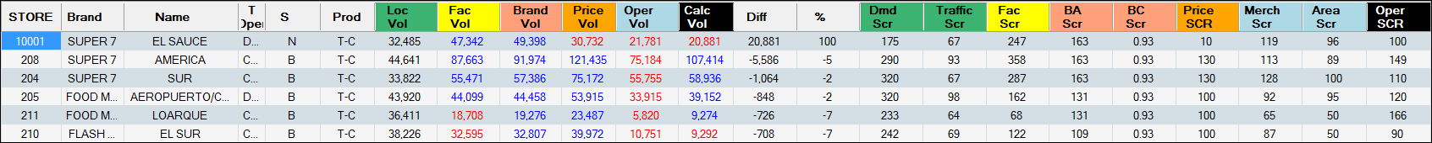
Proactive search of New Locations
How much volume will it sell?
Is it a good location?
Where will the volume come from?
How much is cannibalized from other Puma stations?
How about the C-Store performance?
Notes:
Batallon was closed. We opened it as part of the tactic.

Slide 8
Network Planning Process
Integrated Plan
Economics & Approval
Individual site strategies
Market Analysis/ Market Objectives
Implementation
Monitoring
Network plans help target capital toward risk-managed investments and
position a brand’s network to withstand competitive pressures
and fluctuations in consumer behavior.

