Slide 1
bravo consulting group, Inc.
Petroleum and Convenience Retail Consulting Solutions
for
Network Planning and Price Optimization

Slide 2
Description
BCG is an consulting company that provides personalized and customized consulting services and products to the Retail Petroleum and Convenience Store Industry
Network Planning Models
Price optimization
Market Analyzer
Started Operations in 2008
Currently operating in 9 Countries

Slide 3
Mayor Client base
Terpel
Colombia, Panama, Chile
Seicomart
Japan
Puma Energy
Honduras, Nicaragua
LATS
Honduras

Slide 4
Worldwide Planner databases
Colombia – over 16 Cities
Panama - Country
Santiago, Chile
Puerto Rico – Whole Island
Santo Domingo, Dominican Republic
Hokkaido, Japan – Whole State
Ibaraki, Japan
Honduras - Country
Nicaragua - Country

Slide 5
Network planner
Mathematical Model that uses Spatial Interaction and various other modeling techniques to forecast virtually all retail changes
Proven worldwide in more than 20 studies
Multiple studies and model performance audits in the following markets or countries
Colombia
Hokkaido
Ibaraki
Panama

Slide 6
main benefits
Proven Forecasting Model
Developed in a Hybrid (web-windows) environment to provide corporate access and a robust analysis platform
Customized Service
Our products are developed to the specific needs of our clients to each of the geographies they operate
Continuous Client Services support
Ongoing personalized remote assistance to insure “Best of Practices “ implementations

Slide 7
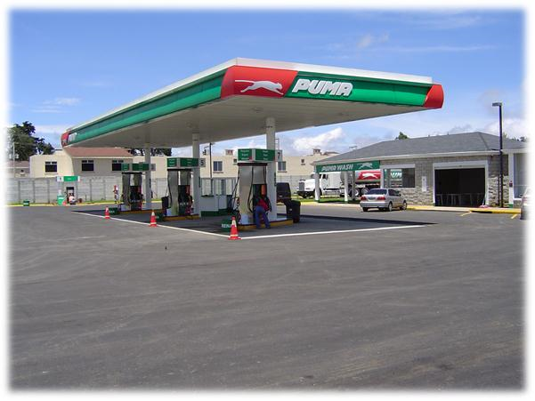
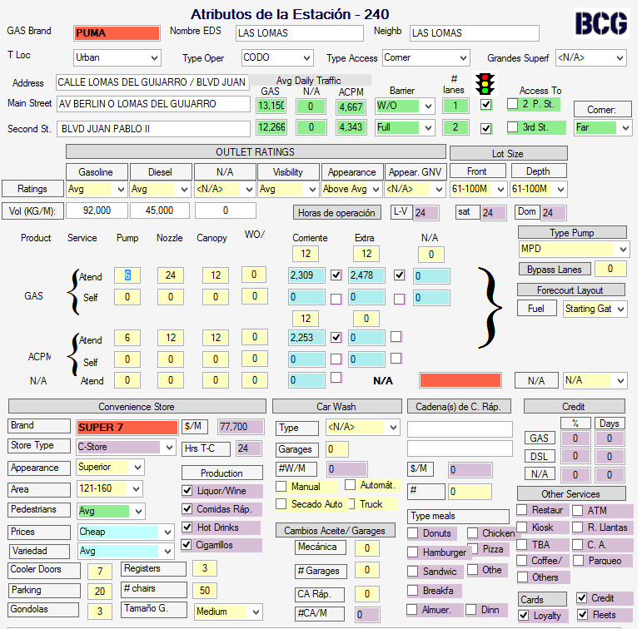
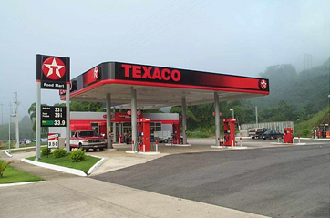
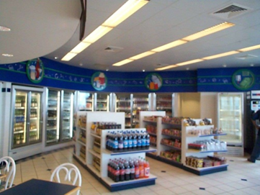
The process begins with a detailed market area study
Survey of all Service Stations
Traffic Counts

Slide 8
A consumer behavior model is then created
Variable Scores describe outlet’s strength and weaknesses
Benchmark Volumes quantify the contribution of the variables in the Retail Value Chain

Slide 9
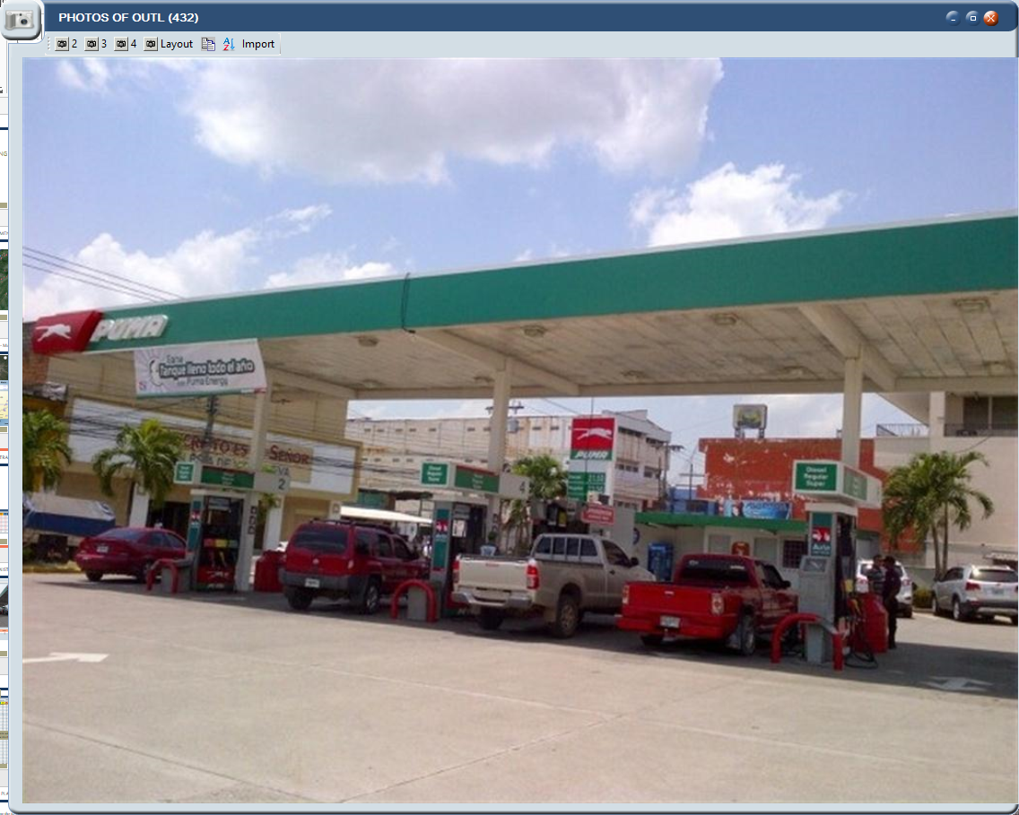
trade area intelligence

Slide 10
Identification of operational opportunities
Gasoline Evaluation:
Excellent location
Facilities better than immediate trade area
However, operational practices show evidence of a well below average performance
Recommendation:
Operational coaching or substitute operator

Slide 11
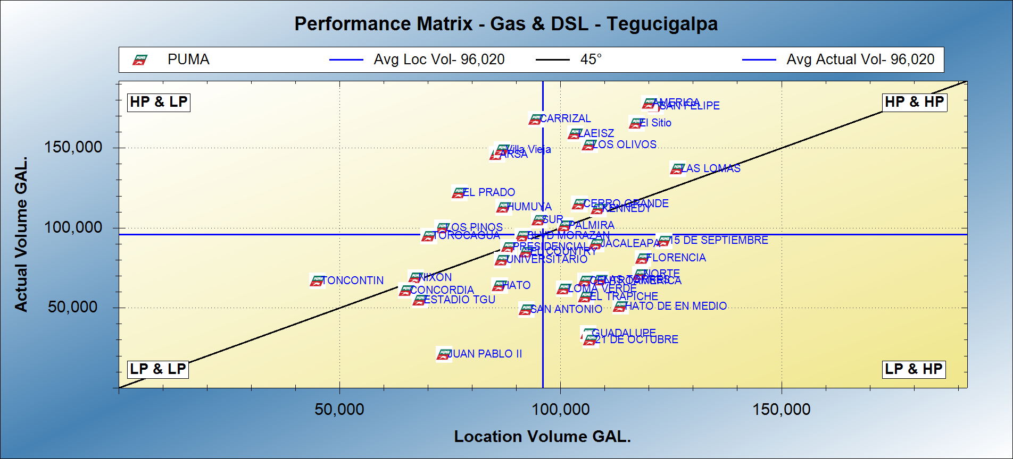
Provides tools for Network optimization
Good operators in poor locations
Stars
Divestment candidates
Low performers but high potential

Slide 12
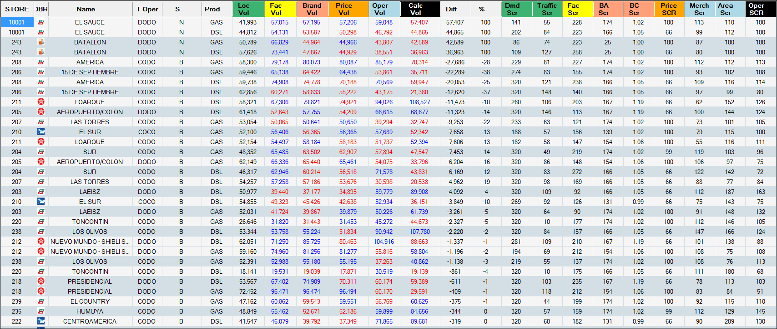
Proactive search of New Locations
How much volume will it sell?
Is it a good location?
Where will the volume come from?
How much is cannibalized from other Client stations?
How about the C-Store performance?
Notes:
Batallon was closed. We opened it as part of the tactic.

Slide 13
Network Planning Process
Integrated Plan
Economics & Approval
Individual site strategies
Market Analysis/ Market Objectives
Implementation
Monitoring

