Slide 1

a proactive process to identify the opportunities that will bring the highest return to puma
Network plan El Salvador 2017
By
Bravo Consulting Group
for

Slide 2
Network Planning Process
Integrated Plan
Economics & Approval
Individual strategies
Market Study / Objectives
Implementation
Monitoring/ Audits
# NTI’s, Budget
PUMA Net. Optimization
Flag Switches
New Site Search
Competitive Actions
Network plans help target capital toward risk-managed investments and
position a brand’s network to withstand competitive pressures
and fluctuations in consumer behavior
Year +1
Year +2
Do nothing
Conservative
Aggressive

Slide 3
A Network plan projected to FY 2019
Was developed following the steps indicated below:
    Market Analysis
    Puma objectives were identified.
    Site-by-site analysis of all Puma stations.
      A strategy was developed for each Puma site.
    Using Puma’s local knowledge, and based on competitor trends and positioning, competitor actions and reactions were anticipated.
    Integrated cases were developed created
      Update + work in progress
      Update + Work in progress + Puma Optimization

Slide 4
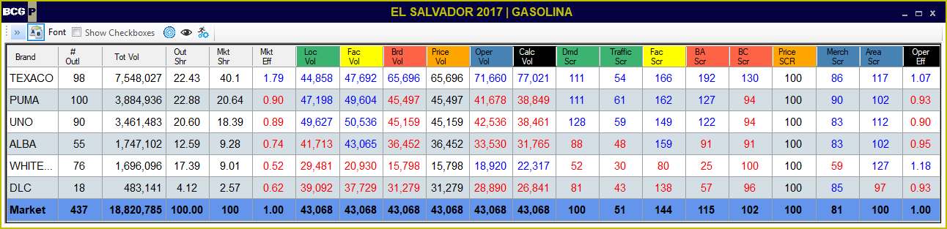
Market Analysis – gasoline 2017
Puma
  Above average locations & Facilities
  Brand contribution below average
Texaco
  Market Leader
  Excellent Brand Contribution
Uno Petrol
  Poor market effectiveness
  Negative brand contribution

Slide 5
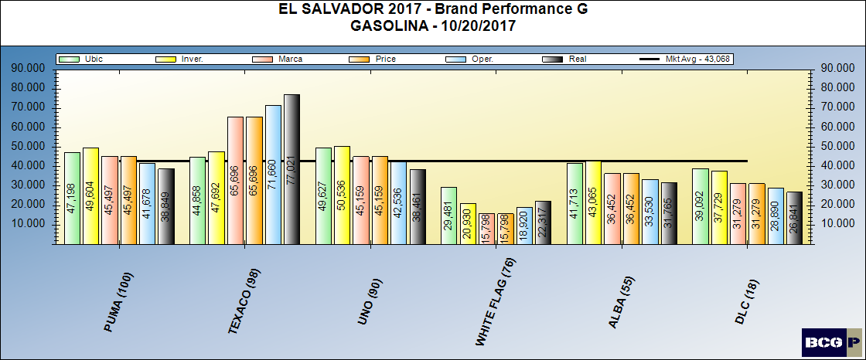
Market performance gasoline 2017

Slide 6
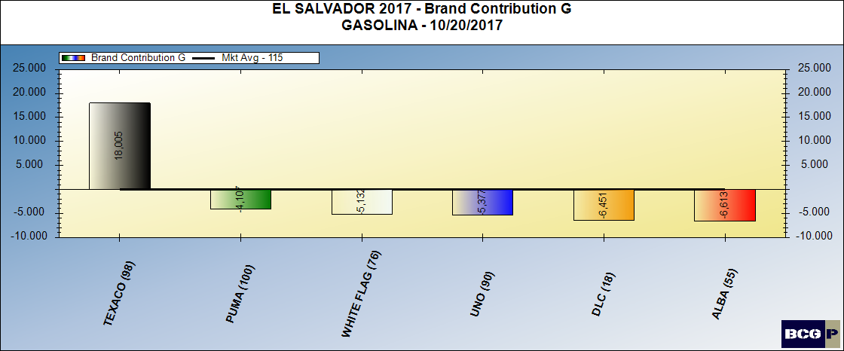
Brand contribution - gasoline 2017

Slide 7
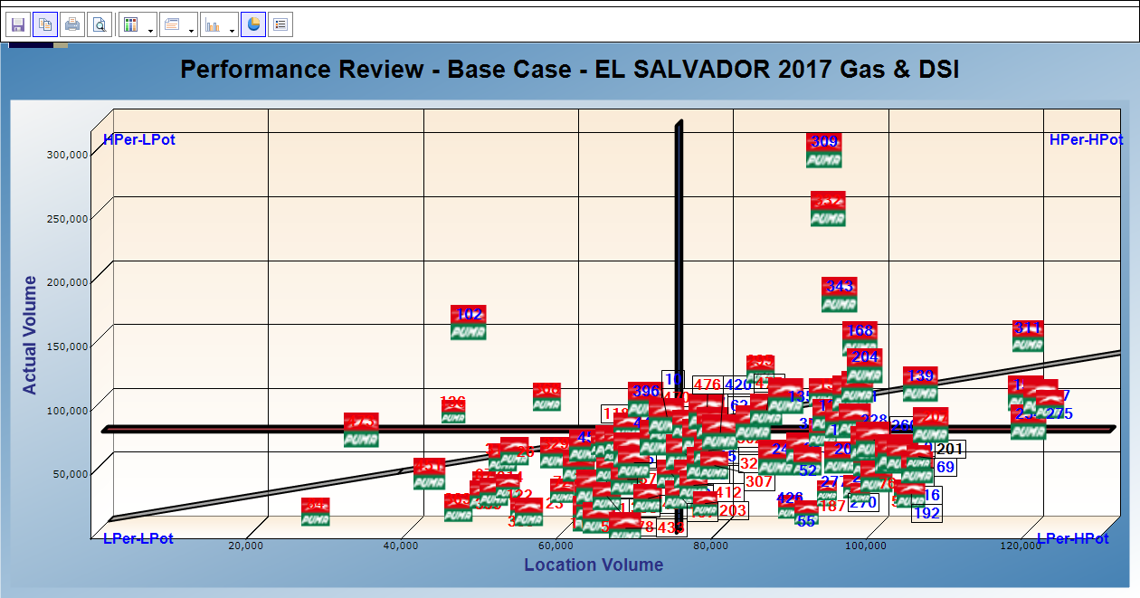
Quadrant Analysis – Puma – GAS & DSL

Slide 8
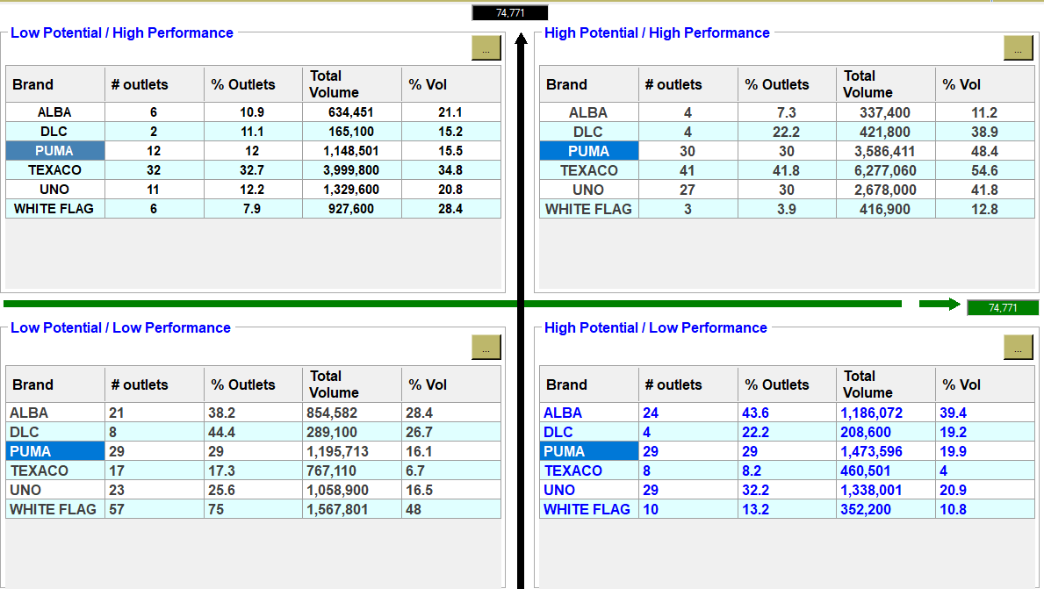
Quad analysis by brand

Slide 9
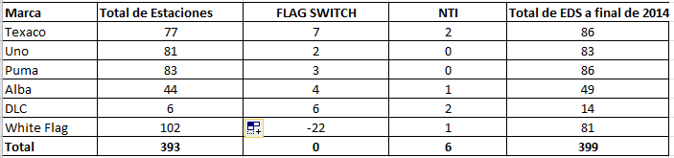
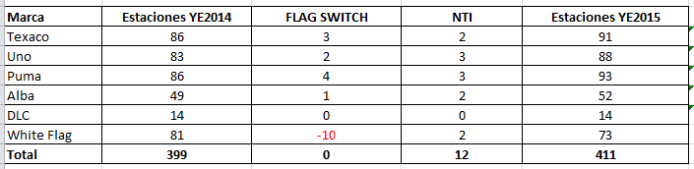
Market Investment trend
2014
2015

Slide 10
Market Investment trend
2018
2019
2020

Slide 11
PUMA 2019 Market Objectives
  Identify and improve operational issues
    Individual dealer actions
  Improve Brand Value
    Consistency of operations in the Network
    Continue Brand Awareness program
  Improve market effectiveness at least to 1.10
  Maintain Network Facilities
    Minor improvements
    Implement Service Station wash/maintenance program
  Build 5 New Sites

Slide 12
San Salvador - new site search (2015)

Slide 13
Santa ana NSS

Slide 14
San Miguel NSS

Slide 15
NTI’s individual tactics (2015)

Slide 16
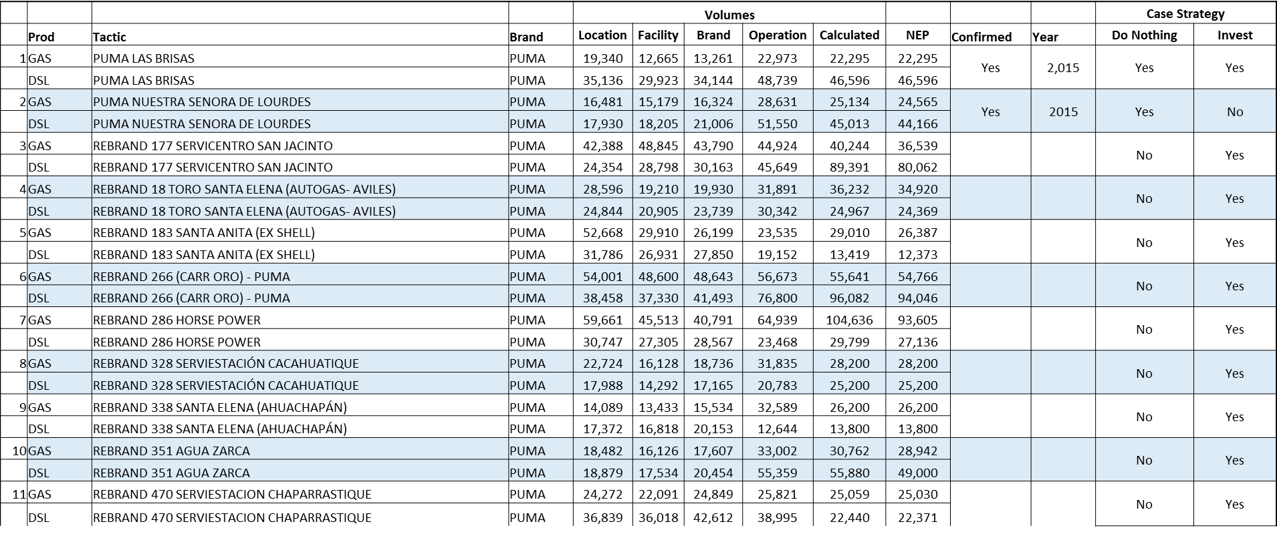
Puma Flag Switches (2015)

Slide 17
Texaco Flag switches (2015)

Slide 18
UNO PETROL, DLC & Alba flag switches (2015)

Slide 19
Integrated Strategies
Once all individual tactics were developed and quality controlled, two integrated strategies were generated to evaluate the net effect of
Puma’s strategy in El Salvador:
  Do-Nothing Case:
    Competition executes the anticipated actions indicated in the individual tactics summary
    Puma does not invest in new builds or major rehabs. Investment is limited to already committed actions
    Puma considers rationalization of the network.
  Investment Case:
    Competition executes the anticipated actions indicated in the individual tactics summary
    Takes into account all actions indicated in the individual tactics
    Considers five Puma New Builds
    Assumes Puma rehabs San Bernardo, Gran Tax.

Slide 20
Outlet review & tactic summary –
TM: Carlos menjivar (2015)

Slide 21
Outlet review & Tactic summary – Ernesto Miranda

Slide 22
Outlet review & Tactic summary – Mario serrano

Slide 23
Outlet review & Tactic summary – Mario diaz

Slide 24
2018 PROJECTS

Slide 25
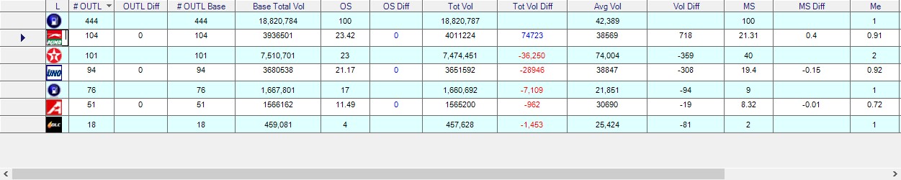
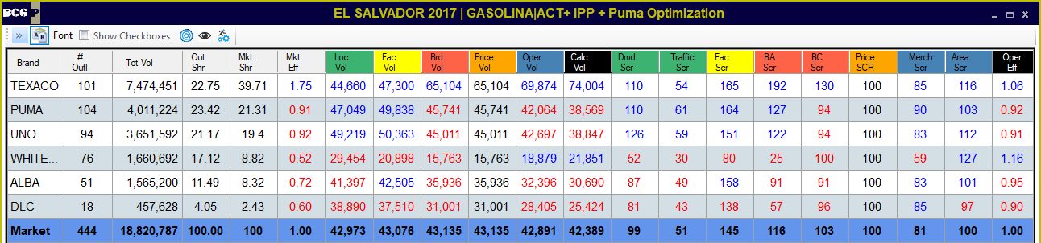
Integrated strategy I – update & known actions
GASOLINE
Changes vs Base
Results

Slide 26
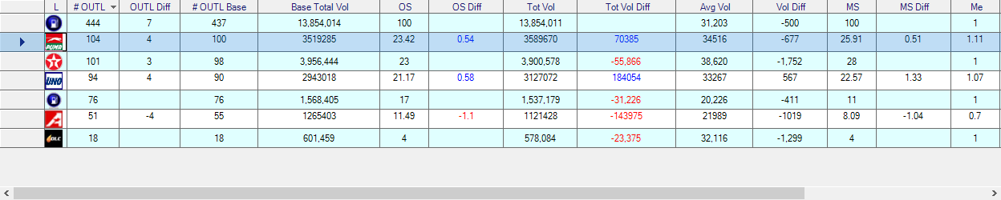
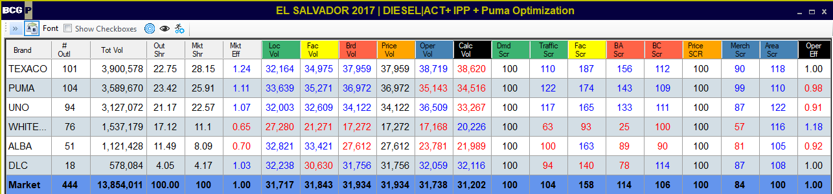
Integrated strategy I – update & known actions
DIESEL
Changes vs Base
Results

