Slide 1

Puma Energy - Network Plan
Panama
TM: Mayisiris Perez
Investments and Action Plans

Slide 2
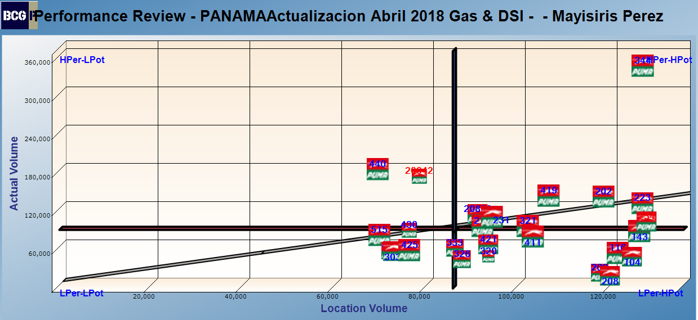
TM: Mayisiris Perez

Slide 3
Mayisiris Perez

Slide 4
Low Potential – Low Performance

Slide 5
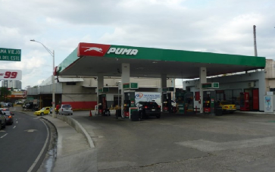
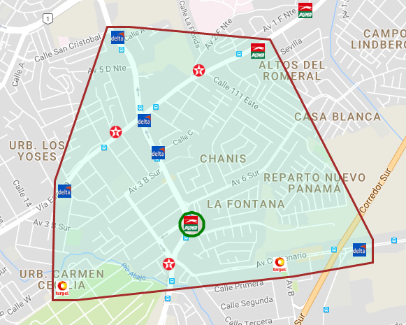
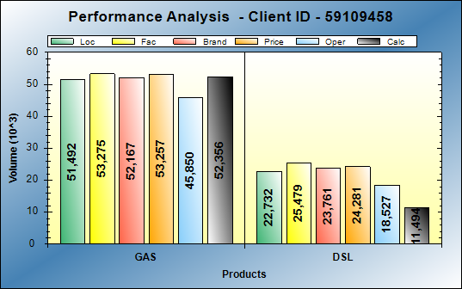
BCG id 303 - PUMA chanis
BCG ID | Loc Vol | Real Vol | Performance | Potential
303 | 74,224 | 63,836 | LOW PERF | LOW POT
Gasoline: Performing at good level
Diesel: Operational opportunities of 11KG
Action Plan:
Change from 2 pumps to 4 products to put Super

Slide 6
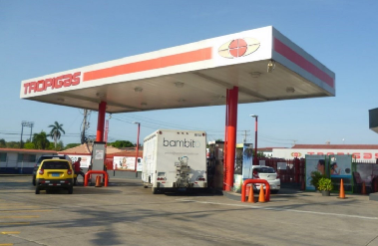
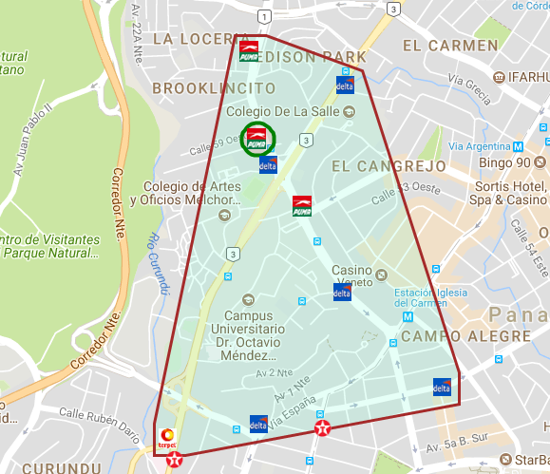
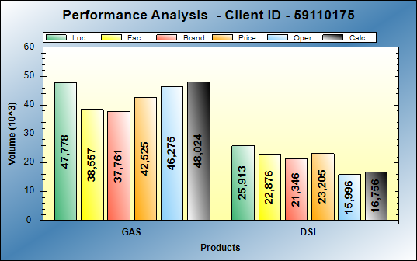
BCG id 412 - PUMA LOCERIA TUMBA MUERTO
BCG ID | Loc Vol | Real Vol | Performance | Potential
412 | 73,691 | 64,780 | LOW PERF | LOW POT
Gasoline: Performing at good level
Diesel: Operational opportunities of 9KG
Action Plan:
None

Slide 7
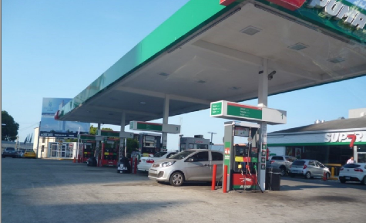
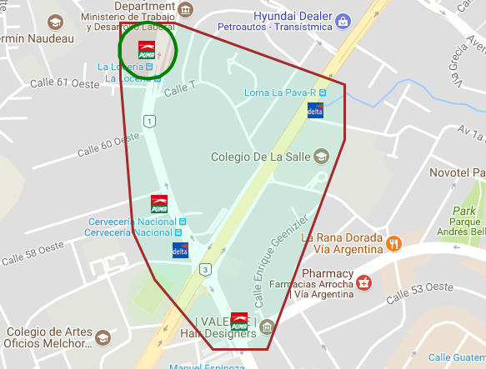
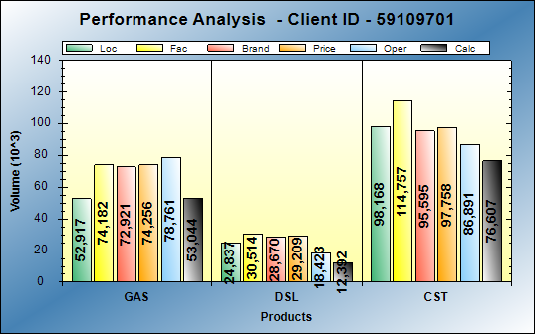
BCG id 425 - PUMA LOCERIA
BCG ID | Loc Vol | Real Vol | Performance | Potential
425 | 77,754 | 65,143 | LOW PERF | LOW POT
Gasoline: Performing at expect level
Diesel: Operational opportunities of 12KG
Action Plan:
Facelift
Change to led lights
Alignment in prices

Slide 8
Low Potential – High Performance

Slide 9
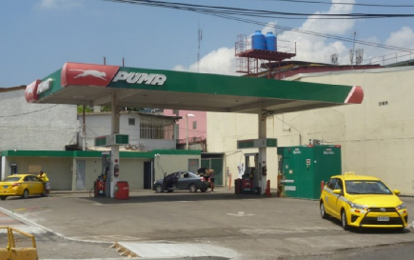
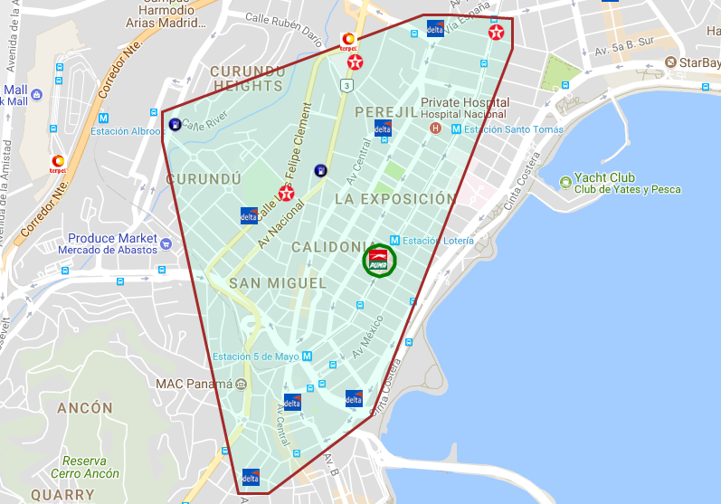
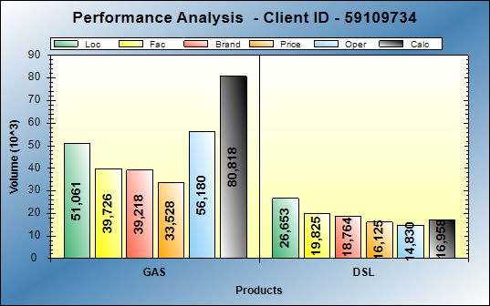
BCG Id 430 – puma ATLAS
BCG ID | Loc Vol | Real Vol | Performance | Potential
430 | 77,714 | 96,916 | HI PERF | LOW POT
Gasoline: Excellent operations
Diesel: Operational opportunities of 10KG
Action Plan:
Increase in MOGAS:
  Increase of employees during peak hours
  Focus on service and image consistency
DIESEL:
    Get discount accounts in local area.

Slide 10
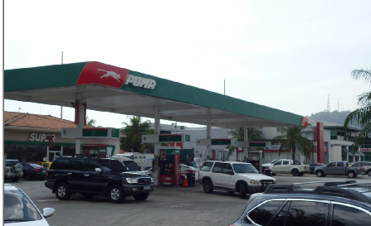
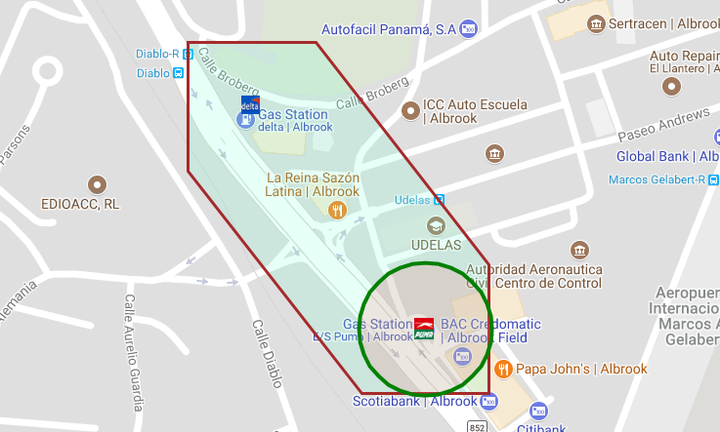
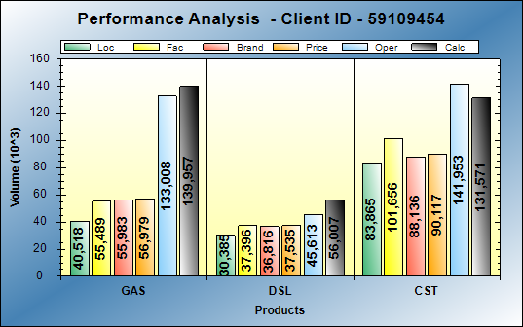
BCG Id 440 - PUMA ALBROOK
BCG ID | Loc Vol | Real Vol | Performance | Potential
440 | 70,903 | 192,299 | HI PERF | LOW POT
Gasoline: Excellent operations
Diesel: Excellent operations
Action Plan:
Facelift
Better identification of high flow pump
maintain consistency in service
    Get discount accounts in local area.

Slide 11
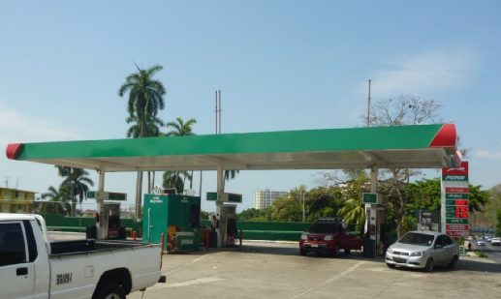
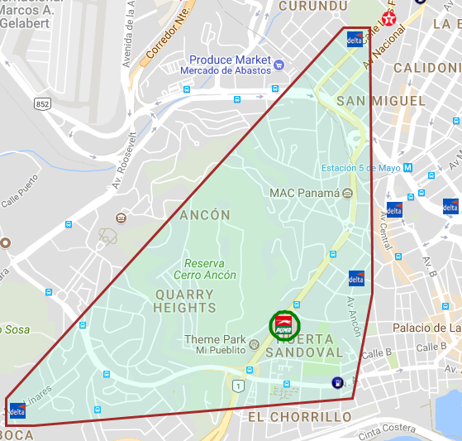
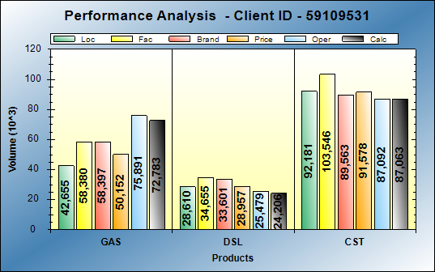
BCG Id 515 – puma LAS AMERICAS
BCG ID | Loc Vol | Real Vol | Performance | Potential
515 | 71,265 | 89,029 | HI PERF | LOW POT
Gasoline: Excellent operations
Diesel: Operational opportunities of 4KG
Action Plan:
    Change of operator
    Exceptional service
    Get discount accounts in local area.

Slide 12
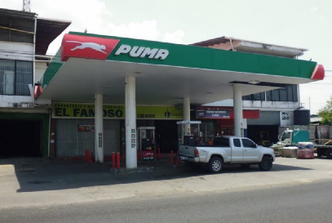
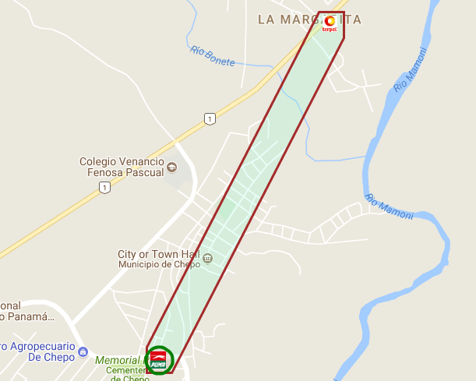
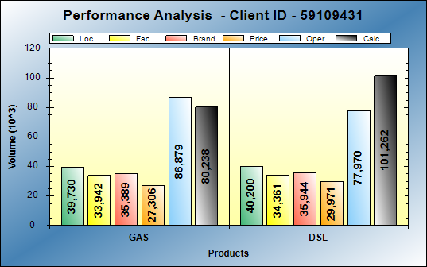
BCG Id 20042 – puma CHEPO KATEMAN
BCG ID | Loc Vol | Real Vol | Performance | Potential
20042 | 74,638 | 106,862 | HI PERF | LOW POT
Gasoline: Excellent operations
Diesel: Excellent operations
Action Plan:
Renew lease
Offer of a CODO station to sign before the expiration of the current contract

Slide 13
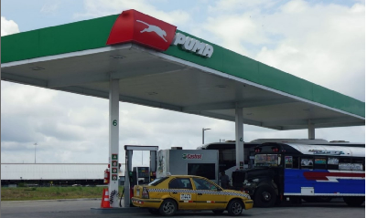
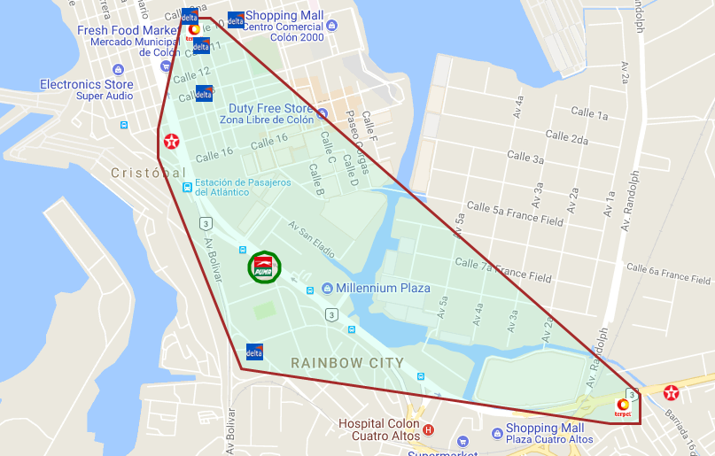
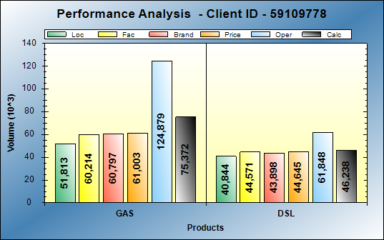
BCG Id 20823 – puma COLON ZONA LIBRE
BCG ID | Loc Vol | Real Vol | Performance | Potential
20042 | 74,638 | 181,500 | HI PERF | LOW POT
Gasoline: Excellent operations
Diesel: Excellent operations
Action Plan:
Increase in MOGAS:
  Focus on service and image consistency
DIESEL:
    Get discount accounts in local area.
    Attendants 24 HRS

Slide 14
High Potential – Low Performance

Slide 15
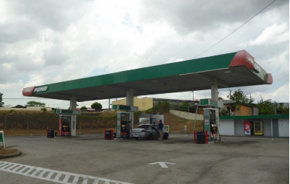
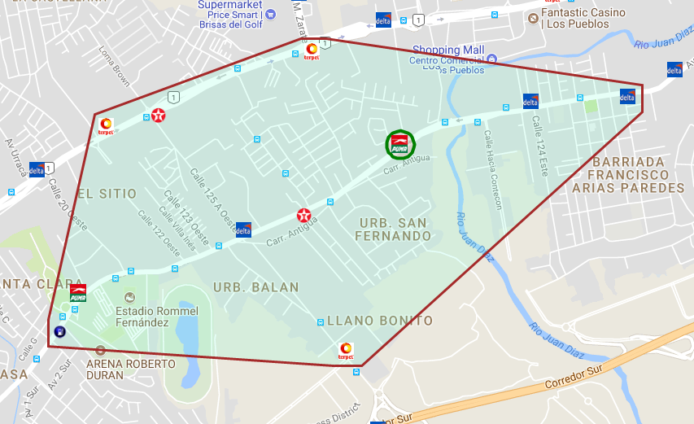
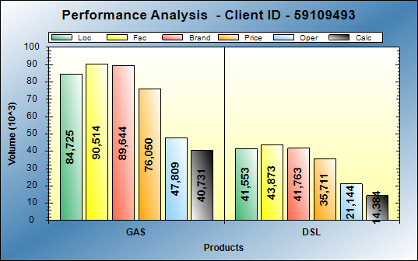
Bcg Id 104 – puma juan diaz
BCG ID | Loc Vol | Real Vol | Performance | Potential
104 | 126,278 | 55,160 | LOW PERF | HI POT
Gasoline: Operational opportunities of 44KG
Diesel: Operational opportunities of 27KG
Action Plan:
Track asphalting

Slide 16
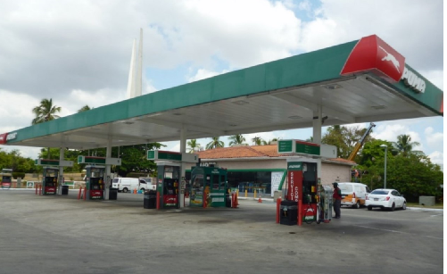
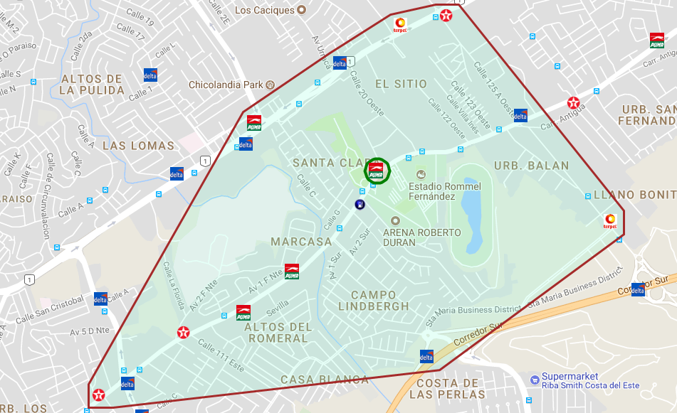
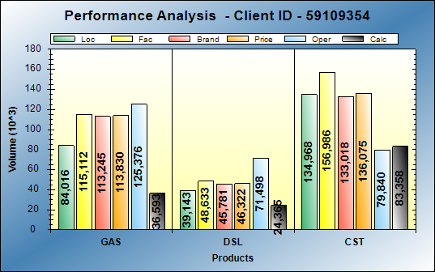
BCG Id 116 - PUMA hipodromo
BCG ID | Loc Vol | Real Vol | Performance | Potential
116 | 123,159 | 60,791 | LOW PERF | HI POT
Gasoline: Operational opportunities of 48KG
Diesel: Operational opportunities of 15KG
Action Plan:
Pipeline new clients
Additional employee

Slide 17
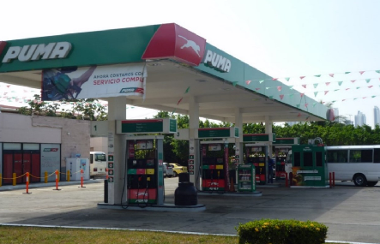
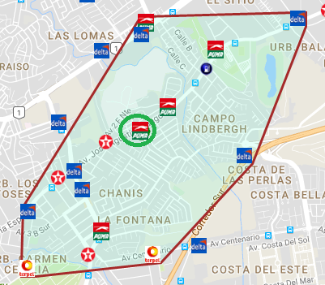
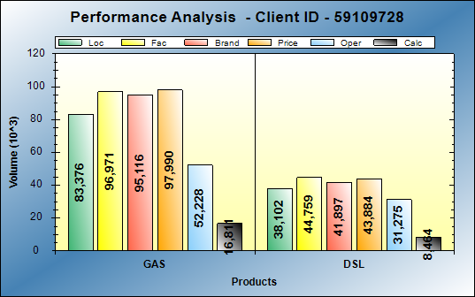
BCG Id 208 – puma independencia
BCG ID | Loc Vol | Real Vol | Performance | Potential
208 | 121,478 | 25,199 | LOW PERF | HI POT
Gasoline: Operational opportunities of 67KG
Diesel: Operational opportunities of 30KG
Action Plan:
Facelift Bathrooms
Additional employee
Get discount accounts in local area

Slide 18
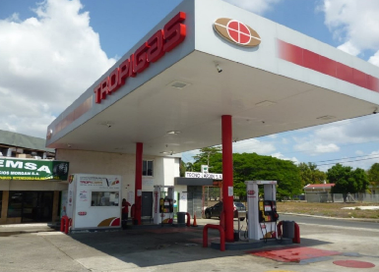
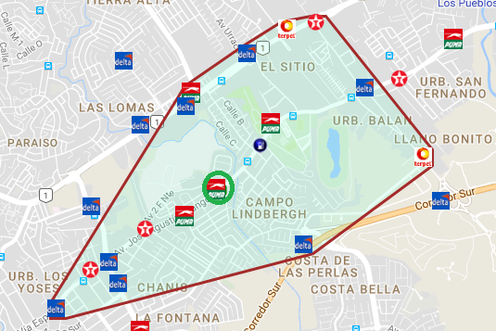
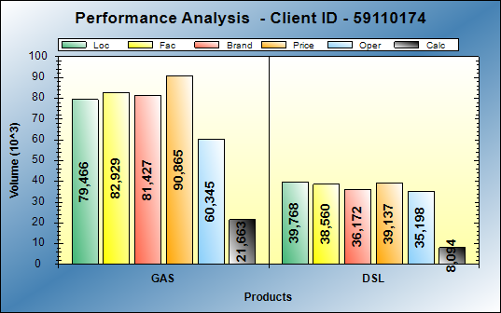
BCG ID 209 - PUMA splash
BCG ID | Loc Vol | Real Vol | Performance | Potential
209 | 119,234 | 29,757 | LOW PERF | HI POT
Gasoline: Operational opportunities of 58KG
Diesel: Operational opportunities of 31KG
Action Plan:
Add dispenser of Regular
Facelift Bathrooms

Slide 19
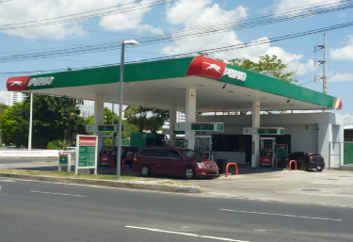
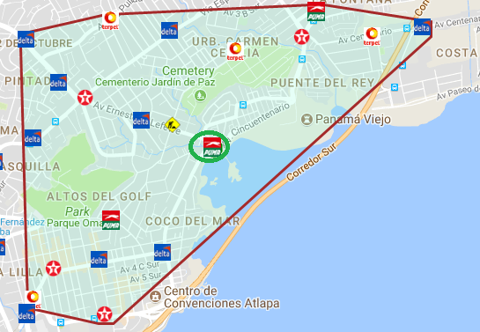
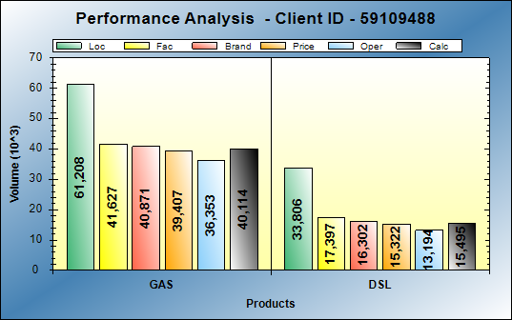
BCG Id 320 - PUMA morelos
BCG ID | Loc Vol | Real Vol | Performance | Potential
320 | 95,014 | 55,607 | LOW PERF | HI POT
Gasoline: Operational opportunities of 21KG
Diesel: Operational opportunities of 18KG
Action Plan:
Build Super 7
Change of operator
Get discount accounts in local area
  Focus on service consistency

Slide 20
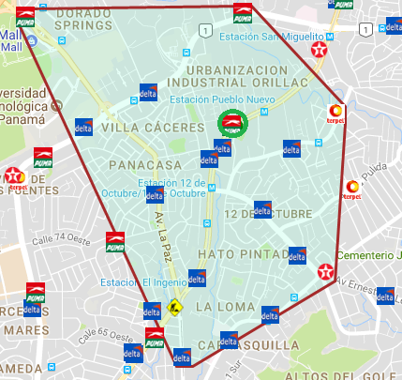
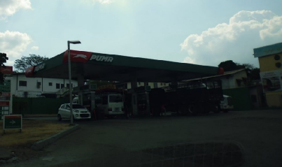
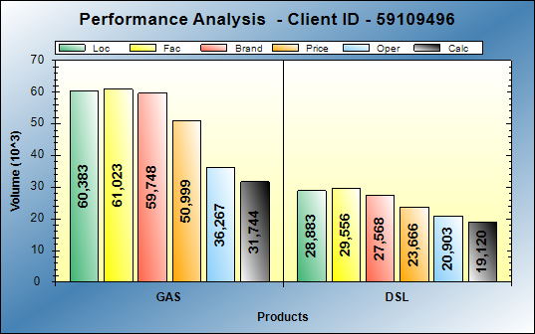
BCG Id 326 – puma via bolivar
BCG ID | Loc Vol | Real Vol | Performance | Potential
326 | 89,266 | 50,871 | LOW PERF | HI POT
Gasoline: Operational opportunities of 29KG
Diesel: Operational opportunities of 9KG
Action Plan:
Renovate lease 2019
Face lift
New price sign

Slide 21
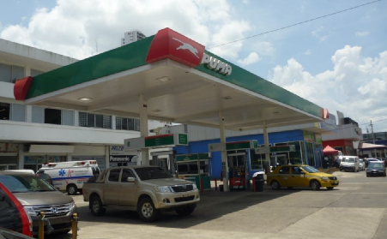
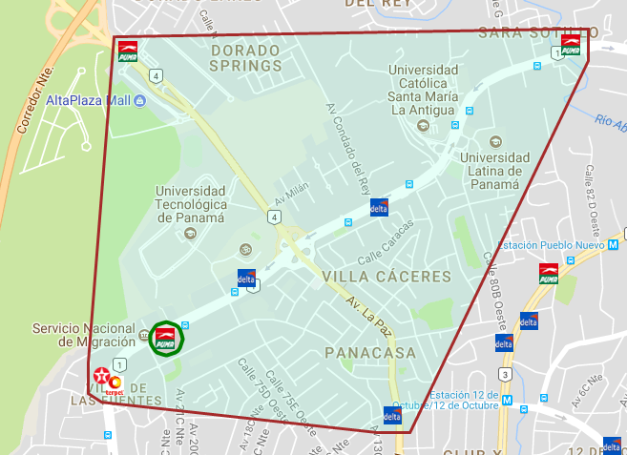
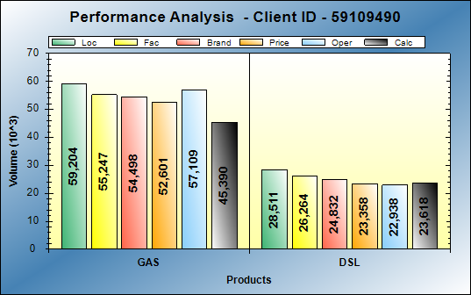
BCG Id 333 – puma villa de la fuente
BCG ID | Loc Vol | Real Vol | Performance | Potential
333 | 87,715 | 68,971 | LOW PERF | HI POT
Gasoline: Operational opportunities of 14KG
Diesel: Operational opportunities of 3KG
Action Plan:
Better access to station
Asphalt all the station

Slide 22
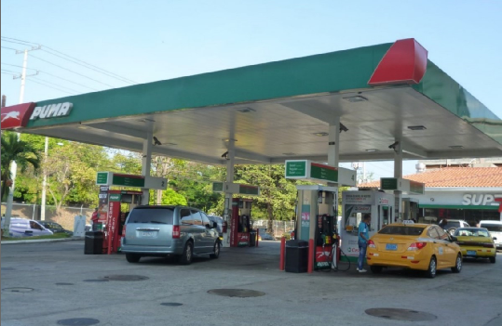
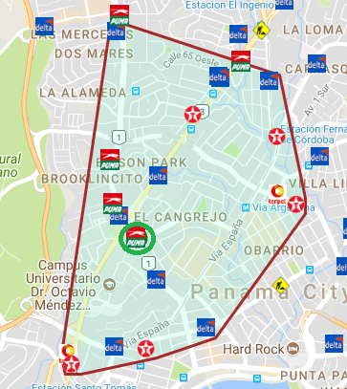

BCG Id 411 – puma via argentina
BCG ID | Loc Vol | Real Vol | Performance | Potential
411 | 104,697 | 86,609 | LOW PERF | HI POT
Gasoline: Performing at expect level
Diesel: Operational opportunities of 19KG
Action Plan:
Installation of four dispensers with the three products.
Canopy in Fuel Service Pump.
Exceptional service.

Slide 23
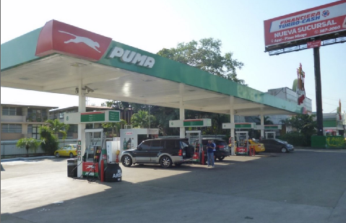
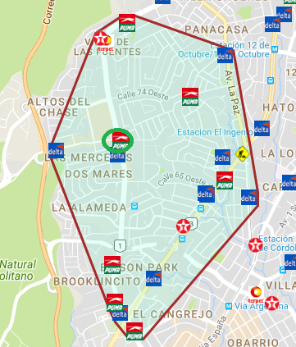

BCG Id 421 – puma el dorado
BCG ID | Loc Vol | Real Vol | Performance | Potential
421 | 94,989 | 74,395 | LOW PERF | HI POT
Gasoline: Operational opportunities of 6KG
Diesel: Operational opportunities of 14KG
Action Plan:
Consistency in service (requirement, commitment of employees)
Search for discount clients
Pipeline of new customers

Slide 24
High Potential – High Performance

Slide 25



BCG Id 143 – puma brisas del golf
BCG ID | Loc Vol | Real Vol | Performance | Potential
143 | 127,885 | 94,995 | HI PERF | HI POT
Gasoline: Operational opportunities of 17KG
Diesel: Operational opportunities of 16KG
Action Plan:
Get discount accounts in local area
Win back Alcaldía Pto. Libertad

Slide 26



BCG Id 202 – puma el bosque
BCG ID | Loc Vol | Real Vol | Performance | Potential
202 | 120,081 | 149,408 | HI PERF | HI POT
Gasoline: Performing at expect level
Diesel: Performing at expect level
Action Plan:
Solve operational problems (cut-shift process in low hours)
Sufficient staff in peak hours
consistency in service and image
Get discount accounts in local area

Slide 27



BCG Id 213 – puma milla 1
BCG ID | Loc Vol | Real Vol | Performance | Potential
213 | 93,694 | 103,180 | HI PERF | HI POT
Gasoline: Operational opportunities of 10KG
Diesel: Excellent operations
Action Plan:
Change to a price digital sign
Promote the lube center
Get discount accounts in local area

Slide 28



BCG Id 223 – puma via tocumen
BCG ID | Loc Vol | Real Vol | Performance | Potential
223 | 128,559 | 139,017 | HI PERF | HI POT
Gasoline: Excellent operations
Diesel: Performing at expect level
Action Plan:
Take back captain of track service in addition to self-service agents
MOGAS:
Focus on consistency of service on the track.
DIESEL
Continue adding discount customers (carriers, taxis, etc).
Maintain an excellent image in season

Slide 29



BCG Id 231 – puma milla 8
BCG ID | Loc Vol | Real Vol | Performance | Potential
231 | 95,780 | 117,730 | HI PERF | HI POT
Gasoline: Excellent operations
Diesel: Performing at expect level
Action Plan:
Change of pump of 2 products (MOGAS), by used pump of 3 products that allows to serve diesel in said position.
Consistency in the service
Get discount accounts in local area
Excellent image

Slide 30



BCG Id 234 – puma las cumbres
BCG ID | Loc Vol | Real Vol | Performance | Potential
234 | 129,456 | 110,000 | HI PERF | HI POT
Gasoline: Operational opportunities of 17KG
Diesel: Operational opportunities of 3KG
Action Plan:
Consistency in the service
Get discount accounts in local area
Build lube center
Add more staff on track attendants 24 HRS

Slide 31



BCG Id 321 – puma via porras
BCG ID | Loc Vol | Real Vol | Performance | Potential
321 | 103,621 | 103,023 | HI PERF | HI POT
Gasoline: Excellent operations
Diesel: Operational opportunities of 17KG
Action Plan:
Renew contract with Borja Letona.
Change of pumps.
Track asphalt.
Price strategy.
Clients Discounts.
Exceptional service

Slide 32



BCG Id 344 – puma centenial
BCG ID | Loc Vol | Real Vol | Performance | Potential
344 | 128,645 | 354,393 | HI PERF | HI POT
Gasoline: Excellent operations
Diesel: Excellent operations
Action Plan:
Order Route 44 and Route 1.
Delimit Bombs and Buses to leave spaces in Gasolines.
Consistency in the service

Slide 33



BCG Id 419 – puma curundu
BCG ID | Loc Vol | Real Vol | Performance | Potential
419 | 108,111 | 150,539 | HI PERF | HI POT
Gasoline: Excellent operations
Diesel: Performing at expect level
Action Plan:
Add more staff on track
Change to a price digital sign
Get discount accounts in local area
Consistency in the service

