Slide 1

Puma Energy - Network Plan
NICARAGUA
TM: JAIR VELASQUEZ
Investments and Action Plans

Slide 2
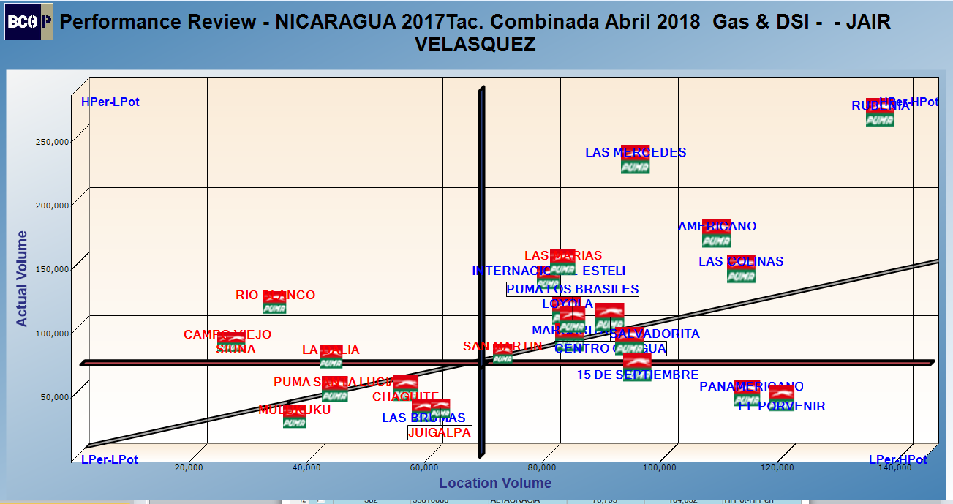
TM: JAIR VELASQUEZ

Slide 3
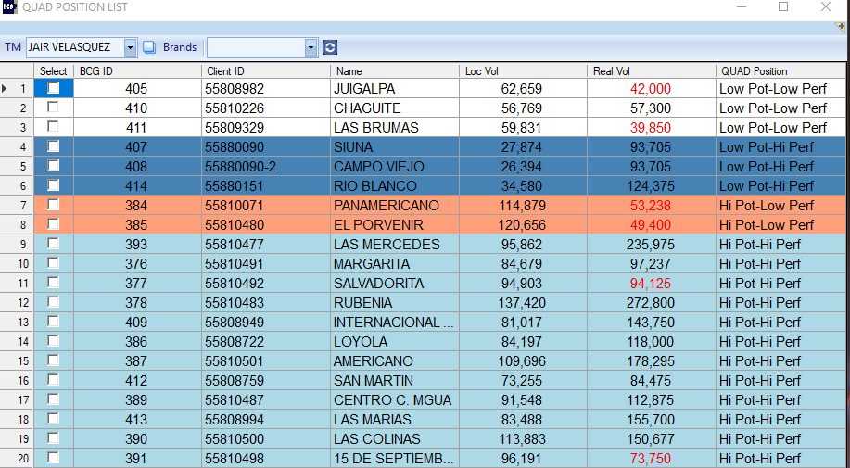
JAIR VELASQUEZ

Slide 4
Low Potential – Low Performance

Slide 5
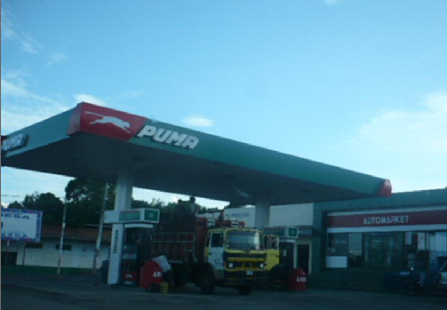
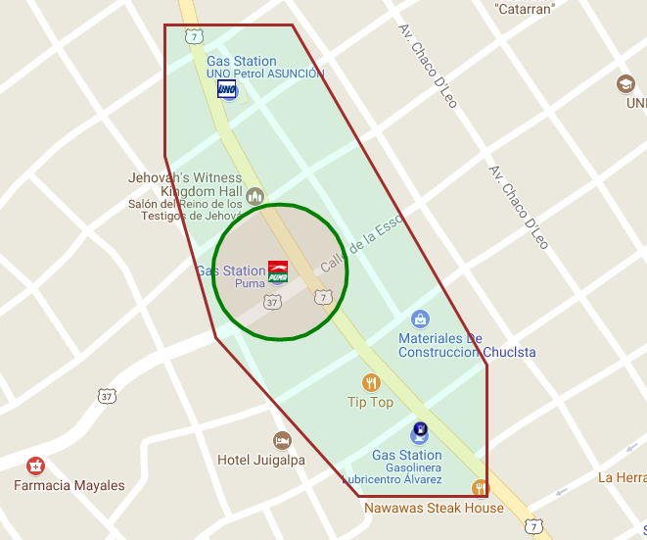
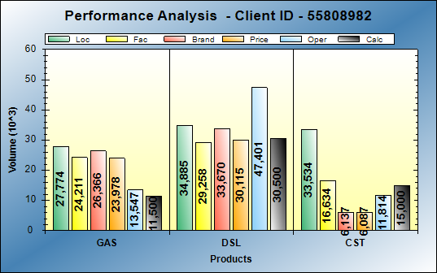
BCG Id 405 – puma juigalpa
BCG ID | Loc Vol | Real Vol | Performance | Potential
405 | 62,659 | 42,000 | LOW PERF | LOW POT
Gasoline: Operational opportunities of 12KG
Diesel: Operational opportunities of 4KG
Action Plan:
Dealer improvement opportunities:
  Greater track supervision to improve Customer Service.
  Increase of capital to offer credit.
Puma improvement opportunities:
  Send a purchase proposal of the station

Slide 6
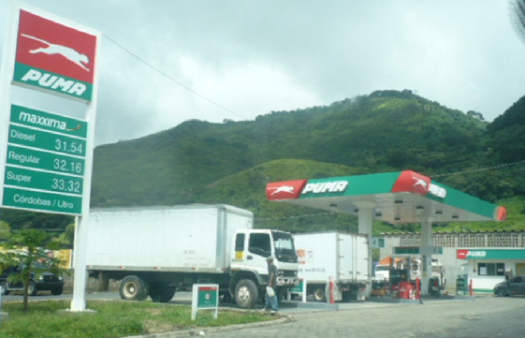
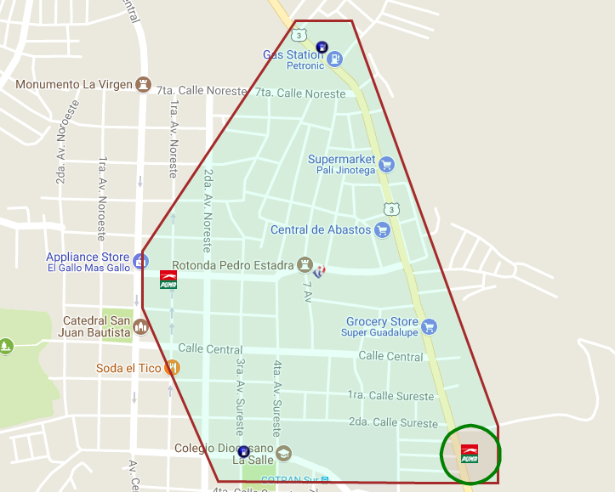
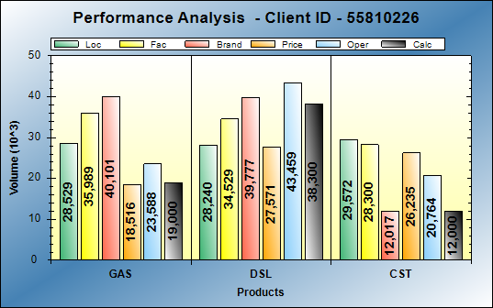
BCG Id 410 – puma chaguite
BCG ID | Loc Vol | Real Vol | Performance | Potential
410 | 56,769 | 57,300 | LOW PERF | LOW POT
Gasoline: Excellent operations
Diesel: Operational opportunities of 9KG
Action Plan:

Slide 7
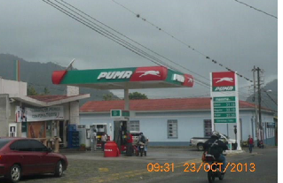
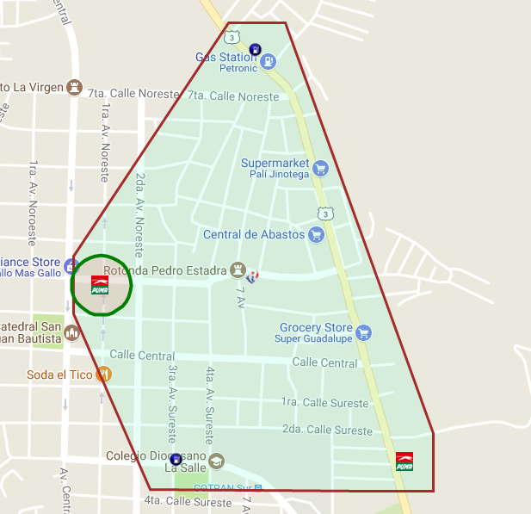
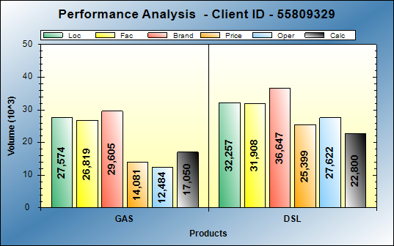
BCG Id 411 – puma las brumas
BCG ID | Loc Vol | Real Vol | Performance | Potential
411 | 59,831 | 39,850 | LOW PERF | LOW POT
Gasoline: Operational opportunities of 10KG
Diesel: Operational opportunities of 10KG
Action Plan:
Dealer improvement opportunities:
  Create a discount strategy for potential customers.
  Create parameters when Puma collaborates with the discount.
  Increase of capital to offer credits.
  Greater track supervision to improve Customer Service.
  Puma improvement opportunities:
  Change of Dealer.
  Create parameters when Puma collaborates with the discount.

Slide 8
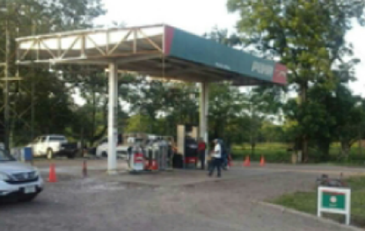
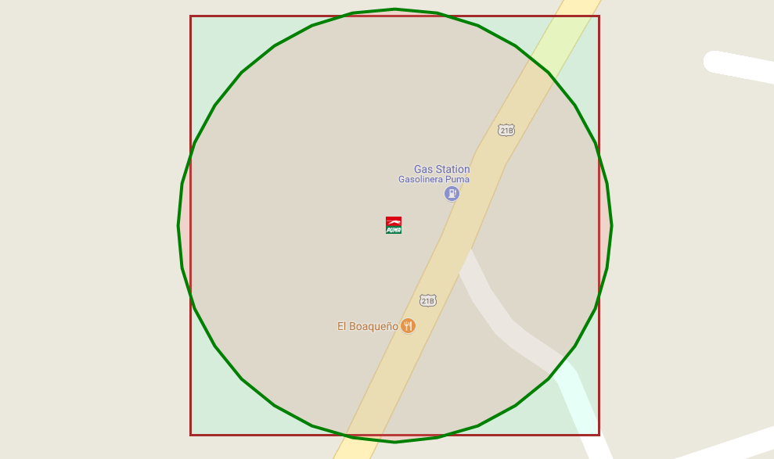
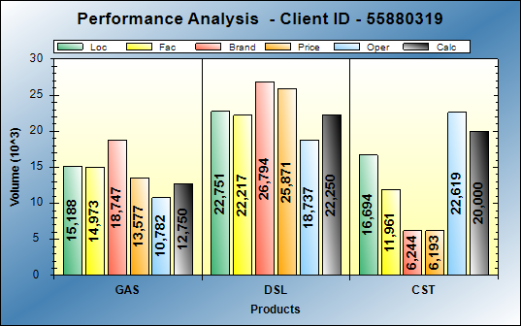
BCG Id 513 – puma mulukuku
BCG ID | Loc Vol | Real Vol | Performance | Potential
513 | 37,939 | 35,000 | LOW PERF | LOW POT
Gasoline: Operational opportunities of 3KG
Diesel: Performing at expect levels
Action Plan:

Slide 9
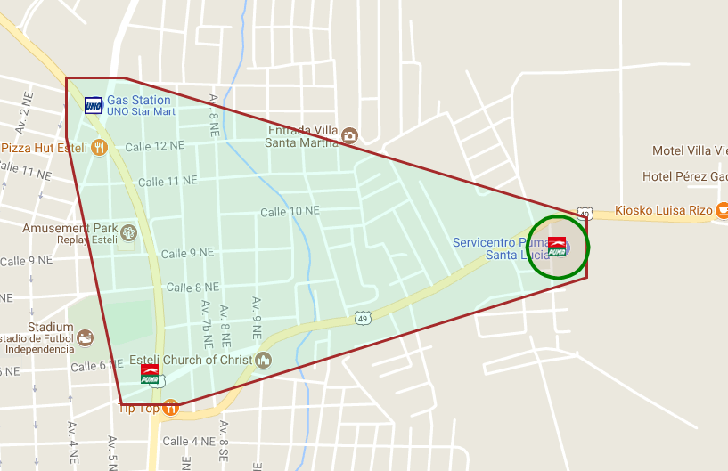
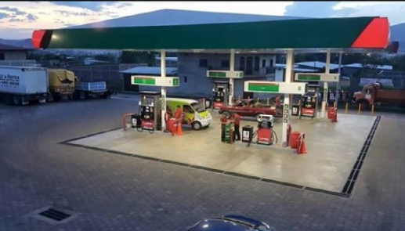
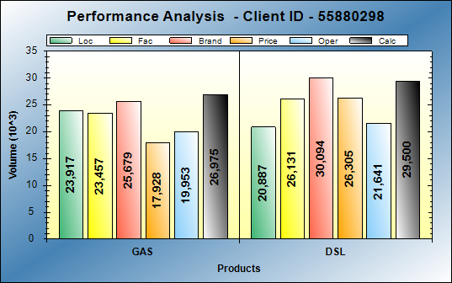
BCG Id 641 – puma santa lucia
BCG ID | Loc Vol | Real Vol | Performance | Potential
641 | 44,804 | 56,475 | LOW PERF | LOW POT
Gasoline: Performing at good levels
Diesel: Performing at good levels
Action Plan:

Slide 10
Low Potential – High Performance

Slide 11
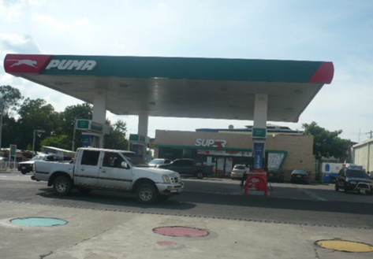
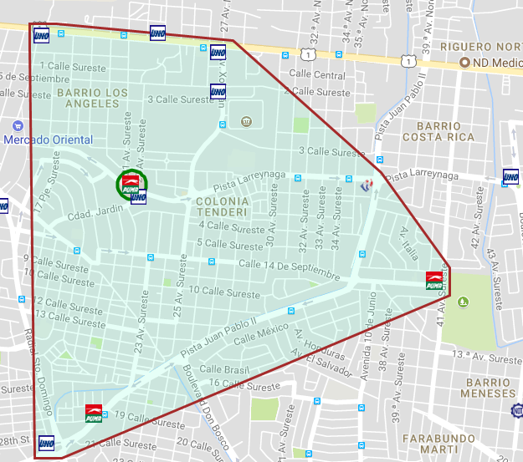
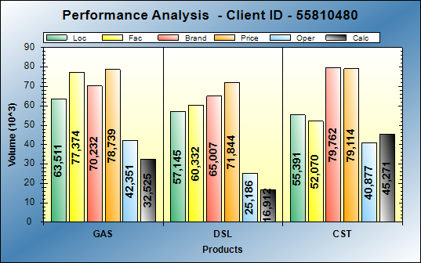
BCG Id 385 – puma EL PORVENIR
BCG ID | Loc Vol | Real Vol | Performance | Potential
385 | 120,656 | 49,400 | LOW PERF | HI POT
Gasoline: Excellent operations
Diesel: Excellent operations
Action Plan:
Dealer improvement opportunities:
  Headcount review.
  Optimized schedule
  Greater supervision in track / shop to improve Customer Service.
  Review opportunities for new potential customers in the area. See what they consume in the competition.

Slide 12
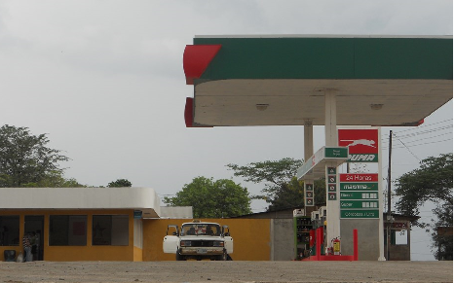
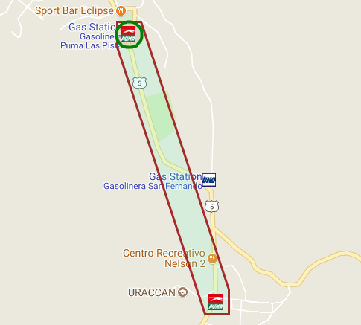
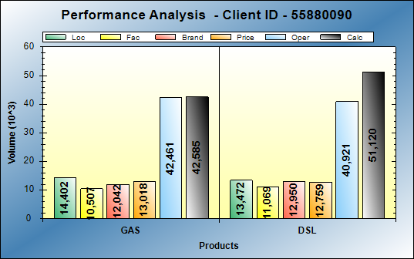
BCG Id 407 – puma SIUNA
BCG ID | Loc Vol | Real Vol | Performance | Potential
407 | 27,874 | 93,705 | HI PERF | LOW POT
Gasoline: Excellent operations
Diesel: Excellent operations
Action Plan:

Slide 13
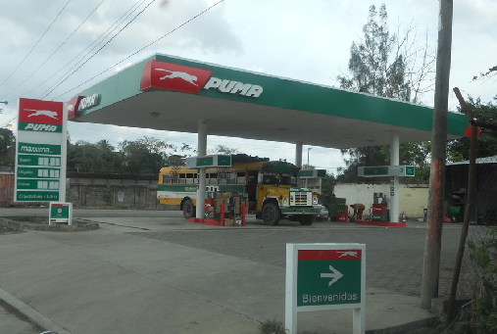
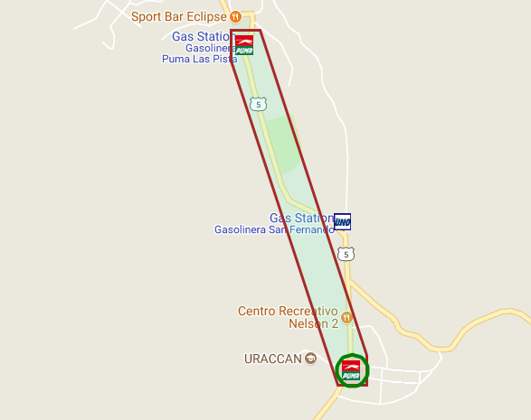
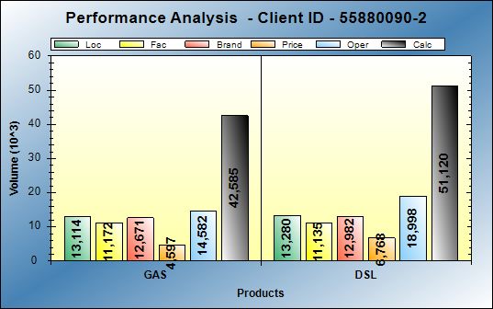
BCG Id 408 – puma CAMPO VIEJO
BCG ID | Loc Vol | Real Vol | Performance | Potential
408 | 26,394 | 93,705 | HI PERF | LOW POT
Gasoline: Excellent operations
Diesel: Excellent operations
Action Plan:

Slide 14
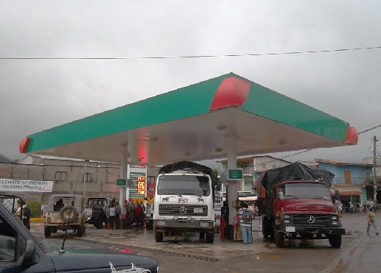
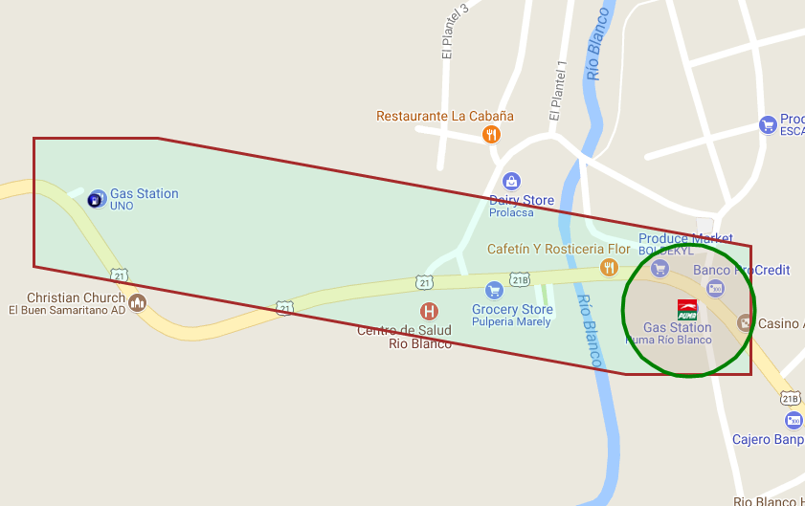
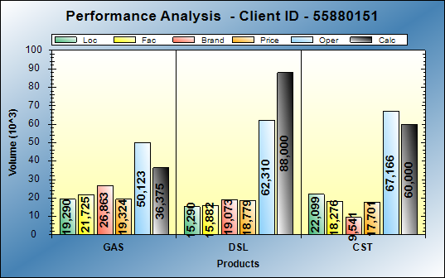
BCG Id 414 – puma RIO BLANCO
BCG ID | Loc Vol | Real Vol | Performance | Potential
414 | 34,580 | 124,375 | HI PERF | LOW POT
Gasoline: Excellent operations
Diesel: Excellent operations
Action Plan:

Slide 15
High Potential – Low Performance

Slide 16
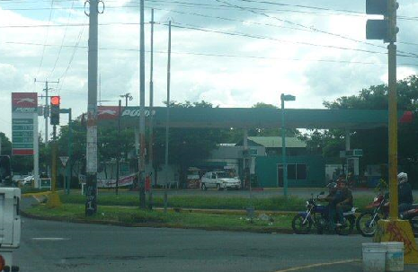
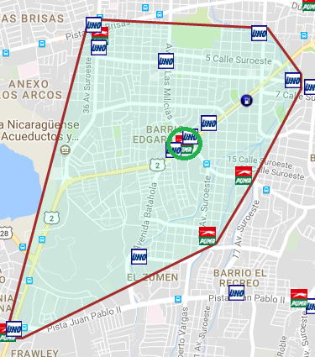
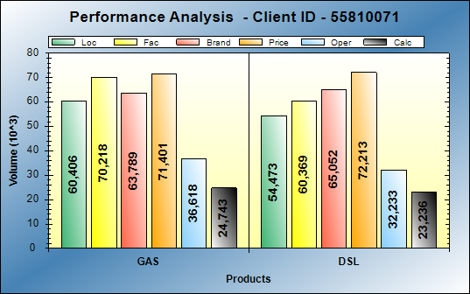
BCG Id 384 – puma PANAMERICANA
BCG ID | Loc Vol | Real Vol | Performance | Potential
384 | 114,879 | 53,238 | LOW PERF | HI POT
Gasoline: Operational opportunities of 36KG
Diesel: Operational opportunities of 31KG
Action Plan:
Goal: 60 to 70 thousand gal monthly
Dealer improvement opportunities:
  Get information from customers in the area, those who consume in the competition and validate recruitment opportunities.
  Increase staff
  Optimized schedules.
  Greater supervision during peak hours.
Puma improvement opportunities:
  Build Kiosko (Small store) to generate more traffic and therefore higher fuel consumption.

Slide 17
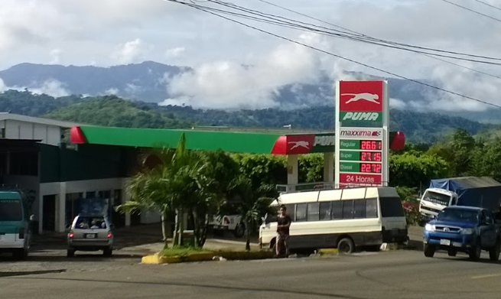
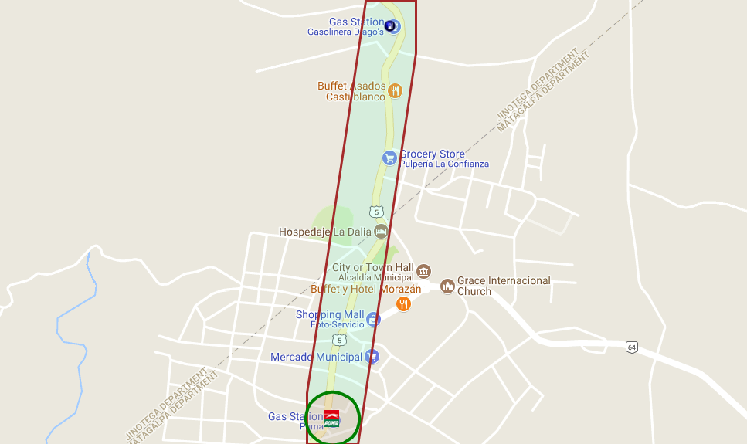
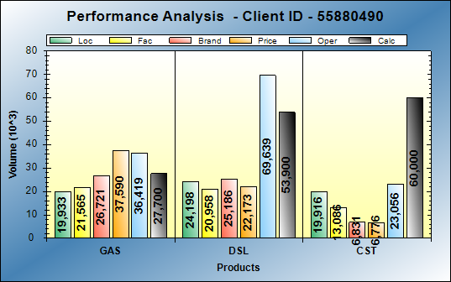
BCG Id 534 – puma la dalia
BCG ID | Loc Vol | Real Vol | Performance | Potential
534 | 44,131 | 81,600 | HI PERF | LOW POT
Gasoline: Operational opportunities of 36KG
Diesel: Operational opportunities of 31KG
Action Plan:

Slide 18
High Potential – High Performance

Slide 19
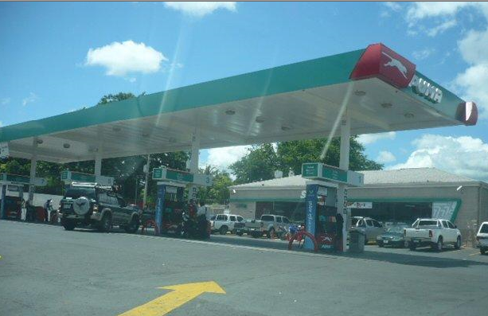
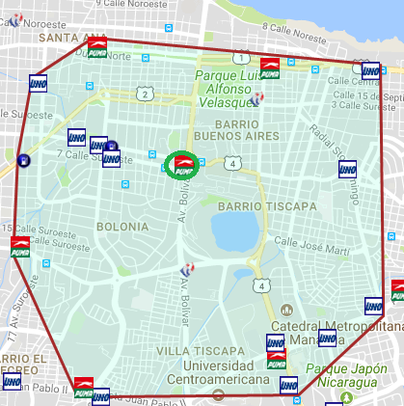
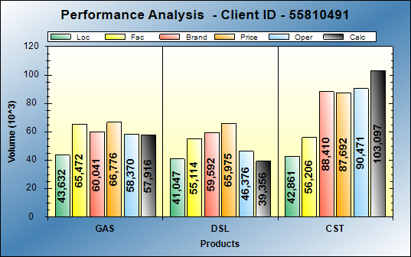
BCG Id 376 – puma MARGARITA
BCG ID | Loc Vol | Real Vol | Performance | Potential
376 | 84,679 | 97,237 | HI PERF | HI POT
Gasoline: Excellent operations
Diesel: Operational opportunities of 6KG
Action Plan:

Slide 20
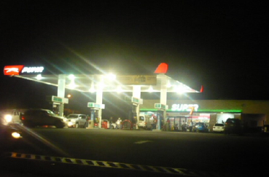
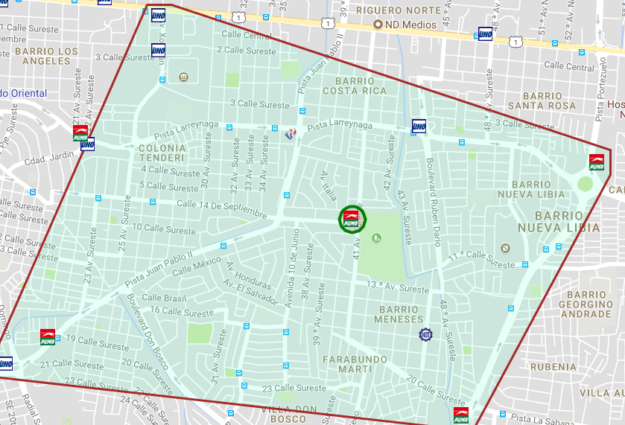
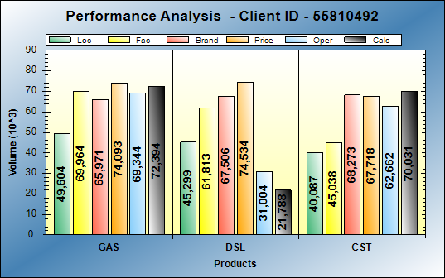
BCG Id 377 – puma SALVADORITA
BCG ID | Loc Vol | Real Vol | Performance | Potential
377 | 94,903 | 94,125 | HI PERF | HI POT
Gasoline: Excellent operations
Diesel: Operational opportunities of 24KG
Action Plan:

Slide 21
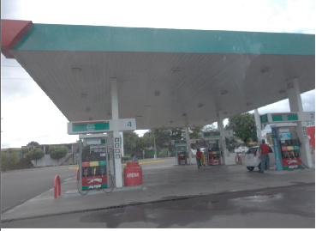
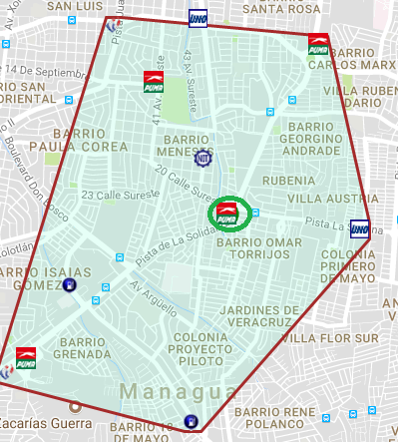
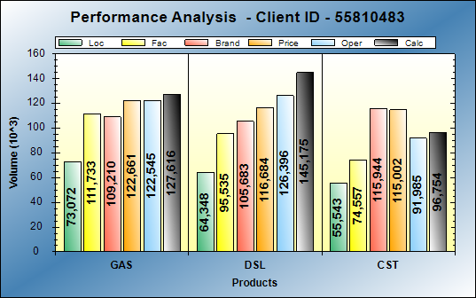
BCG Id 378 – puma RUBENIA
BCG ID | Loc Vol | Real Vol | Performance | Potential
378 | 137,420 | 272,800 | HI PERF | HI POT
Gasoline: Excellent operations
Diesel: Excellent operations
Action Plan:

Slide 22
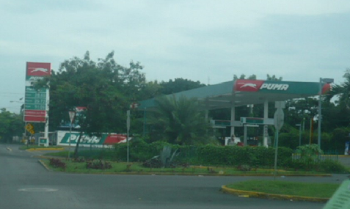
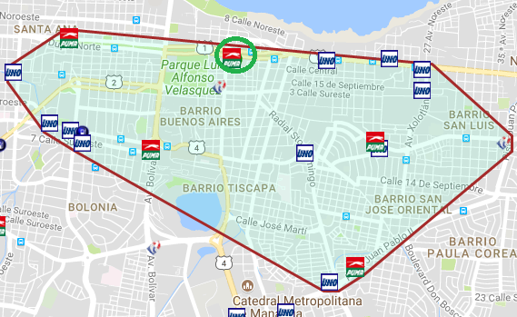
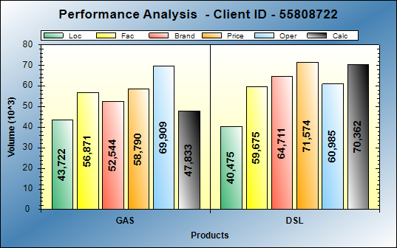
BCG Id 386 – puma LOYOLA
BCG ID | Loc Vol | Real Vol | Performance | Potential
386 | 84,197 | 118,000 | HI PERF | HI POT
Gasoline: Performing at expect levels
Diesel: Excellent operations
Action Plan:

Slide 23
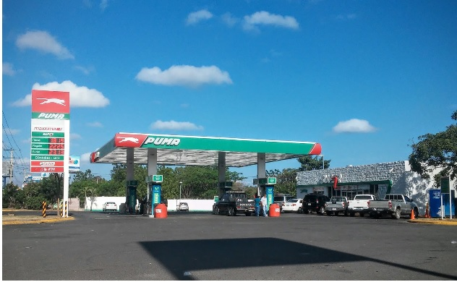
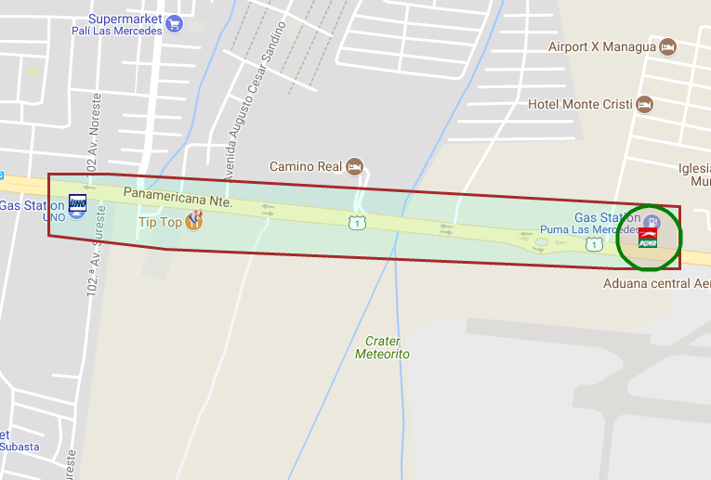
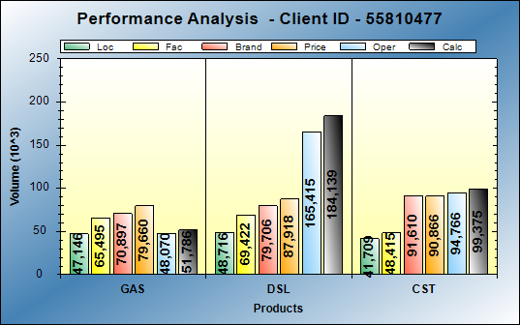
BCG Id 393 – puma LAS MERCEDES
BCG ID | Loc Vol | Real Vol | Performance | Potential
393 | 95,862 | 235,975 | HI PERF | HI POT
Gasoline: Performing at expect levels
Diesel: Excellent operations
Action Plan:

Slide 24



BCG Id 387 – puma AMERICANO
BCG ID | Loc Vol | Real Vol | Performance | Potential
387 | 109,696 | 178,295 | HI PERF | HI POT
Gasoline: Excellent operations
Diesel: Performing at expect levels
Action Plan:

Slide 25



BCG Id 389 – puma CENTRO C.MGUA
BCG ID | Loc Vol | Real Vol | Performance | Potential
389 | 91,548 | 112,875 | HI PERF | HI POT
Gasoline: Excellent operations
Diesel: Excellent operations
Action Plan:

Slide 26



BCG Id 390 – pumA LAS COLINAS
BCG ID | Loc Vol | Real Vol | Performance | Potential
390 | 113,883 | 150,677 | HI PERF | HI POT
Gasoline: Excellent operations
Diesel: Excellent operations
Action Plan:

Slide 27



BCG Id 391 – puma 15 DE SEPTIEMBRE
BCG ID | Loc Vol | Real Vol | Performance | Potential
391 | 96,191 | 73,750 | HI PERF | HI POT
Gasoline: Performing at expect levels
Diesel: Operational opportunities of 21KG
Action Plan:
Dealer improvement opportunities:
  Attract taxis to the area to increase consumption

Slide 28



BCG Id 409 – puma INTERNACIONAL
BCG ID | Loc Vol | Real Vol | Performance | Potential
409 | 81,017 | 143,750 | HI PERF | HI POT
Gasoline: Excellent operations
Diesel: Excellent operations
Action Plan:

Slide 29



BCG Id 412 – puma SAN MARTIN
BCG ID | Loc Vol | Real Vol | Performance | Potential
412 | 73,255 | 84,475 | HI PERF | HI POT
Gasoline: Excellent operations
Diesel: : Excellent operations
Action Plan:

Slide 30



BCG Id 413 – puma LAS MARIAS
BCG ID | Loc Vol | Real Vol | Performance | Potential
413 | 83,488 | 155,700 | HI PERF | HI POT
Gasoline: Performing at expect levels
Diesel: Excellent operations
Action Plan:

Slide 31



BCG Id 640 – puma los brasiles
BCG ID | Loc Vol | Real Vol | Performance | Potential
640 | 85,149 | 110,775 | HI PERF | HI POT
Gasoline: Excellent operations
Diesel: Excellent operations
Action Plan:

