Slide 1

Puma Energy - Network Plan
NICARAGUA
TM: EVELING MOLINA
Investments and Action Plans

Slide 2
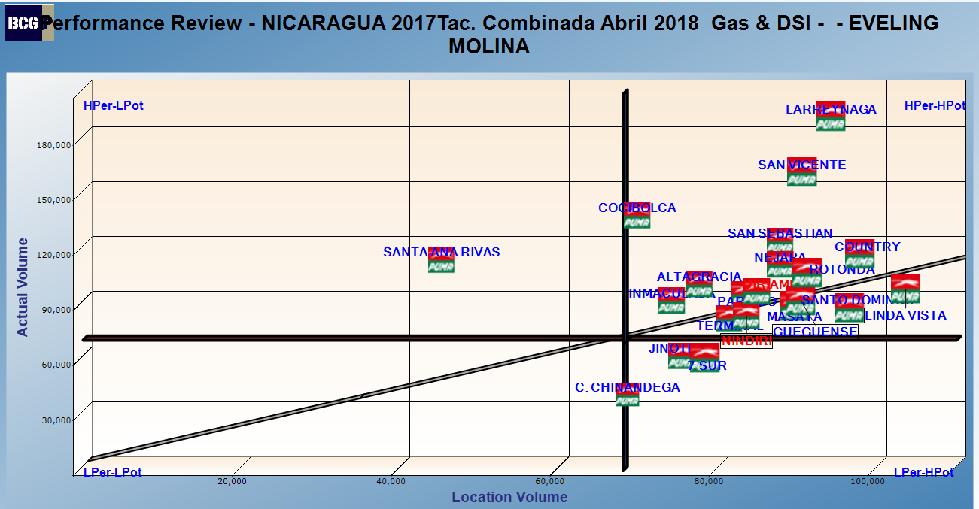
TM: EVELING MOLINA

Slide 3
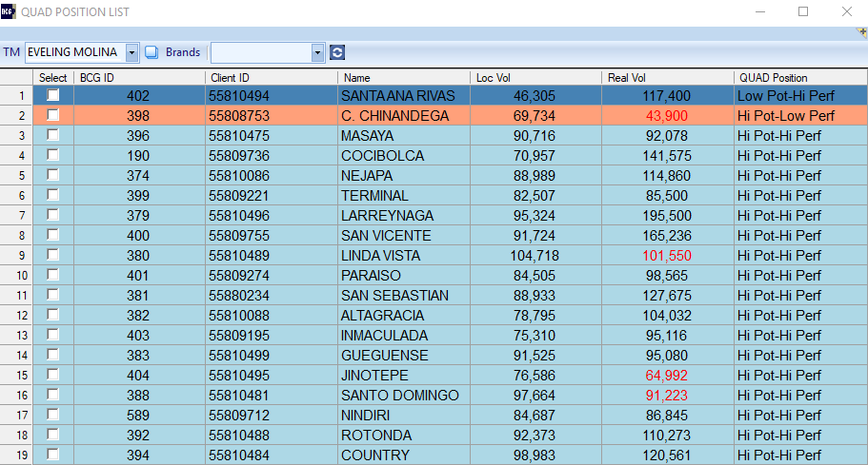
EVELING MOLINA

Slide 4
Low Potential – High Performance

Slide 5
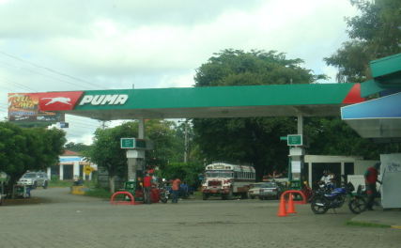
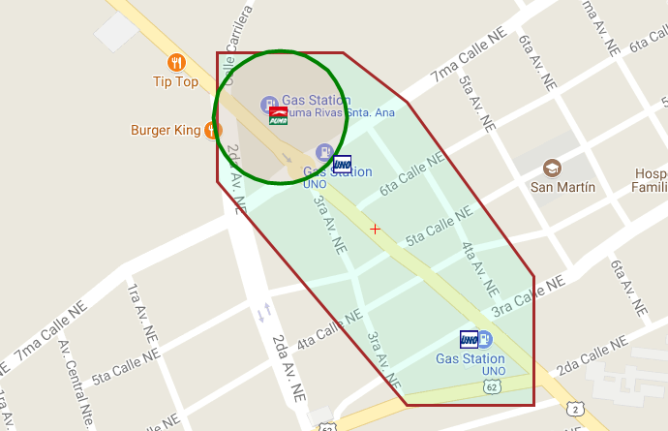
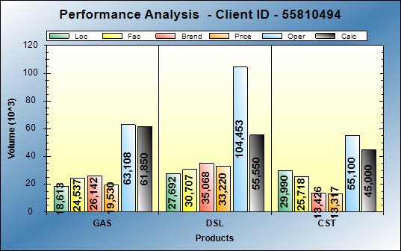
BCG Id 402 – puma santa ana rivas
BCG ID | Loc Vol | Real Vol | Performance | Potential
402 | 46,305 | 117,400 | HI PERF | LOW POT
Gasoline: Excellent operations
Diesel: Excellent operations
Action Plan:
None

Slide 6
High Potential – Low Performance

Slide 7
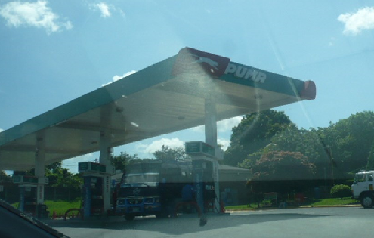
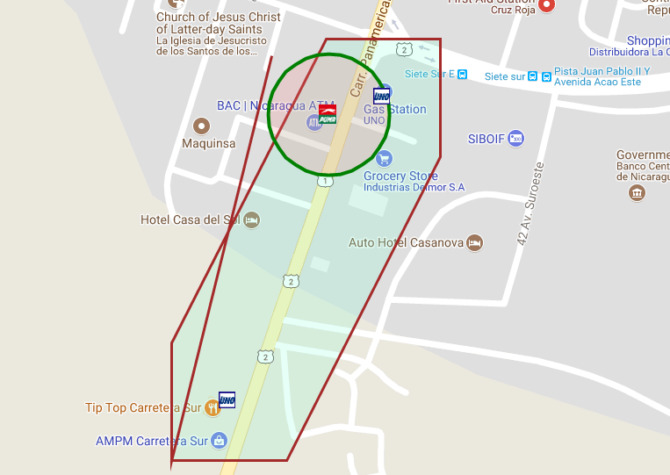
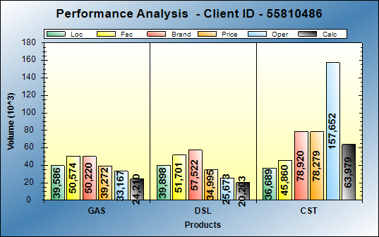
BCG Id 375 – puma c. 7 sur
BCG ID | Loc Vol | Real Vol | Performance | Potential
375 | 79,484 | 63,932 | LOW PERF | HI POT
Gasoline: Operational opportunities of 15KG
Diesel: Operational opportunities of 19KG
Action Plan:
Service station affected by the construction of the overpass in front of the facilities.
Once the station is opened, the action plans to be taken will be analyzed.

Slide 8
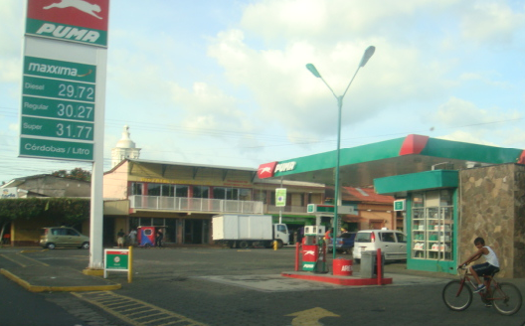
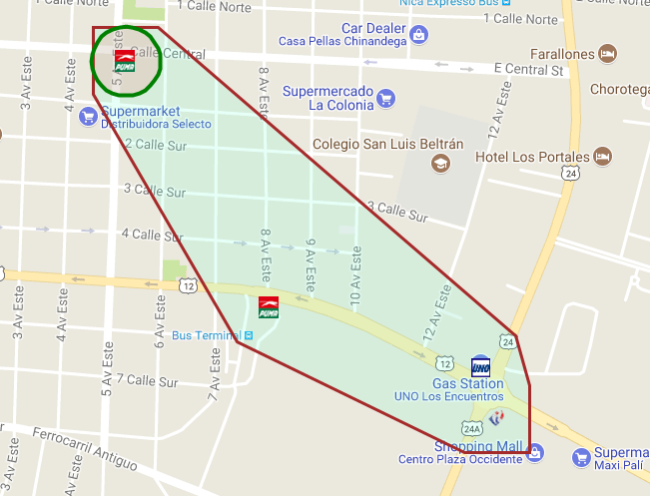
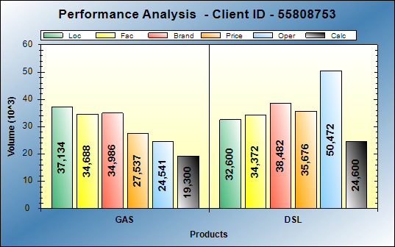
BCG Id 398 – puma c. chinandega
BCG ID | Loc Vol | Real Vol | Performance | Potential
398 | 69,734 | 43,900 | LOW PERF | HI POT
Gasoline: Operational opportunities of 15KG
Diesel: Operational opportunities of 15KG
Action Plan:
Goal: 60 thousands gal monthly
Dealer improvement opportunities:
  Improve inventory levels
Puma improvement opportunities:
  Implement the taxi discount program to attract additional volume.

Slide 9
High Potential – High Performance

Slide 10
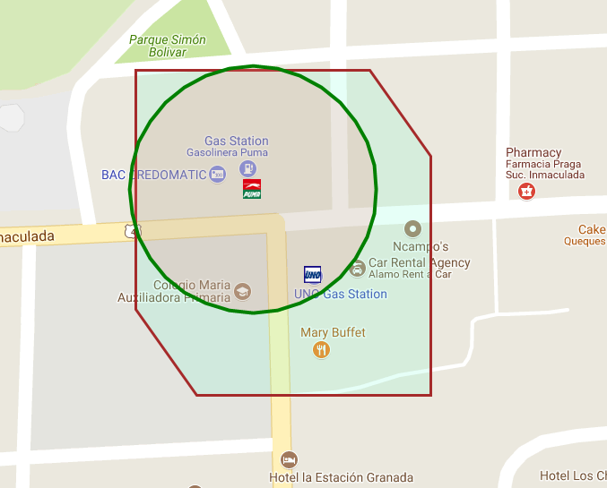
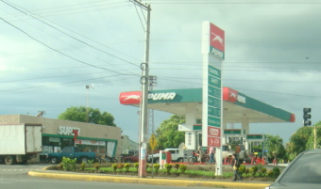
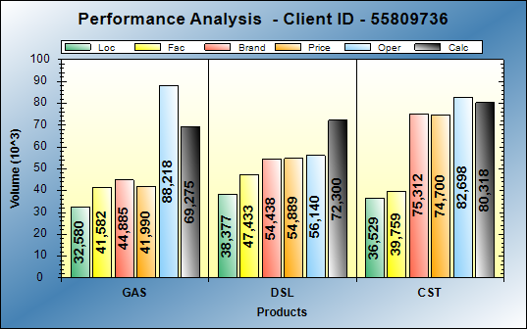
BCG Id 190 – puma cocibolca
BCG ID | Loc Vol | Real Vol | Performance | Potential
190 | 70,957 | 141,575 | HI PERF | HI POT
Gasoline: Excellent operations
Diesel: Excellent operations
Action Plan:

Slide 11
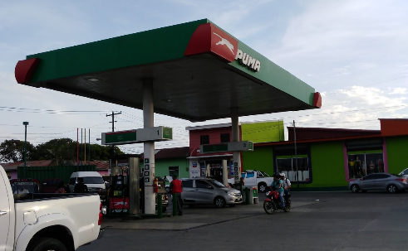
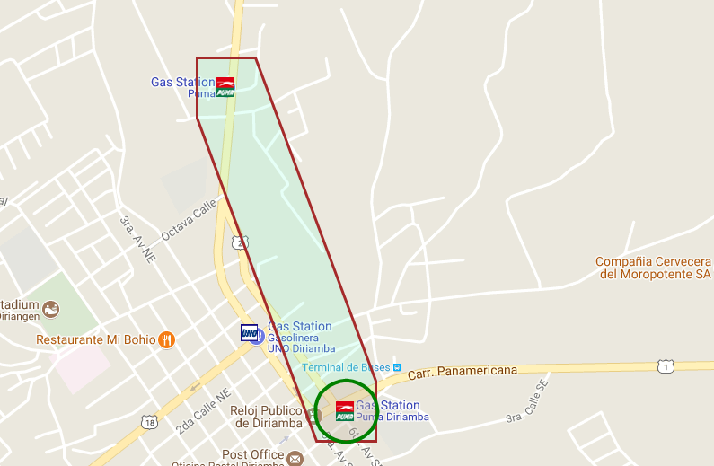
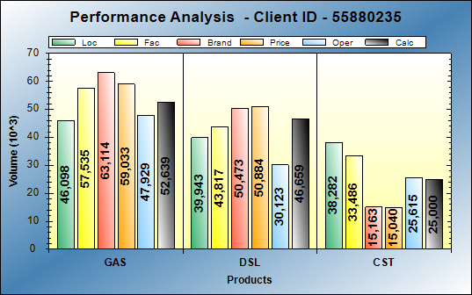
BCG Id 192 – puma diriamba
BCG ID | Loc Vol | Real Vol | Performance | Potential
192 | 86,041 | 100,123 | HI PERF | HI POT
Gasoline: Excellent operations
Diesel: Excellent operations
Action Plan:

Slide 12
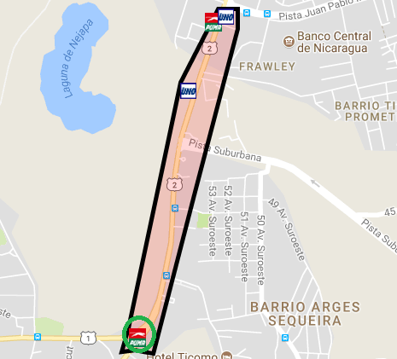
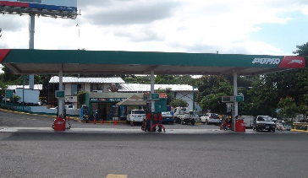
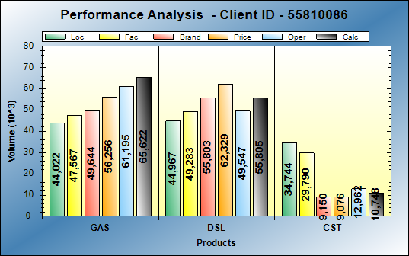
BCG Id 374 – puma nejapa
BCG ID | Loc Vol | Real Vol | Performance | Potential
374 | 88,989 | 114,860 | HI PERF | HI POT
Gasoline: Excellent operations
Diesel: Performing at excellent levels
Action Plan:

Slide 13
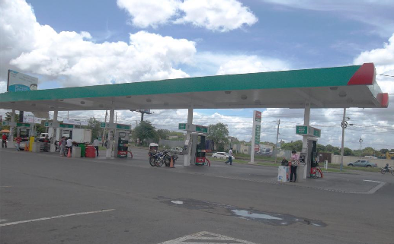
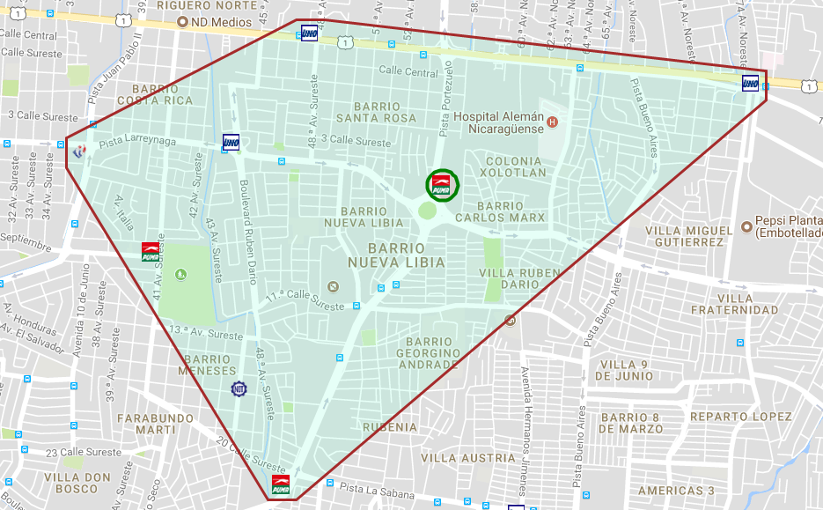
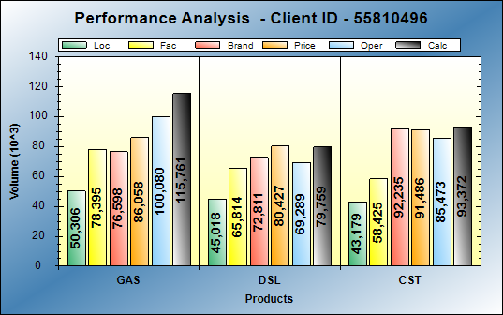
BCG Id 379 – puma LARREYNAGA
BCG ID | Loc Vol | Real Vol | Performance | Potential
379 | 95,324 | 195,500 | HI PERF | HI POT
Gasoline: Operational opportunities of 28KG Diesel: Excellent operations
Action Plan:

Slide 14
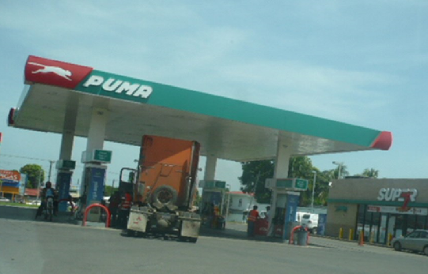
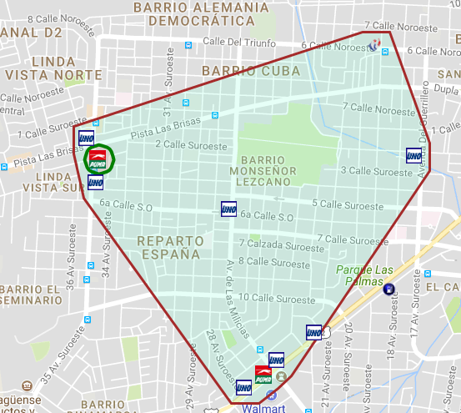
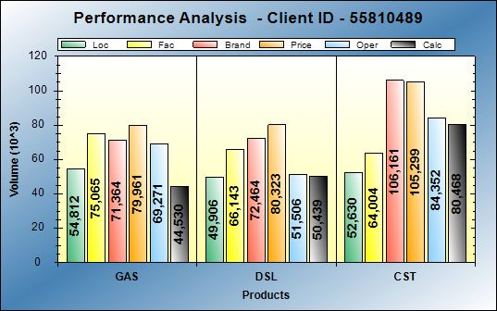
BCG Id 380 – puma linda vista
BCG ID | Loc Vol | Real Vol | Performance | Potential
380 | 104,718 | 101,550 | HI PERF | HI POT
Gasoline: Operational opportunities of 10KG Diesel: Performing at expect levels
Action Plan:

Slide 15
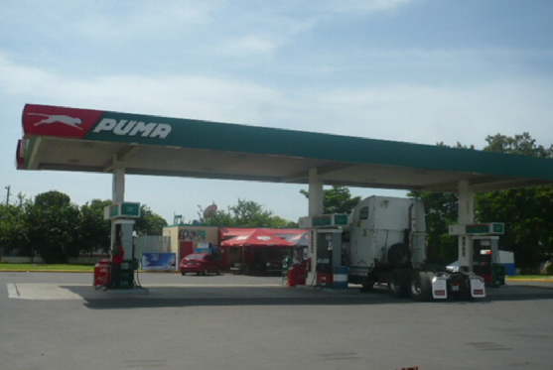
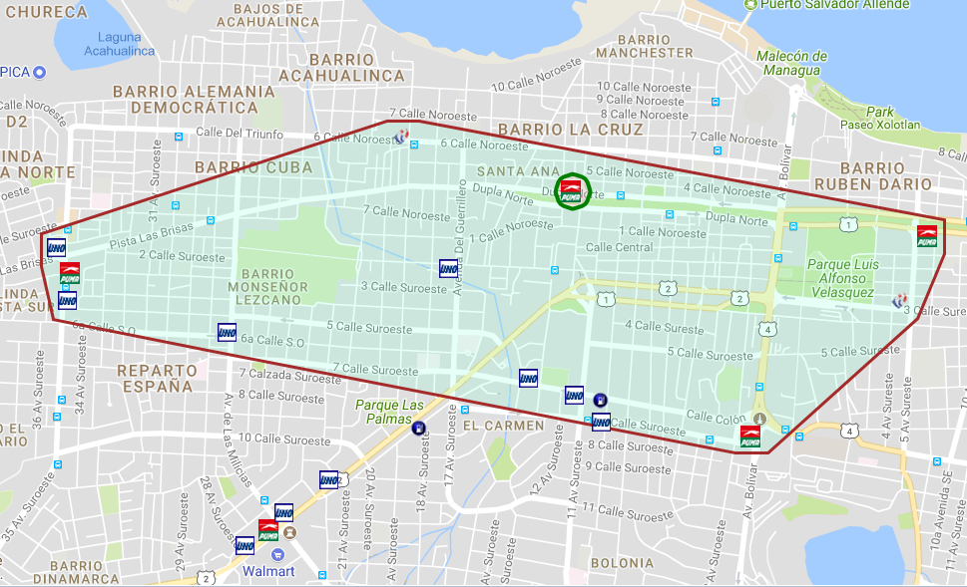
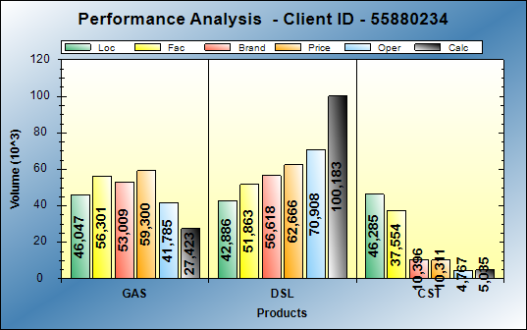
BCG Id 381 – puma san sebastian
BCG ID | Loc Vol | Real Vol | Performance | Potential
381 | 88,933 | 127,675 | HI PERF | HI POT
Gasoline: Operational opportunities of 19KG Diesel: Excellent operations
Action Plan:

Slide 16
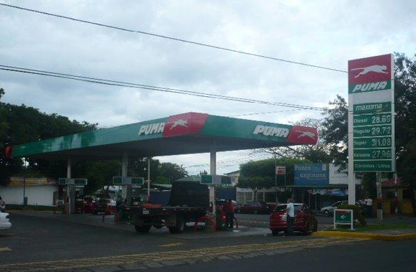
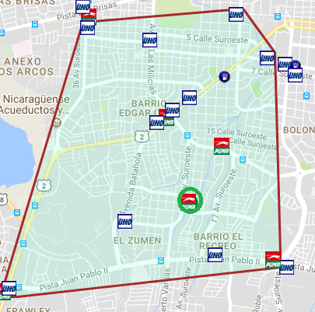
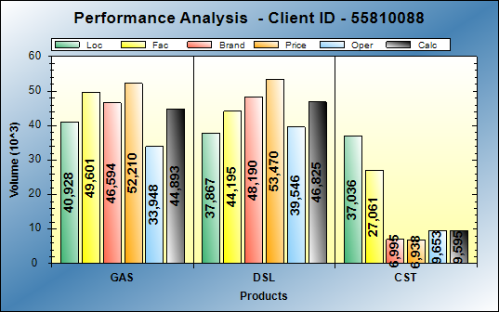
BCG Id 382 – puma altagracia
BCG ID | Loc Vol | Real Vol | Performance | Potential
382 | 78,795 | 104,032 | HI PERF | HI POT
Gasoline: Excellent operations
Diesel: Excellent operations
Action Plan:

Slide 17
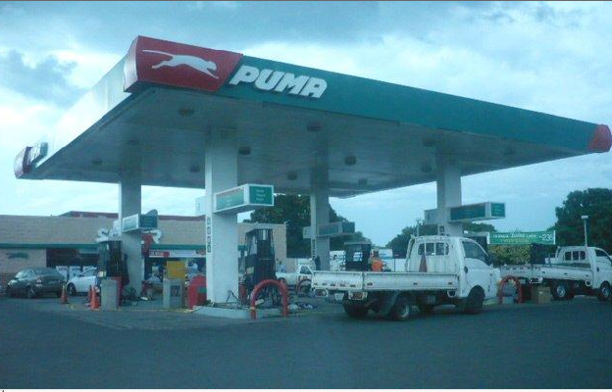
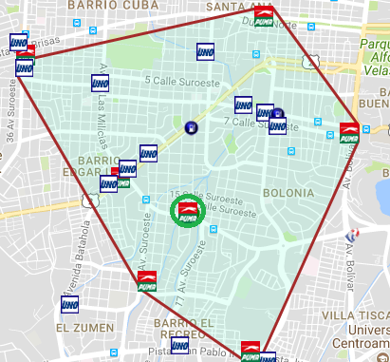
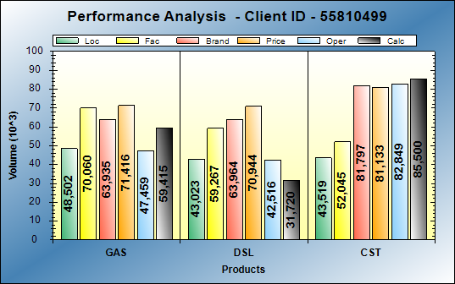
BCG Id 383 – puma gueguense
BCG ID | Loc Vol | Real Vol | Performance | Potential
383 | 91,525 | 95,080 | HI PERF | HI POT
Gasoline: Excellent operations
Diesel: Operational opportunities of 12KG
Action Plan:

Slide 18
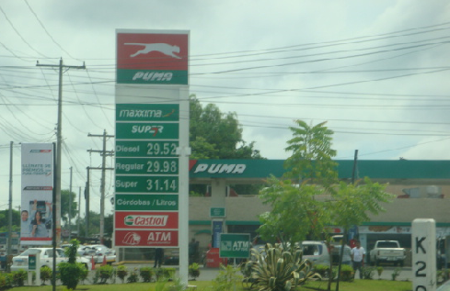
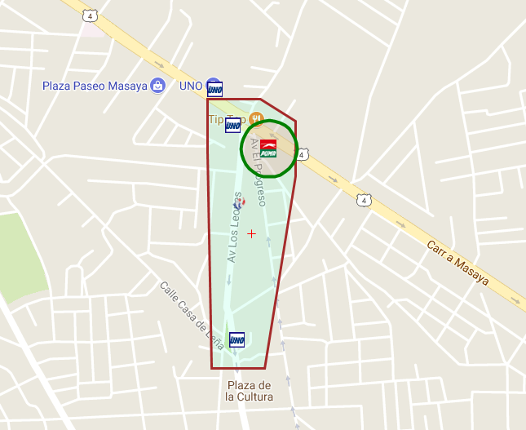
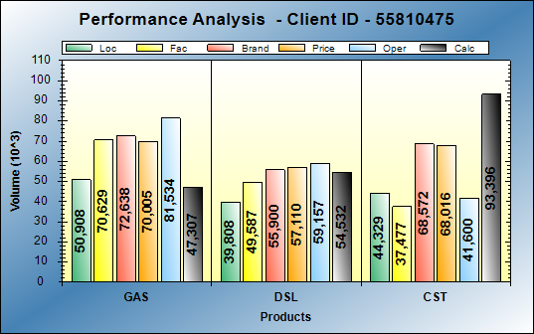
BCG Id 396 – puma masaya
BCG ID | Loc Vol | Real Vol | Performance | Potential
275 | 123,501 | 102,316 | HI PERF | HI POT
Gasoline: Operational opportunities of 4KG
Diesel: Performing at expect levels
Action Plan:

Slide 19
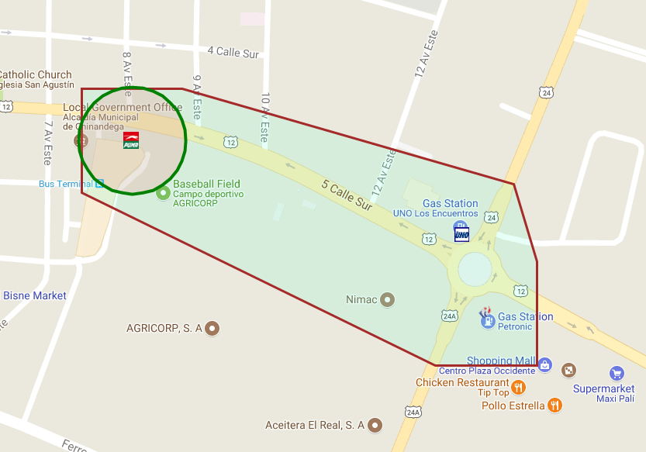
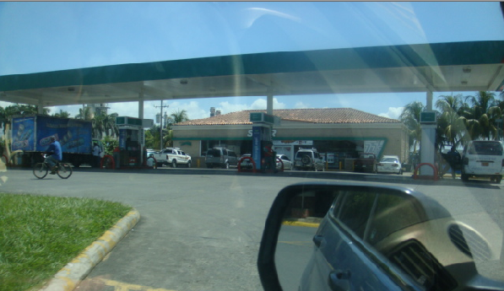
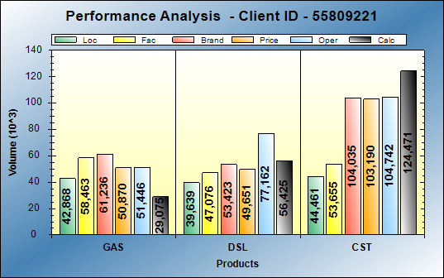
BCG Id 399 – puma terminal
BCG ID | Loc Vol | Real Vol | Performance | Potential
399 | 82,507 | 85,500 | HI PERF | HI POT
Gasoline: Operational opportunities of 13KG
Diesel: Performing at expect level
Action Plan:

Slide 20
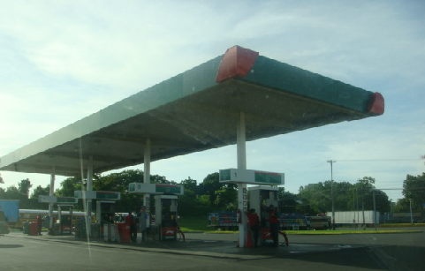
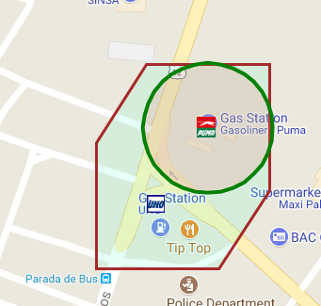
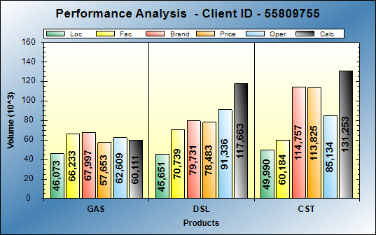
BCG Id 400 – puma SAN VICENTE
BCG ID | Loc Vol | Real Vol | Performance | Potential
400 | 91,724 | 165,236 | HI PERF | HI POT
Gasoline: Performing at expect levels
Diesel: Excellent operations
Action Plan:

Slide 21
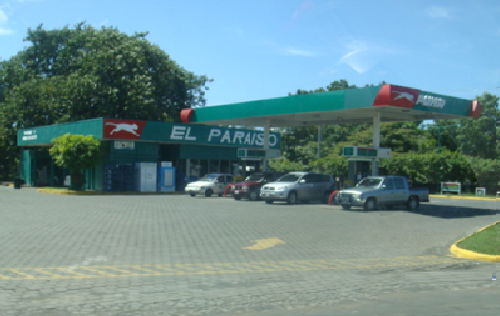
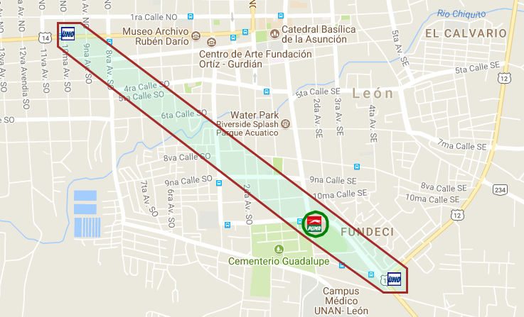
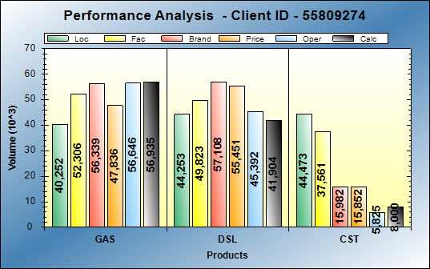
BCG Id 401 – puma paraiso
BCG ID | Loc Vol | Real Vol | Performance | Potential
401 | 84,505 | 98,565 | HI PERF | HI POT
Gasoline: Excellent operations
Diesel: Operational opportunities of 3KG
Action Plan:

Slide 22
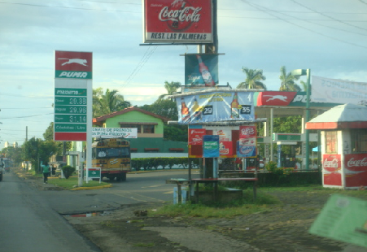
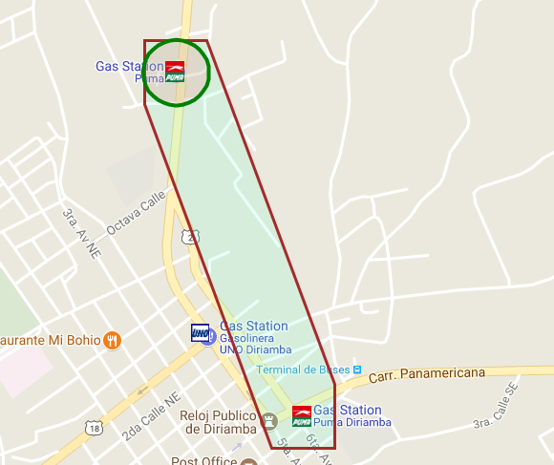
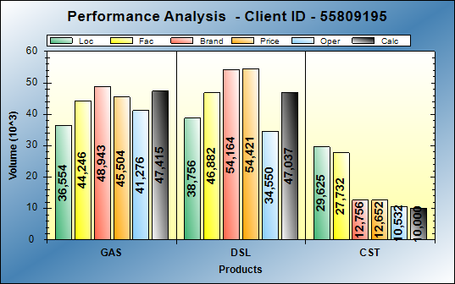
BCG Id 403 – puma inmaculada
BCG ID | Loc Vol | Real Vol | Performance | Potential
403 | 75,310 | 95,116 | HI PERF | HI POT
Gasoline: Excellent operations
Diesel: Excellent operations
Action Plan:

Slide 23



BCG Id 404 – puma jinotepe
Gasoline: Excellent operations
Diesel: Excellent operations
Action Plan:

Slide 24



BCG Id 388 – puma santo domingo
BCG ID | Loc Vol | Real Vol | Performance | Potential
388 | 97,664 | 91,223 | HI PERF | HI POT
Gasoline: Excellent operations
Diesel: Operational opportunities of 12KG
Action Plan:

Slide 25



BCG Id 392 – puma ROTONDA
BCG ID | Loc Vol | Real Vol | Performance | Potential
392 | 92,373 | 110,273 | HI PERF | HI POT
Gasoline: Operational opportunities of 6KG
Diesel: Excellent operations
Action Plan:

Slide 26



BCG Id 394 – puma COUNTRY
BCG ID | Loc Vol | Real Vol | Performance | Potential
394 | 98,983 | 120,561 | HI PERF | HI POT
Gasoline: Excellent operations
Diesel: Operational opportunities of 5KG
Action Plan:

Slide 27



BCG Id 589 – puma NINDIRI
BCG ID | Loc Vol | Real Vol | Performance | Potential
589 | 84,687 | 86,845 | HI PERF | HI POT
Gasoline: Excellent operations
Diesel: Performing at expect levels
Action Plan:

