Slide 1

Puma Energy - Network Plan
Panama
TM: Ariel Cedenio
Investments and Action Plans

Slide 2
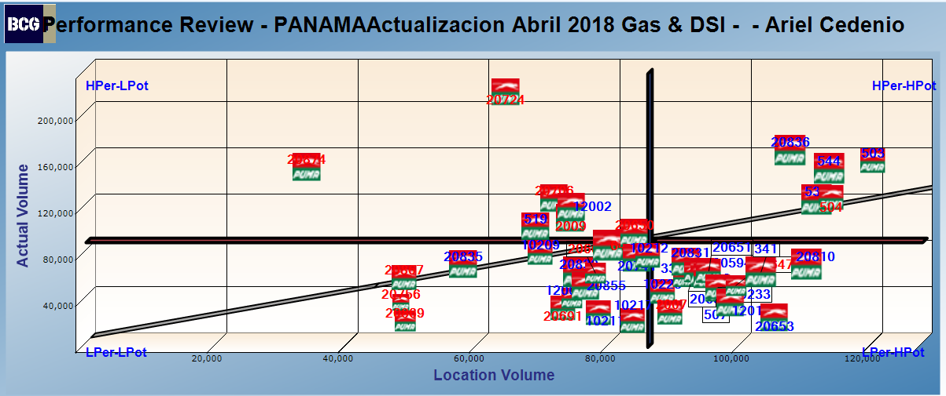
TM: Ariel Cedenio

Slide 3
Ariel Cedenio

Slide 4
Ariel Cedenio

Slide 5
Low Potential – Low Performance

Slide 6
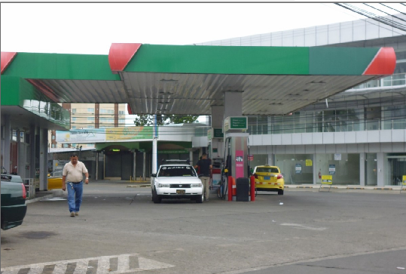
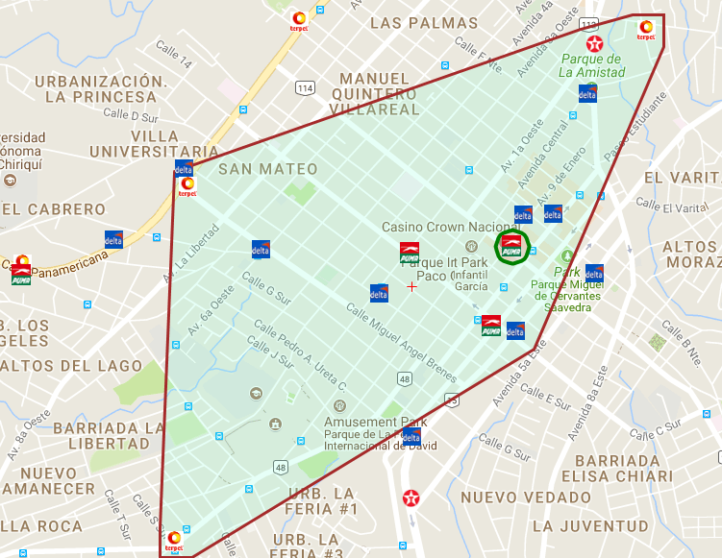
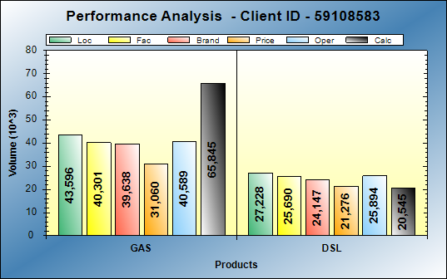
BCG id 10209 - PUMA david central
BCG ID | Loc Vol | Real Vol | Performance | Potential
10209 | 70,824 | 86,058 | LOW PERF | LOW POT
Gasoline: Excellent operations
Diesel: Operational opportunities of 7KG
Action Plan:
    Get discount accounts in local area.

Slide 7
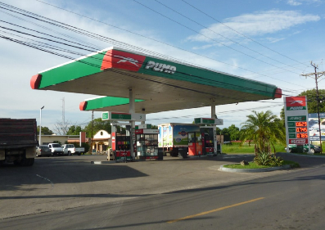
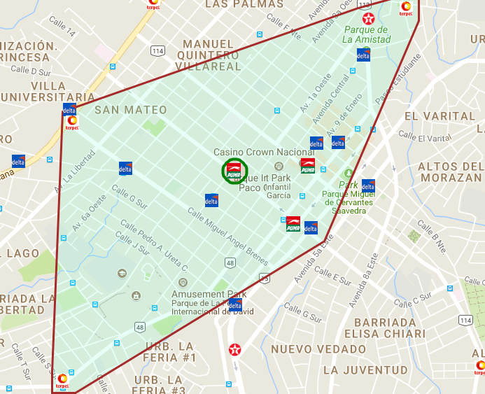
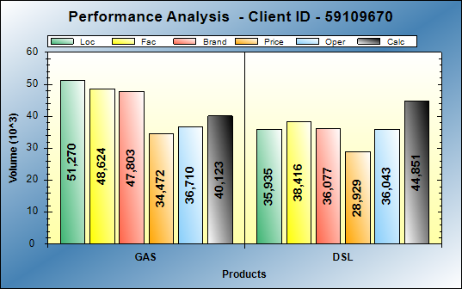
BCG id 10212 - PUMA MAREASA VIA RAPIDA
BCG ID | Loc Vol | Real Vol | Performance | Potential
10212 | 87,205 | 83,592 | LOW PERF | LOW POT
Gasoline: Operational opportunities of 11KG
Diesel: Performing at good level
Action Plan:
    Change of three products pump in Self Service
    Get discount accounts in local area.
    Exceptional service
    Track asphalting

Slide 8
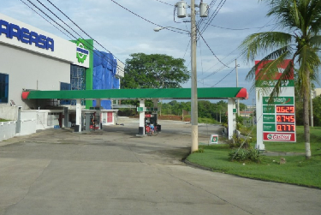
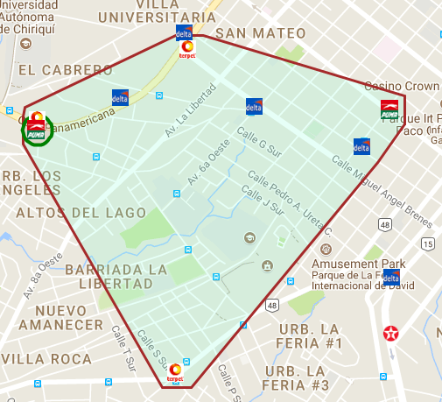
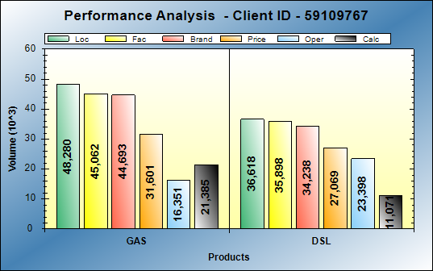
BCG id 10217 - PUMA MAREASA INTERAMERICANA
BCG ID | Loc Vol | Real Vol | Performance | Potential
10217 | 84,898 | 27,164 | LOW PERF | LOW POT
Gasoline: Operational opportunities of 27KG
Diesel: Operational opportunities of 25KG
Action Plan:
    Get discount accounts in local area(Project Fomilenio)
    High flow diesel pump.

Slide 9
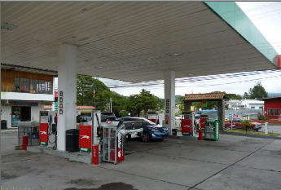
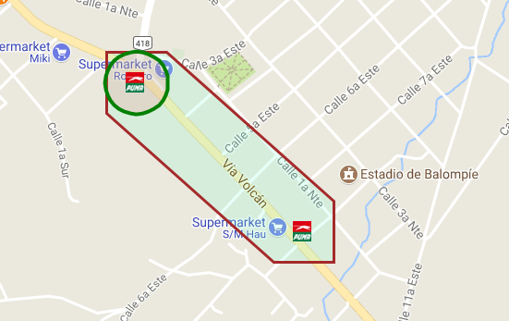
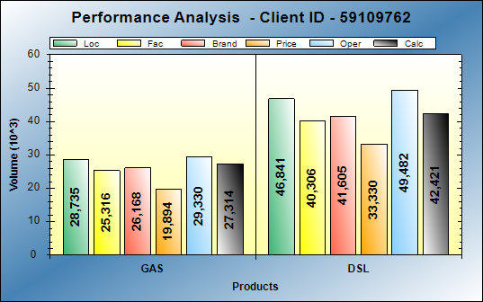
BCG id 12001 - PUMA volcan
BCG ID | Loc Vol | Real Vol | Performance | Potential
12001 | 75,576 | 47,132 | LOW PERF | LOW POT
Gasoline: Performing at expect level
Diesel: Operational opportunities of 4KG
Action Plan:
    Get discount accounts in local area(Project Fomilenio)
    High flow diesel pump.

Slide 10
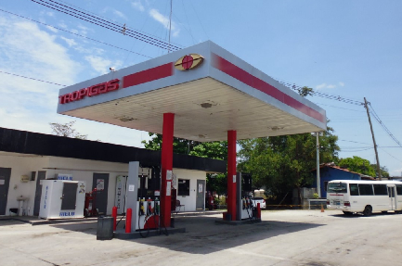
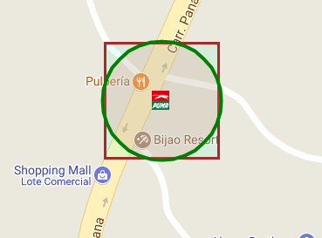
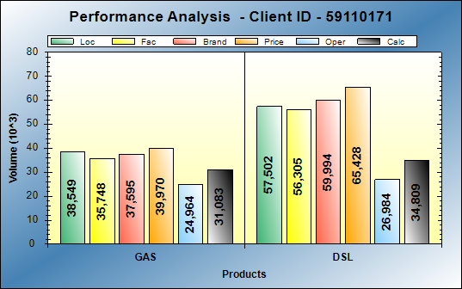
BCG id 20594 - PUMA LA ERMITA
BCG ID | Loc Vol | Real Vol | Performance | Potential
20,594 | 96,051 | 65,892 | LOW PERF | HI POT
Gasoline: Operational opportunities of 7KG
Diesel: Operational opportunities of 23KG
Action Plan:
    None

Slide 11
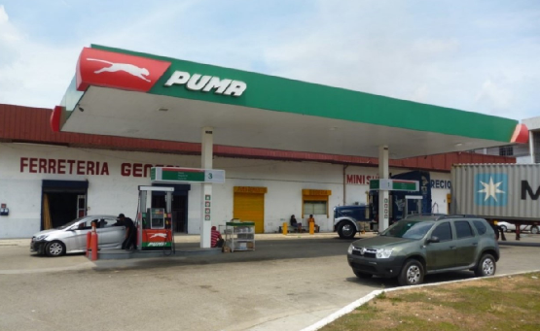
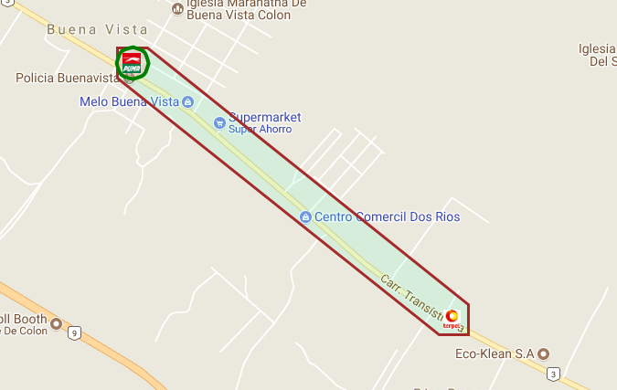
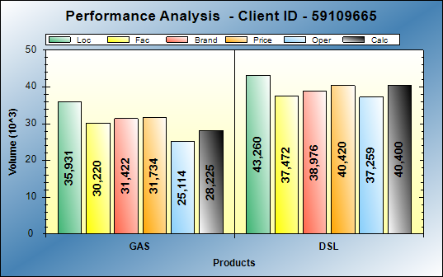
BCG id 20665 - PUMA BUENA VISTA
BCG ID | Loc Vol | Real Vol | Performance | Potential
20,665 | 79,191 | 68,625 | LOW PERF | LOW POT
Gasoline: Operational opportunities of 7KG
Diesel: Operational opportunities of 3KG
Action Plan:
Maintain a good station image
Get discount accounts in local area
Competitive prices

Slide 12
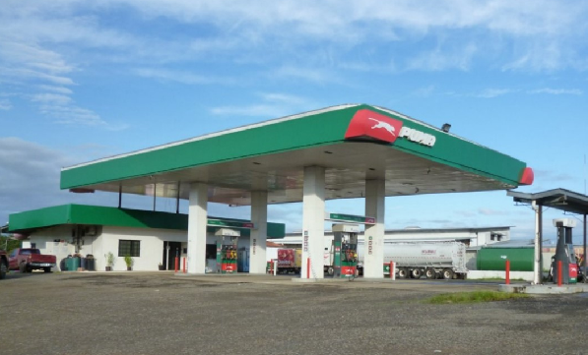
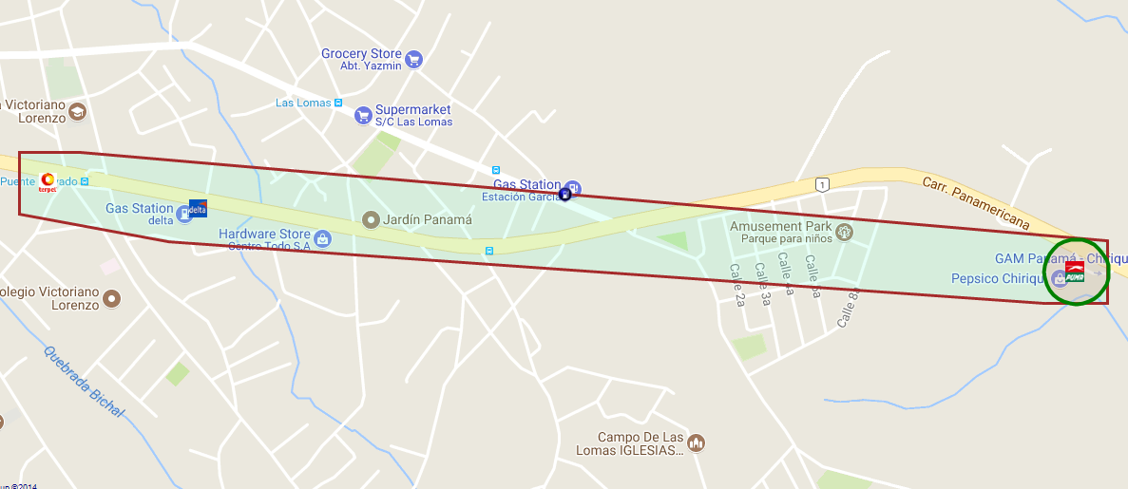
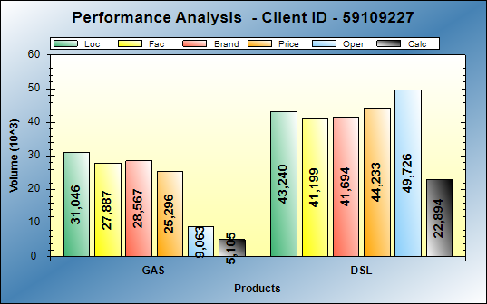
BCG id 20691 - PUMA JULSA
BCG ID | Loc Vol | Real Vol | Performance | Potential
20,691 | 74,286 | 38,225 | LOW PERF | LOW POT
Gasoline: Operational opportunities of 26KG
Diesel: Operational opportunities of 21KG
Action Plan:
None

Slide 13
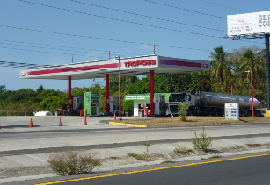
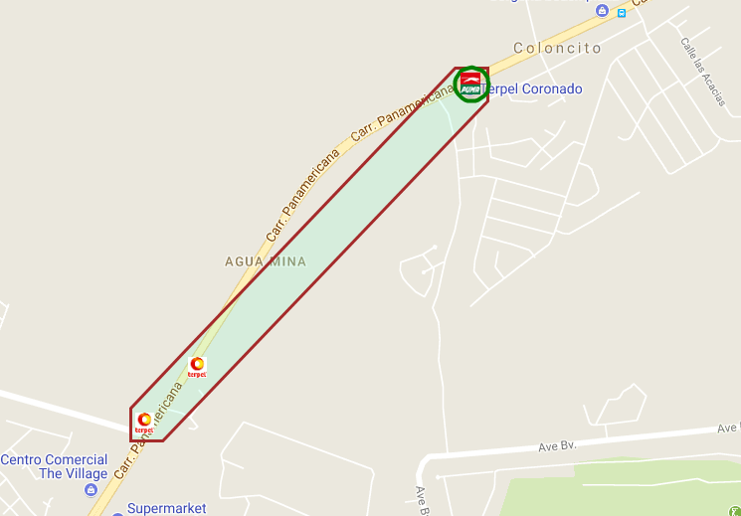
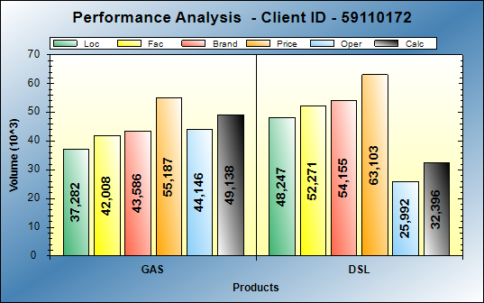
BCG id 20741- PUMA CORONADO
BCG ID | Loc Vol | Real Vol | Performance | Potential
20,741 | 85,529 | 81,534 | LOW PERF | LOW POT
Gasoline: Excellent operations
Diesel: Operational opportunities of 16KG
Action Plan:
Get discount accounts in local area
Add more staff on track attendants 24 HRS
Exceptional service

Slide 14
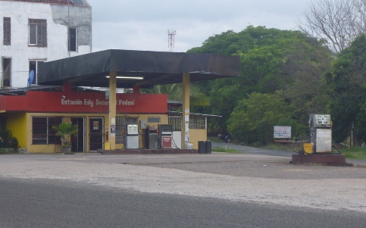
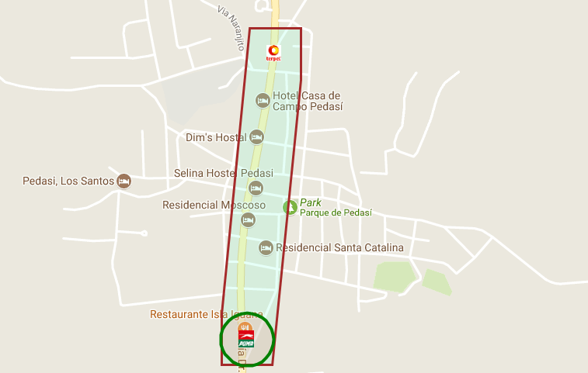
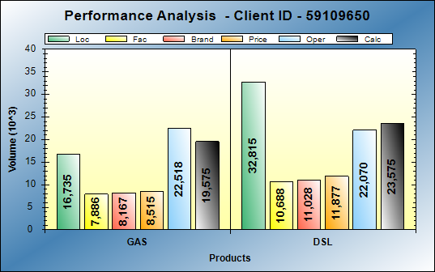
BCG id 20756- PUMA PEDASI
BCG ID | Loc Vol | Real Vol | Performance | Potential
20,756 | 49,550 | 43,150 | LOW PERF | LOW POT
Gasoline: Performing at good level
Diesel: Operational opportunities of 9KG
Action Plan:
Maintain the level of current service
Get discount accounts in local area

Slide 15
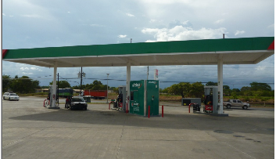
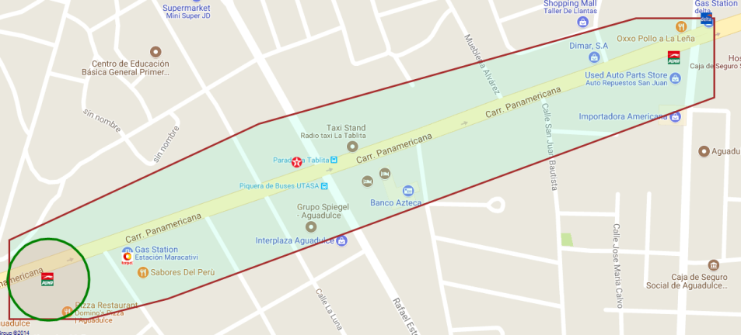
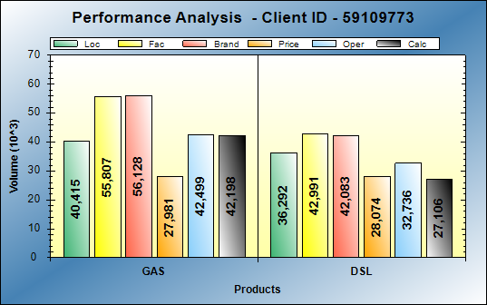
BCG id 20839- PUMA OTG AGUADULCE
BCG ID | Loc Vol | Real Vol | Performance | Potential
20,839 | 76,707 | 69,304 | LOW PERF | LOW POT
Gasoline: Performing at good level
Diesel: Operational opportunities of 9KG
Action Plan:
Lease renewal 2019
Facelift – change false ceiling
Station affected by construction of overpass

Slide 16
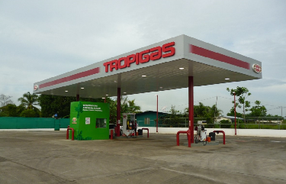
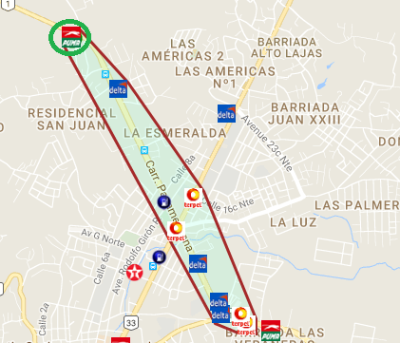
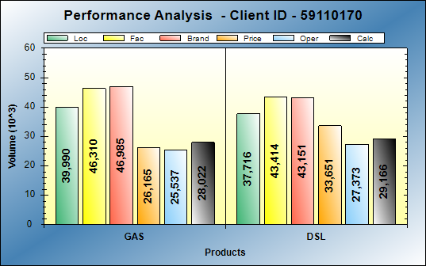
BCG id 20855- PUMA SANTIAGO
BCG ID | Loc Vol | Real Vol | Performance | Potential
20,855 | 77,706 | 57,188 | LOW PERF | LOW POT
Gasoline: Operational opportunities of 11KG
Diesel: Operational opportunities of 8KG
Action Plan:
Remodeling pending.
Resolution of situation with Alcaldia de Zacatecoluca.
Avoid Run Out.
Inject capital to the Station.

Slide 17
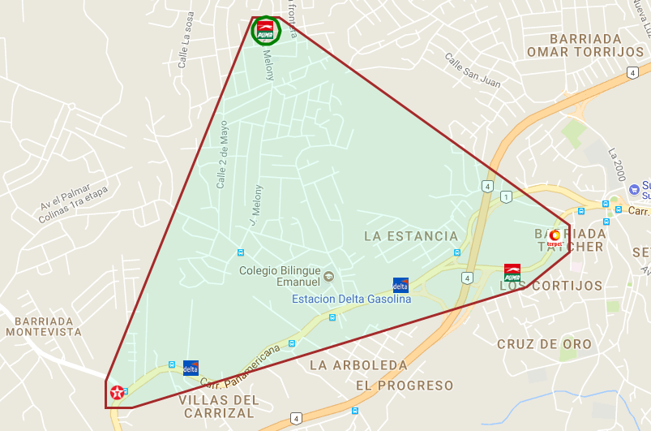
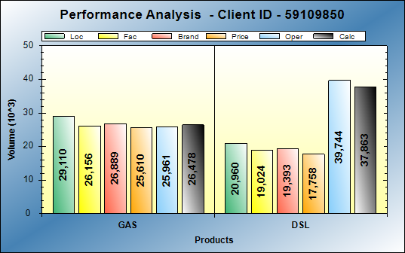
BCG id 20867- PUMA BURUNGA
BCG ID | Loc Vol | Real Vol | Performance | Potential
20,867 | 50,070 | 64,341 | LOW PERF | LOW POT
Gasoline: Operational opportunities of 11KG
Diesel: Operational opportunities of 8KG
Action Plan:
Align DODO dealer to work with PUMA initiatives (fleet card, step by step service)

Slide 18
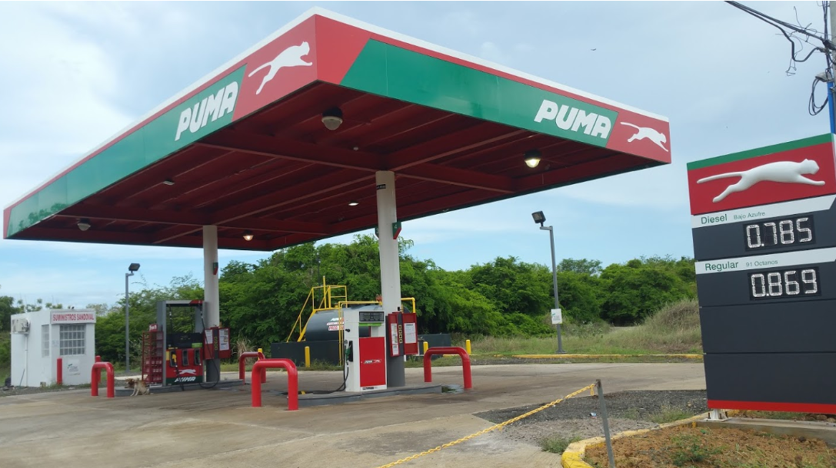
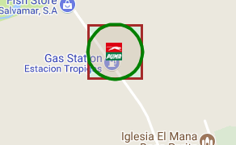
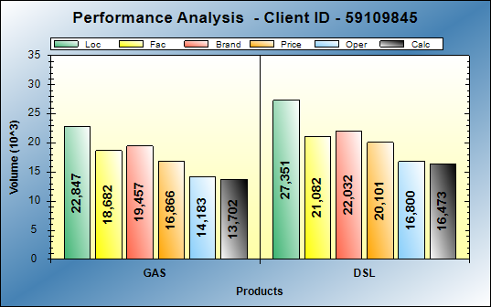
BCG id 20869- PUMA MONAGRILLO
Gasoline: Operational opportunities of 9KG
Diesel: Operational opportunities of 11KG
Action Plan:
Get discount accounts in local area
Labeling improvements on 25 avenue. Exceptional service
Remove sign..

Slide 19
Low Potential – High Performance

Slide 20
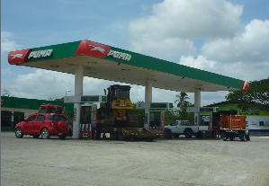
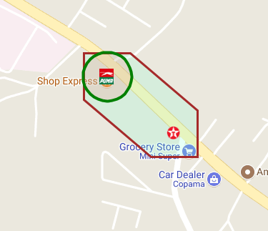
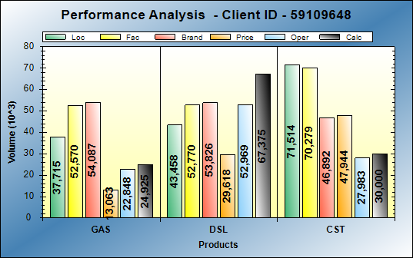
BCG Id 64 – puma MAMA OLY
BCG ID | Loc Vol | Real Vol | Performance | Potential
64 | 81,173 | 92,300 | HI PERF | LOW POT
Gasoline: Operational opportunities of 13KG Diesel: Excellent operations
Action Plan:
High flow new pump that allows a better service to diesel customers
Invest in Ruby’s system set
Be competitive in Diesel price in area
recover transport companies with discounts
Consistency in service and image

Slide 21
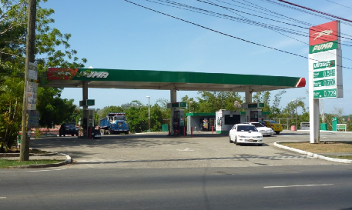
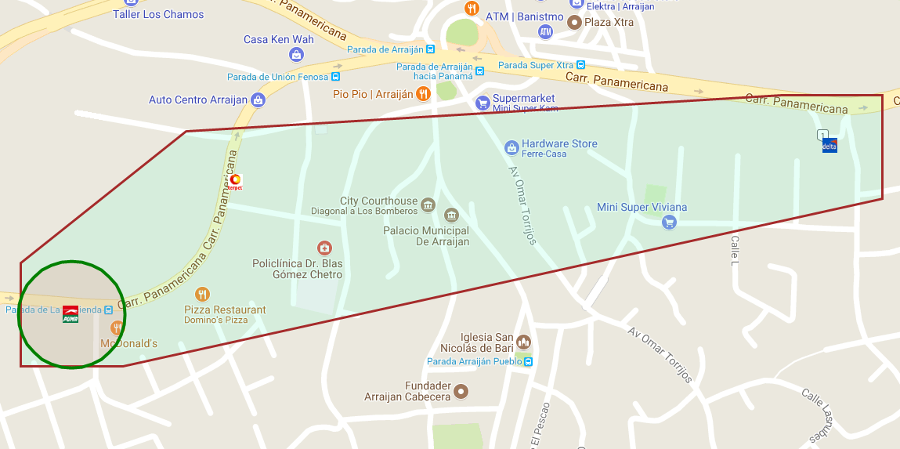
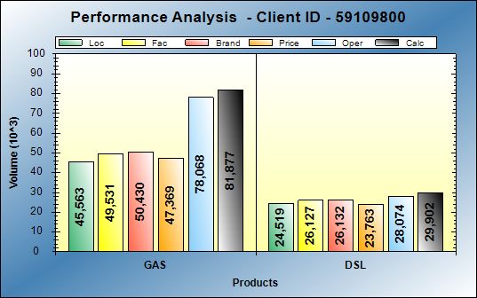
BCG Id 519 - PUMA ARRAIJAN
BCG ID | Loc Vol | Real Vol | Performance | Potential
519 | 70,082 | 108,796 | HI PERF | LOW POT
Gasoline: Excellent operations
Diesel: Performing at good level
Action Plan:
    Consistency in service and image
    Get discount accounts in local area.

Slide 22
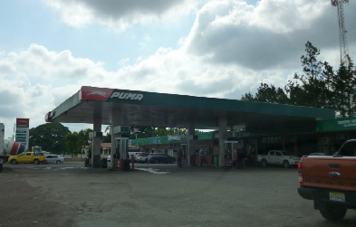
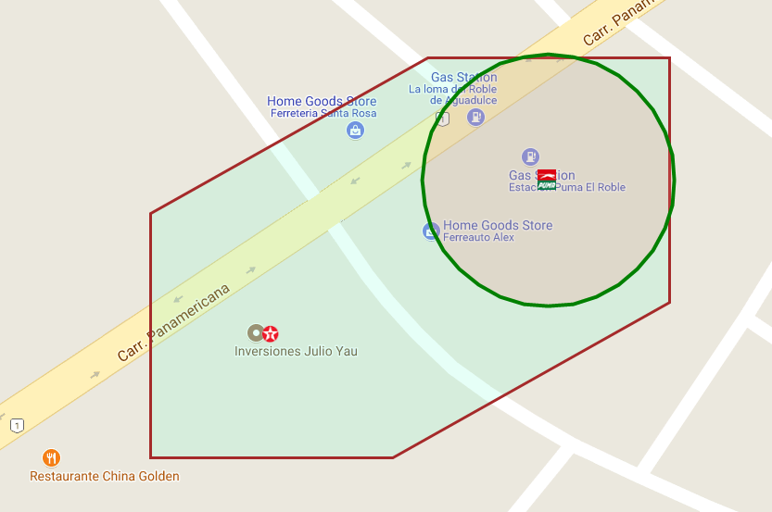
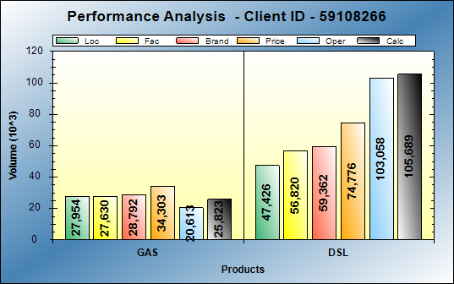
BCG Id 2009 – puma EL ROBLE
BCG ID | Loc Vol | Real Vol | Performance | Potential
2,009 | 75,380 | 116,115 | HI PERF | LOW POT
Gasoline: Performing at good level
Diese: Excellent operations
Action Plan:
    D&R of canopy $100k
    Replacement of tanks and pipes $100k

Slide 23
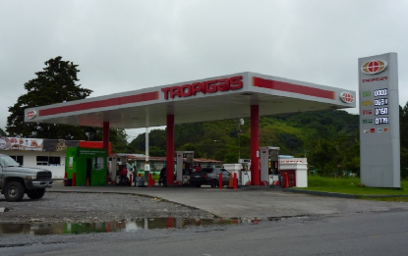
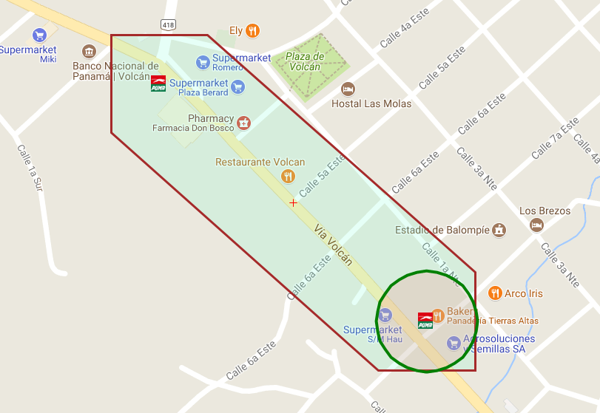

BCG Id 12002 – puma TIERRAS ALTAS
BCG ID | Loc Vol | Real Vol | Performance | Potential
12,002 | 75,532 | 125,720 | HI PERF | LOW POT
Gasoline: Excellent operations
Diesel: Excellent operations
Action Plan:
None

Slide 24



BCG Id 20650 – puma SAN JUAN CARRETERA
BCG ID | Loc Vol | Real Vol | Performance | Potential
20,650 | 85,120 | 102,910 | HI PERF | LOW POT
Gasoline: Performing at good level
Diesel: Excellent operations
Action Plan:
None

Slide 25



BCG Id 20706 – puma ANTON
BCG ID | Loc Vol | Real Vol | Performance | Potential
20,706 | 72,907 | 133,225 | HI PERF | LOW POT
Gasoline: Operational opportunities of 17KG Diesel: Excellent operations
Action Plan:
Facelift
Installation of preset in 3 pumps to be able to program
    Get discount accounts in local area.

Slide 26



BCG Id 20724 – puma FRONTERA
BCG ID | Loc Vol | Real Vol | Performance | Potential
20,724 | 65,563 | 225,450 | HI PERF | LOW POT
Gasoline: Excellent operations
Diesel: Excellent operations
Action Plan:
Substitution of high flow diesel dispenser was made (the one that is used the most and constantly failed) there will be efficiency in service.
Consistency in the service and image of the station

Slide 27



BCG Id 20874 – puma RIO SERENO
BCG ID | Loc Vol | Real Vol | Performance | Potential
20,874 | 35,213 | 160,000 | HI PERF | LOW POT
Gasoline: Excellent operations
Diesel: Excellent operations
Action Plan:
Facelift
Additional tank installation of 5K gal

Slide 28
High Potential – Low Performance

Slide 29



Bcg Id 336 – puma PANAMA
BCG ID | Loc Vol | Real Vol | Performance | Potential
336 | 92,593 | 65,532 | LOW PERF | HI POT
Gasoline: Operational opportunities of 22KG
Diesel: Operational opportunities of 5KG
Action Plan:
Negotiate change of operator (lease)
Getting the operator to solve cash flow problems (loan?)
Achieve commitment to the level of service (hire a supervisor)

Slide 30



BCG Id 341 - PUMA BETHANIA
BCG ID | Loc Vol | Real Vol | Performance | Potential
341 | 104,457 | 69,428 | LOW PERF | HI POT
Gasoline: Operational opportunities of 18KG
Diesel: Operational opportunities of 16KG
Action Plan:
    Rent or buy the station?
    Fleet Card
    Login to PASO A PASO
    Hire new employee on track
    Get discount accounts in local area.

Slide 31



BCG Id 507 – puma VISTA ALEGRE
BCG ID | Loc Vol | Real Vol | Performance | Potential
507 | 97,583 | 52,972 | LOW PERF | HI POT
Gasoline: Operational opportunities of 24KG
Diesel: Operational opportunities of 20KG
Action Plan:
    Facelift Bathrooms
    Achieve consistency in service level (commitment of the manager).
    Hire another employee on the track
    Get discount accounts in local area.

Slide 32



BCG ID 520 - PUMA VACAMONTE
BCG ID | Loc Vol | Real Vol | Performance | Potential
520 | 95,815 | 69,195 | LOW PERF | HI POT
Gasoline: Operational opportunities of 6KG
Diesel: Operational opportunities of 21KG
Action Plan:
None

Slide 33



BCG id 2007 - PUMA SAN JUAN PUEBLO
BCG ID | Loc Vol | Real Vol | Performance | Potential
2,007 | 90,621 | 34,303 | LOW PERF | HI POT
Gasoline: Operational opportunities of 36KG
Diesel: Operational opportunities of 19KG
Action Plan:
    Face lift for contract reinsurance,
    Get discount accounts in local area.
    Price Counseling,
    Improve service level (commitment of the station manager)

Slide 34



BCG Id 10223 - PUMA DAVID VIA AEROPUERTO
BCG ID | Loc Vol | Real Vol | Performance | Potential
10,223 | 89,473 | 52,403 | LOW PERF | HI POT
Gasoline: Operational opportunities of 22KG
Diesel: Operational opportunities of 14KG
Action Plan:
Facelift bathrooms
Pipeline customers discounts
Achieve consistency in the service (commitment of the manager)

Slide 35



BCG Id 10233 – puma DAVID INTERBOQUETE
BCG ID | Loc Vol | Real Vol | Performance | Potential
10,233 | 97,882 | 56,147 | LOW PERF | HI POT
Gasoline: Operational opportunities of 25KG
Diesel: Operational opportunities of 17KG
Action Plan:
Get the operator to solve cash flow problems (Loan?)
Achieve consistency in the service (commitment of the manager)

Slide 36



BCG Id 12011 – puma BUGABA
BCG ID | Loc Vol | Real Vol | Performance | Potential
12,011 | 99,784 | 42,825 | LOW PERF | HI POT
Gasoline: Operational opportunities of 26KG
Diesel: Operational opportunities of 30KG
Action Plan:
Fleet Card
Achieve consistency in service level
Install MID Digital
Add more staff on track attendants 24 HRS
Facelift

Slide 37



BCG Id 20647 – puma CAPIRA
BCG ID | Loc Vol | Real Vol | Performance | Potential
20,647 | 100,613 | 57,801 | LOW PERF | HI POT
Gasoline: Operational opportunities of 21KG
Diesel: Operational opportunities of 22KG
Action Plan:
Repair of pumps,
High flow pump (Evaluate access modification).
Consistency in the service
    Get discount accounts in local area.

Slide 38



BCG Id 20651 – puma CHITRE
BCG ID | Loc Vol | Real Vol | Performance | Potential
20,651 | 96,495 | 70,325 | LOW PERF | HI POT
Gasoline: Operational opportunities of 16KG
Diesel: Operational opportunities of 10KG
Action Plan:
Hire new employee on track
Pipeline of new customers

Slide 39



BCG Id 20653 – puma COQUITO
BCG ID | Loc Vol | Real Vol | Performance | Potential
20,653 | 106,480 | 29,902 | LOW PERF | HI POT
Gasoline: Operational opportunities of 30KG
Diesel: Operational opportunities of 44KG
Action Plan:
Implement the change of dispensers by contract reinsurance
Improve the service

Slide 40



BCG Id 20655 – puma URRACA
BCG ID | Loc Vol | Real Vol | Performance | Potential
20,655 | 94,310 | 69,527 | LOW PERF | HI POT
Gasoline: Operational opportunities of 6KG
Diesel: Operational opportunities of 19KG
Action Plan:
Change to CODO
Achieve commitment with operator service

Slide 41



BCG Id 20810 – puma penonome
BCG ID | Loc Vol | Real Vol | Performance | Potential
20,810 | 111,413 | 75,816 | LOW PERF | HI POT
Gasoline: Operational opportunities of 22KG
Diesel: Operational opportunities of 14KG
Action Plan:
Negotiate extension 2019
Improve image
Manage pipeline of new clients,
Add an employee
Place approximation signs

Slide 42
High Potential – High Performance

Slide 43



BCG Id 503 – puma CHORRERA EL COCO
BCG ID | Loc Vol | Real Vol | Performance | Potential
503 | 121,538 | 165,607 | HI PERF | HI POT
Gasoline: Excellent operations
Diesel: Performing at good level
Action Plan:
Change of operator,
Incorporate Ion Diesel
    Get discount accounts in local area.
Exceptional Service

Slide 44



BCG Id 504 – puma CHORRERA EDDIE
BCG ID | Loc Vol | Real Vol | Performance | Potential
504 | 115,198 | 133,512 | HI PERF | HI POT
Gasoline: Operational opportunities of 6KG
Diesel: Excellent operations
Action Plan:
Reinsurance contract lease.
Capture customers credit and discount
Transfer volume of handing to another site.
Improvements in label of the station.
Exceptional service
MID Digital

Slide 45



BCG Id 537 – puma CHORRERA
BCG ID | Loc Vol | Real Vol | Performance | Potential
537 | 112,952 | 131,986 | HI PERF | HI POT
Gasoline: Performing at good level
Diesel: Performing at good level
Action Plan:
Track asphalting
Increase bus route
    Get discount accounts in local area.

Slide 46



BCG Id 544 – puma HATO MONTANA
BCG ID | Loc Vol | Real Vol | Performance | Potential
544 | 114,882 | 158,838 | HI PERF | HI POT
Gasoline: Excellent operations
Diesel: Performing at expect level
Action Plan:
None

Slide 47



BCG Id 20831 – puma AEROPUERTO
BCG ID | Loc Vol | Real Vol | Performance | Potential
20,831 | 93,024 | 78,064 | HI PERF | HI POT
Gasoline: Excellent operations
Diesel: Operational opportunities of 5KG
Action Plan:
    Initiative of new access to the store, which leads directly to a high flow pump that benefits heavy vehicle revenue from the new terminal
    Get discount accounts in local area.

Slide 48



BCG Id 20836 – puma RODMAN
BCG ID | Loc Vol | Real Vol | Performance | Potential
20,836 | 108,937 | 174,700 | HI PERF | HI POT
Gasoline: Excellent operations
Diesel: Operational opportunities of 20KG
Action Plan:
Change of operator

