Slide 1

Puma Energy - Network Plan
El Salvador
TM: Carlos Castillo
Investments and Action Plans

Slide 2
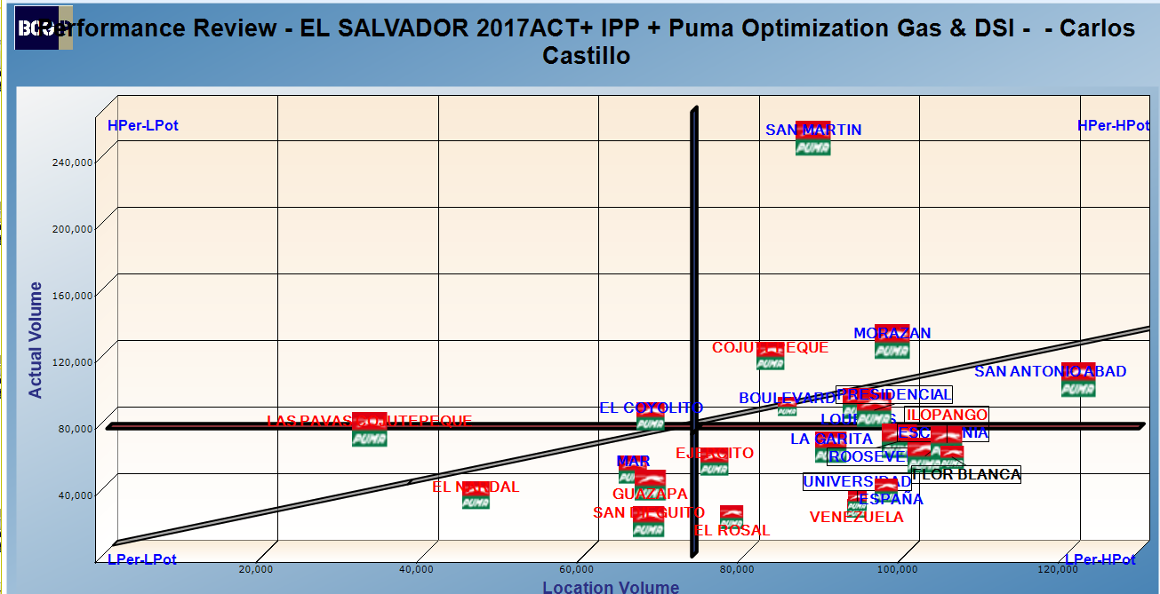
TM: CARLOS CASTILLO

Slide 3
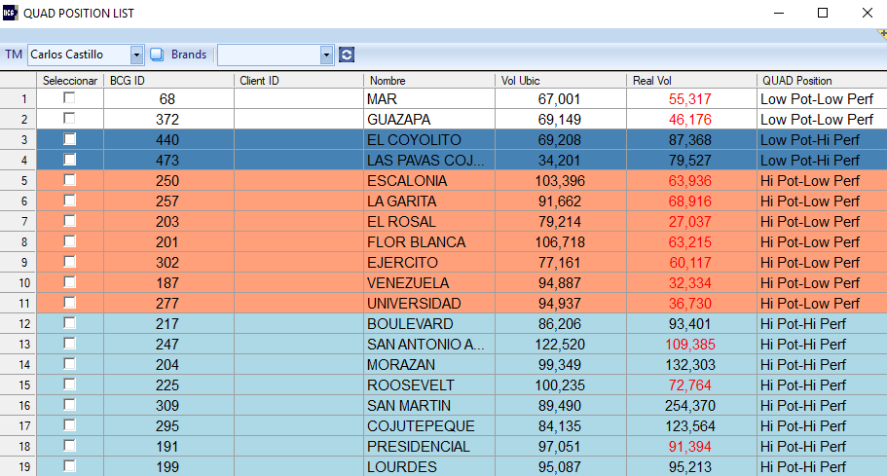
CARLOS CASTILLO

Slide 4
Low Potential – Low Performance

Slide 5
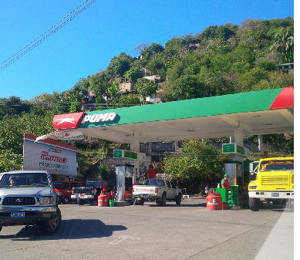
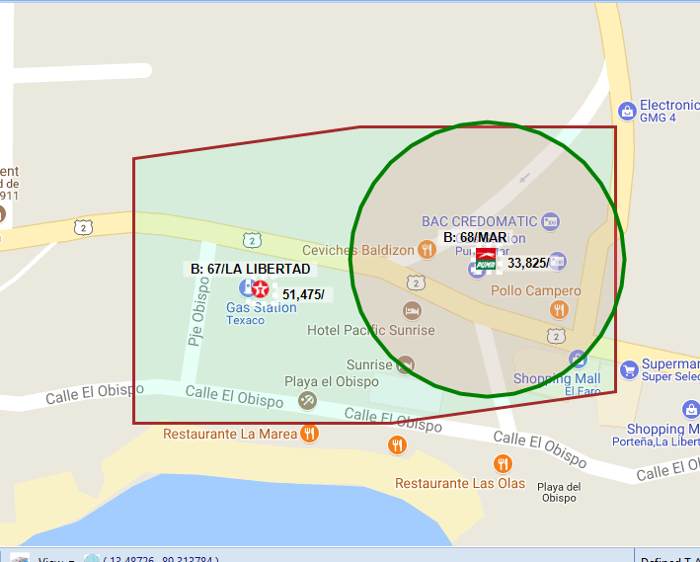
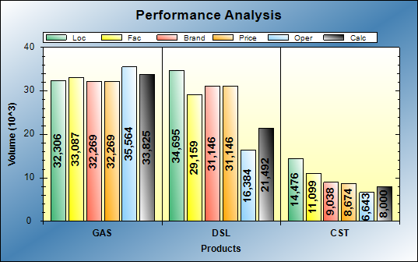
BCG ID 68 - PUMA MAR
BCG ID | Loc Vol | Real Vol | Performance | Potential
68 | 67001 | 55317 | LOW PERF | LOW POT
Gasoline: Performing at expected level
Diesel: Operational opportunities of 10KG
Action Plan:
Increase credit
Win back Alcaldía Pto. libertad

Slide 6
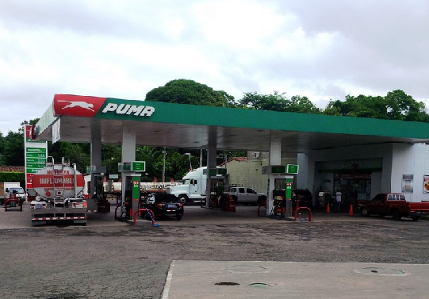
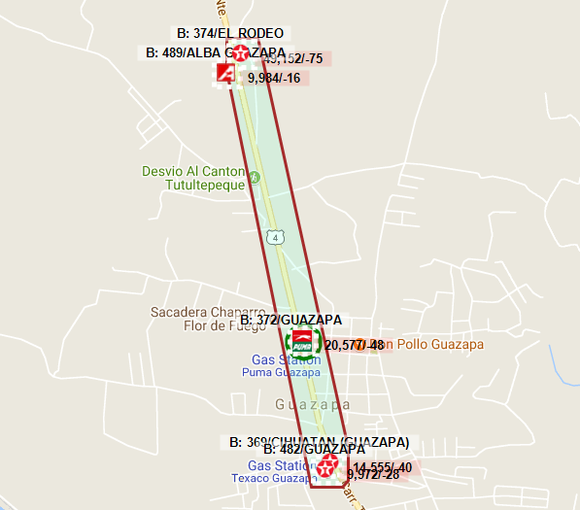
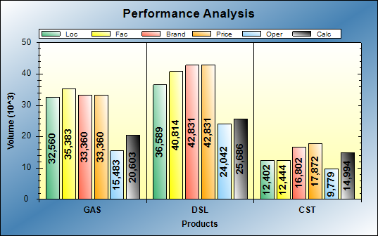
BCG id 372 - PUMA GUAZAPA
BCG ID | Loc Vol | Real Vol | Performance | Potential
372 | 69,149 | 46,176 | LOW PERF | LOW POT
Gasoline: Operational opportunities: 13KG
Diesel: Operational opportunities: 16KG
Action Plan:
Facelift for image consistency.
Service consistency via Puma Program
Get discount accounts in local area.

Slide 7
Low Potential – High Performance

Slide 8
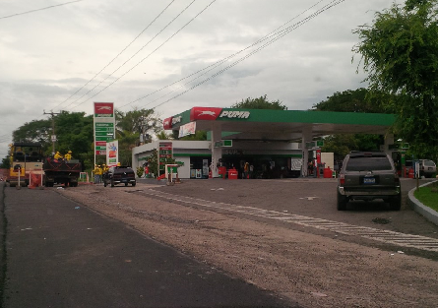
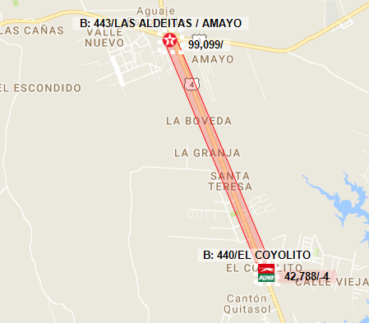
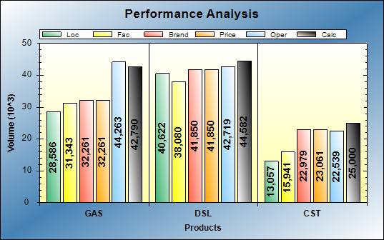
Bcg Id 440 - PUMA EL COYOLITO
BCG ID | Loc Vol | Real Vol | Performance | Potential
440 | 69,208 | 87,368 | HI PERF | LOW POT
Gasoline: Performing at excellent level
Diesel: Performing at expect level
Action Plan:
Add a used pump of 3 products to make the service more efficient
Continue improving service consistency with Paso

Slide 9
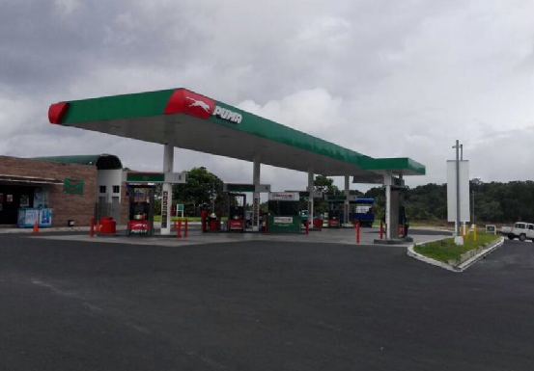
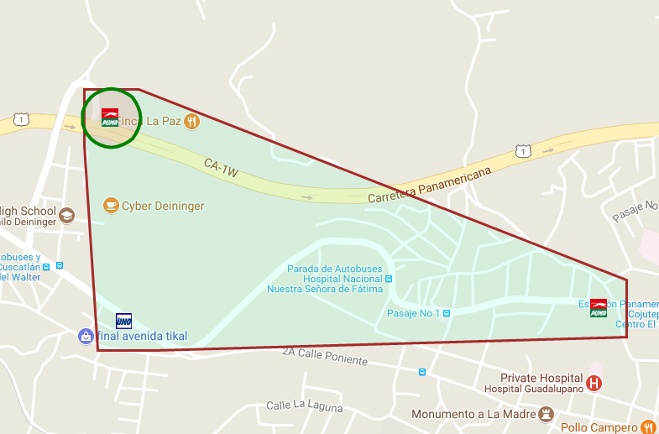
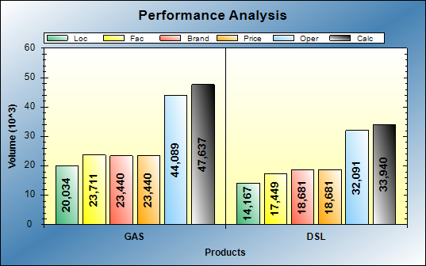
Bcg Id 473 - PUMA LAS PAVAS COJUTEPEQUE
BCG ID | Loc Vol | Real Vol | Performance | Potential
473 | 34,201 | 79,527 | HI PERF | LOW POT
Gasoline: Performing at excellent level
Diesel: Performing at excellent level
Action Plan:
Add used pump of 3 products to make the service more efficient
Continue improving service consistency with Paso
Image consistency

Slide 10
High Potential – Low Performance

Slide 11
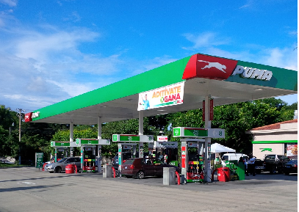
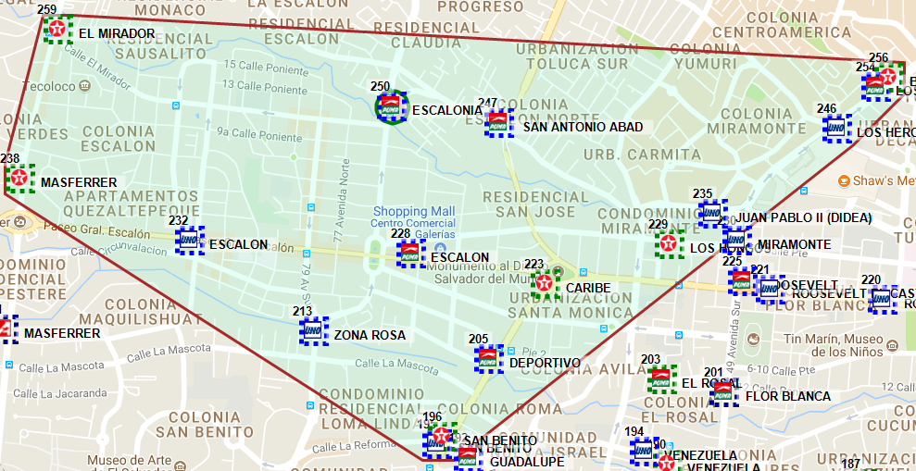
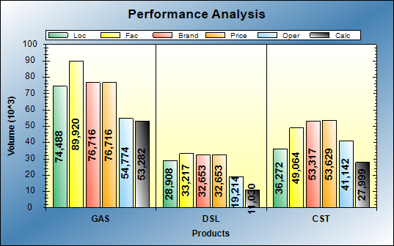
Bcg Id 250 - Puma ESCALONIA
BCG ID | Loc Vol | Real Vol | Performance | Potential
250 | 103,396 | 63,936 | LOW PERF | HI POT
Gasoline: Operational opportunities of 22KG Diesel: Operational opportunities of 21KG
Action Plan:
Increase in MOGAS:
  Increase of employees during peak hours
  Focus on service and image consistency
DIESEL:
  Get discount accounts in local area.

Slide 12
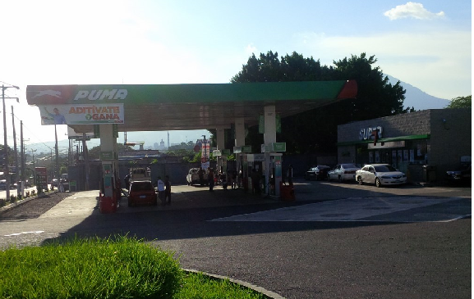
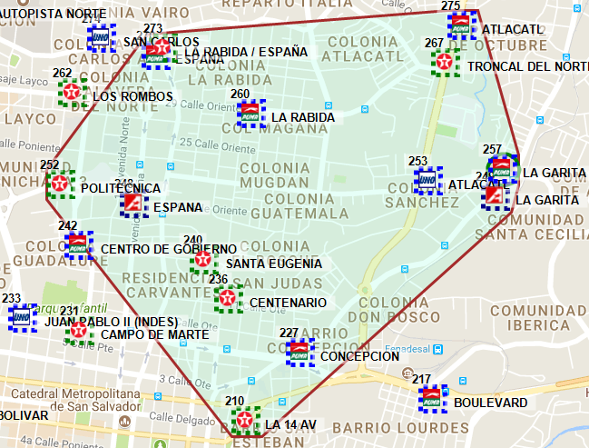
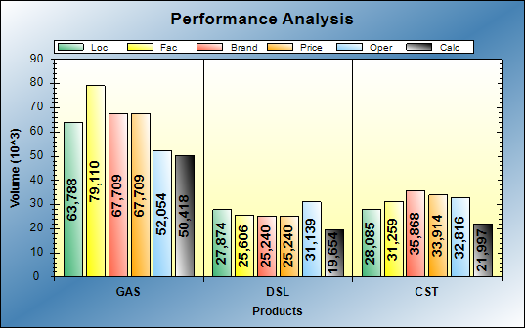
Bcg Id 257 - PUMA LA GARITA
BCG ID | Loc Vol | Real Vol | Performance | Potential
257 | 91,662 | 68,916 | LOW PERF | HI POT
Gasoline: Operational opportunities of 17KG Diesel: Operational opportunities of 6KG
Action Plan:
Increase in MOGAS:
  Focus on service and image consistency
DIESEL:
  Get discount accounts in local area.
  Open 24 hours

Slide 13
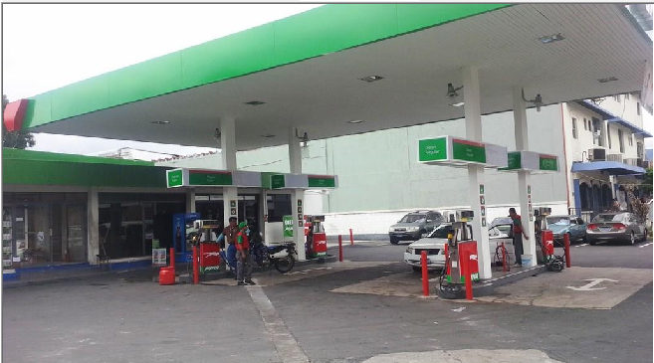
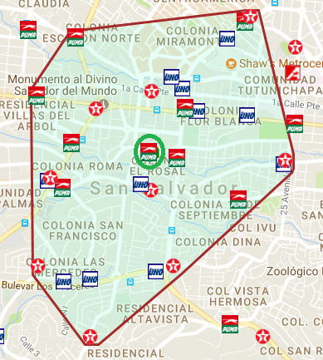
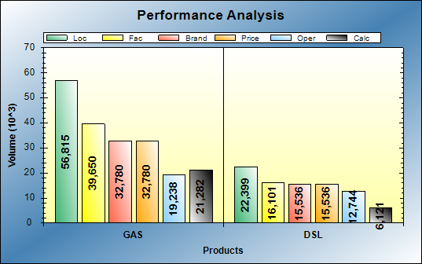
Bcg Id 203 - Puma el rosal
BCG ID | Loc Vol | Real Vol | Performance | Potential
203 | 79,214 | 27,037 | LOW PERF | HI POT
Gasoline: Small facilities and Brand contribution limit outlet potential.
Operational opportunity: 11KG
Diesel: Operational opportunities of 6KG
Action Plan:
Get discount accounts in local area
Participation in tenders
Versatec: service consistency

Slide 14
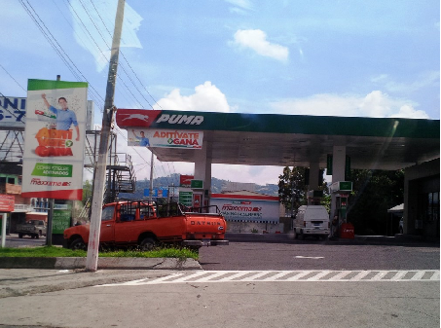
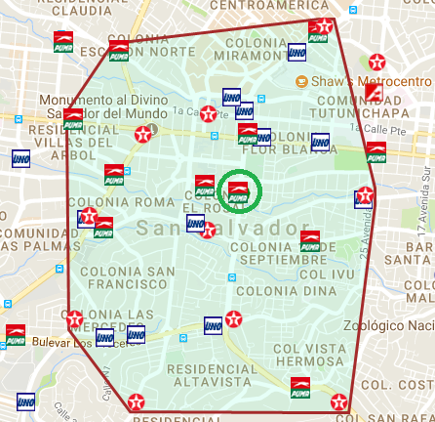
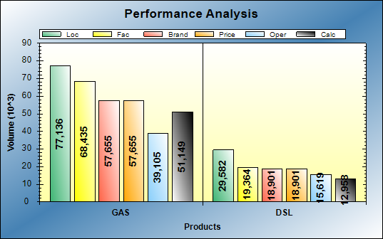
Bcg Id 201 - PUMA FLOR BLANCA
BCG ID | Loc Vol | Real Vol | Performance | Potential
201 | 106,718 | 63,215 | LOW PERF | HI POT
Gasoline: Operational opportunity of 6KG
Diesel: Operational opportunities of 6KG
Action Plan:
Change to a price digital sign
Promote the lube center
Push dealer
Get discount accounts in local area

Slide 15
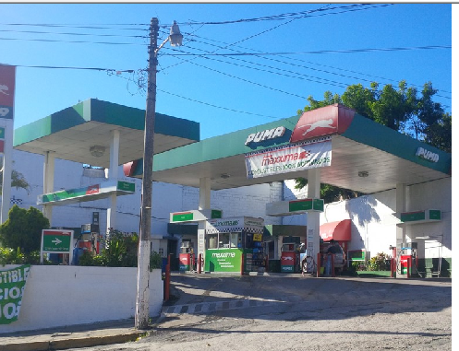
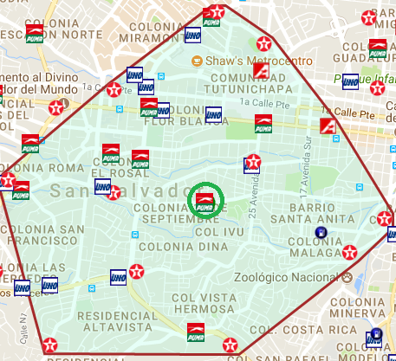
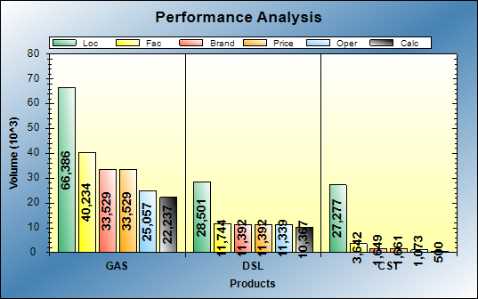
Bcg Id 187 - PUMA VENEZUELA
BCG ID | Loc Vol | Real Vol | Performance | Potential
187 | 94,887 | 32,334 | LOW PERF | HI POT
Gasoline: Small facilities and Brand contribution limit outlet potential.
Operational opportunity: 18KG
Diesel: Operational opportunities of 6KG
Action Plan:
Maintain a good station image
Get discount accounts in local area
Competitive prices

Slide 16
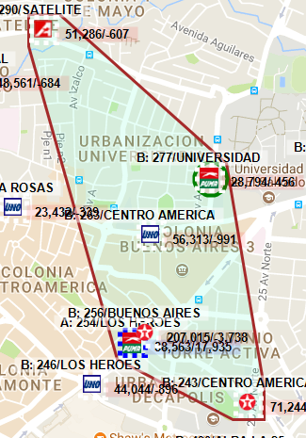
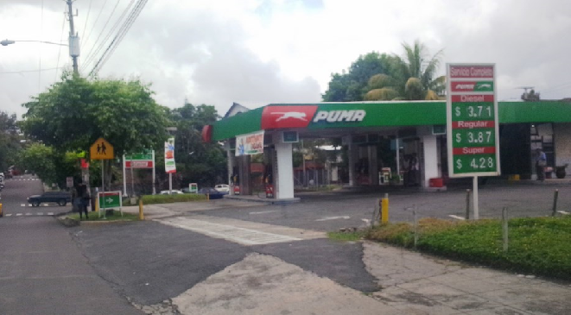
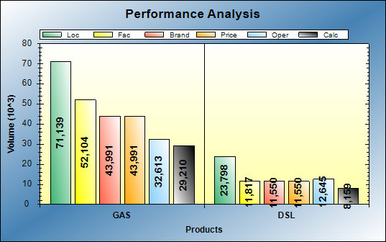
Bcg Id 277 - PUMA UNIVERSIDAD
BCG ID | Loc Vol | Real Vol | Performance | Potential
277 | 94,937 | 36,730 | LOW PERF | HI POT
Gasoline: Operational opportunity of 13KG
Diesel: Operational opportunities of 3KG
Action Plan:
D&R of canopy $100k
Replacement of tanks and pipes $100k

Slide 17
High Potential – High Performance

Slide 18
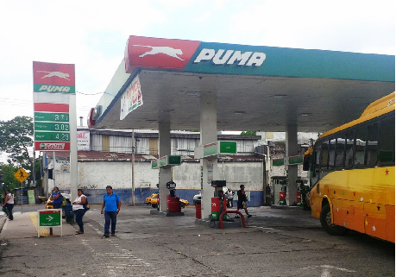
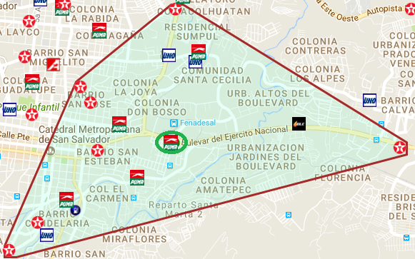
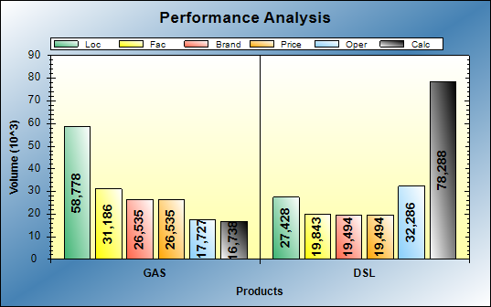
BCG Id 217 – puma boulevard
BCG ID | Loc Vol | Real Vol | Performance | Potential
217 | 86,206 | 93,401 | HI PERF | HI POT
Gasoline: Gasoline performance is hindered by diesel business
Diesel: Excellent operations
Action Plan:
High Flow diesel pump
Invest in Ruby system set
Work on diesel price competiveness
Win back transportation companies via discounts
Service and image consistency

Slide 19
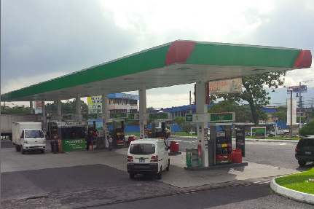
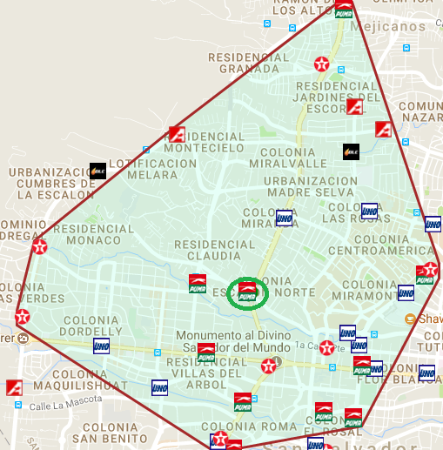
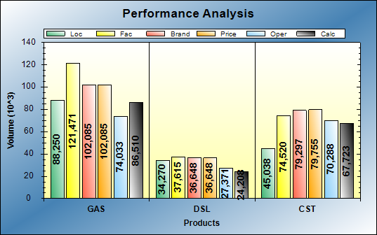
Bcg Id 247 – puma san antonio abad
BCG ID | Loc Vol | Real Vol | Performance | Potential
247 | 122,520 | 109,385 | HI PERF | HI POT
Gasoline: Excellent operations
Diesel: Operational opportunities of 12KG
Action Plan:
Solve operational problems
Have sufficient staff in peaks hours
Service and image consistency
Get discount accounts in local area

Slide 20
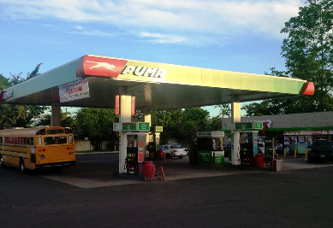
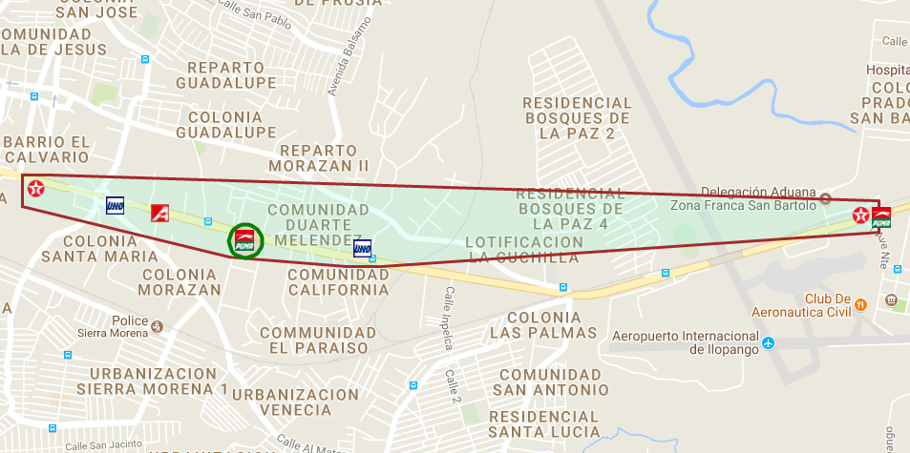
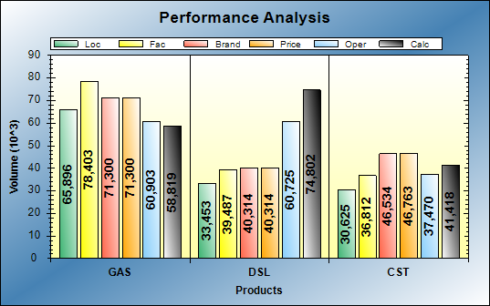
Bcg Id 204 – puma morazan
BCG ID | Loc Vol | Real Vol | Performance | Potential
204 | 99,349 | 132,303 | HI PERF | HI POT
Gasoline: Operational opportunities of 13KG Diesel: Excellent operations
Action Plan:
New access trough back of the store that leads directly to a high flow pump
Release flow in canopy pumps.
Get discount accounts in local area

Slide 21
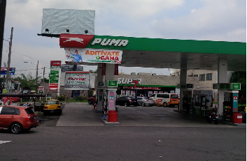
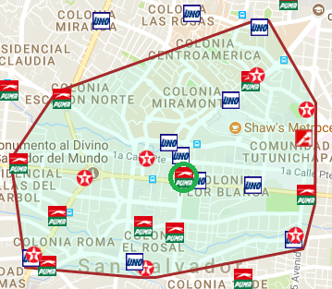
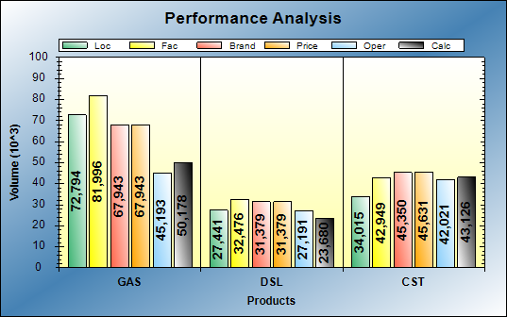
Bcg Id 225 – puma roosevelt
BCG ID | Loc Vol | Real Vol | Performance | Potential
204 | 99,349 | 132,303 | HI PERF | HI POT
Gasoline: Operational opportunities of 17KG Diesel: Operational opportunities of 8KG
Action Plan:
Get discount accounts in local area
Service and image consistency
Add Premium Gasoline on pumps 3/4 and 7/8 an reducer ION in the same pumps
Hire a person on the track after 10 pm

Slide 22
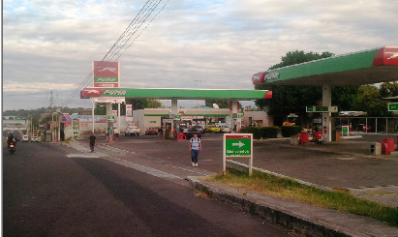
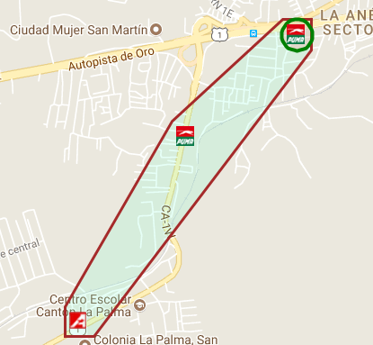
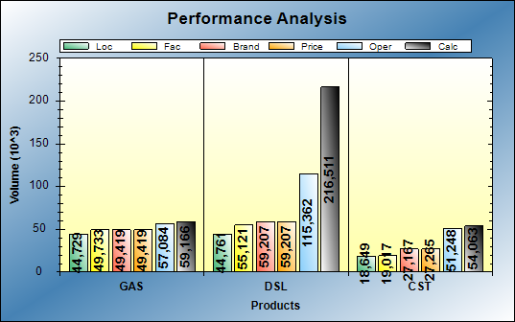
Bcg Id 309 – puma san martin
BCG ID | Loc Vol | Real Vol | Performance | Potential
309 | 89,490 | 254,370 | HI PERF | HI POT
Gasoline: Performing at expect level
Diesel: Excellent operations
Action Plan:
Substitution of high flow diesel dispenser was made there will be efficiency in service
Service and image consistency

Slide 23
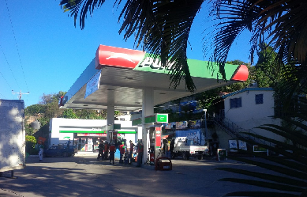
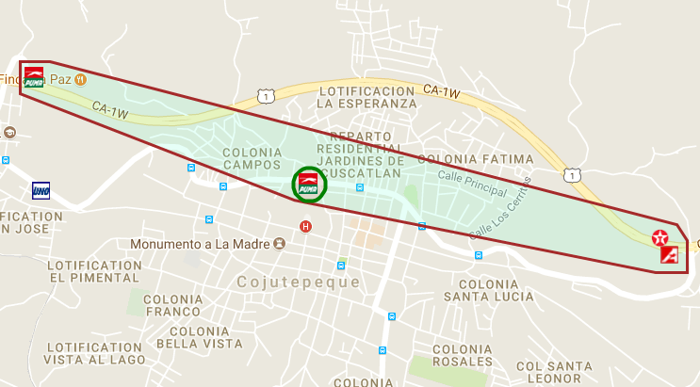
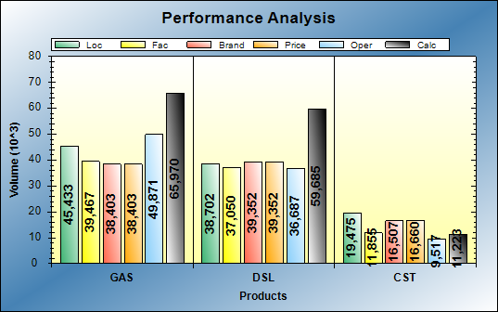
Bcg Id 295 – puma cojutepeque
BCG ID | Loc Vol | Real Vol | Performance | Potential
295 | 84,135 | 123,564 | HI PERF | HI POT
Gasoline: Excellent operations
Diesel: Excellent operations
Action Plan:
Contract renewal.
Make an offer on CODO station before the expiration of the current contract

Slide 24



BCG Id 191 - Puma Presidencial
BCG ID | Loc Vol | Real Vol | Performance | Potential
191 | 97,051 | 91,394 | HI PERF | HI POT
Gasoline: Operational opportunities of 11KG
Diesel: Performing at expect level
Action Plan:
Retrain full and self service attendants
MOGAS:
  Focus on track service consistency
DIESEL:
  Get discount accounts in local area
  Maintain an excellent image of the station

Slide 25



BCG Id 199 – puma lourdes
BCG ID | Loc Vol | Real Vol | Performance | Potential
199 | 95,087 | 95,213 | HI PERF | HI POT
Gasoline: Operational opportunities of 21KG
Diesel: Excellent operations
Action Plan:
Maintain the level of current service
Get discount accounts in local area

