Slide 1
Executive summary PUERTO RICO
Prepared for
PUMA ENERGY
by
Bravo Consulting Group, Inc.
Febrero 2015

Slide 2
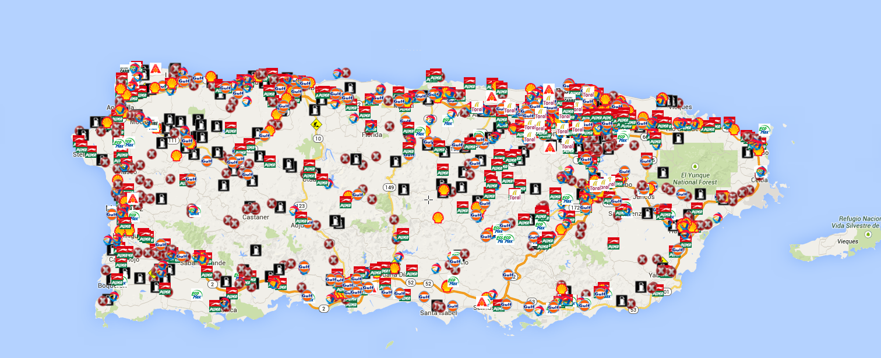
Market area

Slide 3
Market summary - gasoline
Bravo Consulting Group

Slide 4
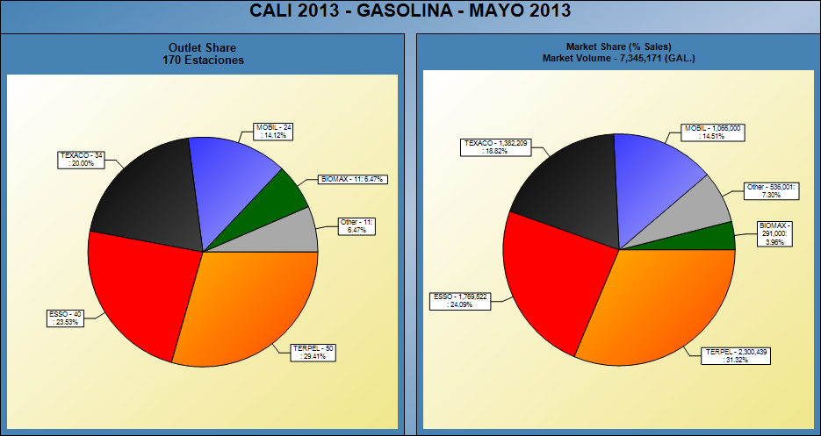
gasoline shares - 2014

Slide 5
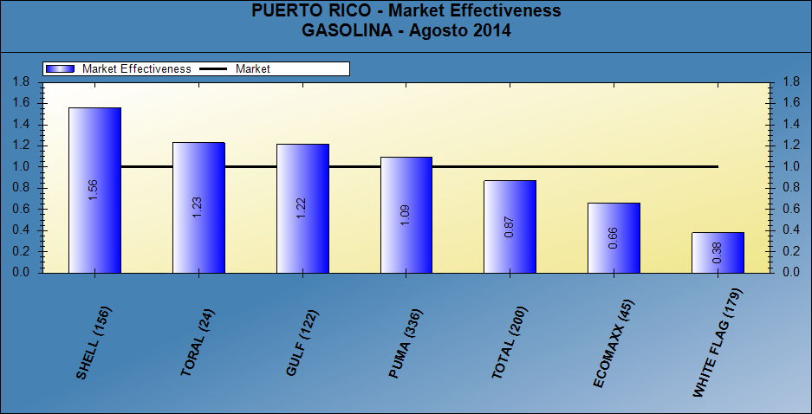
Gasoline market effectiveness

Slide 6
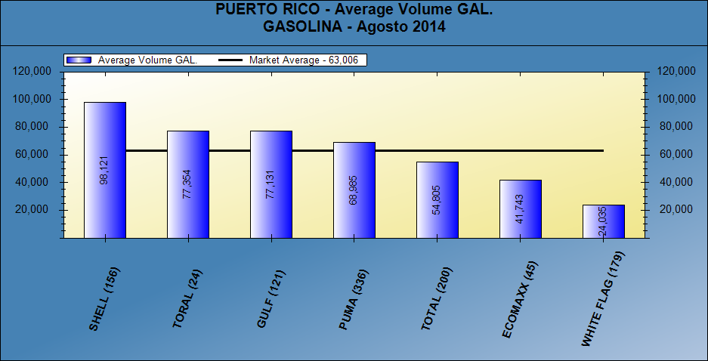
Gasoline average volumes

Slide 7
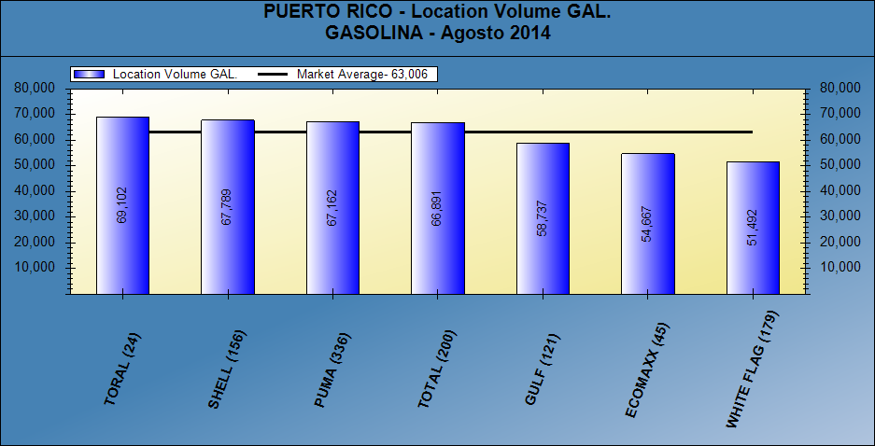
Location volume - gasoline

Slide 8
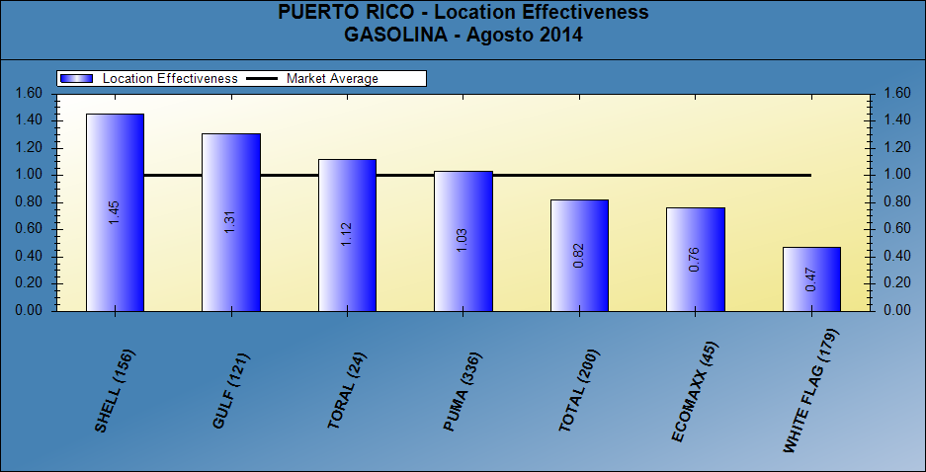
Location volume effectiveness - gasoline

Slide 9
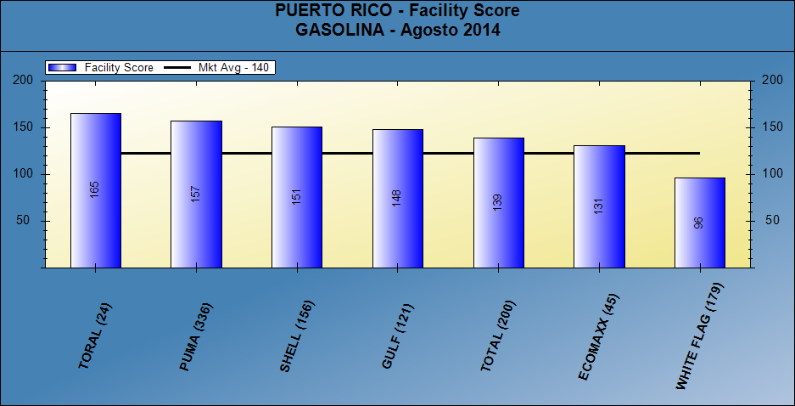
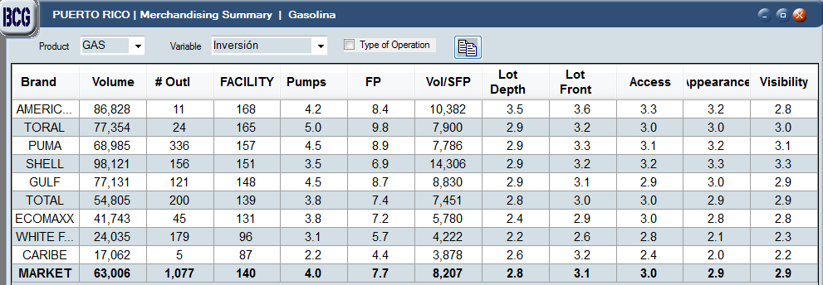
Facility score - gasoline

Slide 10
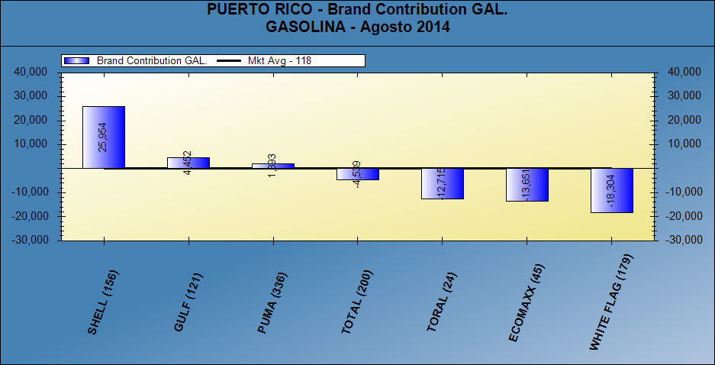
Brand contribution - gasoline

Slide 11
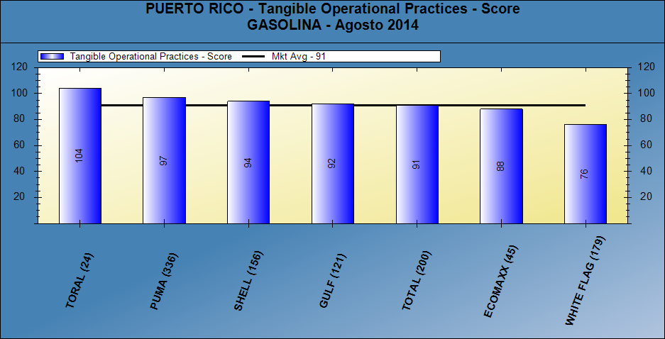
Merchandising score - gasoline

Slide 12
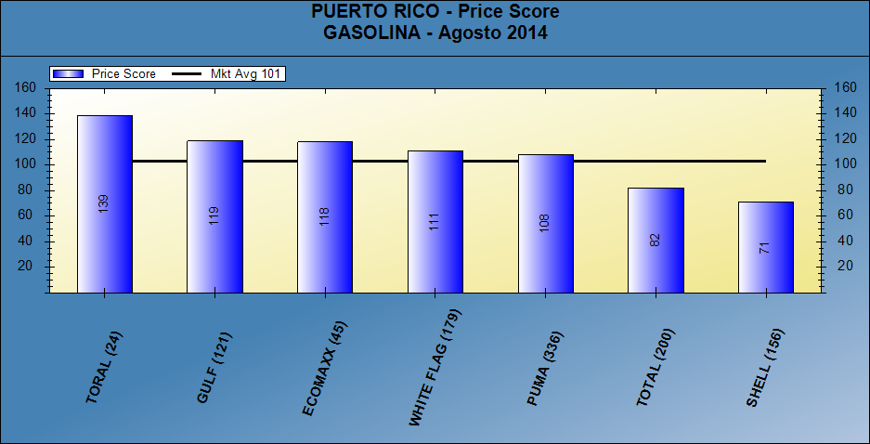
Pricing posture - gasoline

Slide 13
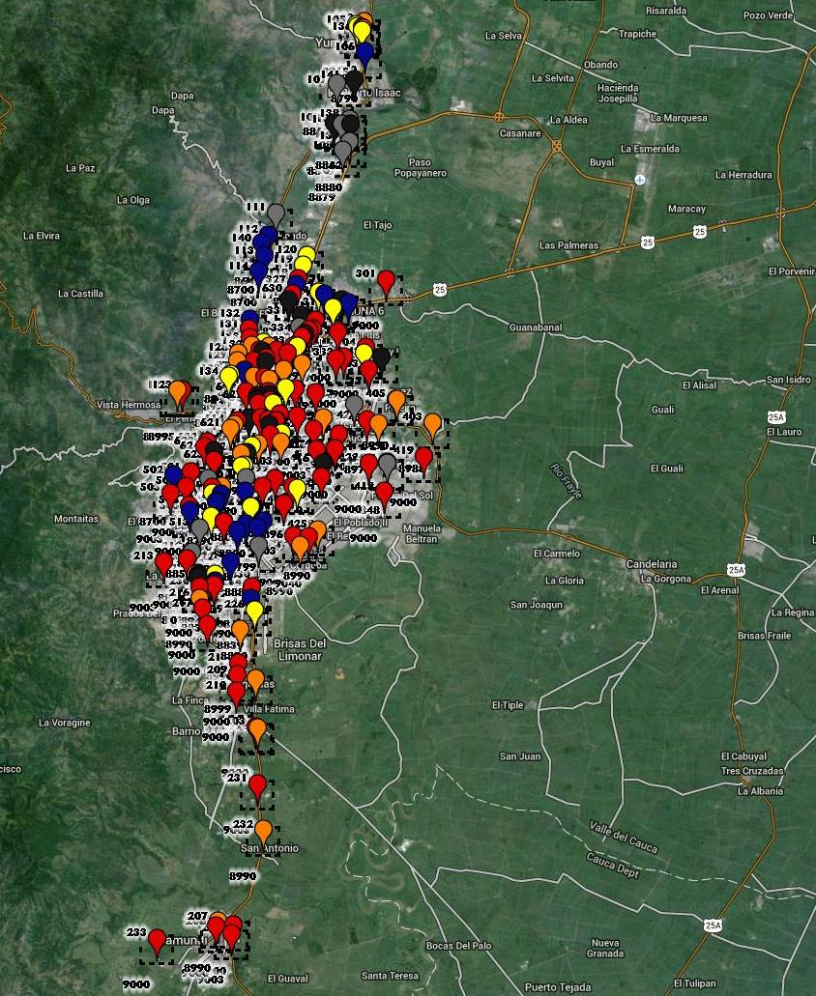
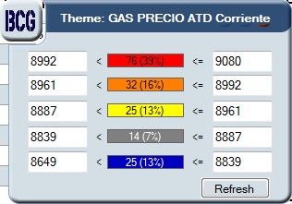
Price thematic map - gasoline

Slide 14
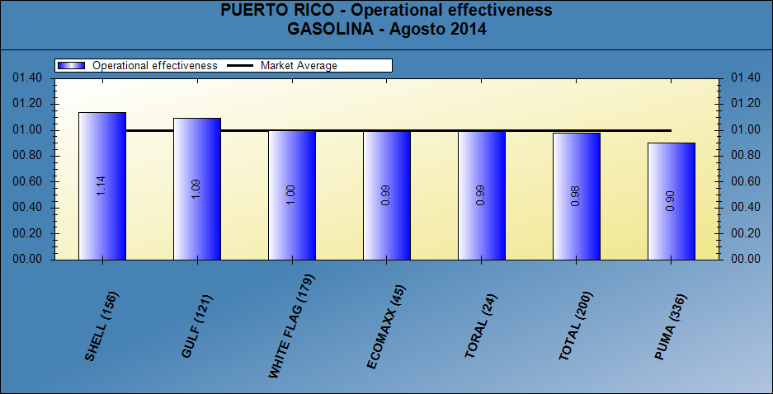
dealer (intangible) contribution - gasoline

Slide 15
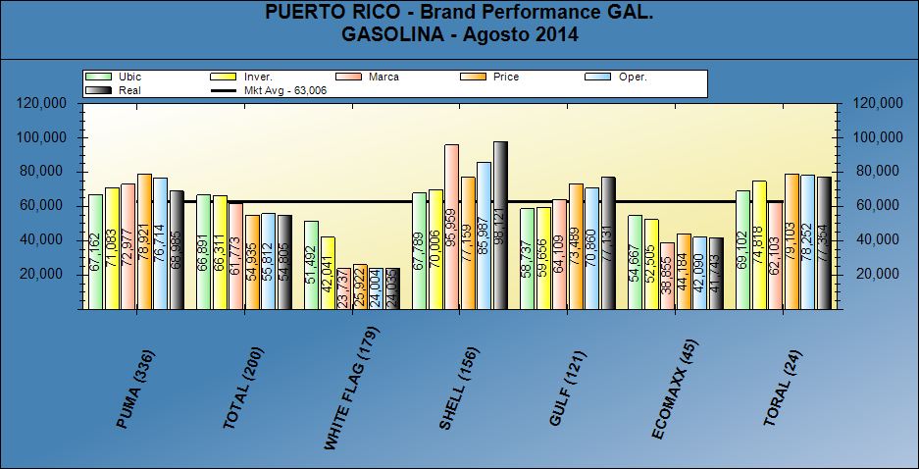
Brand performance - gasoline

Slide 16
Market summary - gasoline

Slide 17
Market summary - diesel
Bravo Consulting group

Slide 18
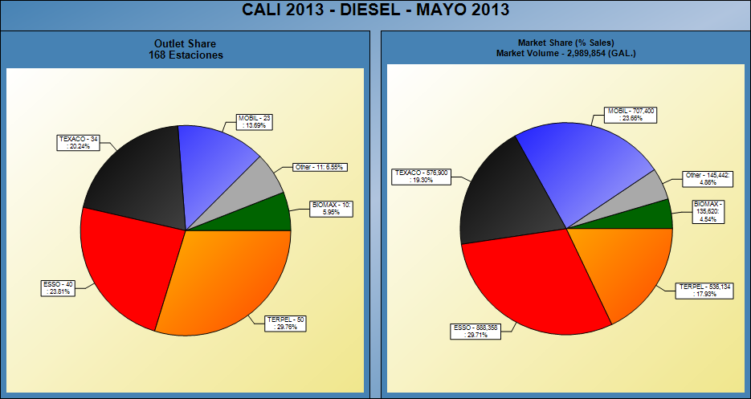
diesel shares - 2014

Slide 19
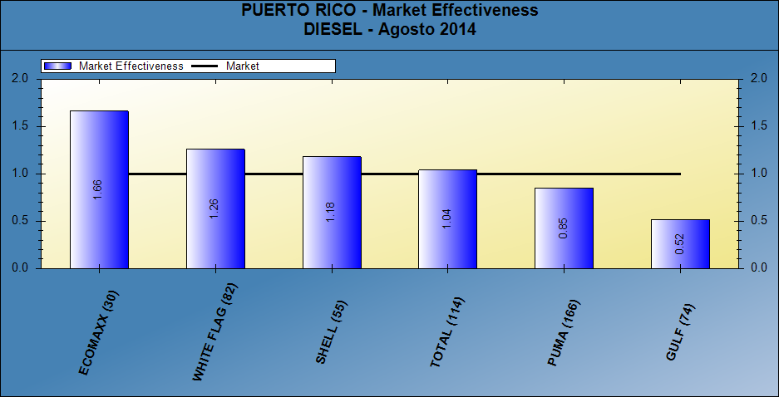
market effectiveness - diesel

Slide 20
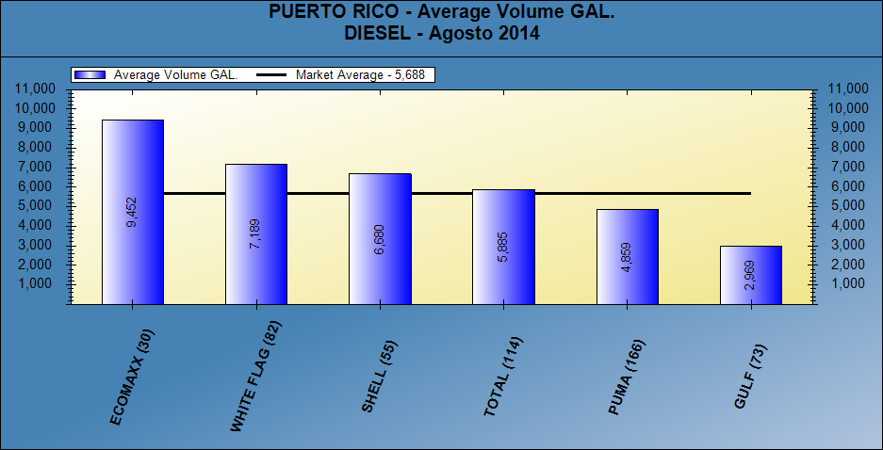
average volumes - diesel

Slide 21
Location volume - diesel

Slide 22
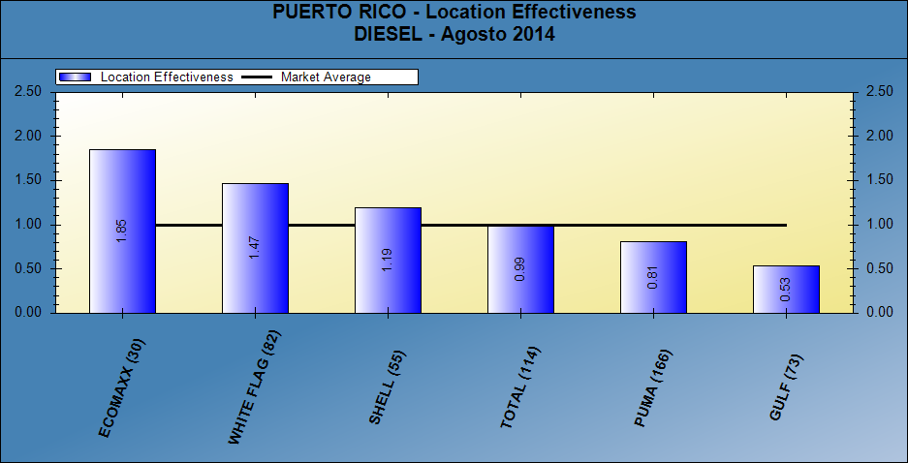
Location effectiveness - diesel

Slide 23
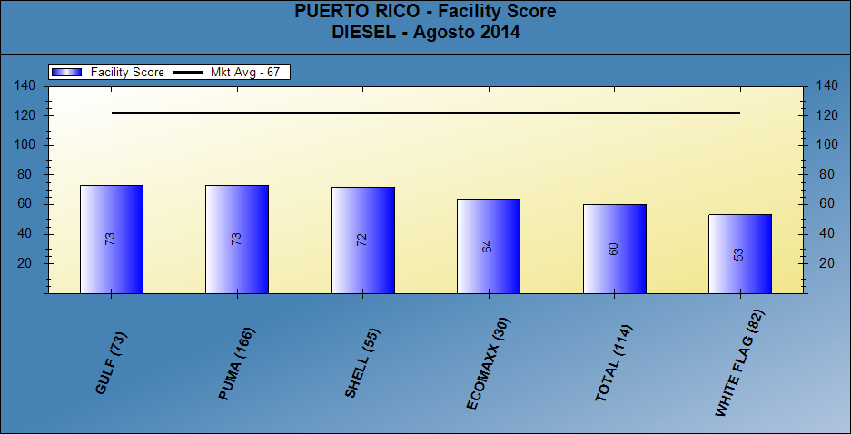
Facility score - diesel

Slide 24
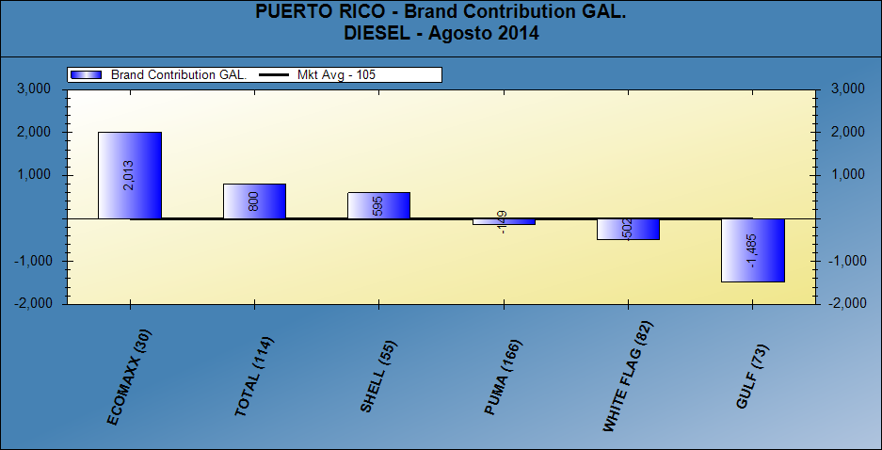
Brand consistency - diesel

Slide 25
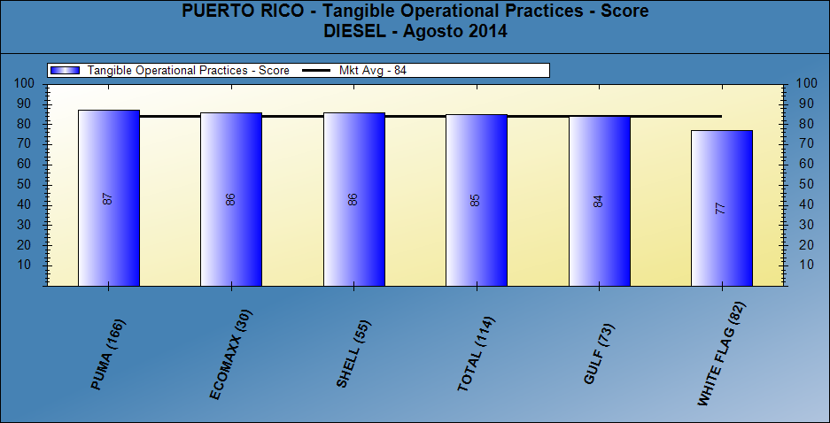
Merchandising score - diesel

Slide 26
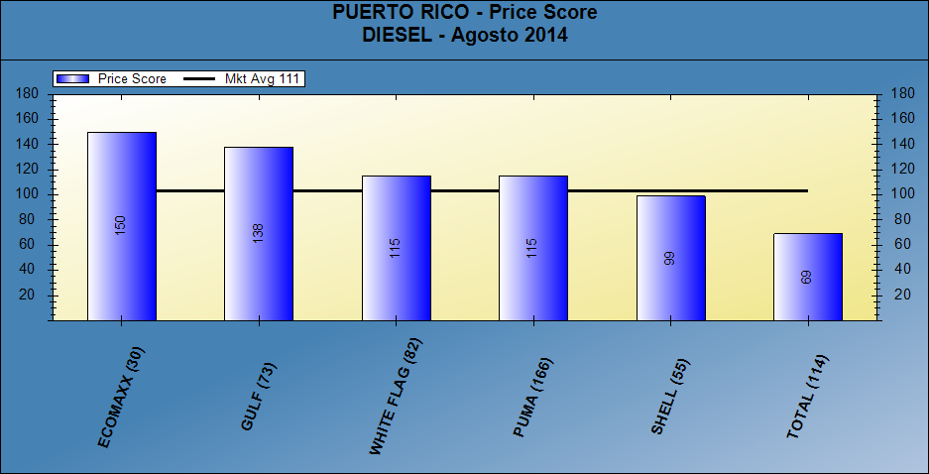
Price score - diesel

Slide 27
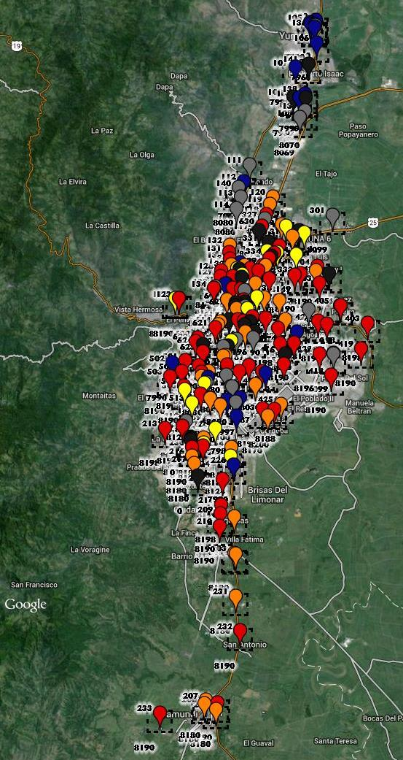
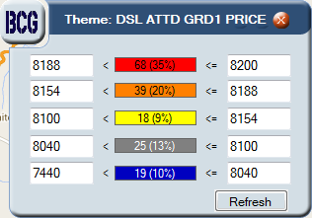
Price thematic map - diesel

Slide 28
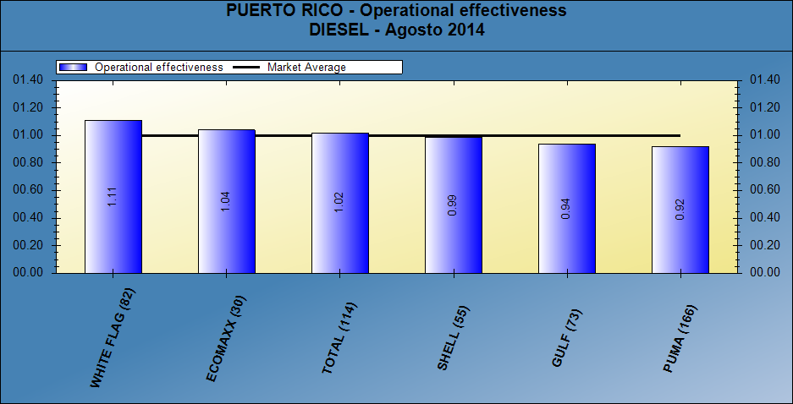
Operational effectiveness - diesel

Slide 29
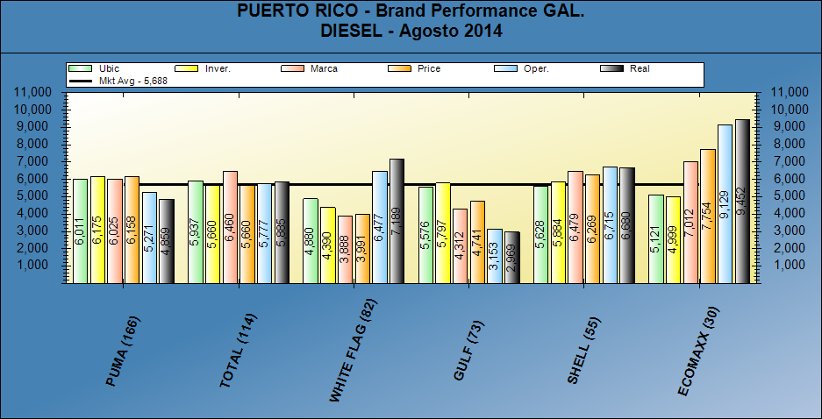
Brand performance - diesel

Slide 30
Market summary - diesel

Slide 31
Performance analysis gasoline & diesel
Bravo Consulting group

Slide 32
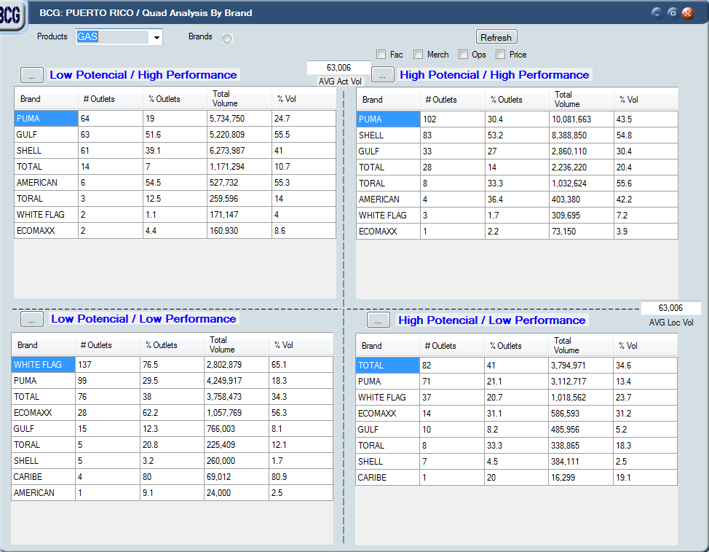
Performance analysis– Gasoline & Diesel

