Slide 1
Executive summary BogotA
Prepared for
PUMA ENERGY
by
Bravo Consulting Group, Inc.
October 2014

Slide 2
Market area

Slide 3
Market summary - gasoline
Bravo Consulting Group

Slide 4
gasoline shares - 2014

Slide 5
Gasoline market effectiveness

Slide 6
Gasoline average volumes

Slide 7
Location volume - gasoline

Slide 8
Location volume effectiveness - gasoline

Slide 9
Facility score - gasoline

Slide 10
Brand contribution - gasoline

Slide 11
Merchandising score - gasoline

Slide 12
Pricing posture - gasoline

Slide 13
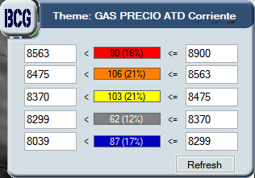
Price thematic map - gasoline

Slide 14
dealer (intangible) contribution - gasoline

Slide 15
Brand performance - gasoline

Slide 16
Market summary - gasoline

Slide 17
Market summary - diesel
Bravo Consulting group

Slide 18
diesel shares - 2014

Slide 19
market effectiveness - diesel

Slide 20
average volumes - diesel

Slide 21
Location volume - diesel

Slide 22
Location effectiveness - diesel

Slide 23
Facility score - diesel

Slide 24
Brand consistency - diesel

Slide 25
Merchandising score - diesel

Slide 26
Price score - diesel

Slide 27
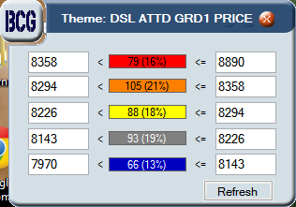
Price thematic map - diesel

Slide 28
Operational effectiveness - diesel

Slide 29
Brand performance - diesel

Slide 30
Market summary - diesel

Slide 31
Performance analysis gasoline & diesel
Bravo Consulting group

Slide 32
Performance analysis– Gasoline & Diesel

Slide 33
Market summary - GNV
Bravo Consulting group

Slide 34
GNV shares - 2014

Slide 35
Gnv market effectiveness

Slide 36
Average volume - gnv

Slide 37
Location volume - gnv

Slide 38
Location effectiveness - gnv

Slide 40
Brand consistency - gnv

Slide 41
Merchandising score - GNV

Slide 42
Price posture - gnv

Slide 43
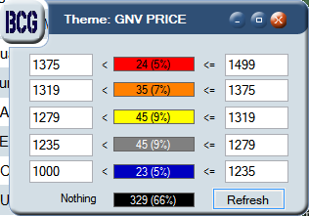
Price thematic map - gnv

Slide 44
Operational effectiveness - gnv

Slide 45
Brand performance - gnv

Slide 46
Market summary - gnv

