Slide 1
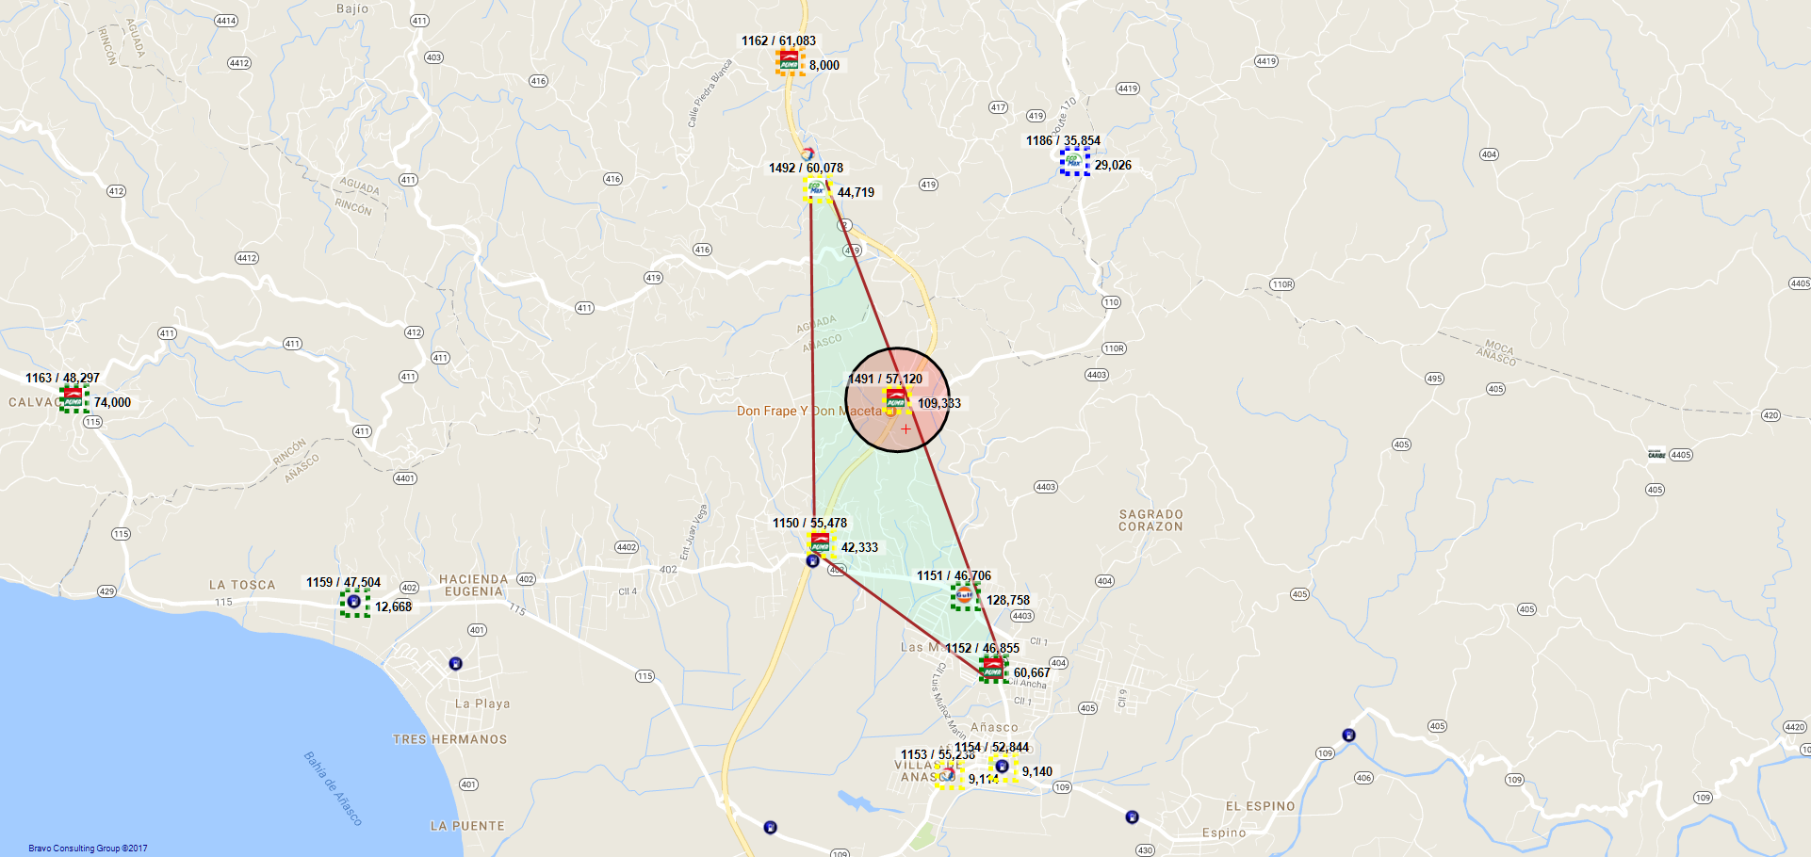
1491 / VP PETROLEUM INC. - 919 - ANASCO

Slide 2
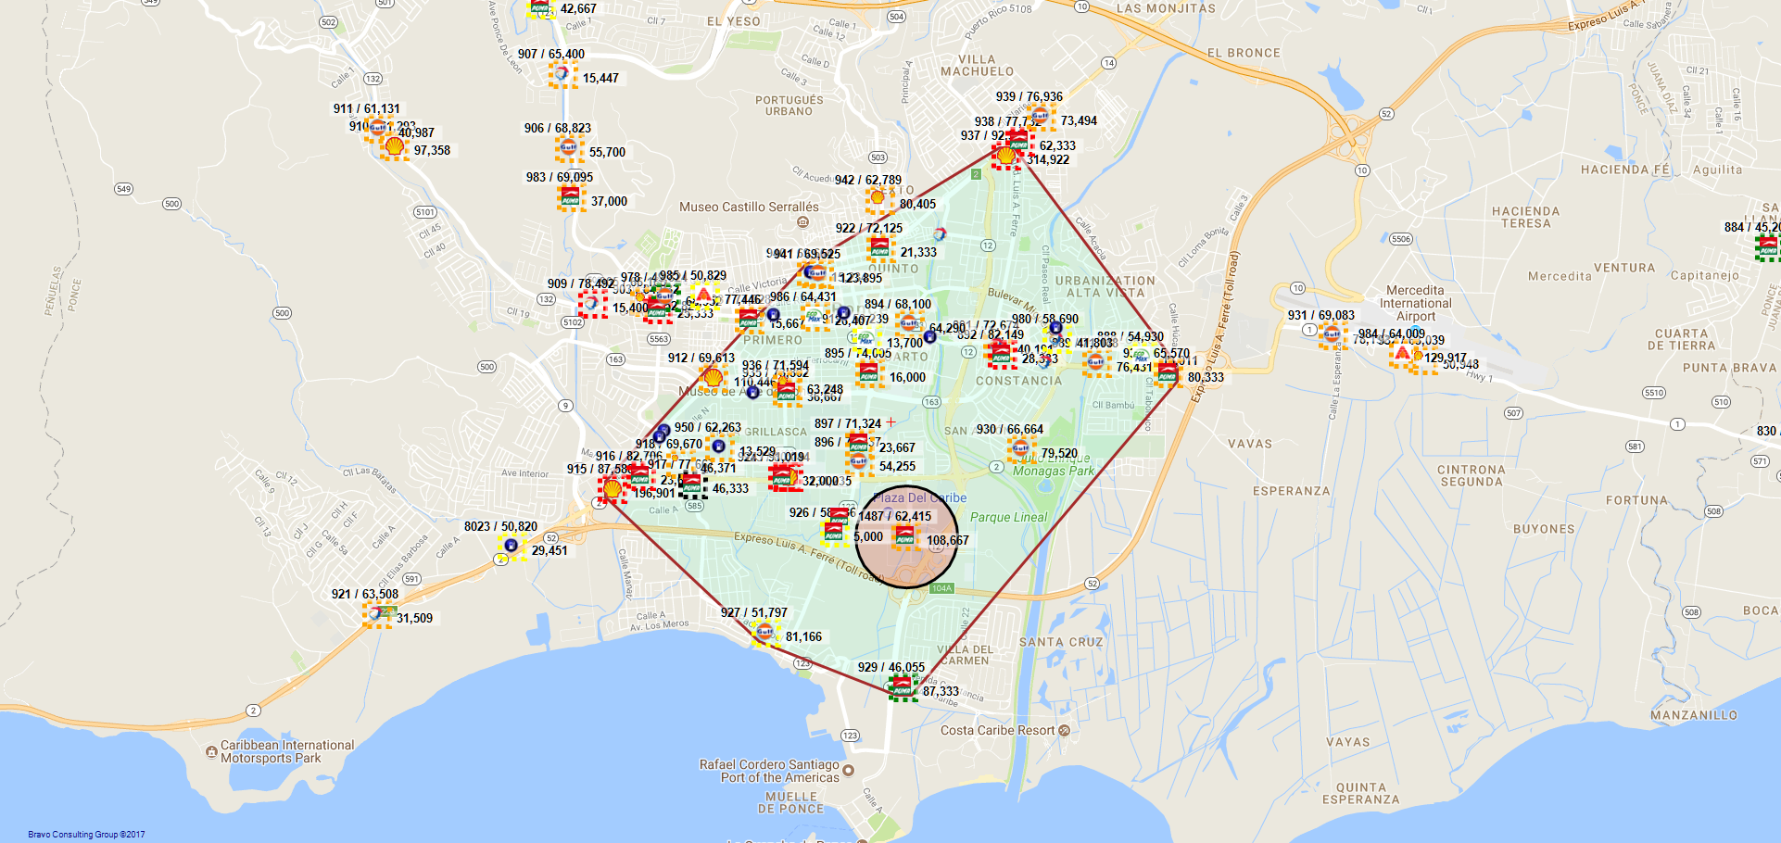
1487 / MISTER MAGIC C/W INC. - 904 - PONCE

Slide 3
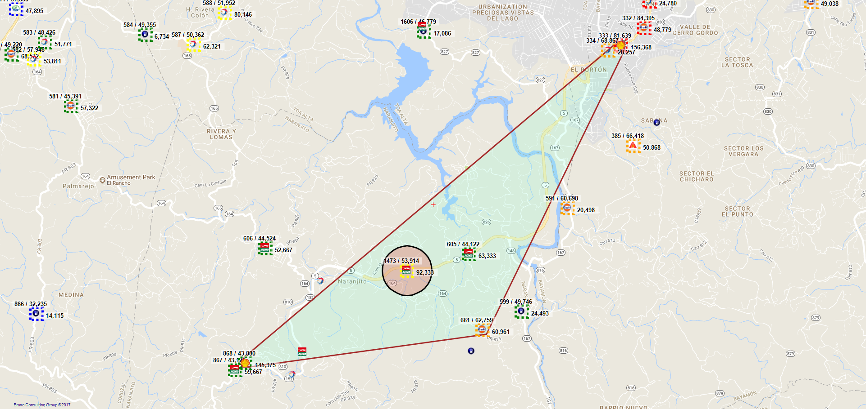
1473 / GAMA GROUP, INC. - 300 - NARANJITO

Slide 4
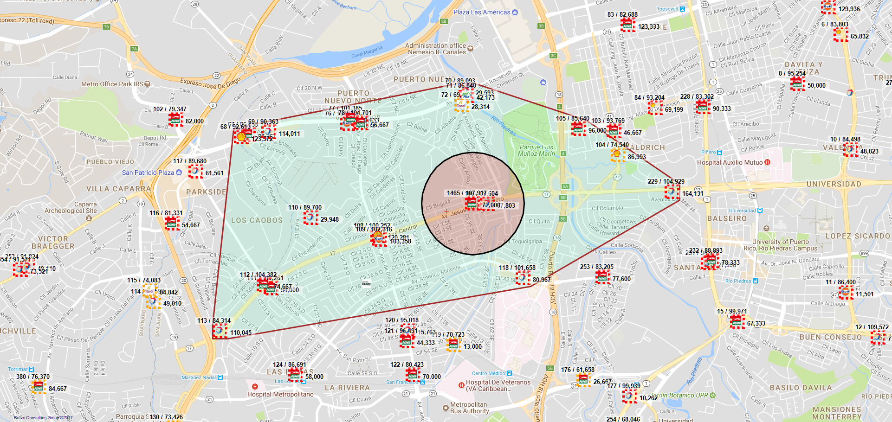
1465 / GUERRA 5, INCORPORADO - 119 - SAN JUAN

Slide 5
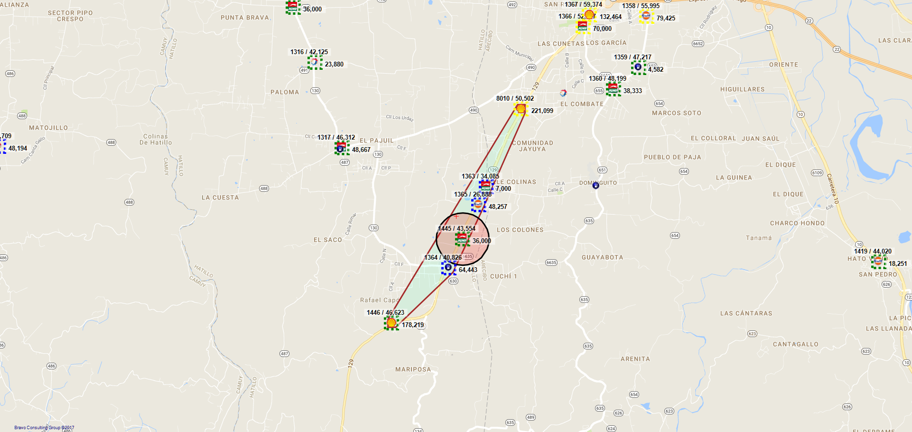
1445 / TOP GASOLINE LLC - 997 - HATILLO

Slide 6
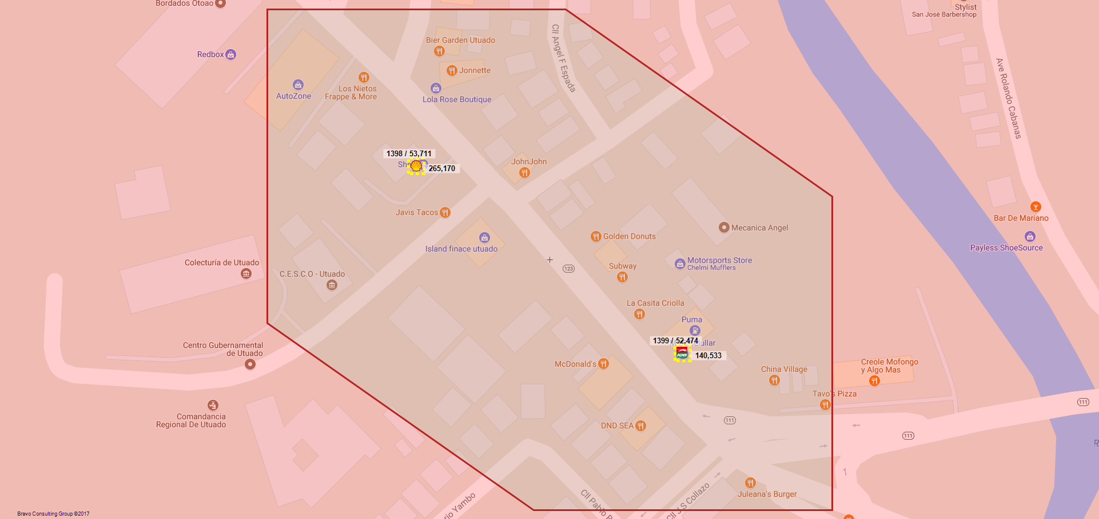
1399 / VP PETROLEUM - UTUADO - 793 - UTUADO

Slide 7
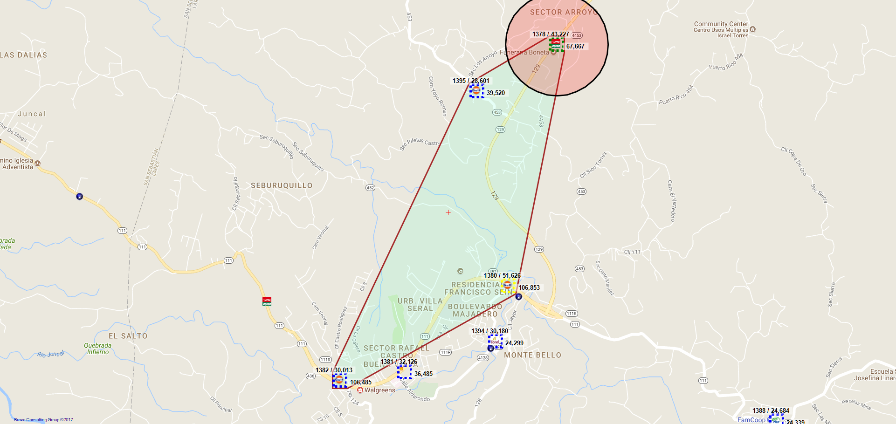
1378 / LUZ N GONZALEZ VELEZ - 578 - LARES

Slide 8
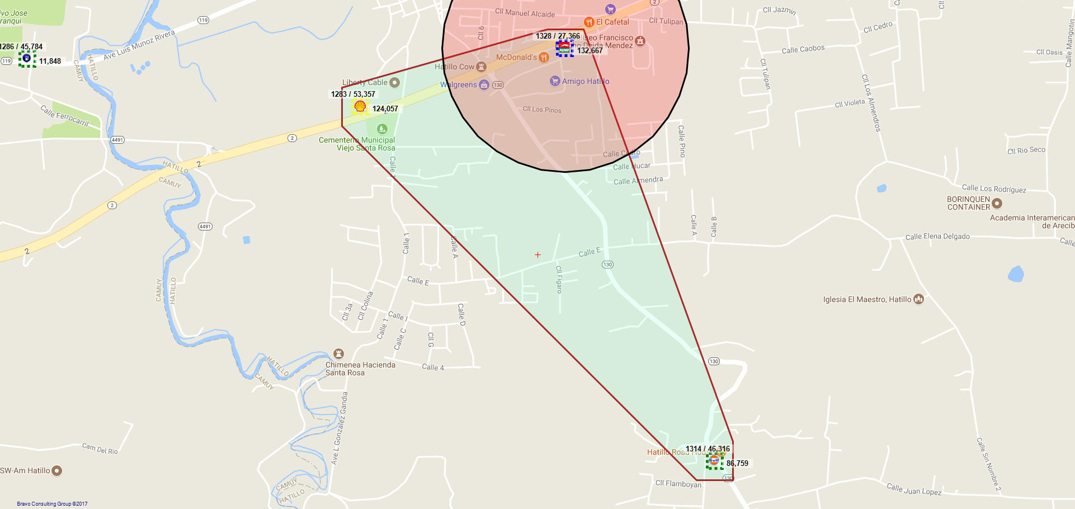
1328 / GA WEST INVESTMENT LLC - 910 - HATILLO

Slide 9
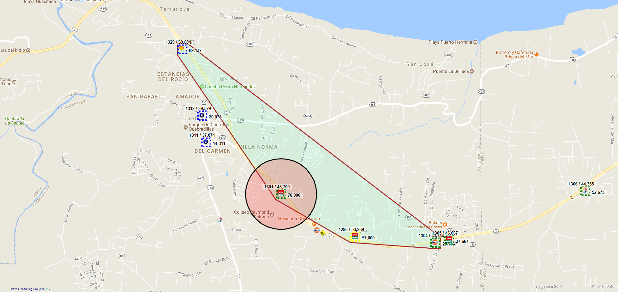
1301 / JAVIER ESPINOSA AVILA - 550 - QUEBRADILLAS

Slide 10
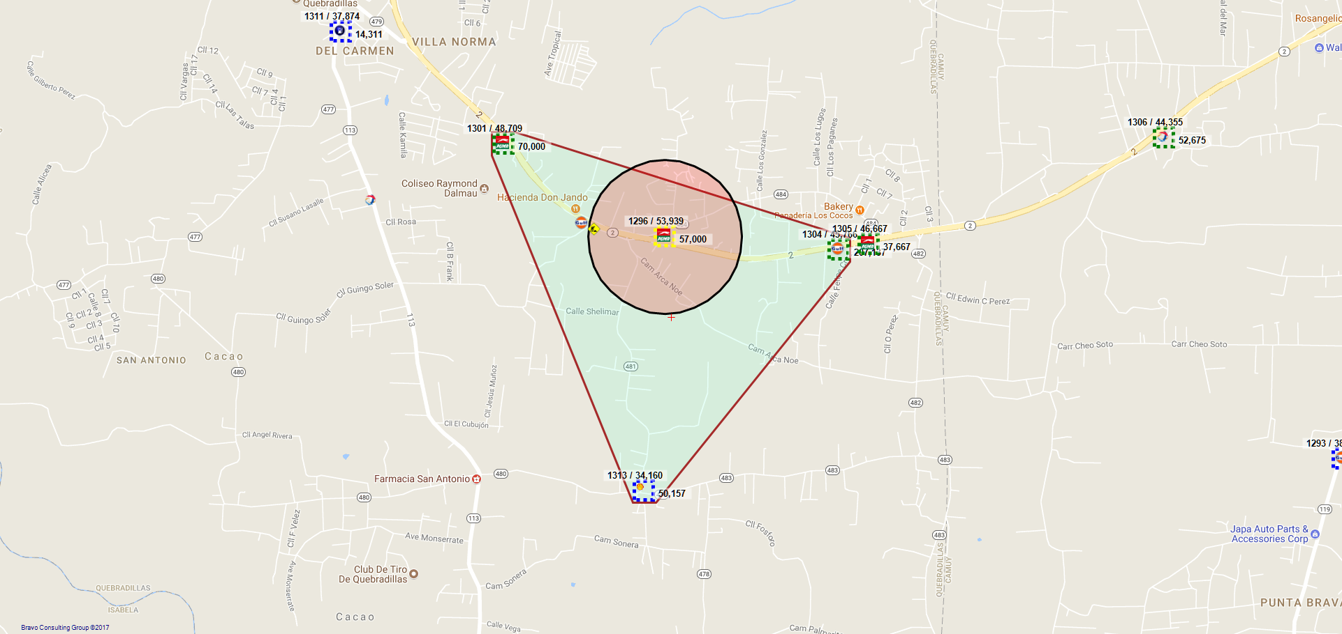
1296 / JAVIER ESPINOSA AVILA - 573 - QUEBRADILLAS

Slide 11
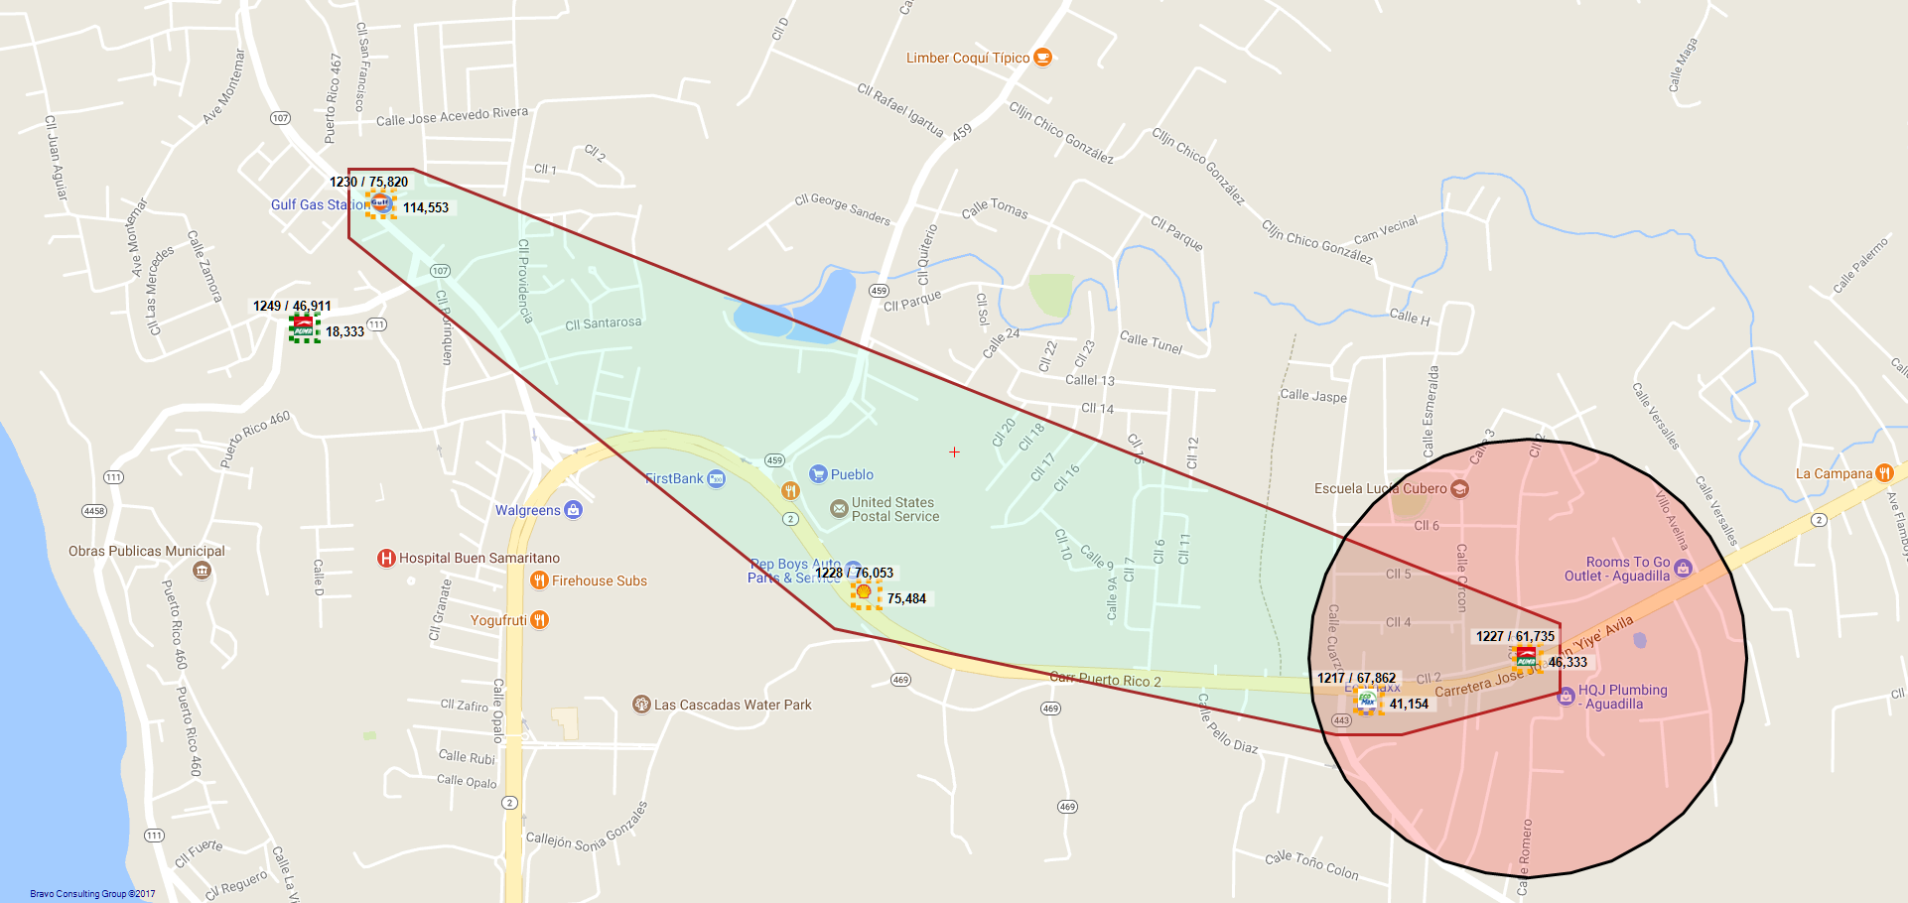
1227 / EDUARDO HERNANDEZ COURCEVIL - 648 - AGUADILLA

Slide 12
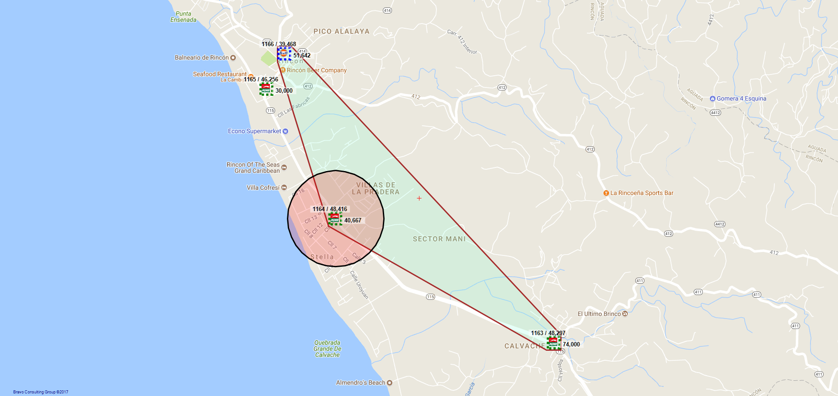
1164 / ANDRES RUIZ ARIZMENDI (640) - 640 - RINCON

Slide 13
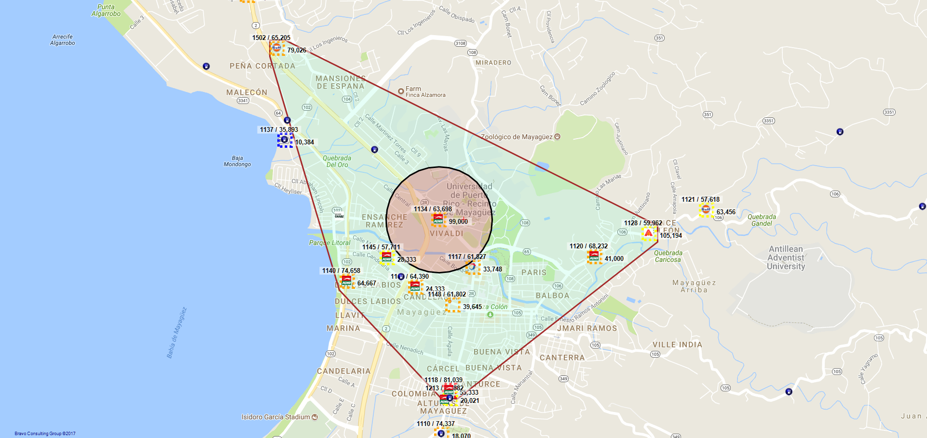
1134 / C-FUELS, LLC - 23 - MAYAGUEZ

Slide 14
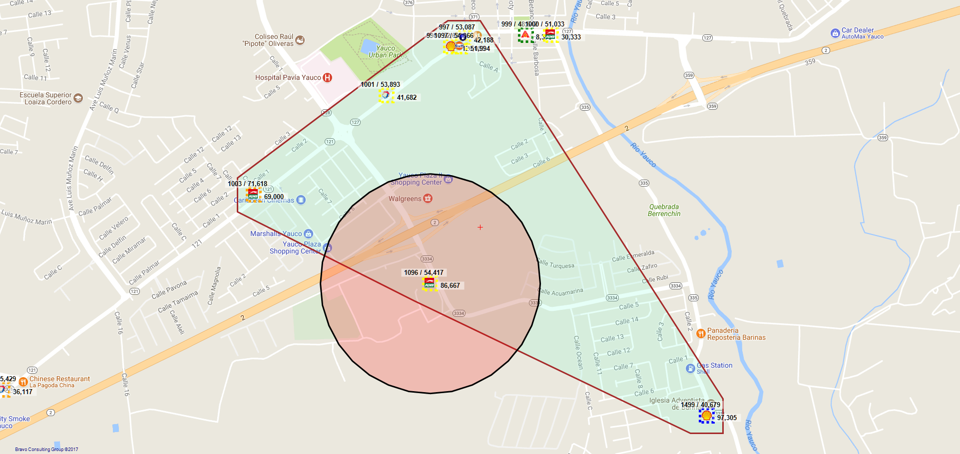
1096 / SOUTHERN GAS STATION INC. - 983 - YAUCO

Slide 15
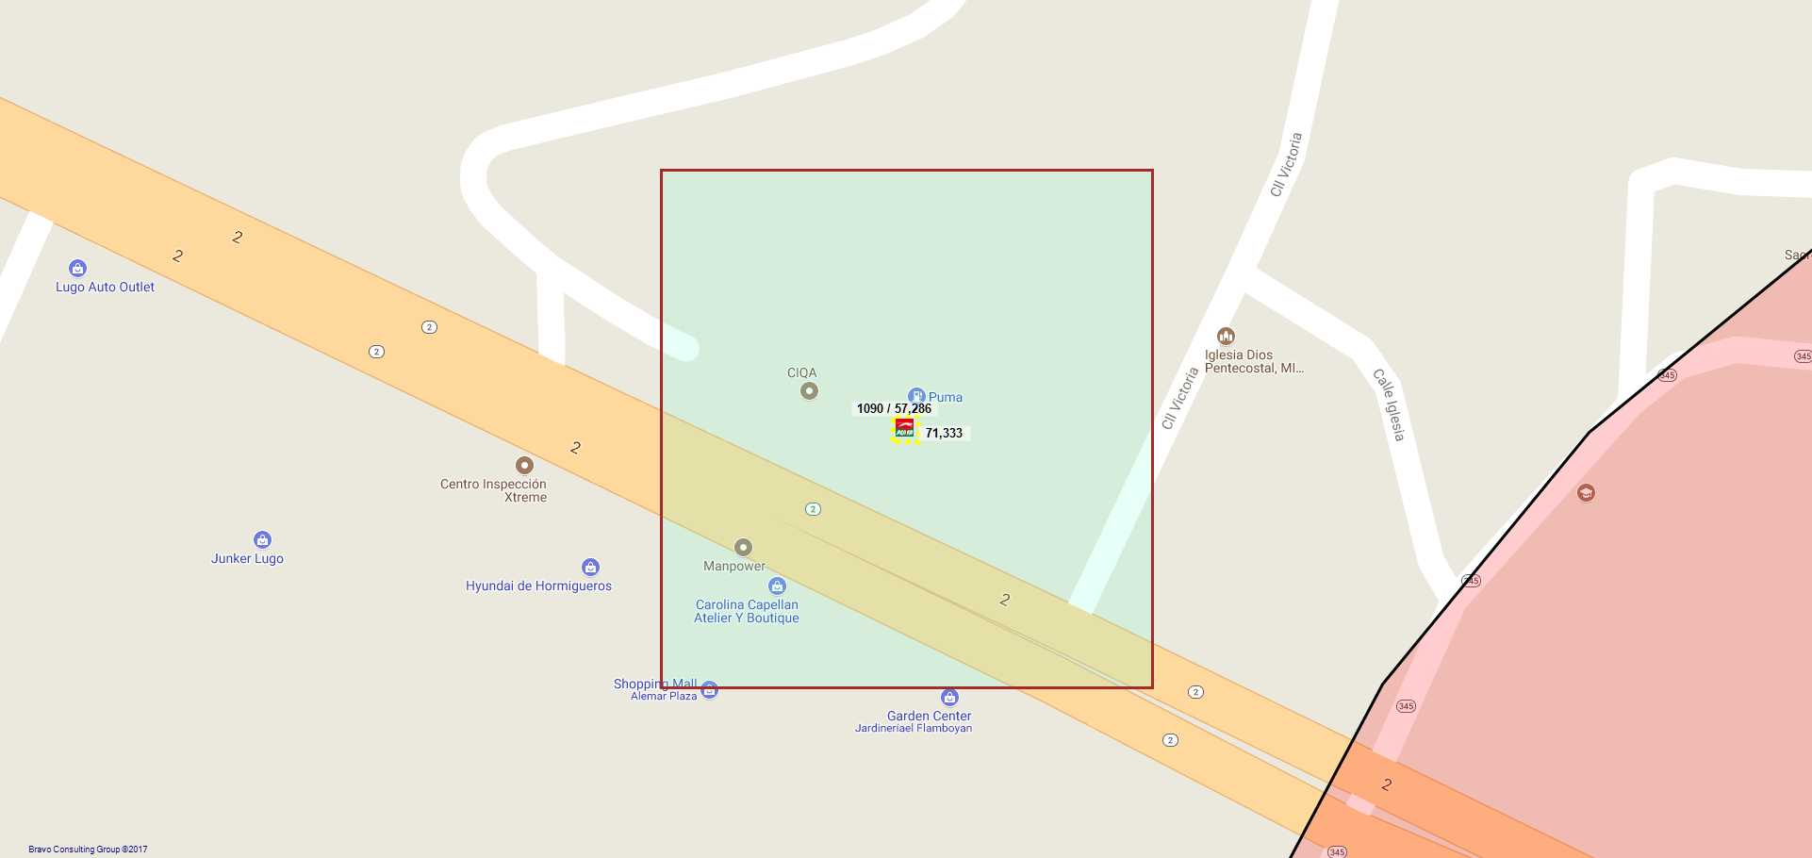
1095 / VP PETROLEUM INC. - 965 - HORMIGUEROS

Slide 16
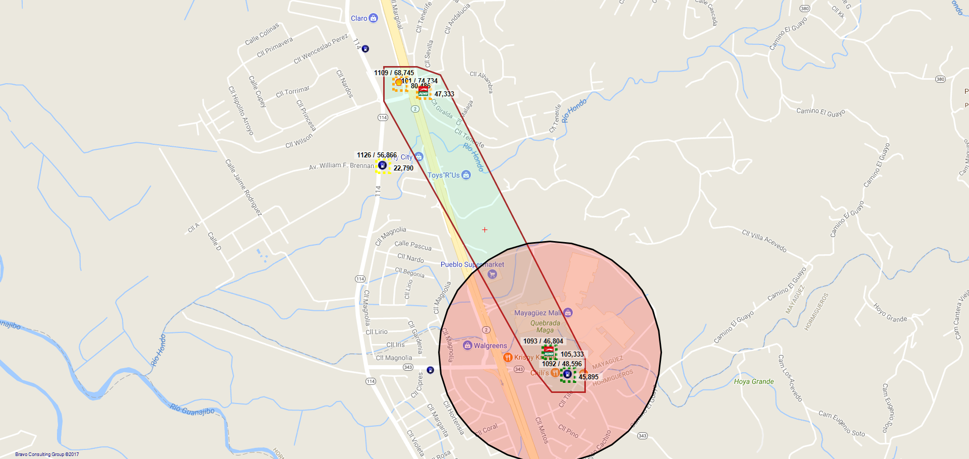
1093 / DAWAHRA PETROLEUM, LLC - 354 - HORMIGUEROS

Slide 17
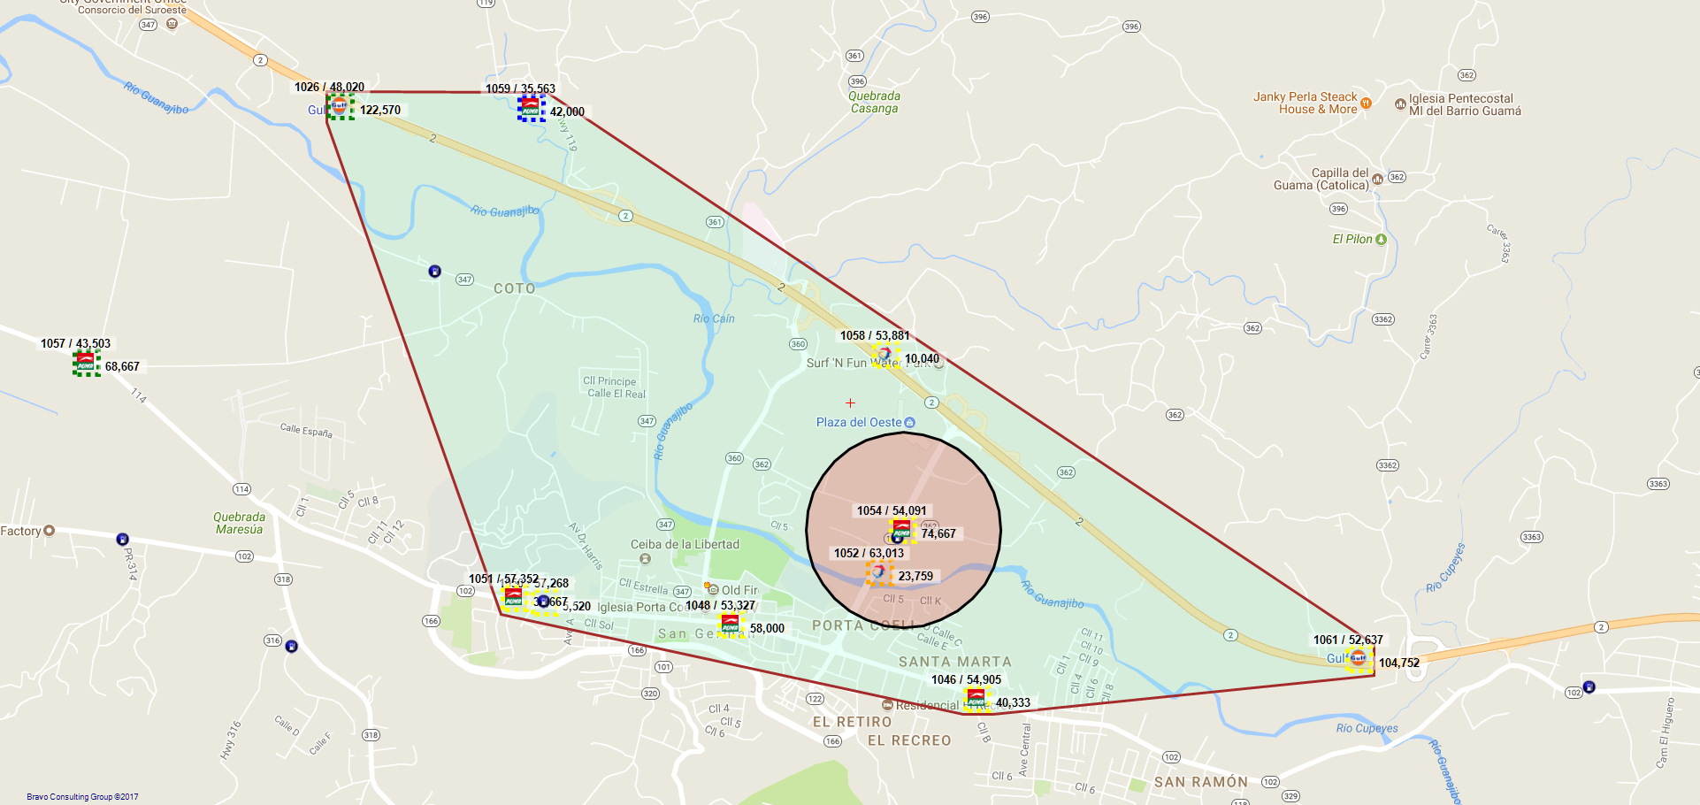
1054 / SAN GERMAN SERVICE STATION, INC. - 929 - SAN GERMAN

Slide 18
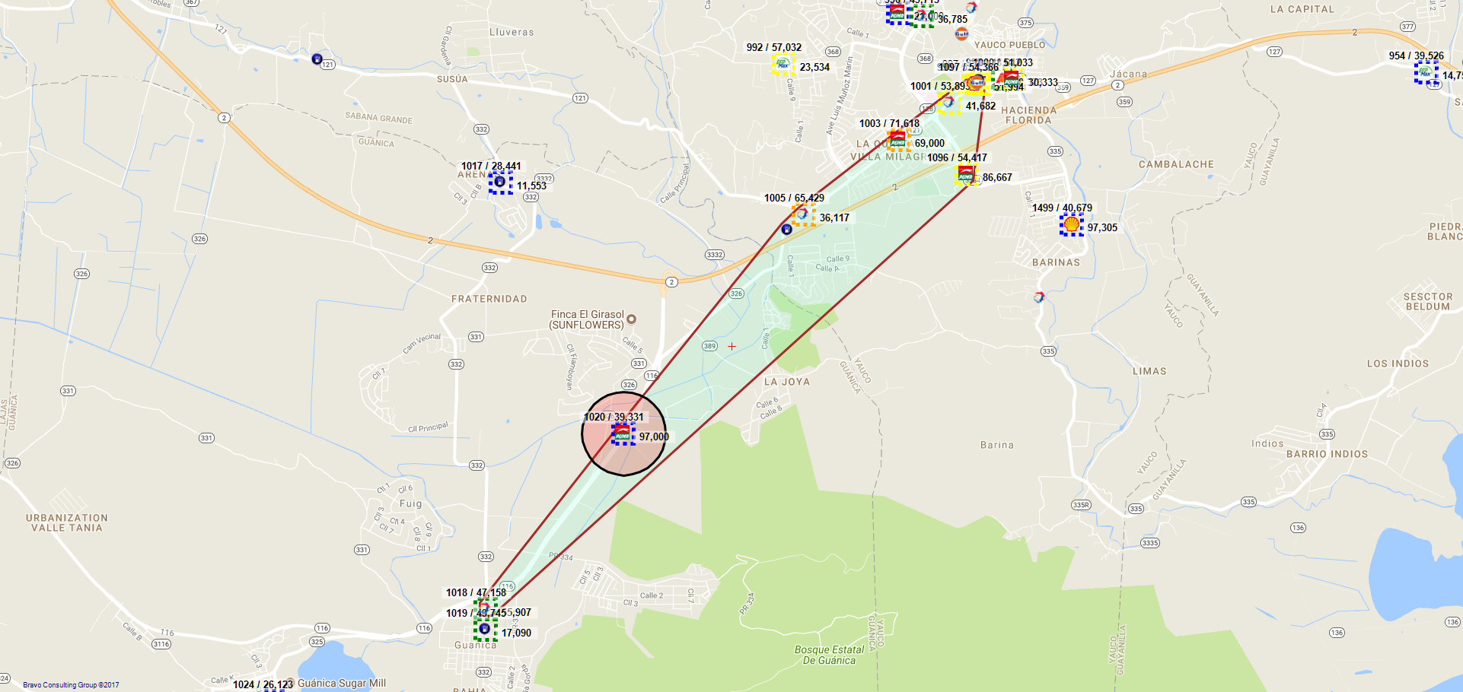
1020 / SERVISTATION MS, INC. - 801 - GUANICA

Slide 19
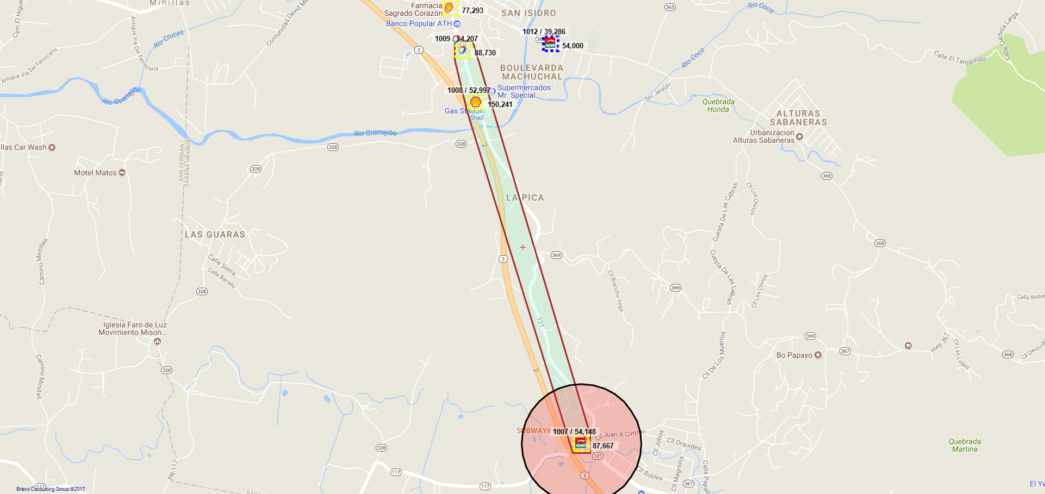
1007 / SAN GERMAN SERVICE STATION, INC. - 697 - SABANA GRANDE

Slide 20
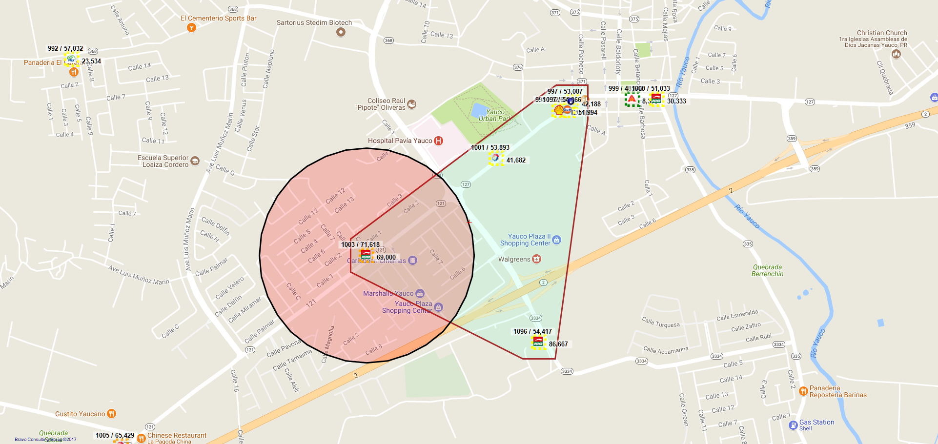
1003 / SR. GHASSAN JALAL ZAYED - 105 - YAUCO

Slide 21
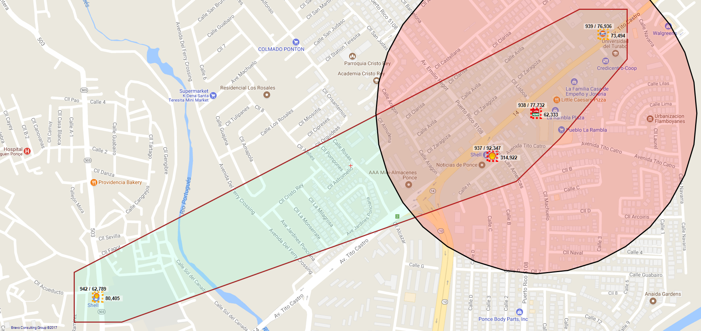
938 / PUNTO CARIBE PETROLEUM LLC - 816 - PONCE

Slide 22
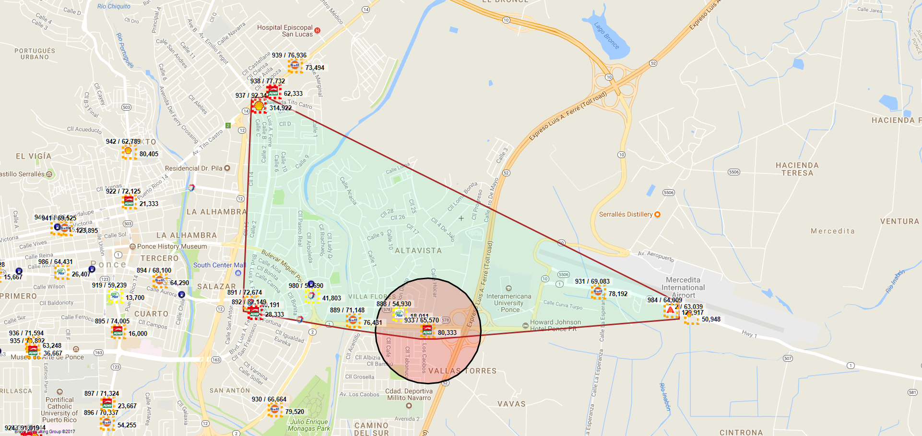
933 / AJL SERVICE STATION, LLC - 600 - PONCE

Slide 23
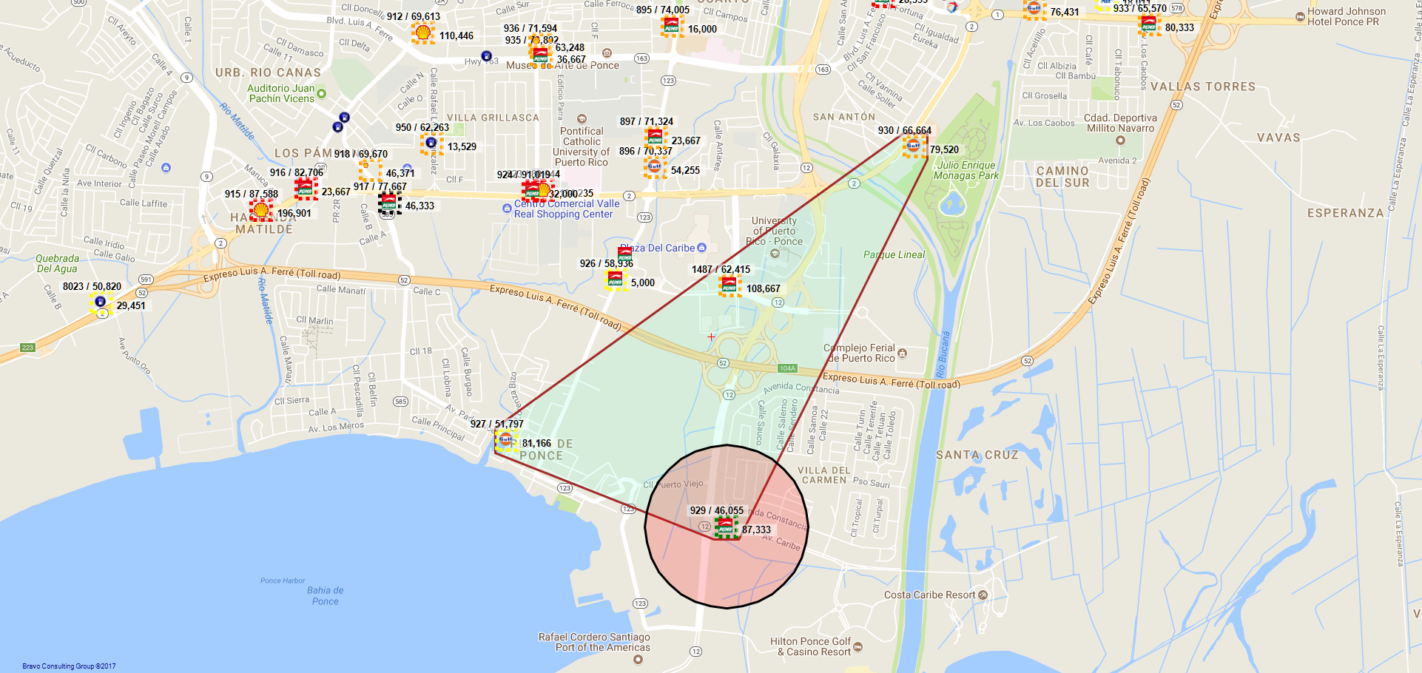
929 / CARIBE FUELS LLC - 859 - PONCE

Slide 24
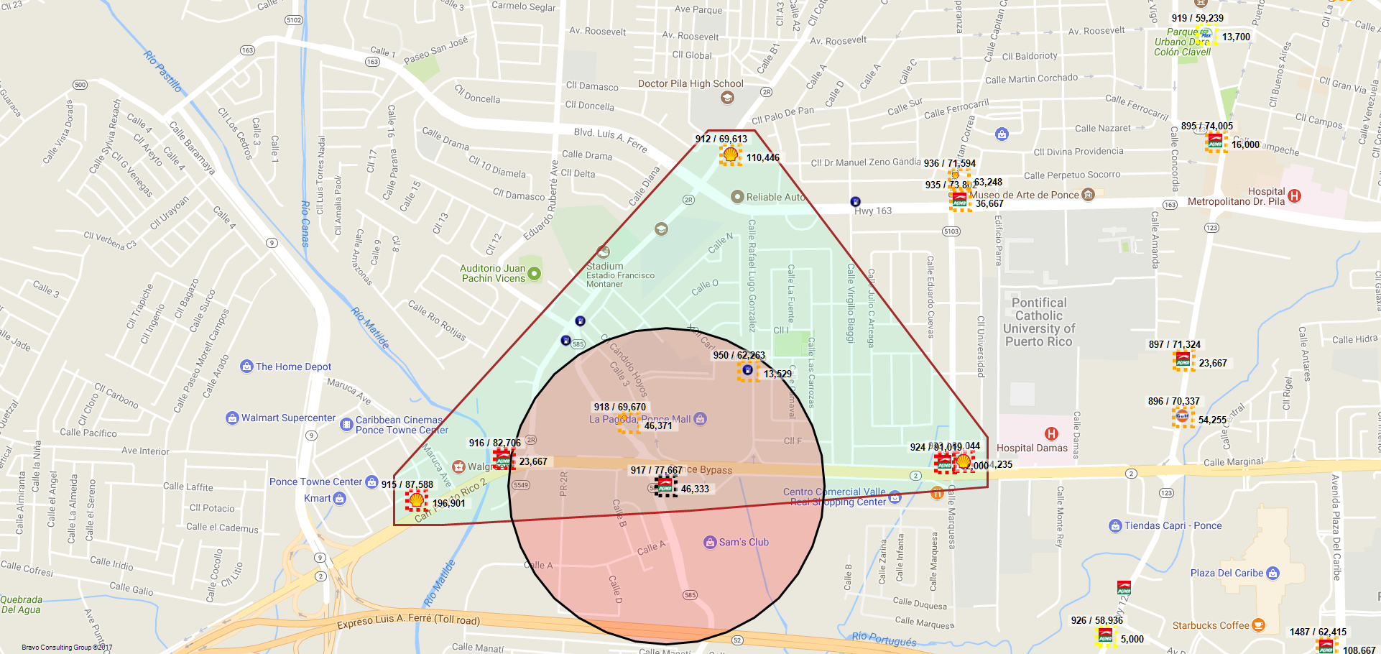
917 / SR. GHASSAN JALAL ZAYED - 184 - PONCE

Slide 25
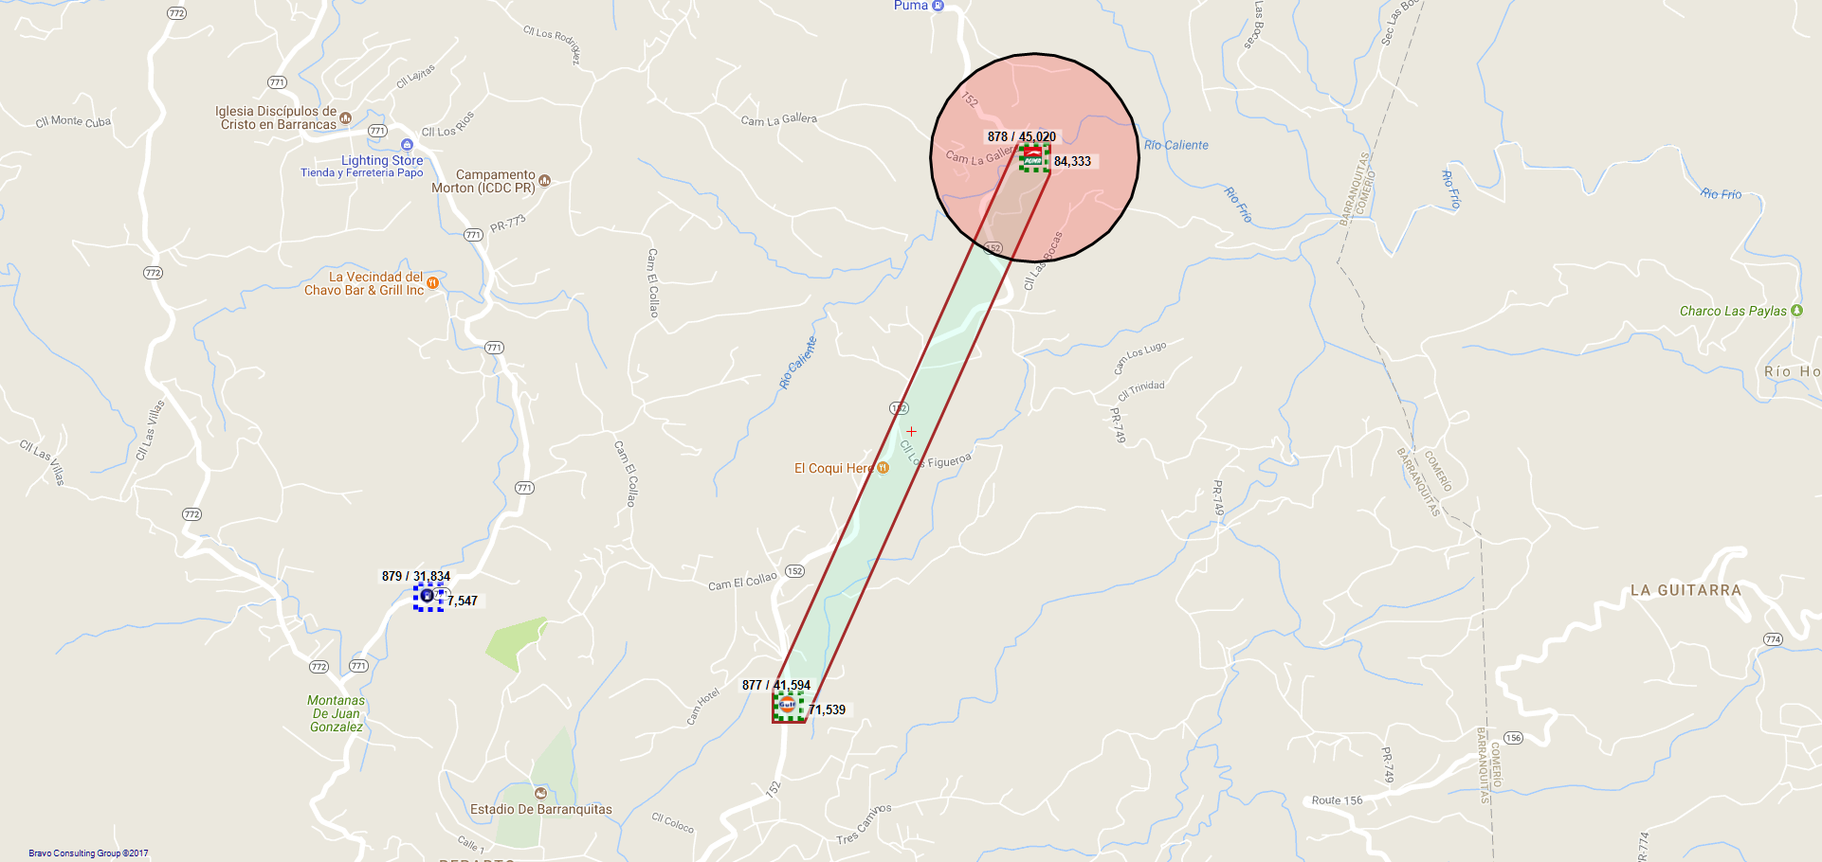
878 / JAVIER PÉREZ MARCANO - 971 - BARRANQUITAS

Slide 26
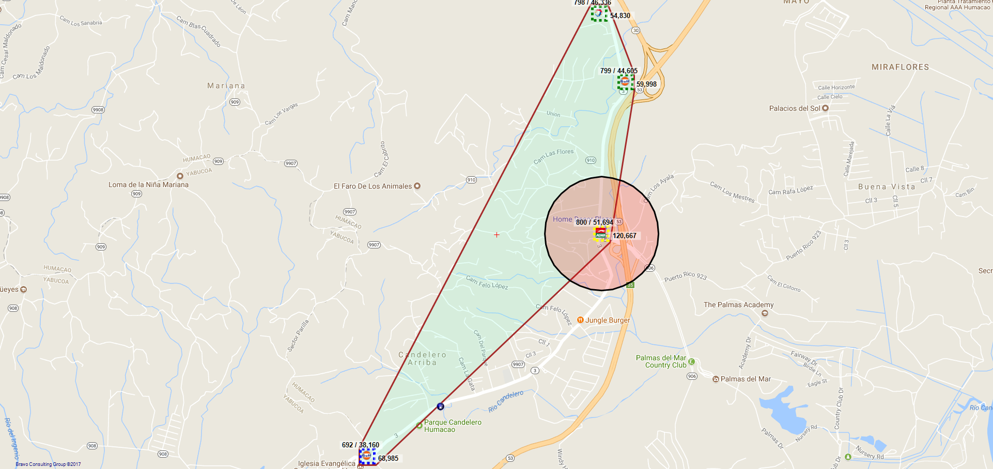
800 / PALMAS FAMILY MART INC - 990 - HUMACAO

Slide 27
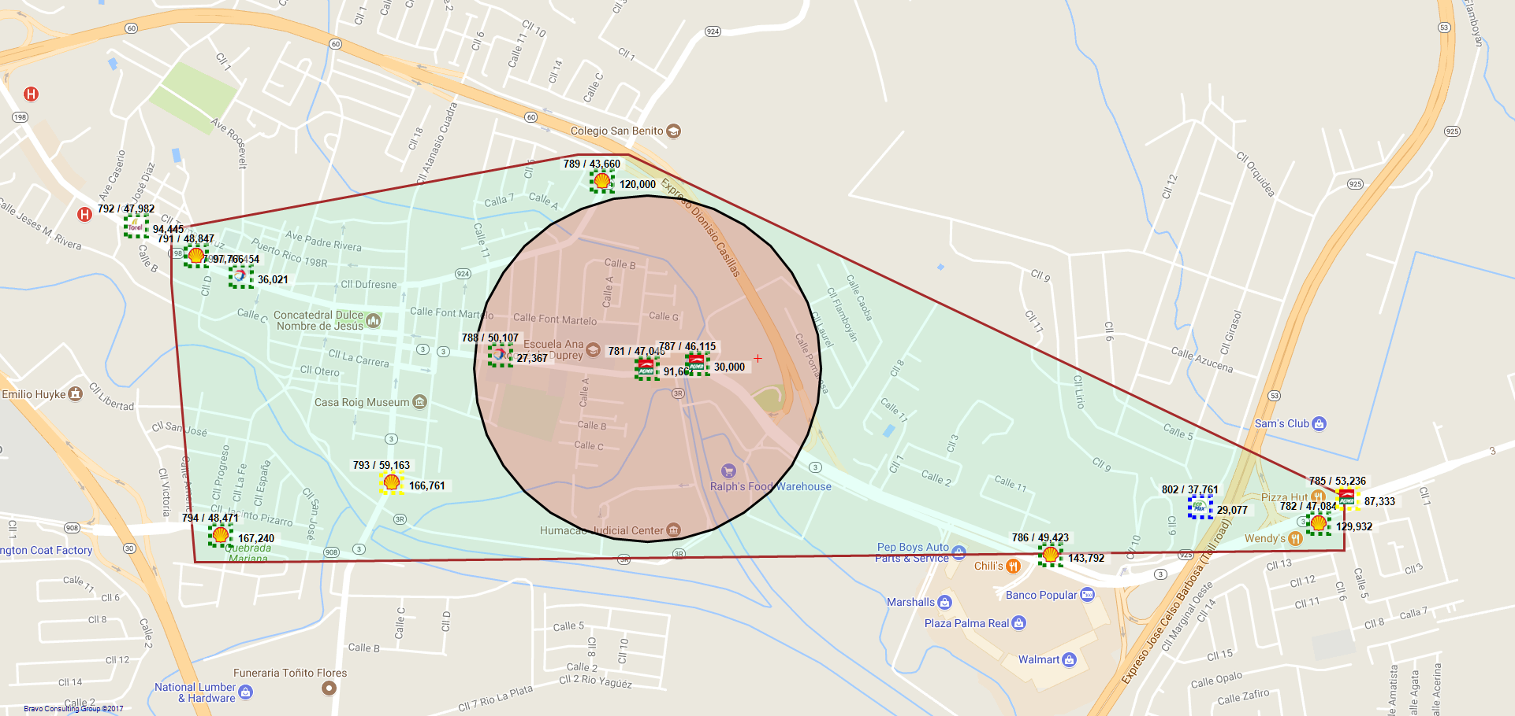
781 / SR. ARAFAT MOHAMED MOHAMED HAMEED - 343 - HUMACAO

Slide 28
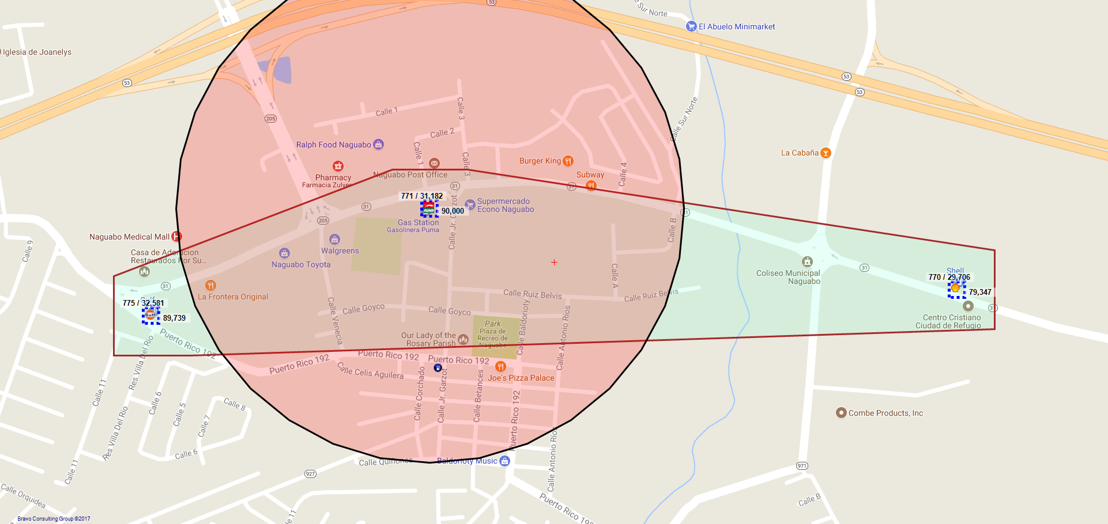
771 / BENJAMIN PLACERES - 961 - NAGUABO

Slide 29
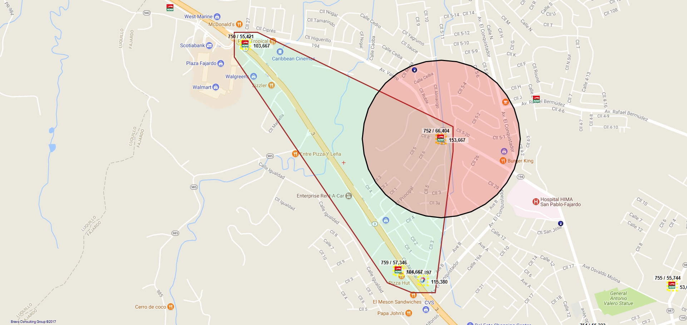
752 / FAJARDO S/S INC - 376 - FAJARDO

Slide 30
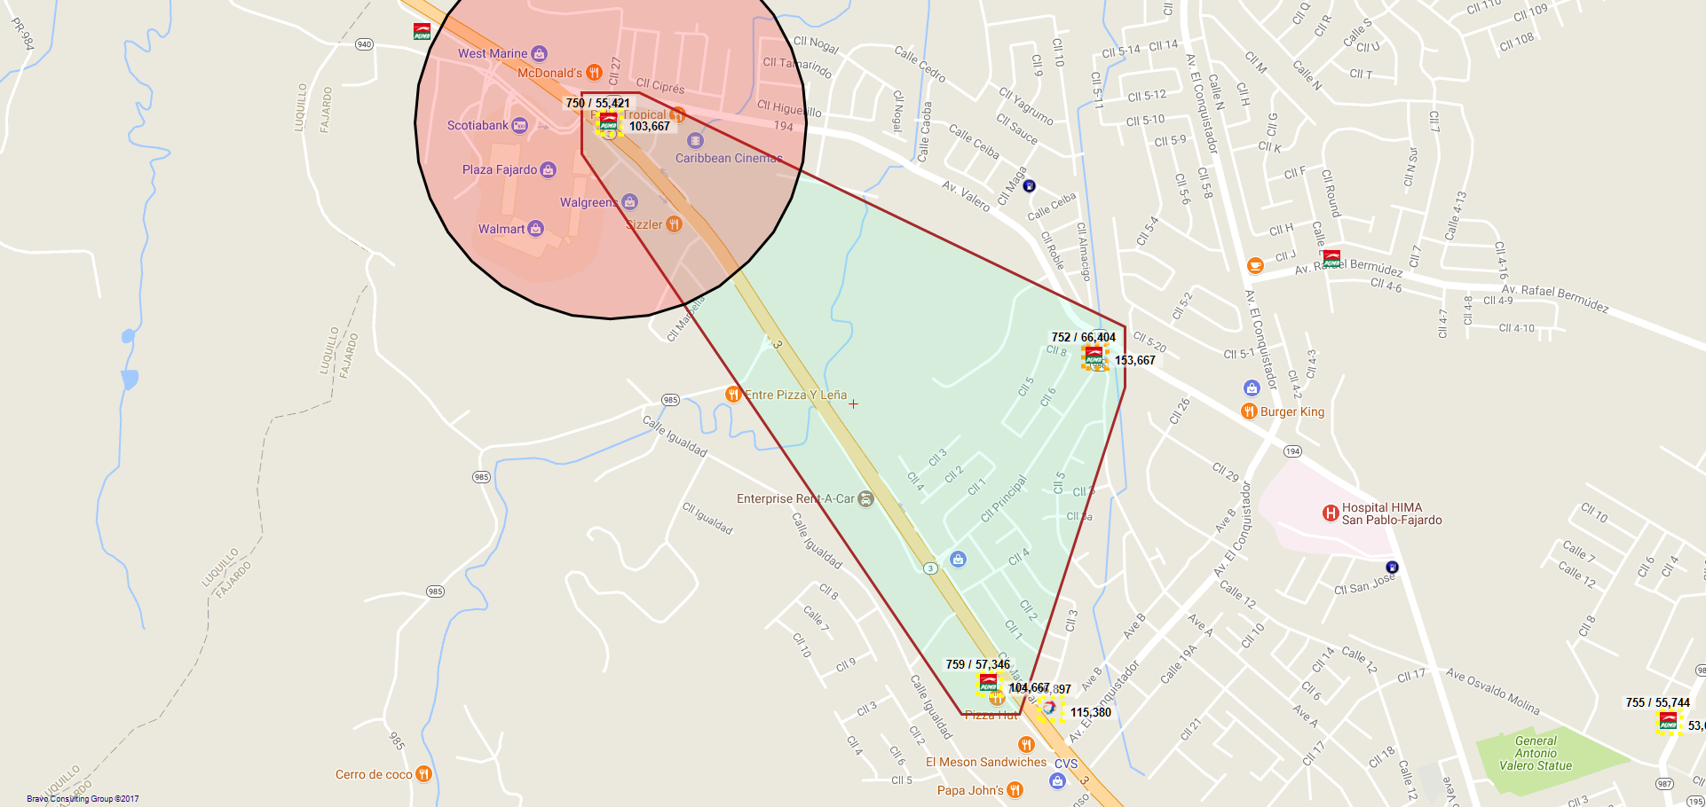
750 / C-FUELS, LLC - 73 - FAJARDO

Slide 31
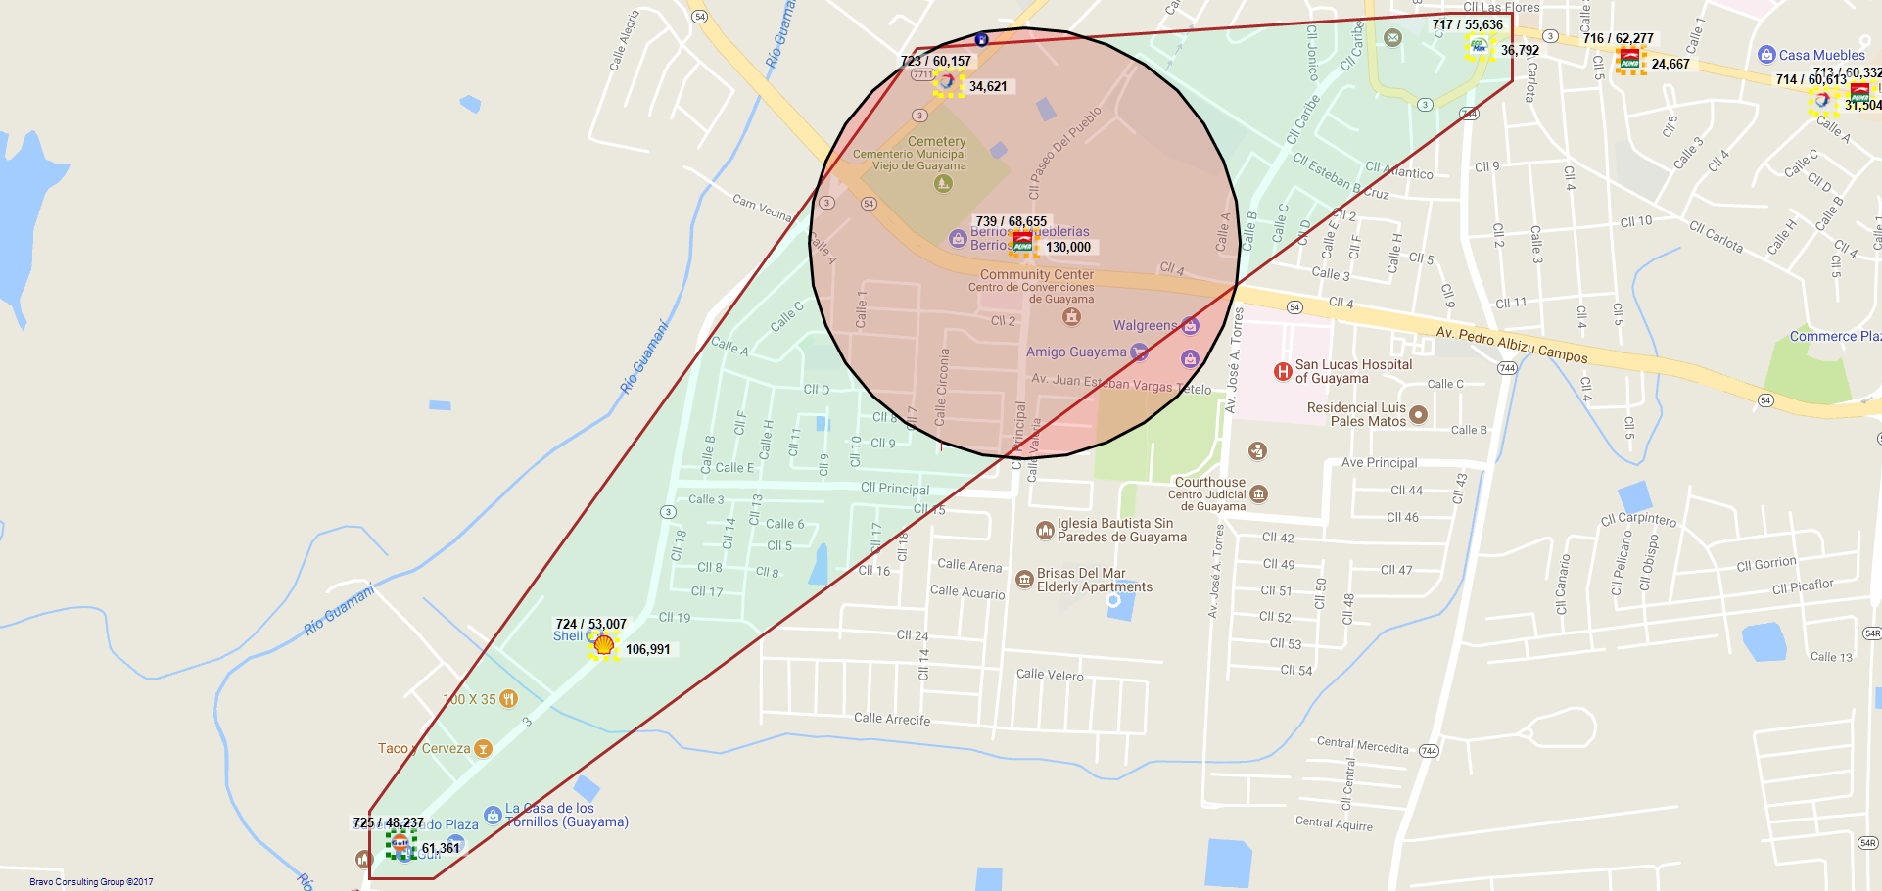
739 / CARLOS A BURGOS ROCA - 809 - GUAYAMA

Slide 32
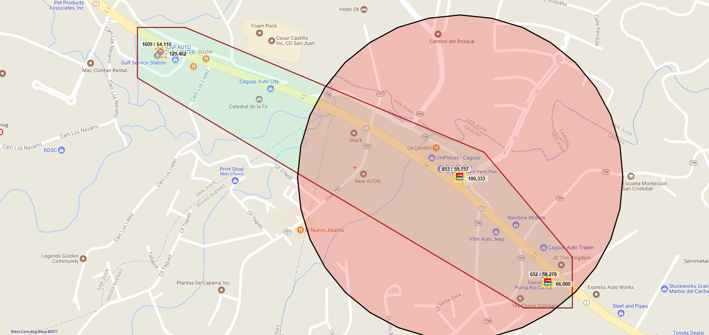
653 / JAIME SAMHAN ESPINEL - 379 - CAGUAS

Slide 33
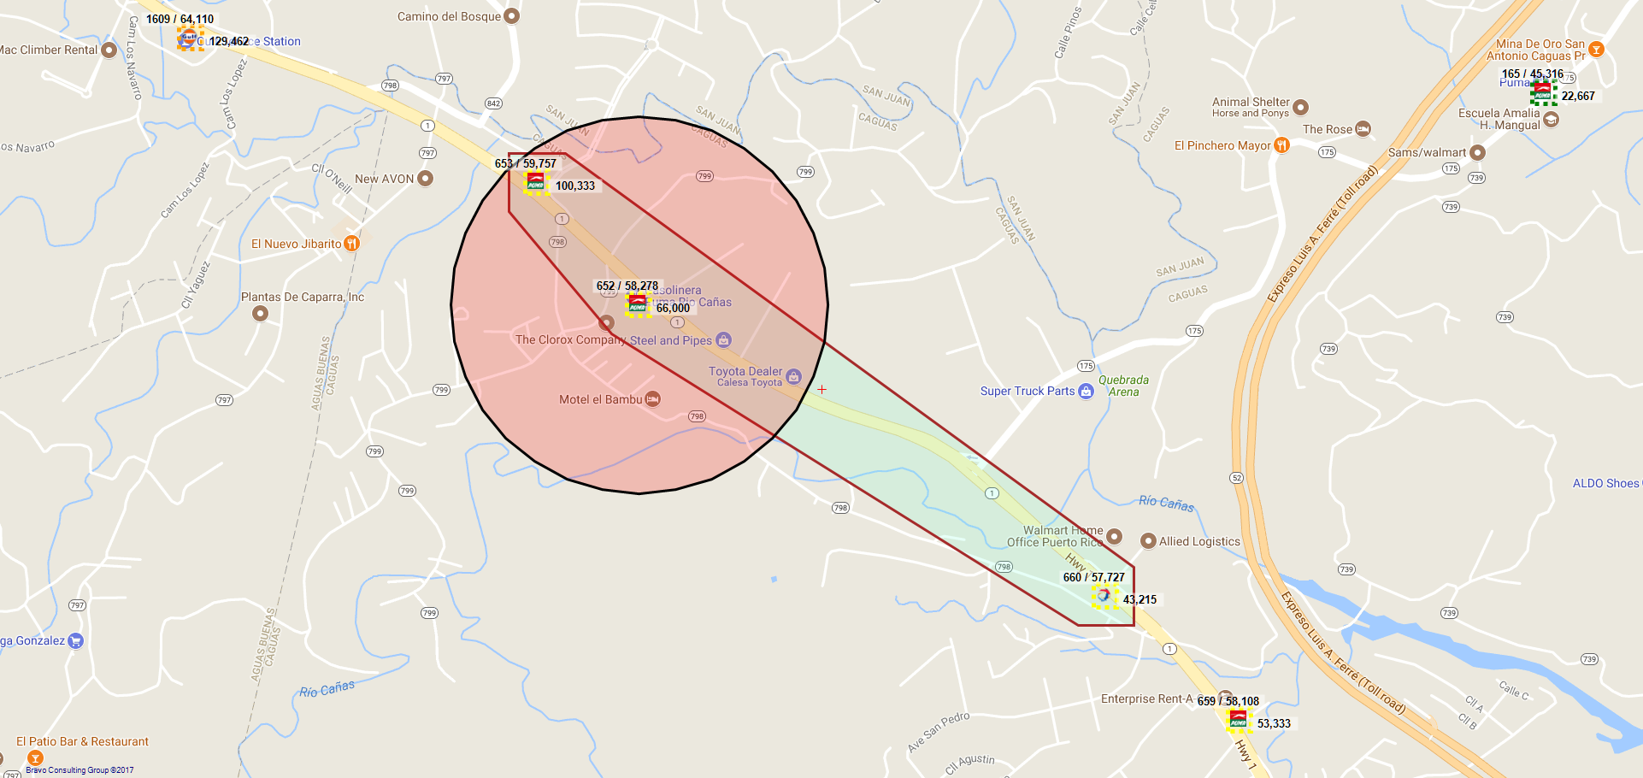
652 / GASOLINERA RIO CAÑAS CORP. - 391 - CAGUAS

Slide 34
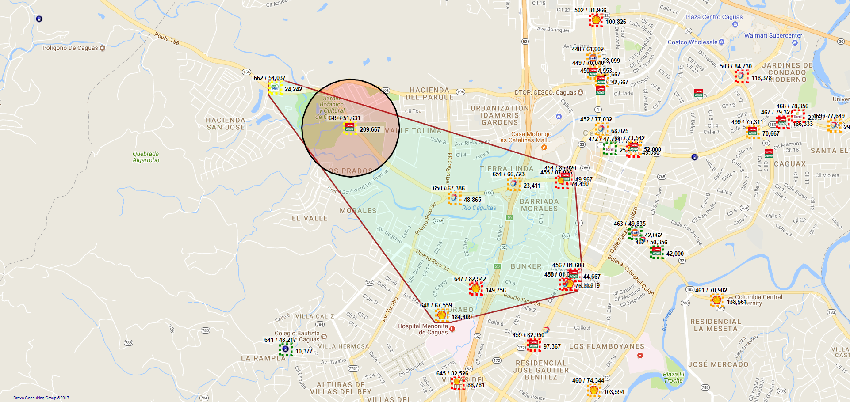
649 / J.C. POWER OIL, INC. - 147 - CAGUAS

Slide 35
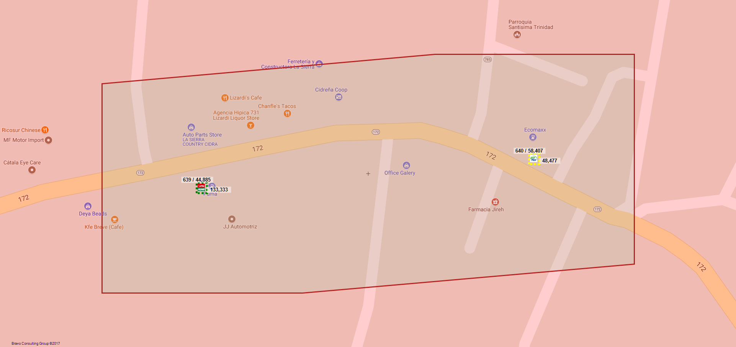
639 / CERTENEJAS S.S. INC - 396 - CAGUAS

Slide 36
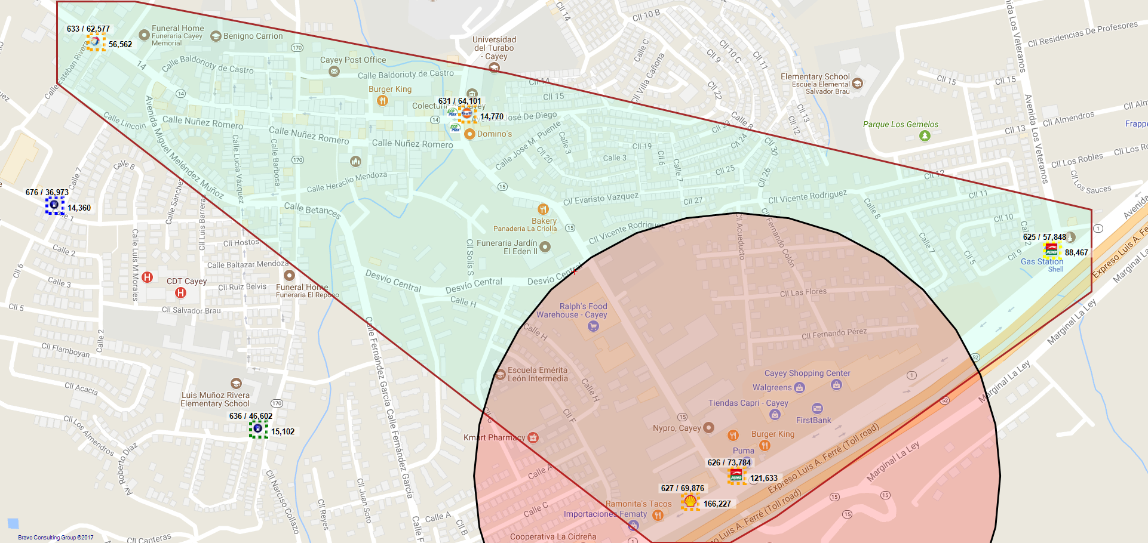
626 / VP PETROLEUM, INC. - CAYEY - 76 - CAYEY

Slide 37
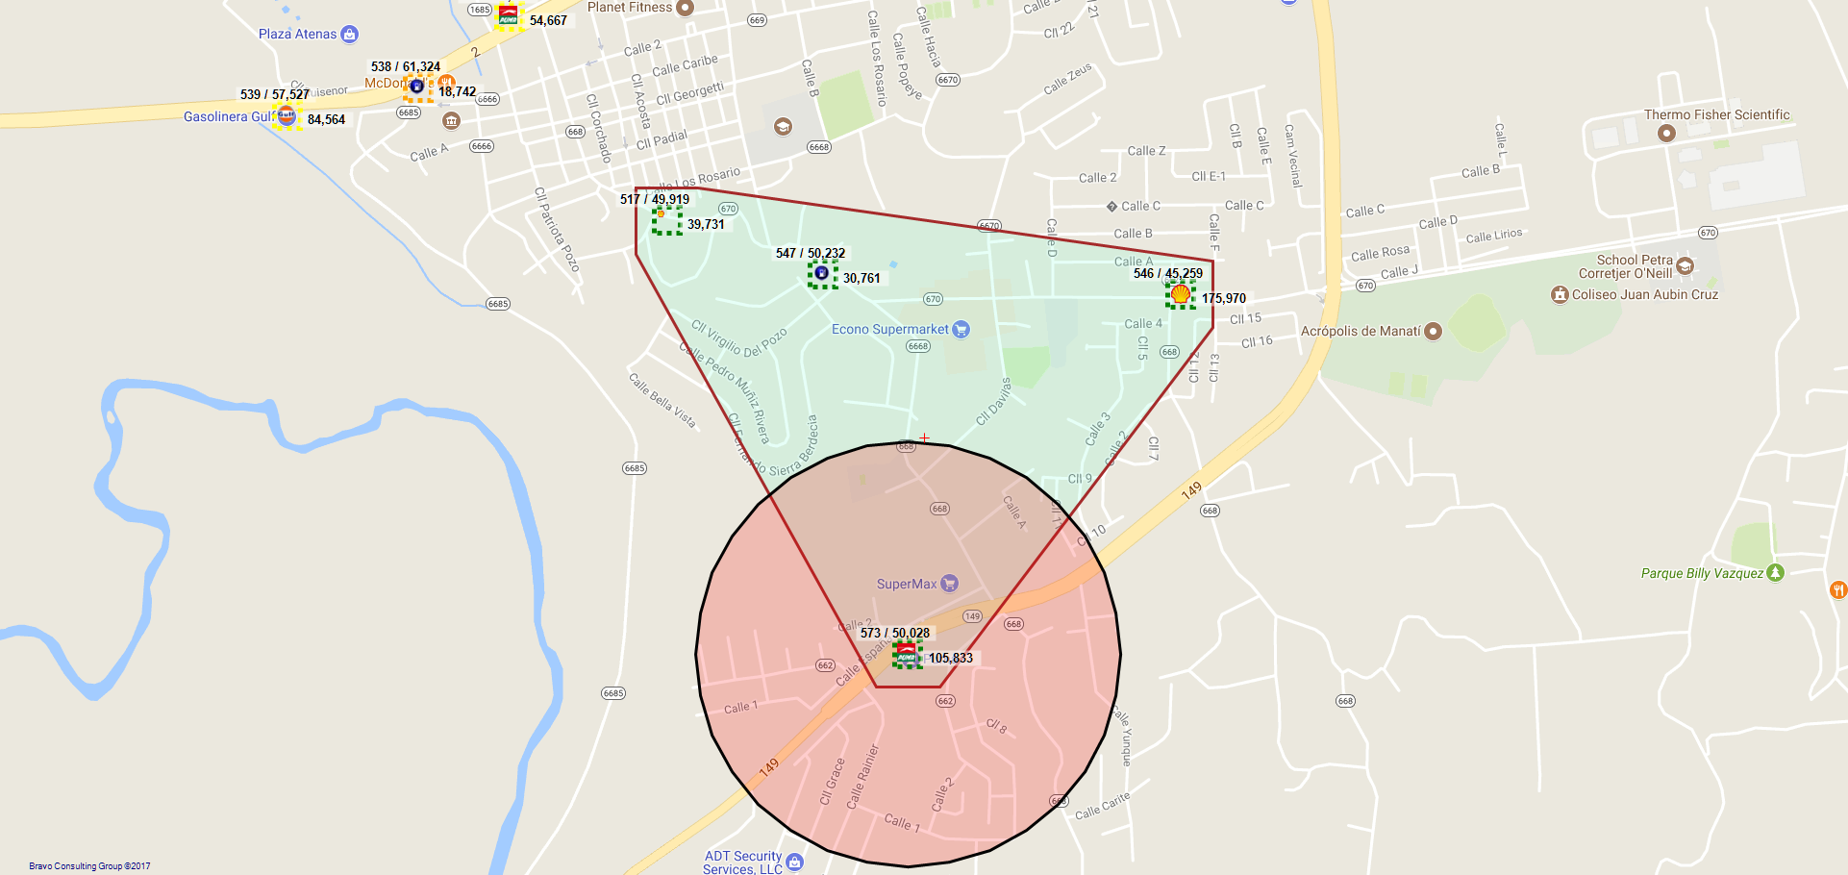
573 / VP PETROLEUM INC - 903 - MANATI

Slide 38
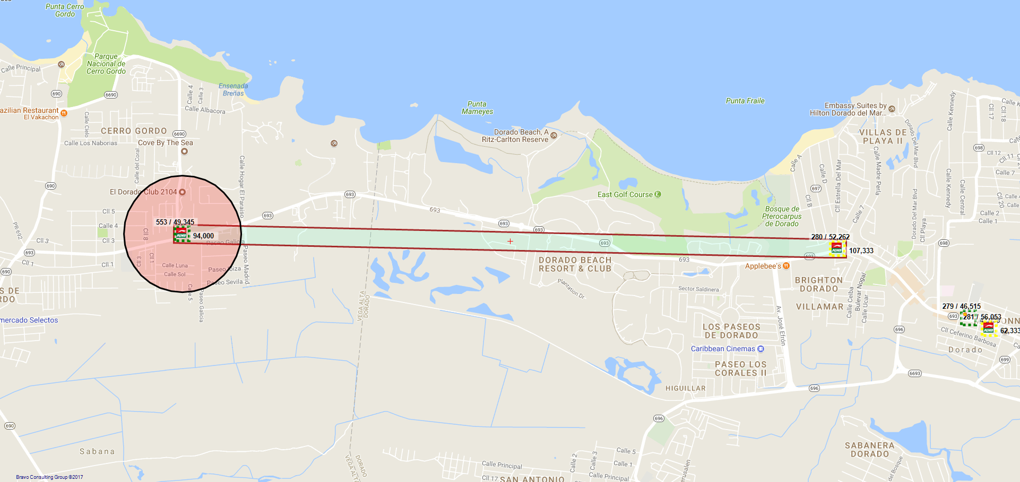
553 / JAIME A. SAMHAN ESPINEL - 996 - VEGA ALTA

Slide 39
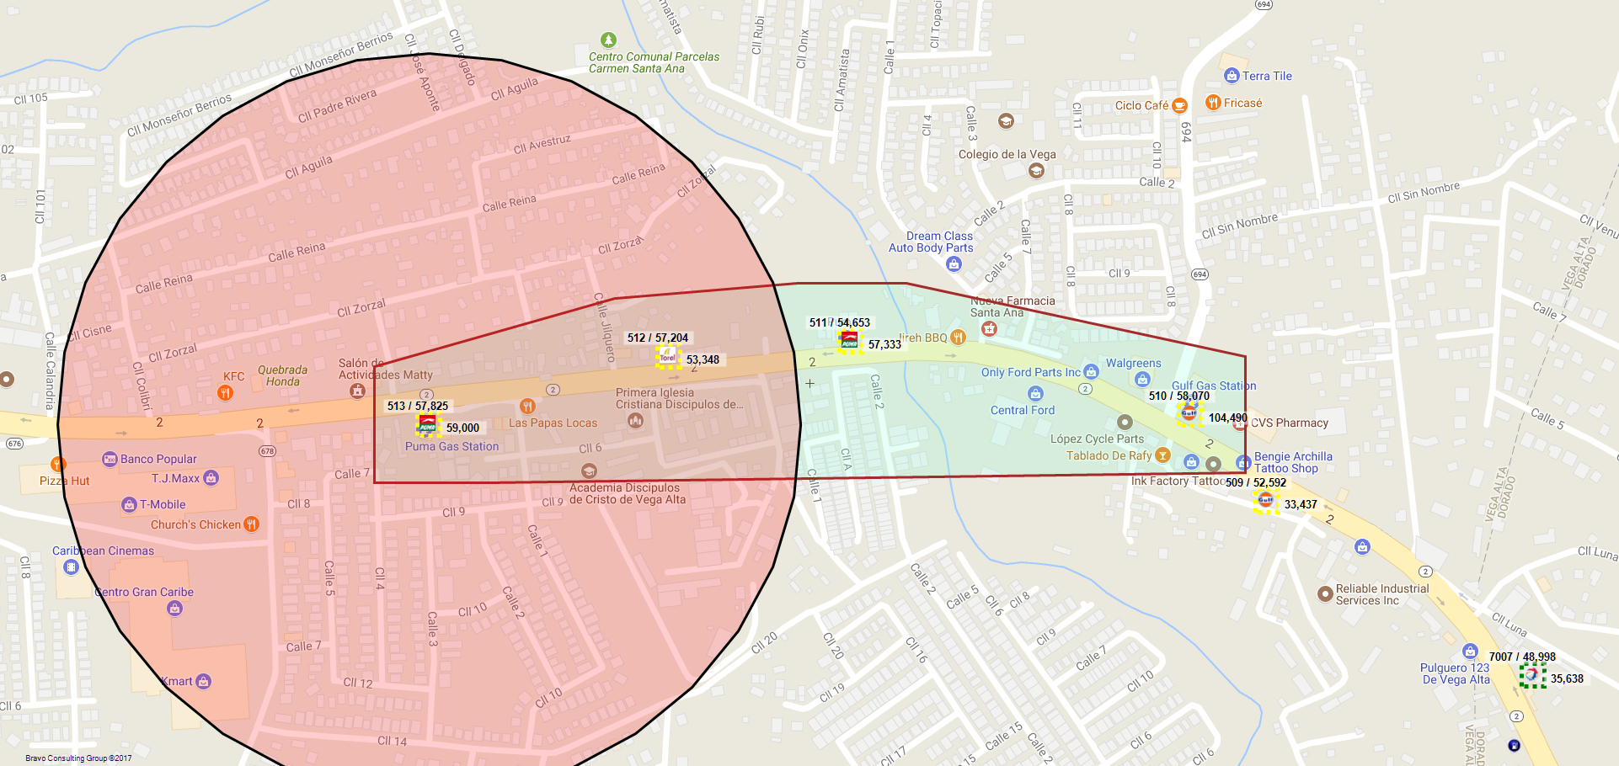
513 / MONTHER MOHAMMAD MOHAMMAD - 259 - VEGA ALTA

Slide 40
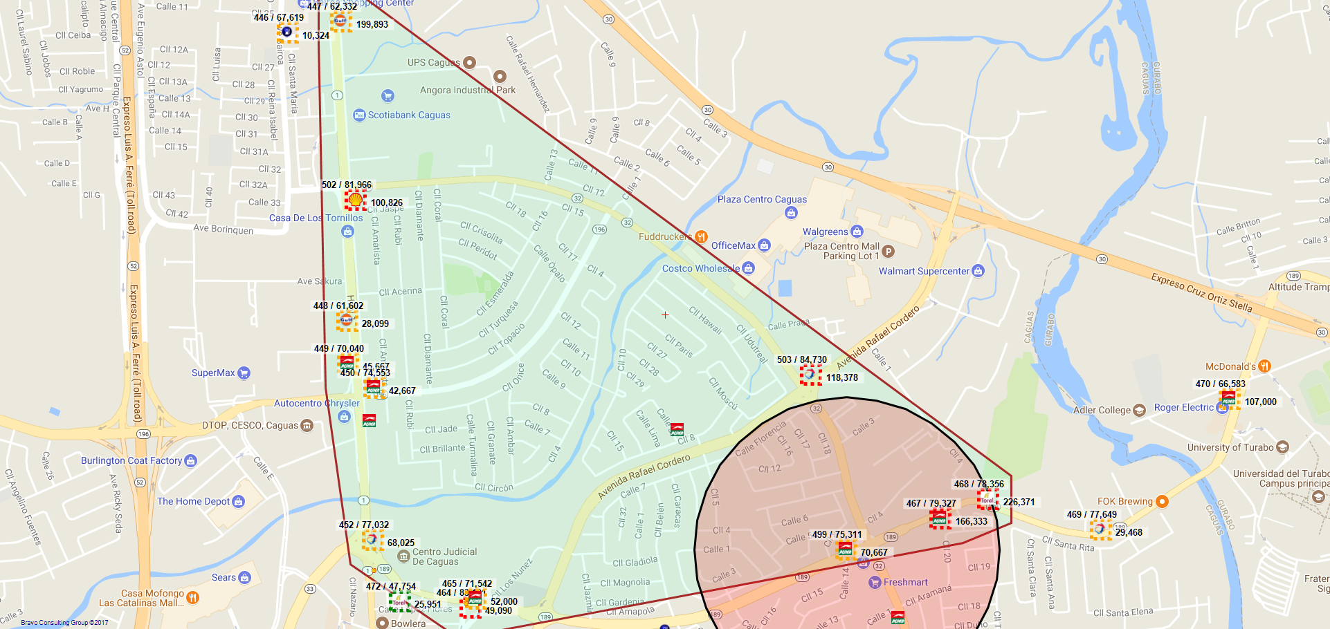
499 / ALVERIO SERVICE STATION INC. - 302 - CAGUAS

Slide 41
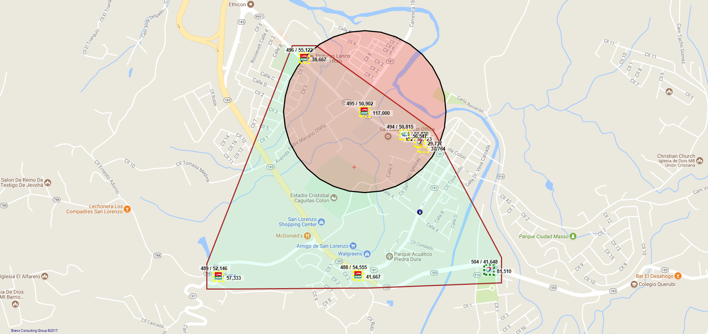
495 / HHF SERVICES STATION INC. - 18 - SAN LORENZO

Slide 42
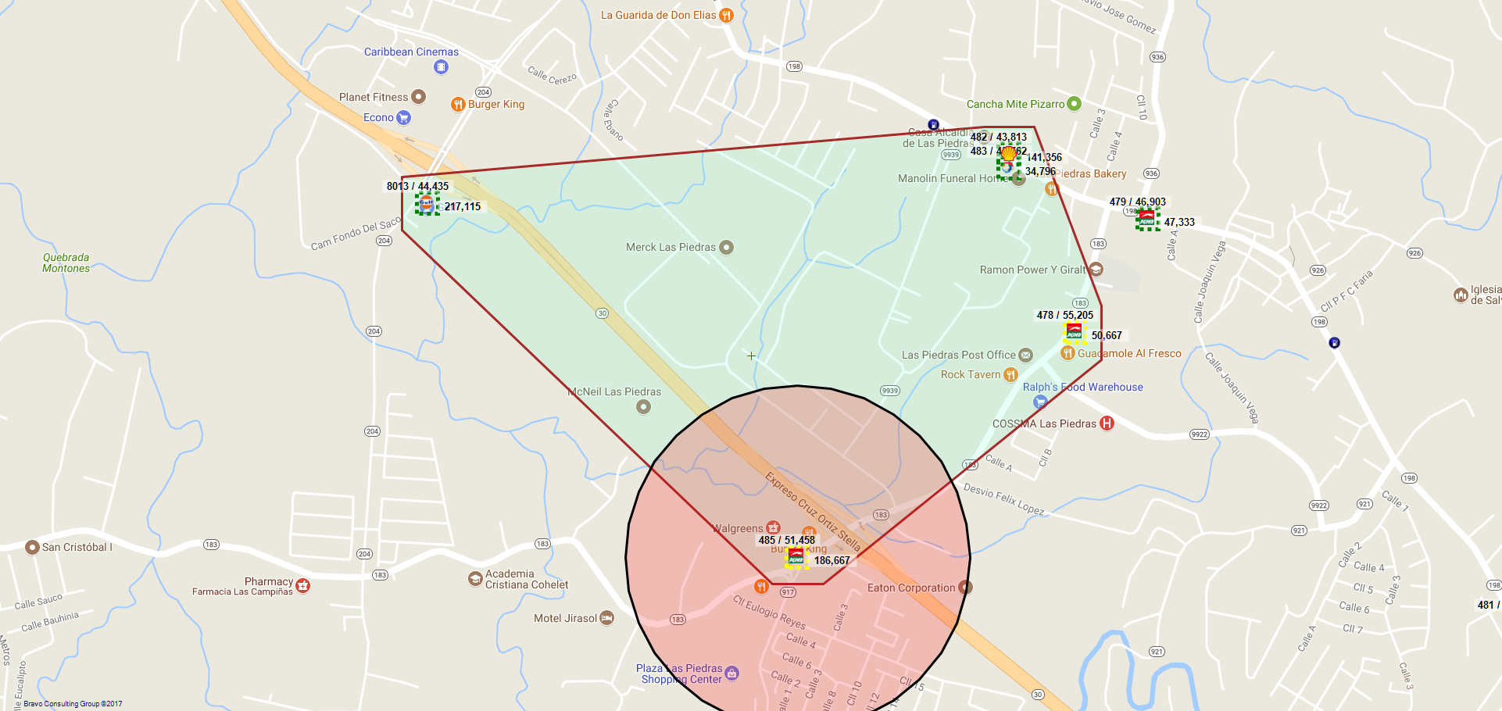
485 / VP PETROLEUM INC LAS PIEDRAS - 927 - LAS PIEDRAS

Slide 43
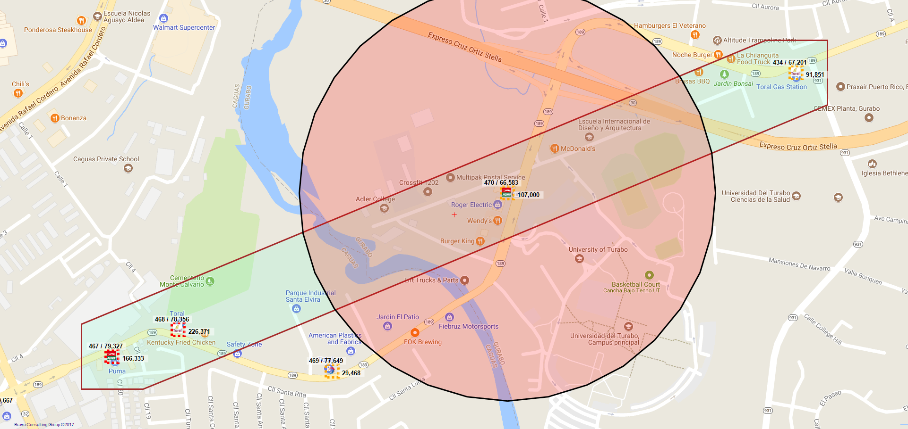
470 / ODEH PETROLEUM, INC.. - 177 - GURABO

Slide 44
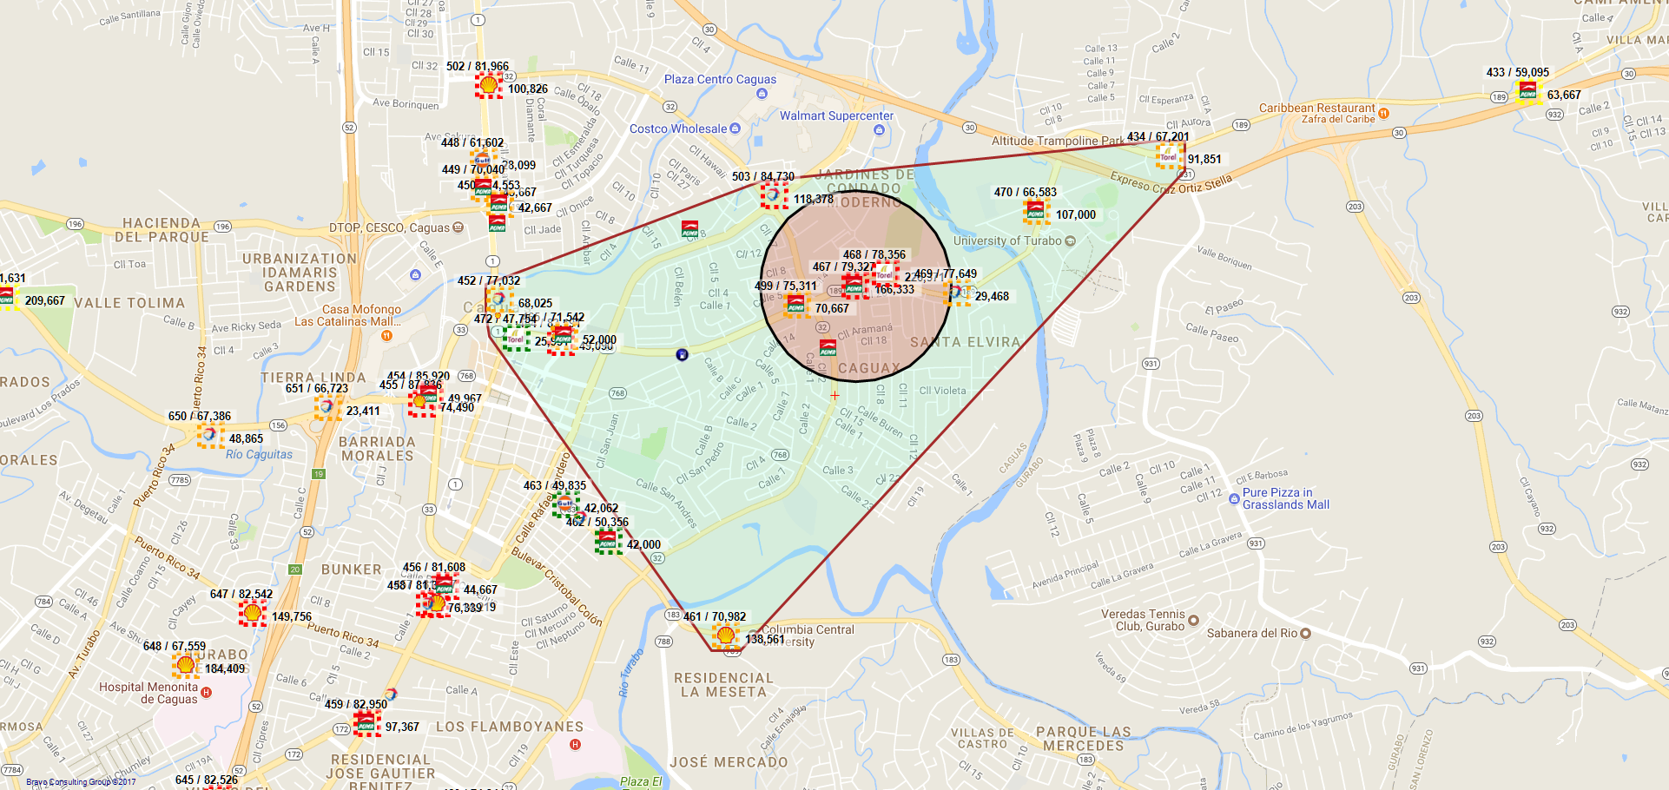
467 / ALVERIO SERVICE STATION, INC - 229 - CAGUAS

Slide 45
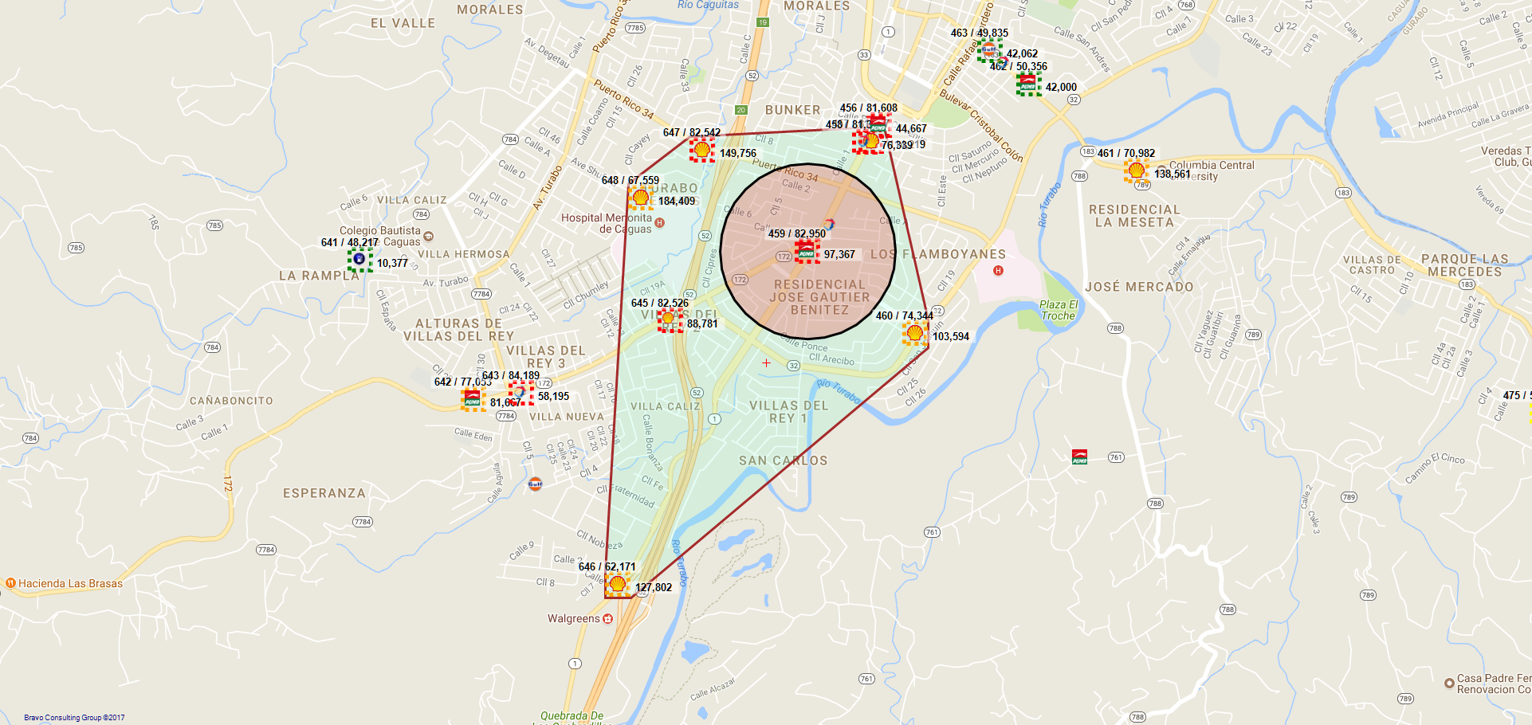
459 / VP PETROLEUM, INC. - CAGUAS VILLA TURABO - 427 - CAGUAS

Slide 46
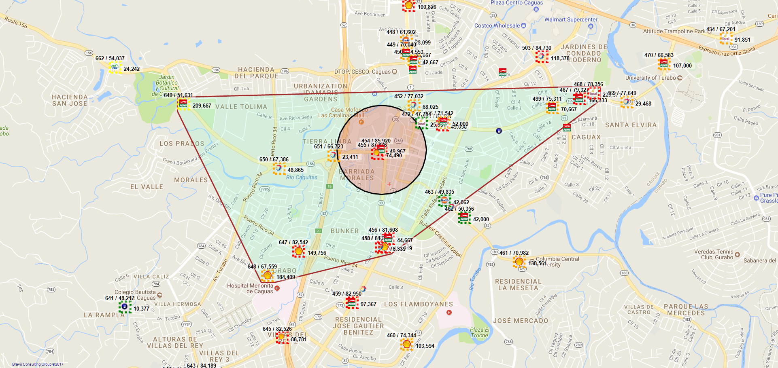
454 / VP PETROLEUM CAGUAS II - 11 - CAGUAS

Slide 47
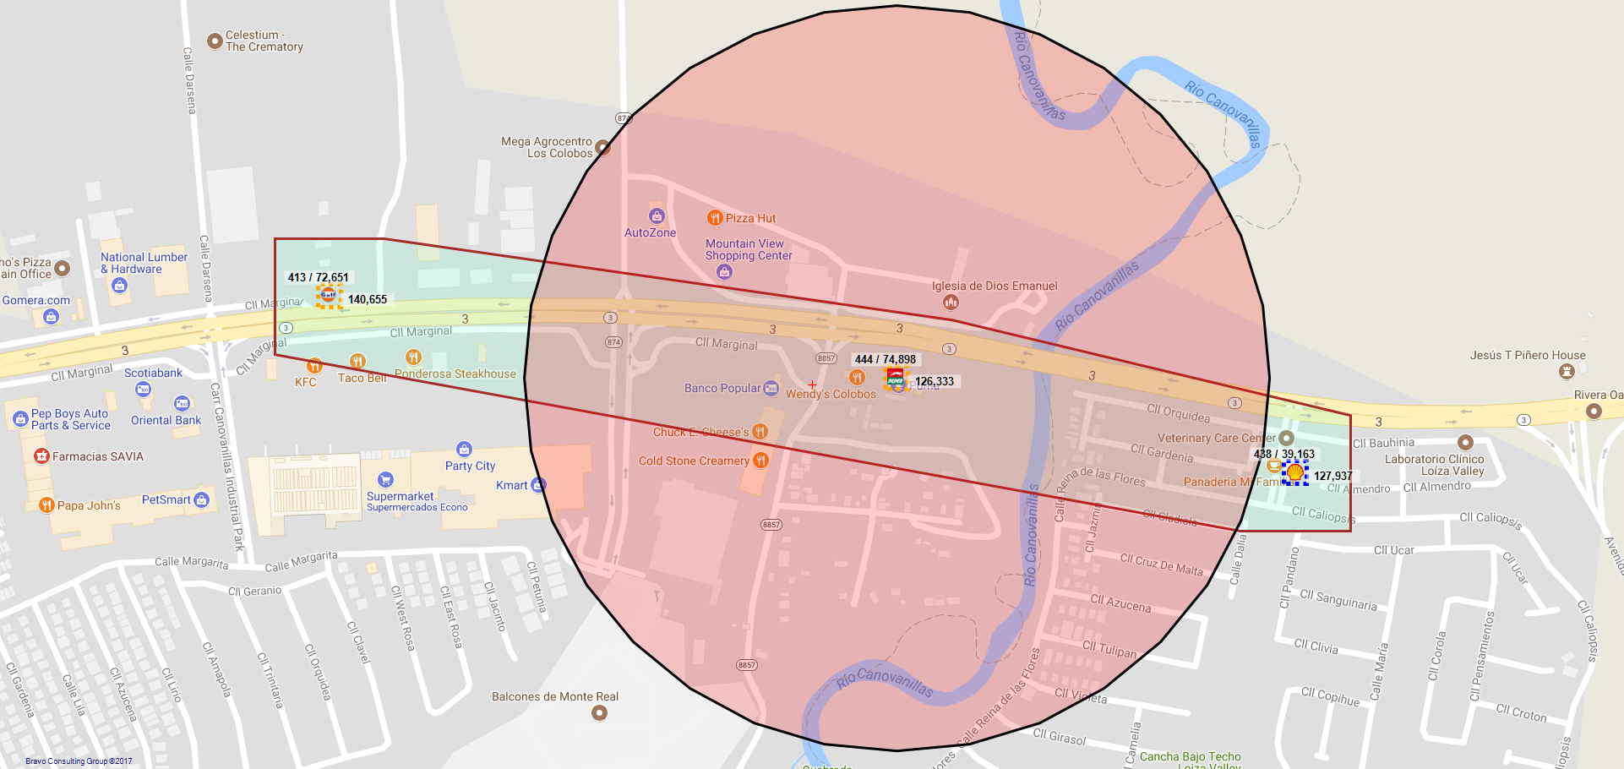
444 / VP PETROLEUM, INC. - 338 - CAROLINA

Slide 48
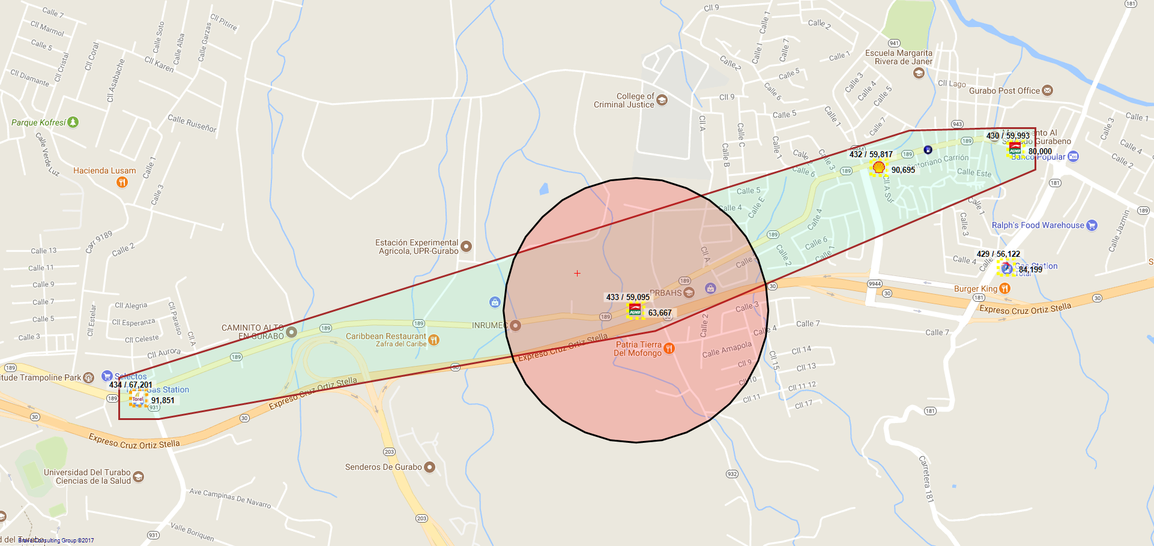
433 / MARCELINO SOLA MARQUEZ - 283 - GURABO

Slide 49
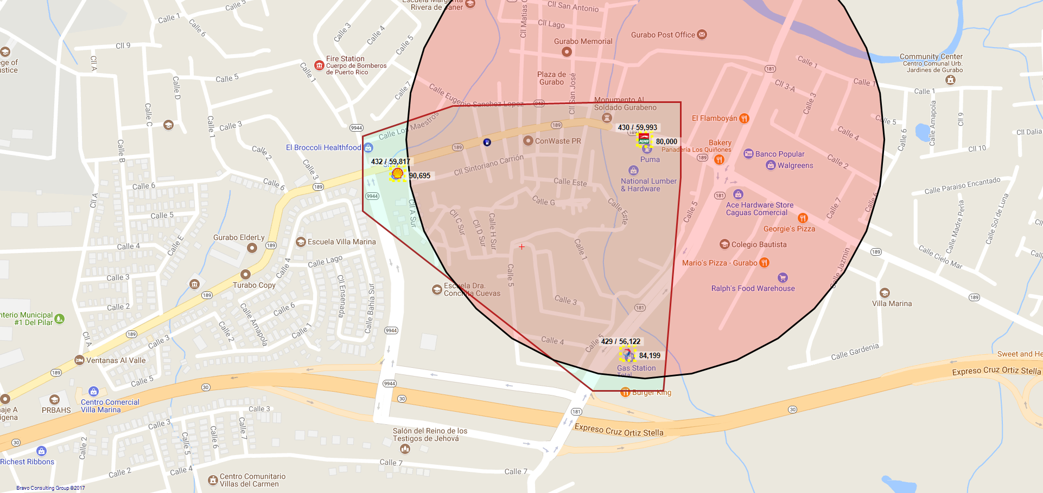
430 / MARCELINO SOLA - 318 - GURABO

Slide 50
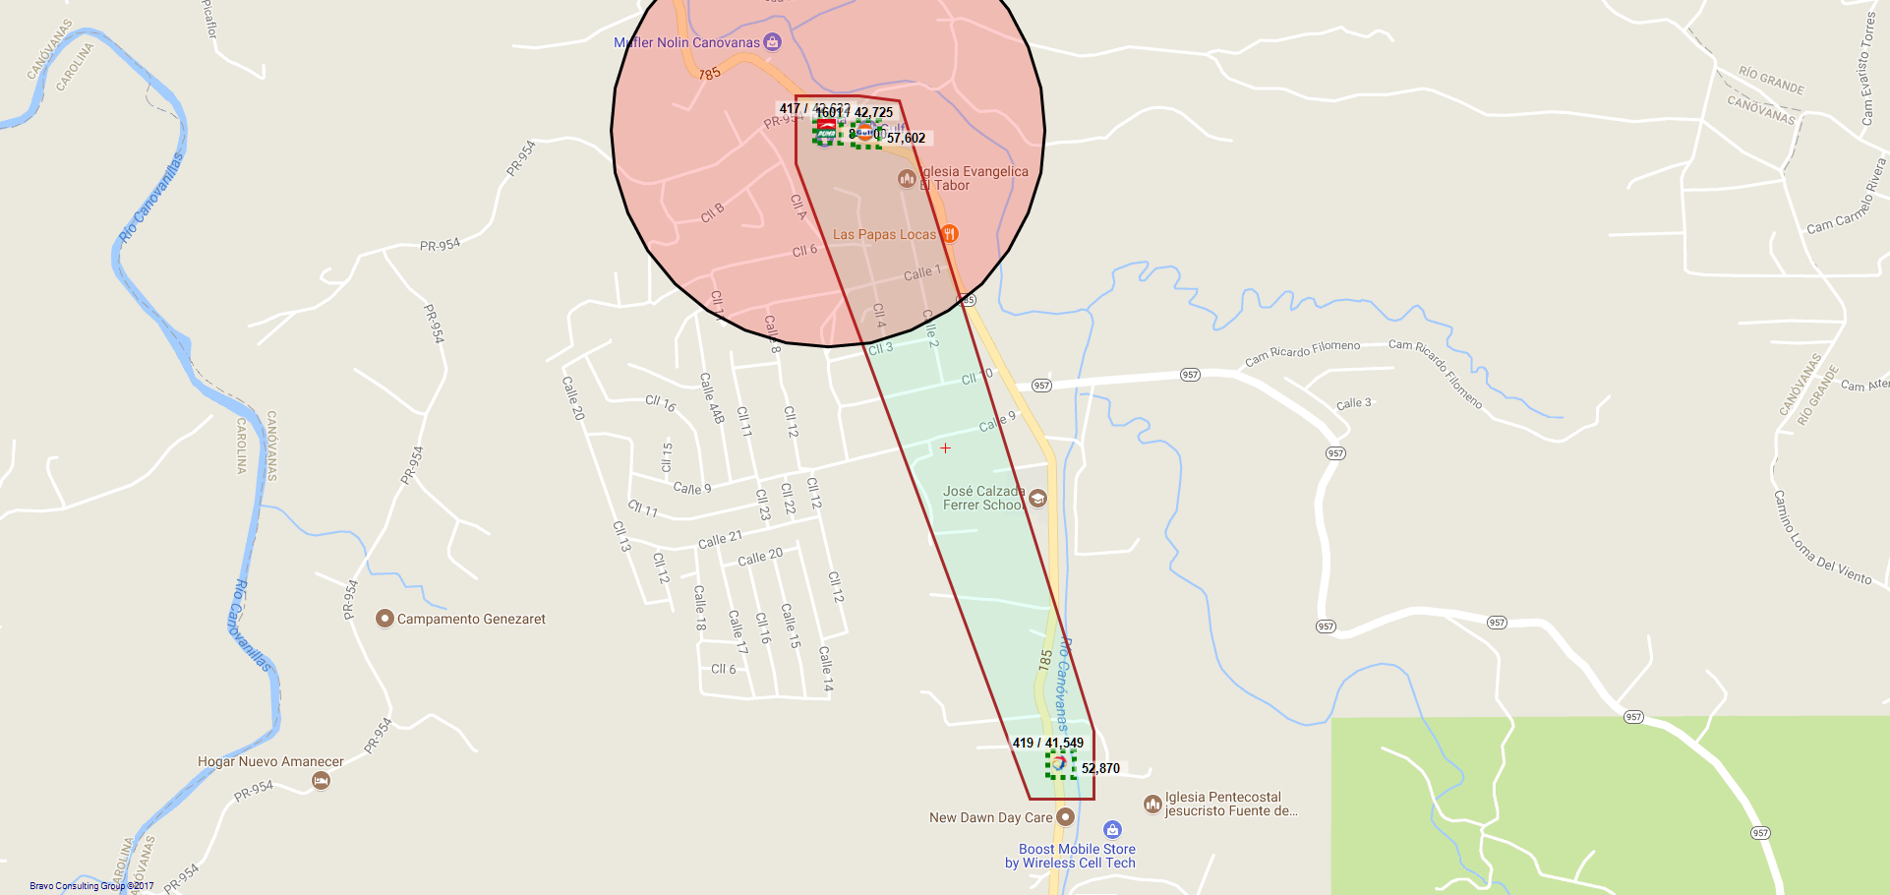
417 / LUZ M. AGOSTO JIMENEZ - 235 - CANOVANAS

Slide 51

396 / LEESAN INVESTMENT CORP. - 28 - CANOVANAS

Slide 52

394 / RAKAN SERVICE STATION CORP - 339 - CANOVANAS

Slide 53

370 / GAMA GROUP, INC. - 214 - BAYAMON

Slide 54

356 / SANTA CRUZ FUEL CORP. - 273 - BAYAMON

Slide 55

355 / C-FUELS, LLC - 139 - BAYAMON

Slide 56

320 / SR. JORGE AVILES VEVE - 377 - BAYAMON

Slide 57

288 / TOA ALTA FUEL CORP. - 103 - DORADO

Slide 58

280 / FUENTES SERVICE STATION, INC. - 191 - DORADO

Slide 59

277 / MEGA PETROLEUM CORP. - 122 - DORADO

Slide 60

270 / SR. RICARDO ROMÁN EYXARON - 333 - BAYAMON

Slide 61

268 / LEVITTOWN SERVICE STATION INC - 299 - TOA BAJA

Slide 62

256 / ODEH PETROLEUM, INC - 802 - GUAYNABO

Slide 63

247 / LAS CUMBRES FUEL, CORP. - 239 - TRUJILLO ALTO

Slide 64

243 / VP PETROLEUM, INC. - 901 - SAN JUAN

Slide 65

234 / GASOLINERA C. VEGA INC. - 212 - SAN JUAN

Slide 66

228 / HATO REY FUEL CORP - 230 - SAN JUAN

Slide 67

223 / VP PETROLEUM INC. - 277 - SAN JUAN

Slide 68

220 / ISLA VERDE SERVICE STATION,INC. - 206 - CAROLINA

Slide 69

201 / SR. EUGENIO RODRÍGUEZ FERNÁNDEZ - 210 - SAN JUAN

Slide 70

182 / VP PETROLEUM, INC. - 906 - TRUJILLO ALTO

Slide 71

178 / SENORIAL FUEL CORP - 94 - SAN JUAN

Slide 72

173 / GAMA GROUP, INC. - 209 - SAN JUAN

Slide 73

156 / GURABO FUEL CORP. - 374 - TRUJILLO ALTO

Slide 74

139 / ANTONIO SANTOS RIVERA. - 135 - GUAYNABO

Slide 75

137 / TAWFEEG A MAHMOUD ABUOSBA. - 225 - SAN JUAN

Slide 76

131 / C-FUELS, LLC - 43 - GUAYNABO

Slide 77

122 / C-FUELS, LLC - 7 - SAN JUAN

Slide 78

116 / MG ENERGY LLC. - 58 - GUAYNABO

Slide 79

112 / N & L INC. - 213 - SAN JUAN

Slide 80

111 / ODEH PETROLEUM, INC. - 6 - SAN JUAN

Slide 81

105 / GULF PLAZA, INC. - 148 - SAN JUAN

Slide 82

102 / REXCO PARK FUEL CORP. - 351 - GUAYNABO

Slide 83

95 / GAMA GROUP, INC. - 207 - CAROLINA

Slide 84

92 / H VEGA'S SERVICE STATION INC. - 173 - CAROLINA

Slide 85

83 / FELIX A. BETANCES - 226 - SAN JUAN

Slide 86

78 / EMA INVESTMENT CORP. - 220 - SAN JUAN

Slide 87

77 / VP PETROLEUM, INC. - 227 - SAN JUAN

Slide 88

74 / VP PETROLEUM- CAMPO RICO - 791 - SAN JUAN

Slide 89

67 / VP PETROLEM INC. - 334 - SAN JUAN

Slide 90

45 / ABDEL, INC - 337 - CAROLINA

Slide 91

31 / VP PETROLEUM, INC. - SAN MARTIN #902 - 902 - SAN JUAN

Slide 92

29 / VP PETROLEUM - 65 INFANTERIA. - 792 - SAN JUAN

Slide 93

15 / MAHMOOD IBRAHIM ABU USBA - 268 - SAN JUAN

Slide 94

14 / VP PETROLEUM, INC. EL TUNEL - 905 - SAN JUAN

