Slide 1
BCG GUATEMALA Hi-Potential – Low-Performance Quadrant
Prepared for
Puma Energy
By
Bravo Consulting Group
July 8, 2015

Slide 2
GUATEMALA – 2014 – Gasoline & Diesel

Slide 3
GUATEMALA – 2014 – Gasoline & Diesel

Slide 4
GUATEMALA – 2014 – Gasoline & Diesel
BCG ID | Brand | Name | Municipality | Loc_Vol | Calc_Vol
121 | PUMA | EL TRIGAL | GUATEMALA | 68,579 | 44,850
122 | PUMA | NIAGARA | GUATEMALA | 71,708 | 45,782
136 | PUMA | DELTA SAN PEDRITO | GUATEMALA | 62,885 | 37,750
159 | PUMA | 5 CALLES | GUATEMALA | 52,682 | 41,500
179 | PUMA | MARTI | GUATEMALA | 76,728 | 17,607
220 | PUMA | UNIVERSAL | GUATEMALA | 61,454 | 37,750
264 | PUMA | MINERVA | MIXCO | 72,204 | 42,561
321 | PUMA | AGUILAR BATRES I | GUATEMALA | 66,875 | 46,212
632 | PUMA | BOCA DEL MONTE - ELIAS CORP | VILLA CANALES | 76,261 | 44,500
812 | PUMA | EL FRUTAL | PETAPA | 87,691 | 35,690
1293 | PUMA | SAN CRISTOBAL | HUEHUETENANGO | 48,156 | 18,512
1543 | PUMA | REAL JOCOTENANGO | JOCOTENANGO | 65,677 | 32,000
1734 | PUMA | SERVIAL II | ESCUINTLA | 54,212 | 16,125
1850 | PUMA | SERVIAL 1 | ESCUINTLA | 55,760 | 33,016
1876 | PUMA | LAS PALMERAS | ESCUINTLA | 64,623 | 39,125
2121 | PUMA | MONUMENTO II | PUERTO BARRIOS | 52,591 | 43,625
2132 | PUMA | PETROL XOLVE | SOLOL | 55,361 | 40,668
2134 | PUMA | VALPARAISO | CHIQUIMULA | 50,833 | 20,625
2140 | PUMA | MARGARITA | SAN ANDRES ITZAPA | 53,760 | 42,500
2171 | PUMA | MIRAFLORES | AMATITLAN | 80,281 | 43,093
2176 | PUMA | BARILLAS | VILLA CANALES | 46,772 | 40,322
2186 | PUMA | ROOSEVELT | MIXCO | 69,933 | 34,750
2187 | PUMA | CHUATUJ | COATEPEQUE | 46,581 | 42,063
2193 | PUMA | FRAIJANES | FRAIJANES | 50,909 | 18,625
2264 | PUMA | LAS CHARCAS / SAN CRISTOBAL | GUATEMALA | 62,463 | 21,875
2275 | PUMA | GAS EXPRESS | GUATEMALA | 52,533 | 22,813
2445 | PUMA | EL CENTRO | JALAPA | 54,094 | 44,059
2486 | PUMA | BUENOS AIRES | JUTIAPA | 50,850 | 38,469
2554 | PUMA | SANTA FE | ESCUINTLA | 47,233 | 38,343
2587 | PUMA | LA FRONTERA | SANTA CATARINA PINULA | 63,117 | 36,037
3056 | PUMA | GRACIAS A DIOS | SOLOL | 56,182 | 28,709
3091 | PUMA | CONCEPCION | ANTIGUA GUATEMALA | 49,242 | 6,124
3215 | PUMA | VILLA HERMOSA | PETAPA | 64,289 | 43,812
4038 | PUMA | LA MONTAÑA | MIXCO | 73,054 | 21,500

Slide 5
121 | EL TRIGAL

Slide 6
122 | NIAGARA

Slide 7
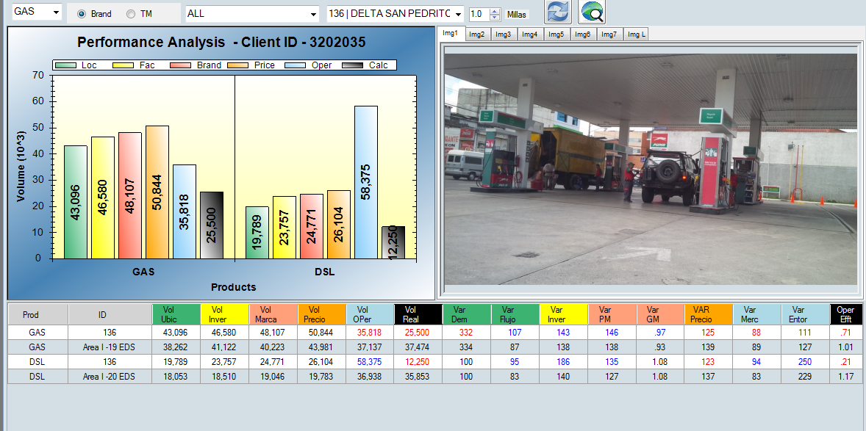
136 | DELTA SAN PEDRITO

Slide 8
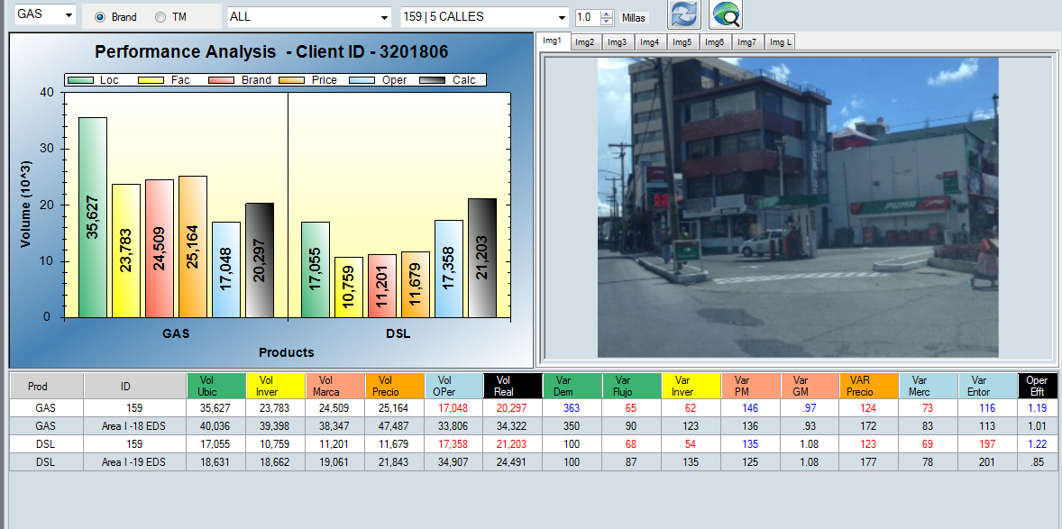
159 | 5 CALLES

Slide 9
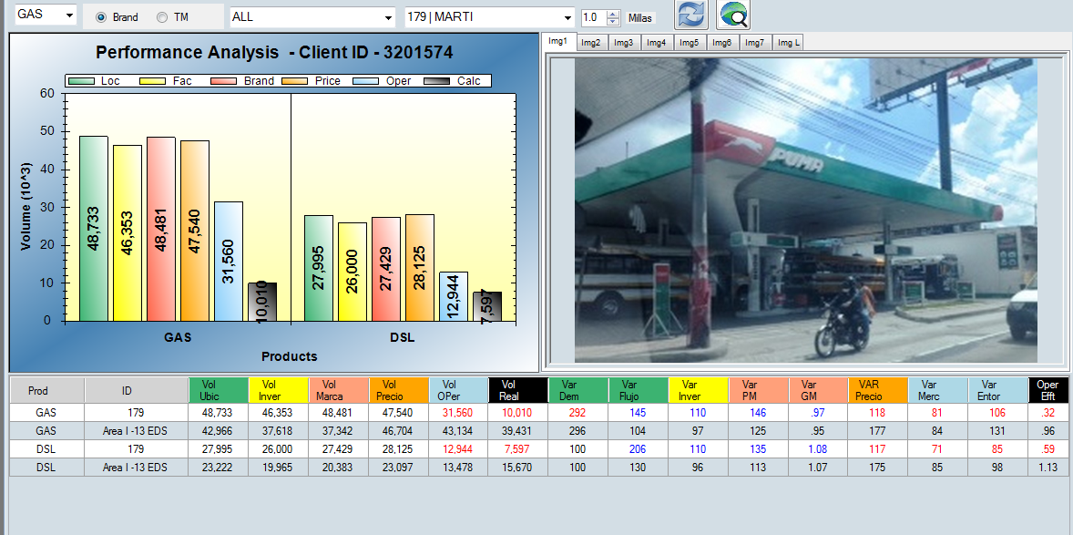
179 | MARTI

Slide 10
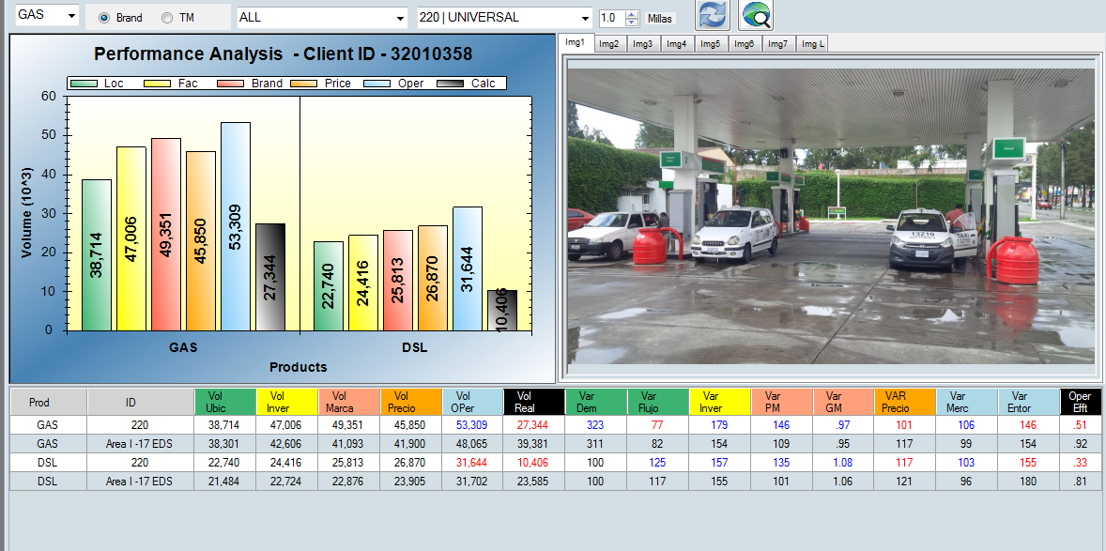
220 | UNIVERSAL

Slide 11
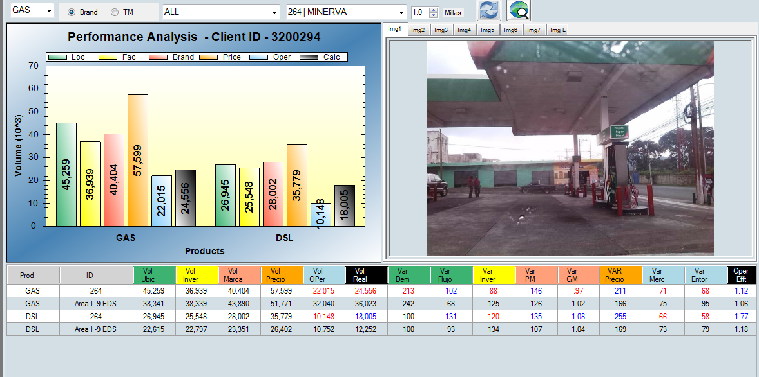
264 | MINERVA

Slide 12
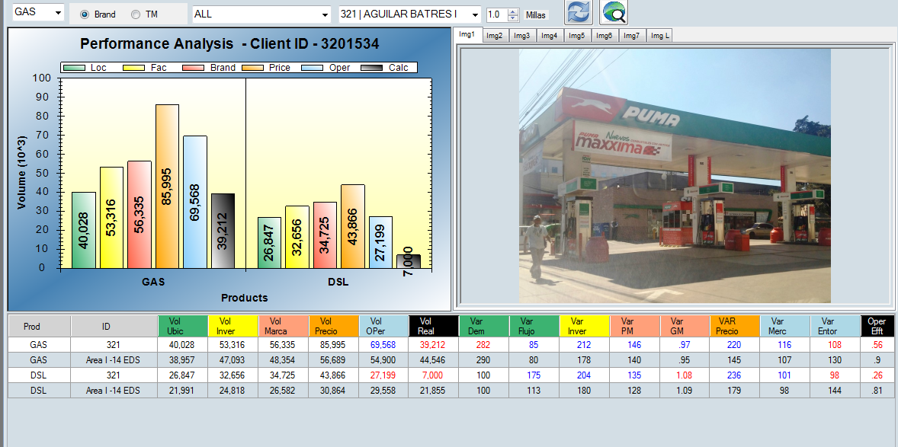
321 | AGUILAR BATRES I

Slide 13
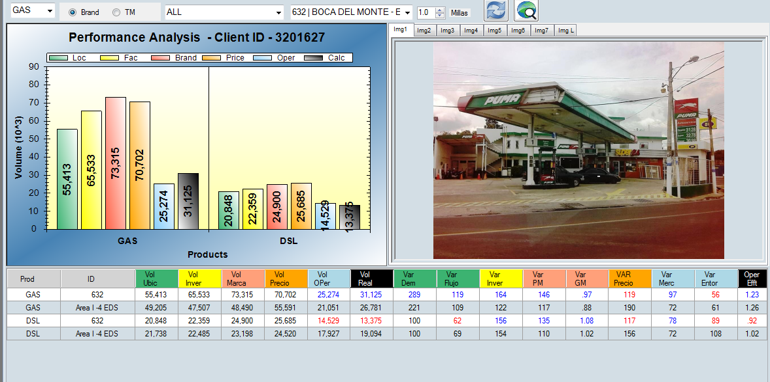
632 | BOCA DEL MONTE - ELIAS CORP

Slide 14
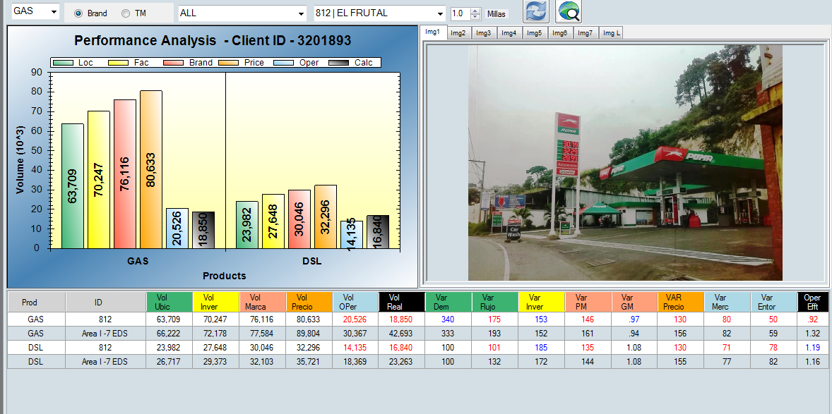
812 | EL FRUTAL

Slide 15
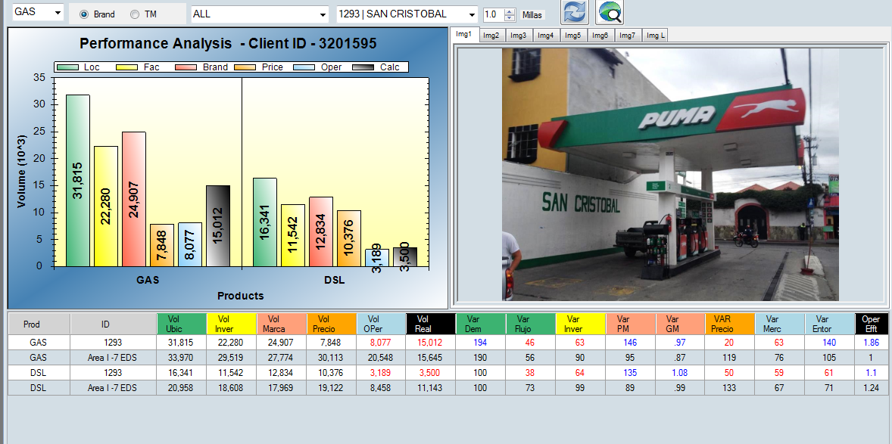
1293 | SAN CRISTOBAL

Slide 16
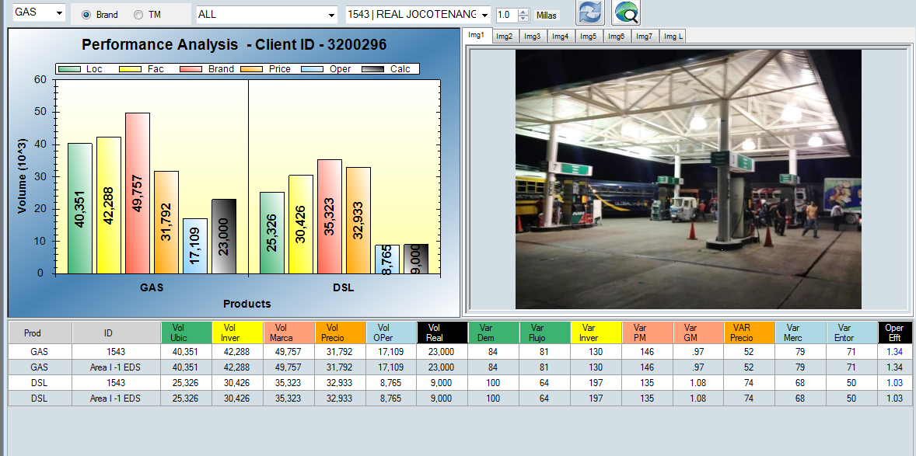
1543 | REAL JOCOTENANGO

Slide 17
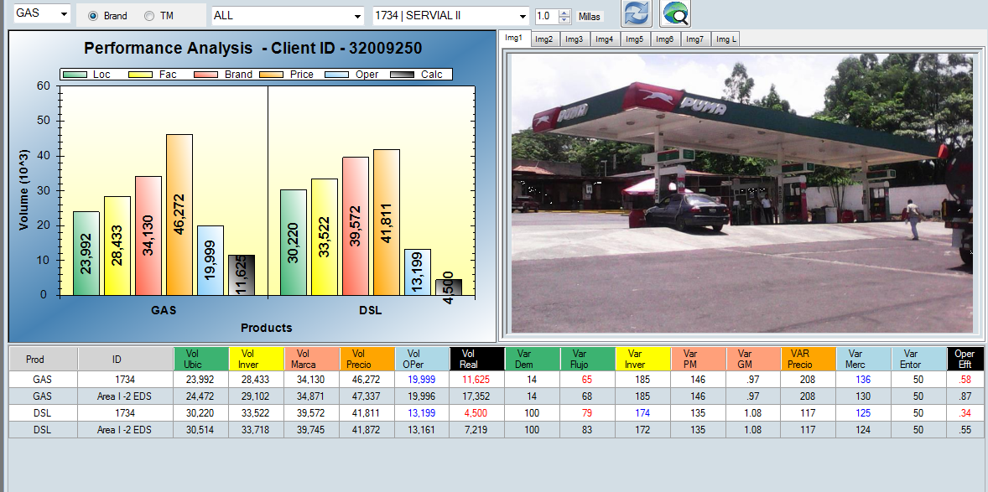
1734 | SERVIAL II

Slide 18
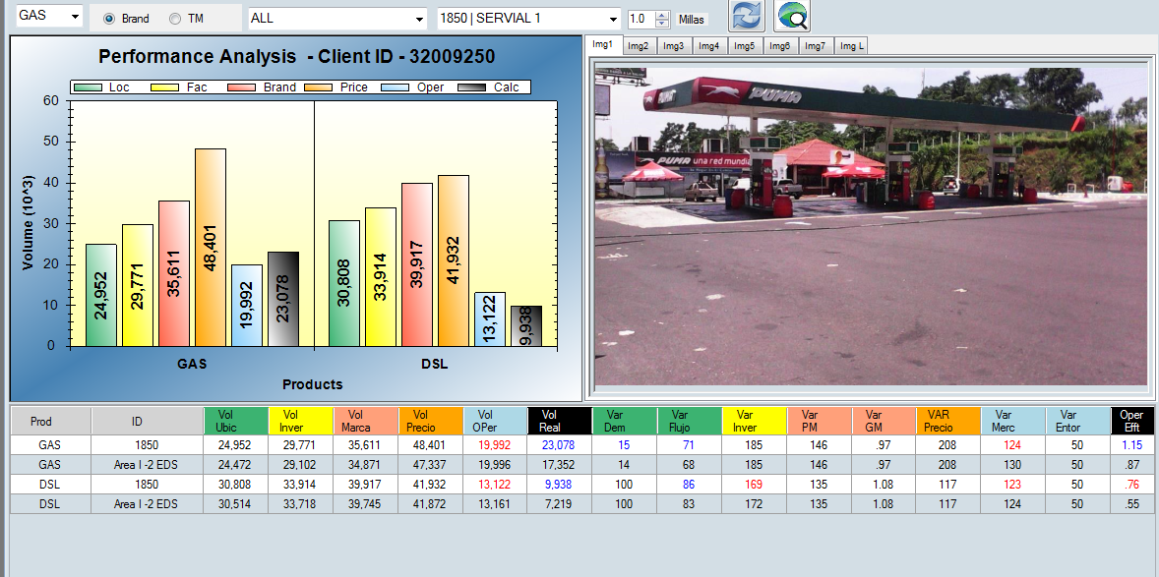
1850 | SERVIAL 1

Slide 19
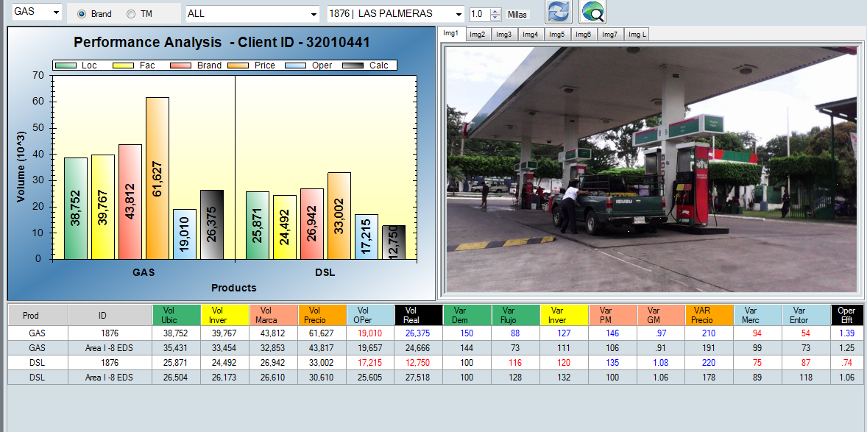
1876 | LAS PALMERAS

Slide 20
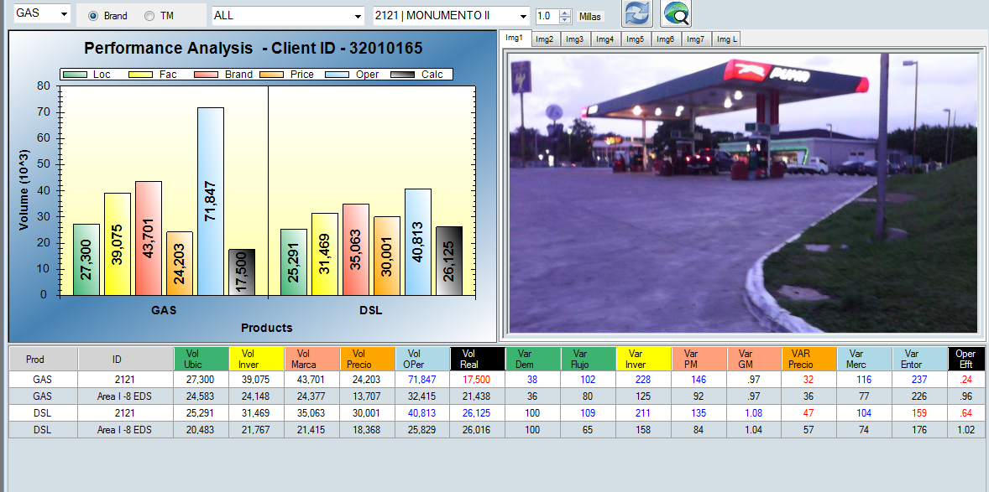
2121 | MONUMENTO II

Slide 21
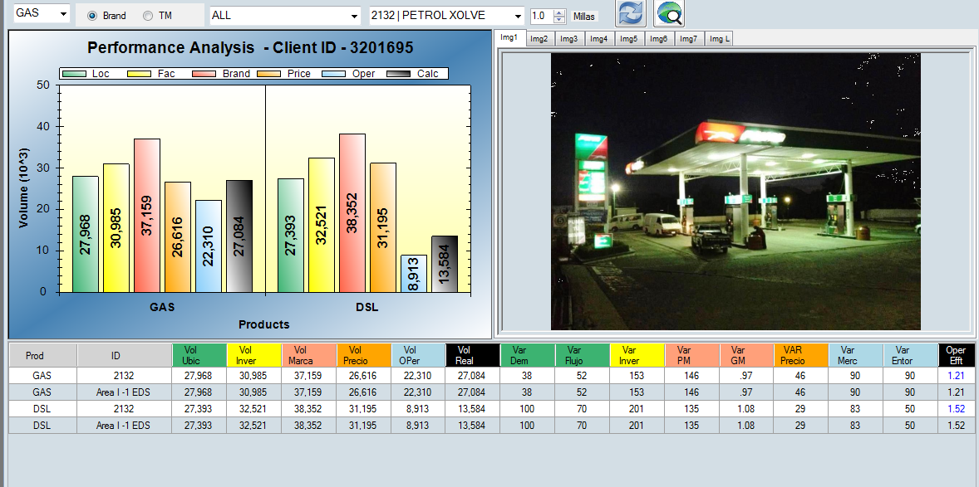
2132 | PETROL XOLVE

Slide 22
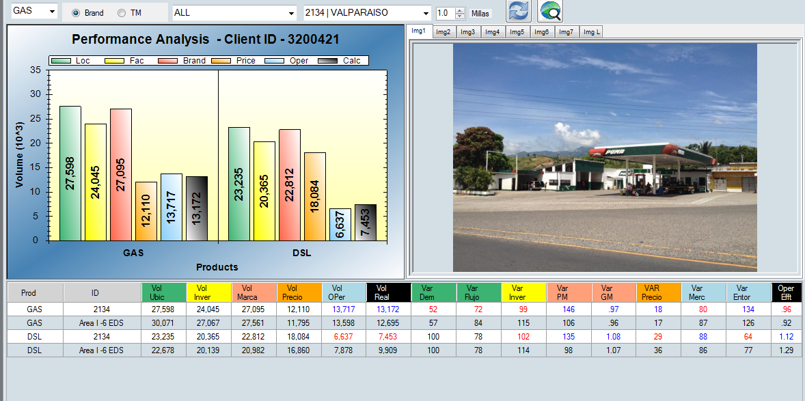
2134 | VALPARAISO

Slide 23
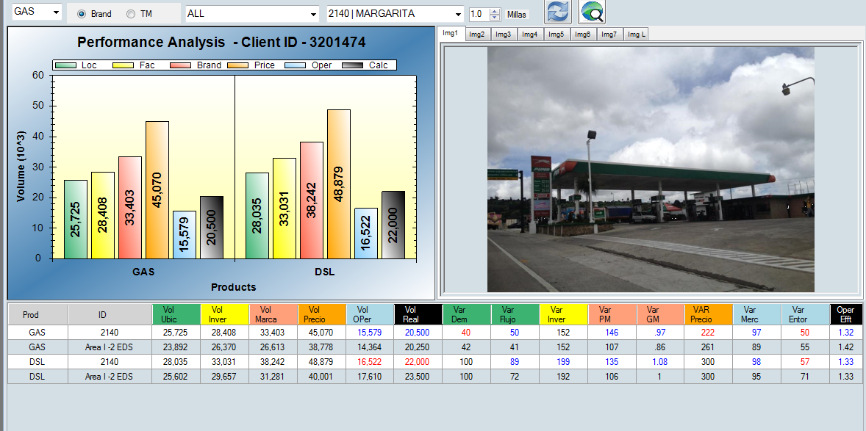
2140 | MARGARITA

Slide 24
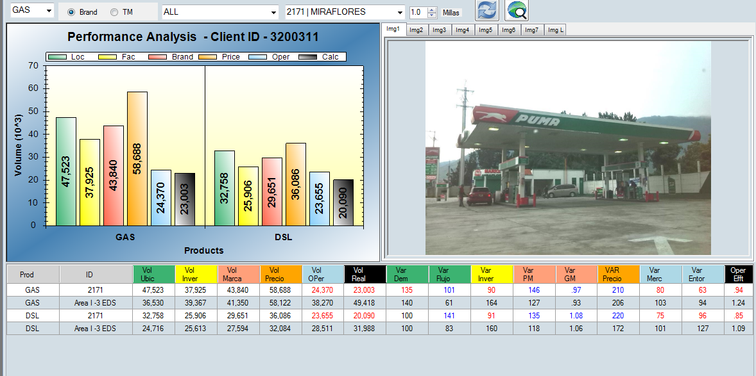
2171 | MIRAFLORES

Slide 25
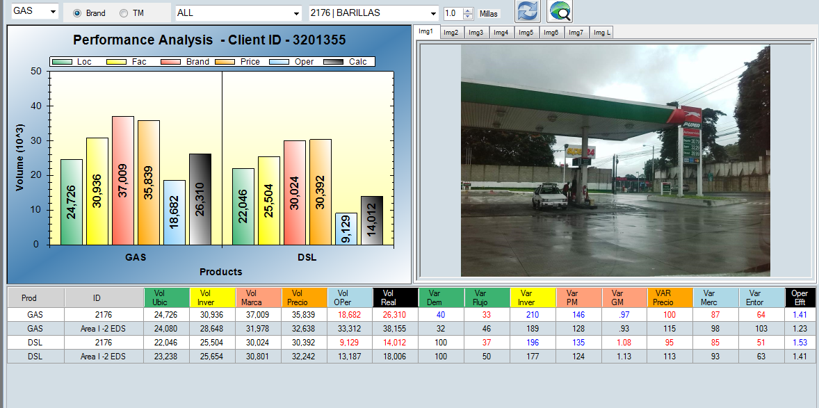
2176 | BARILLAS

Slide 26
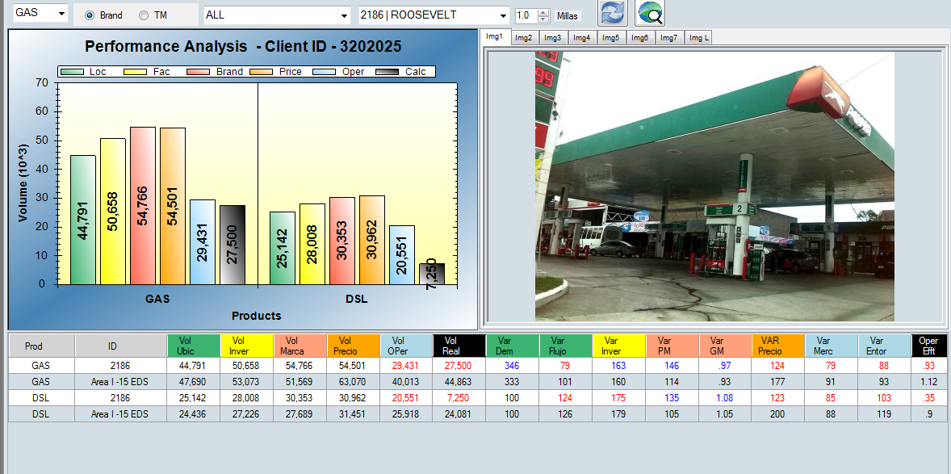
2186 | ROOSEVELT

Slide 27
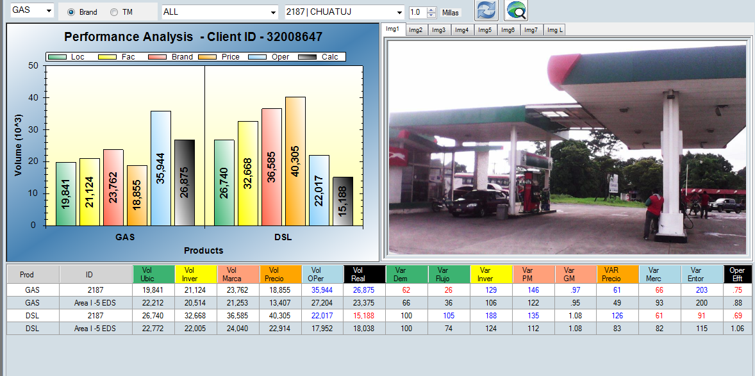
2187 | CHUATUJ

Slide 28
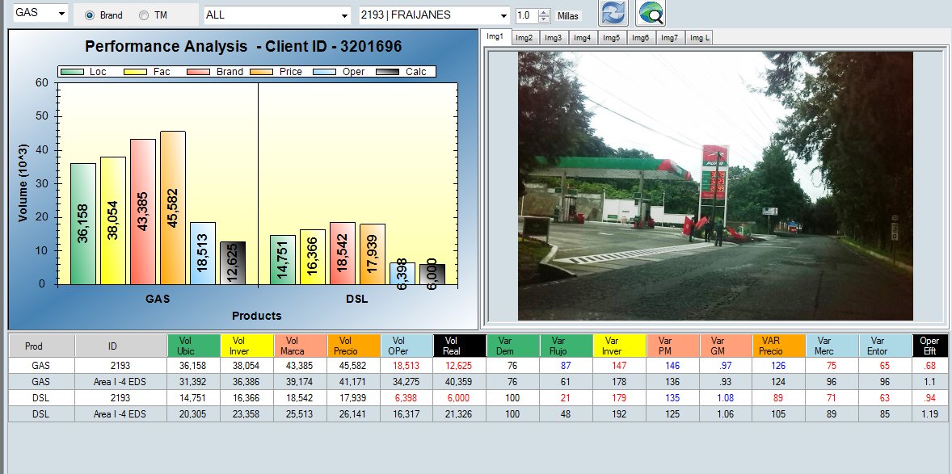
2193 | FRAIJANES

Slide 29
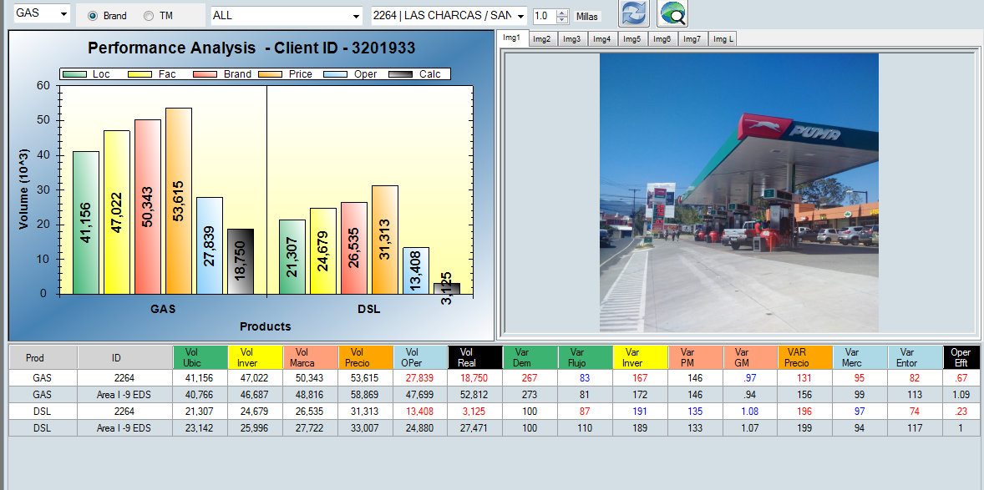
2264 | LAS CHARCAS / SAN CRISTOBAL

Slide 30
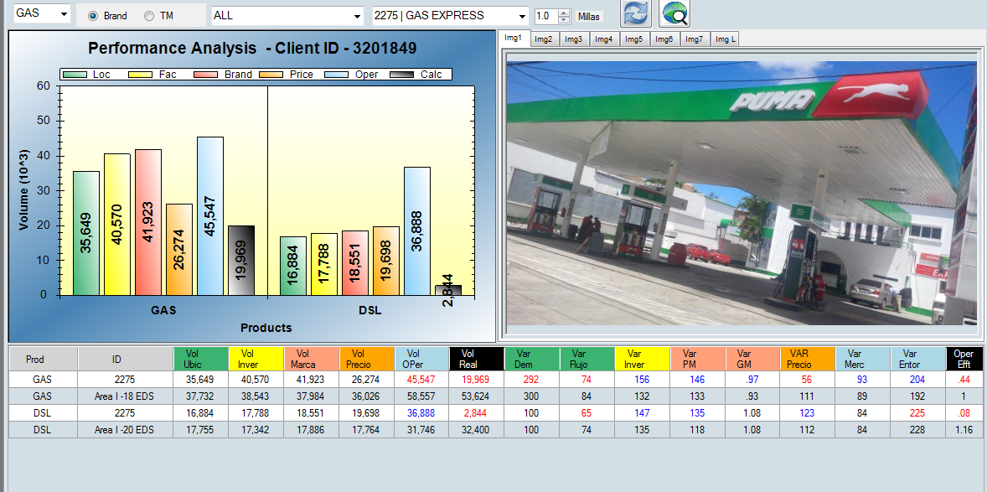
2275 | GAS EXPRESS

Slide 31
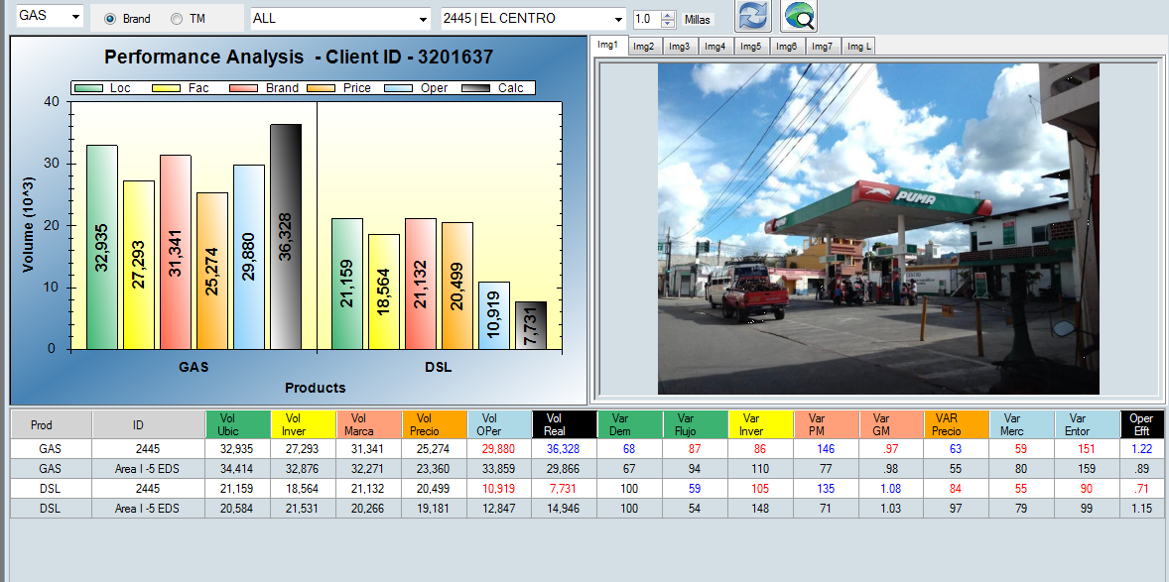
2445 | EL CENTRO

Slide 32
2486 | BUENOS AIRES

Slide 33
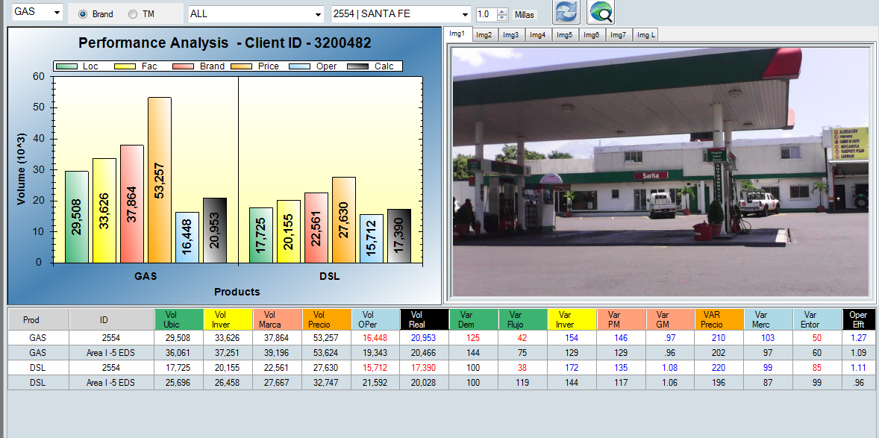
2554 | SANTA FE

Slide 34
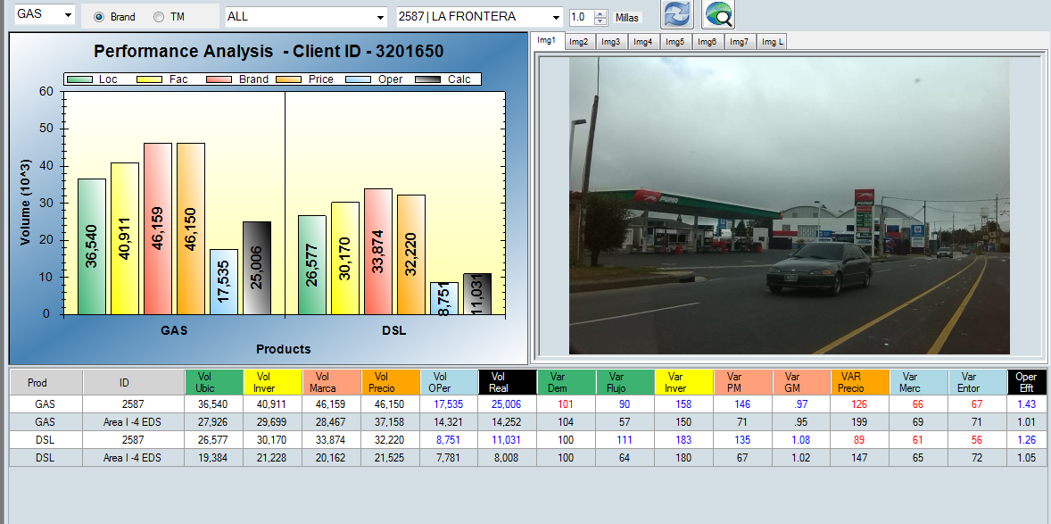
2587 | LA FRONTERA

Slide 35
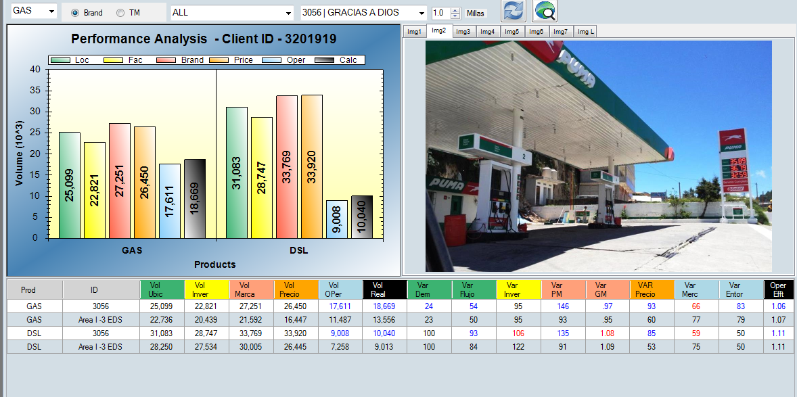
3056 | GRACIAS A DIOS

Slide 36
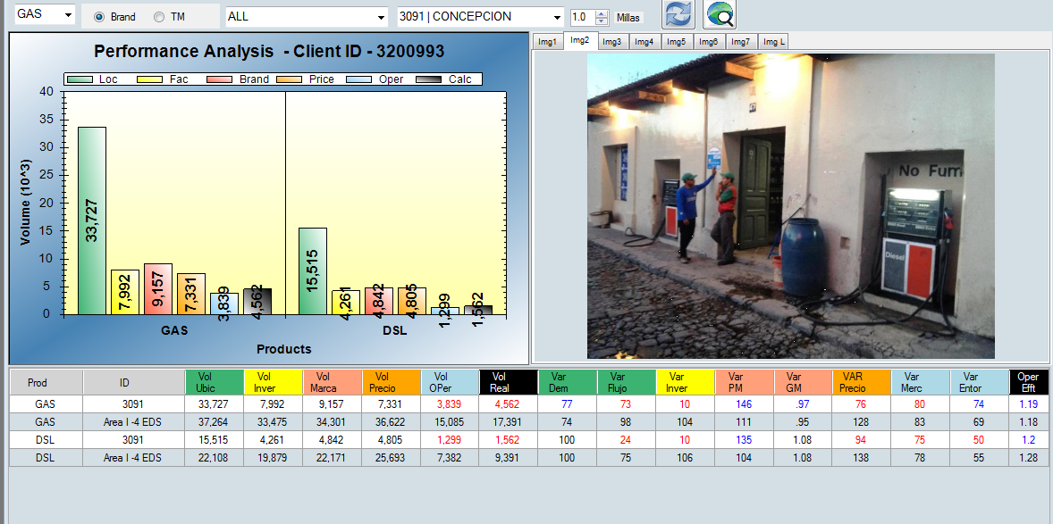
3091 | CONCEPCION

Slide 37
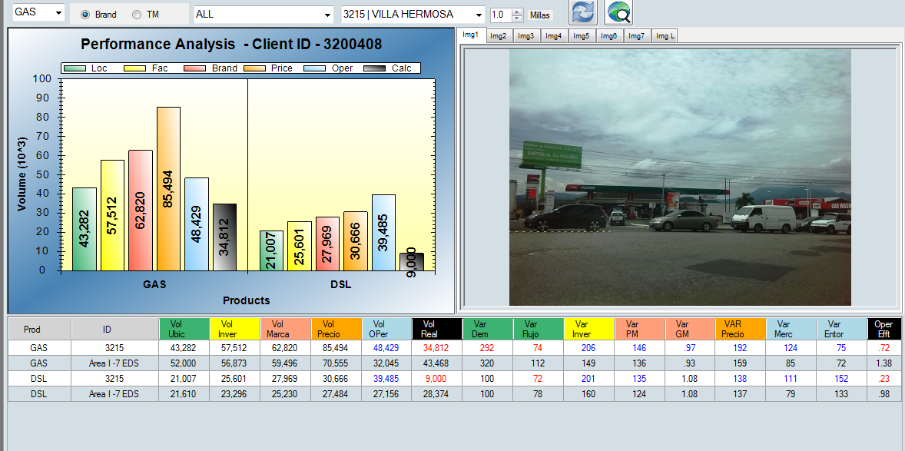
3215 | VILLA HERMOSA

Slide 38
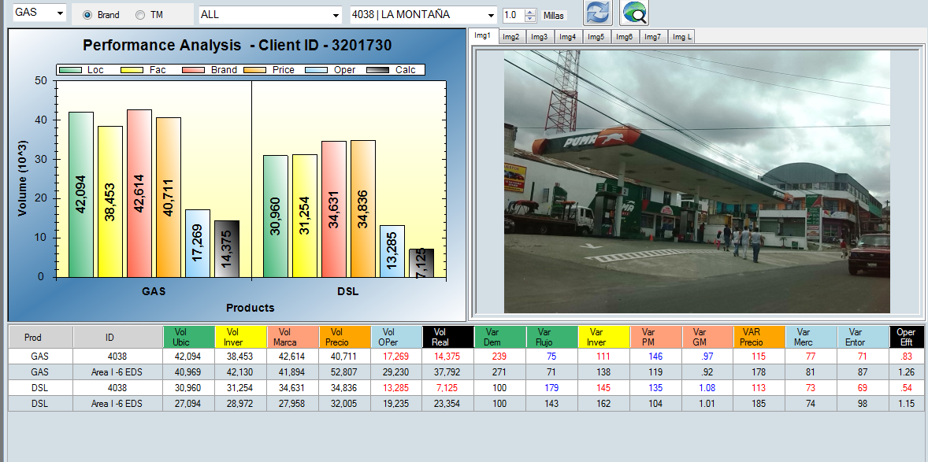
4038 | LA MONTAÑA

